Slide 1
Comprehensive Thermal Simulation Power: From Heat Transfer Analysis to Human Thermal Comfort
Simon Wegmann, Vice President Thermal Management

Slide 2
The History Of THESEUS-FE
1983: BMW’s cabin simulation idea
INKA/TILL
2003
2006
2007
2009
2011
2016
2018
2020
2023
Internal tool
3Dthermosol
Our own GUI
v7.0
v8.0
v9.0
Product launch
THESEUS‑FE v1.0
v6.0, New Homepage
v2.0
FIALA
Manikin
v4.0
THESEUS-FE Oven
Buyback from VW
governmental support
Initial software development financed by...
extra project support from BMW
Exclusively financed by license income
extra project support from VW

Slide 3
Introduction To Cabin Simulation

Slide 4

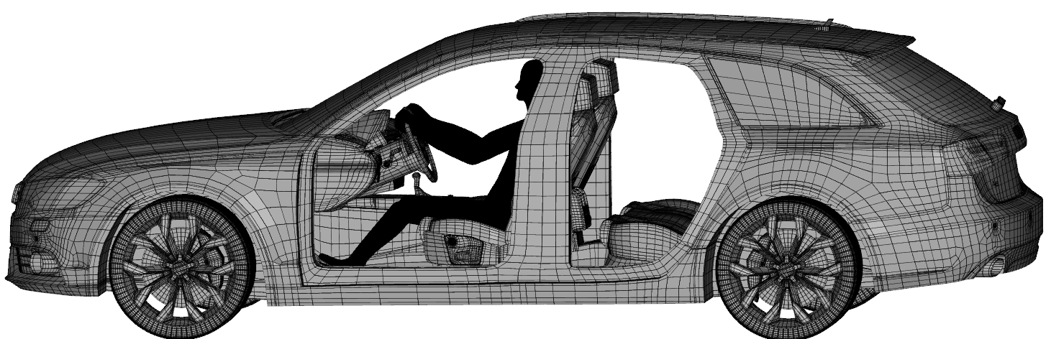


The General Idea Of Cabin Modelling
Boundary conditions
Sun
H₂O
$$T_{sky}$$
Infrared thermography (IRT)
• reflection
solar short wave radiation
long wave radiation heat exchange
R
diffusive
Cabin
• absorption
A
direct
• Transmission
T
T_{air}
$$T_{air}$$
$$v_{air}$$
HVAC
heat conduction

Slide 5
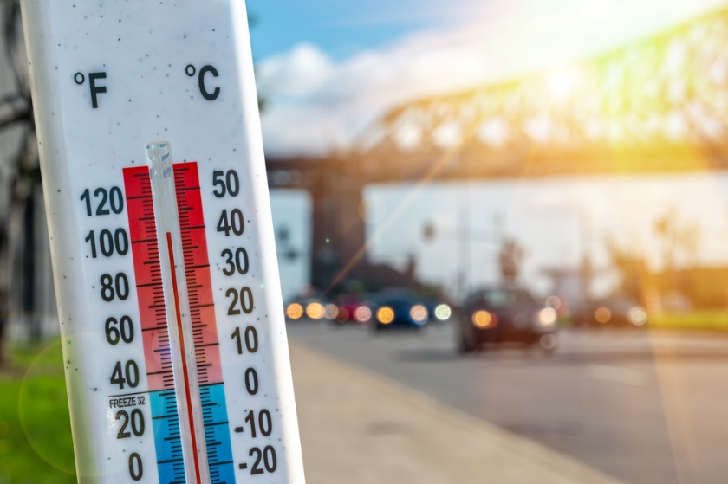
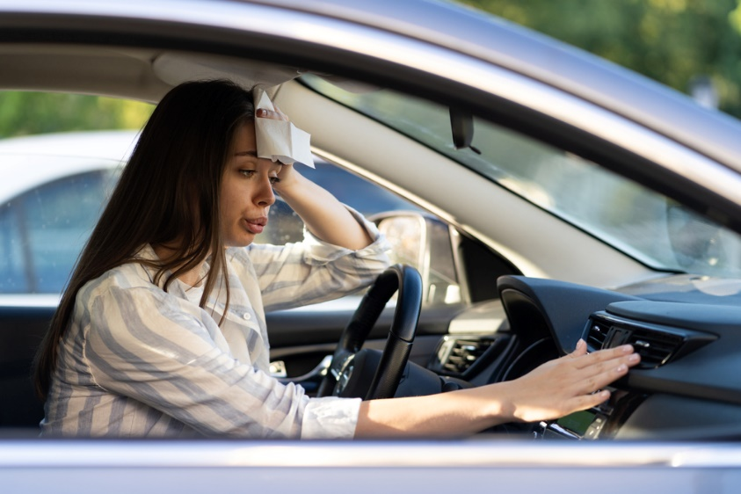
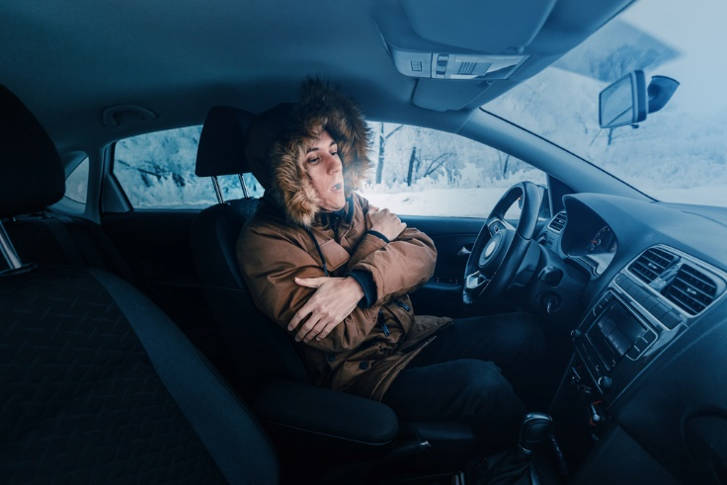
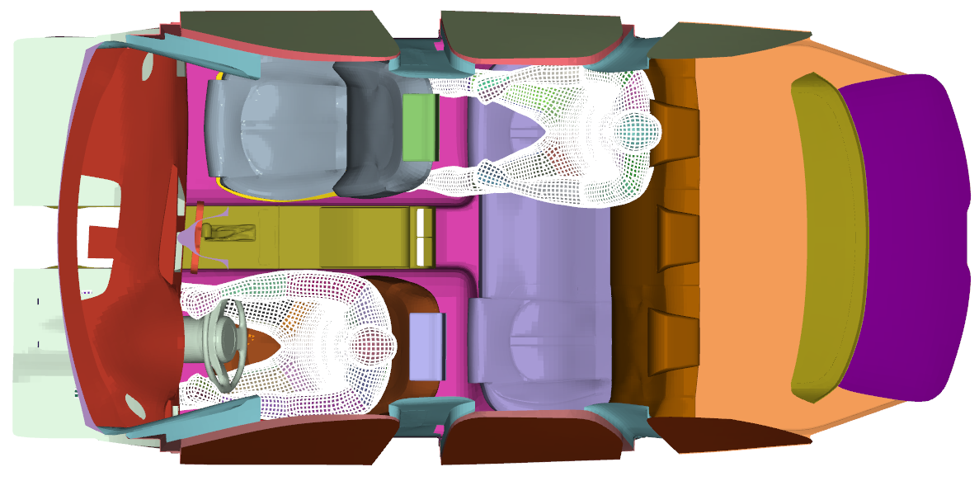
Prevent Humans From Thermal Discomfort
Summer load case
Winter load case
hot
PMV
hot
neutral
neutral
t
t
cold
cold

Slide 6
Outstanding Features Of Cabin Simulation
With THESEUS-FE

Slide 7
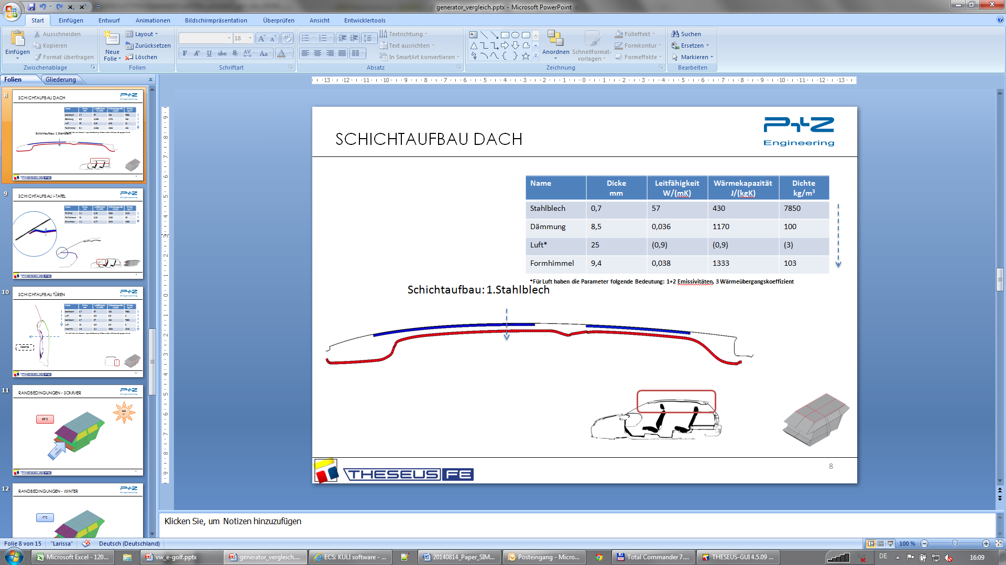
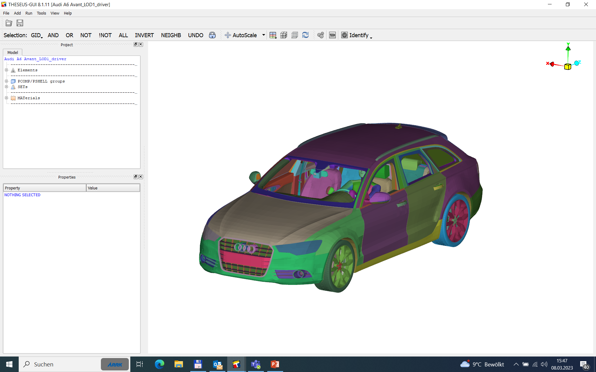
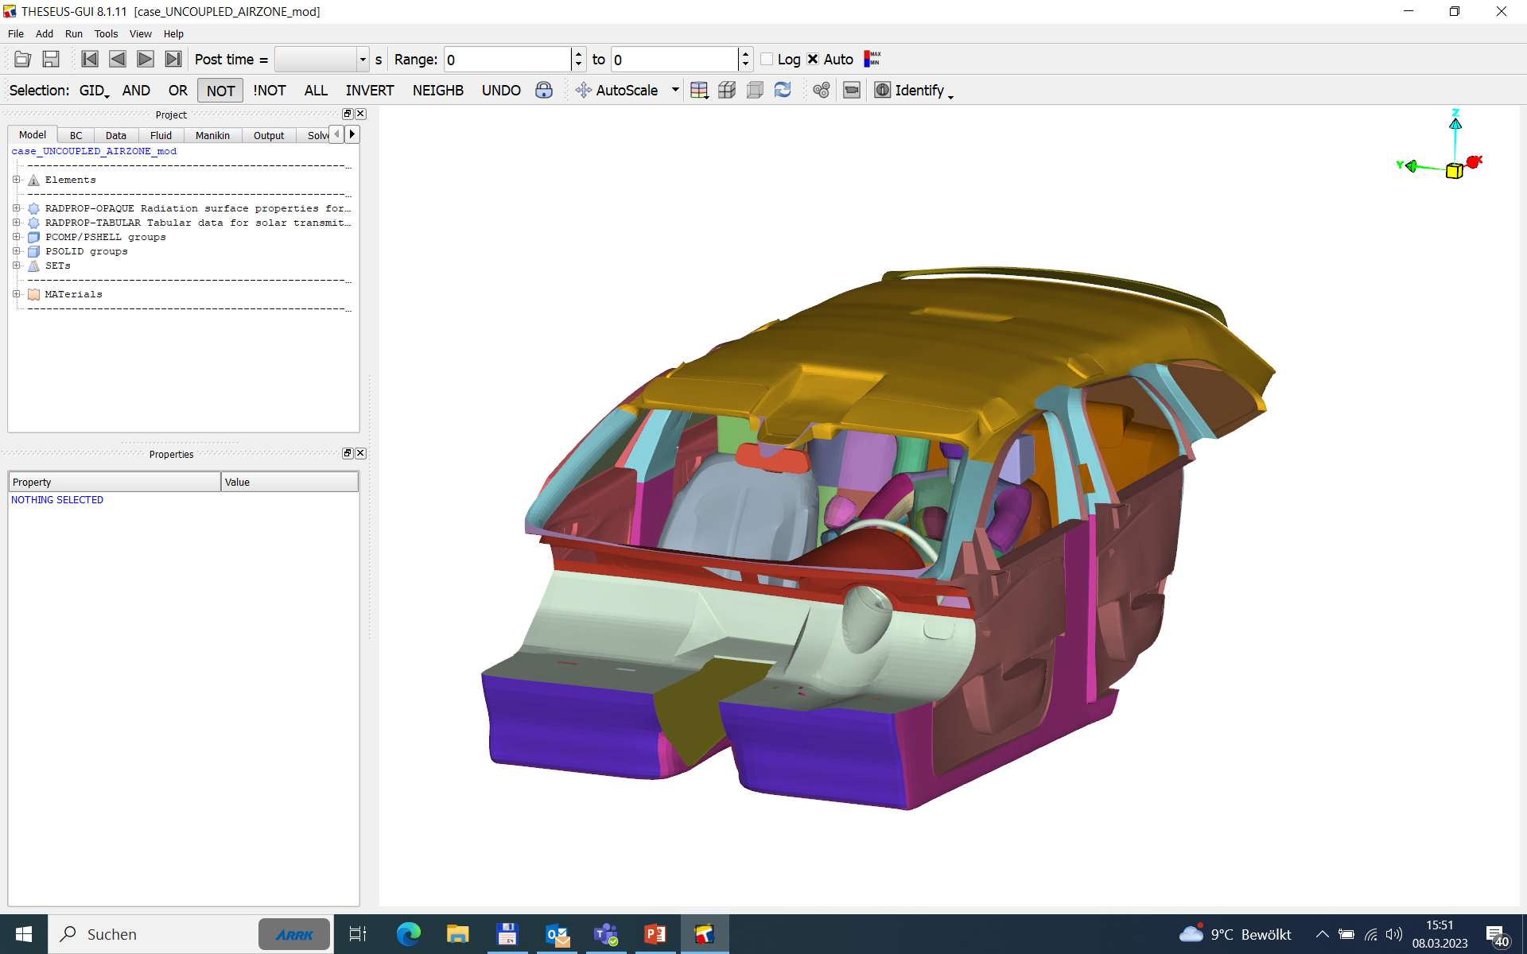
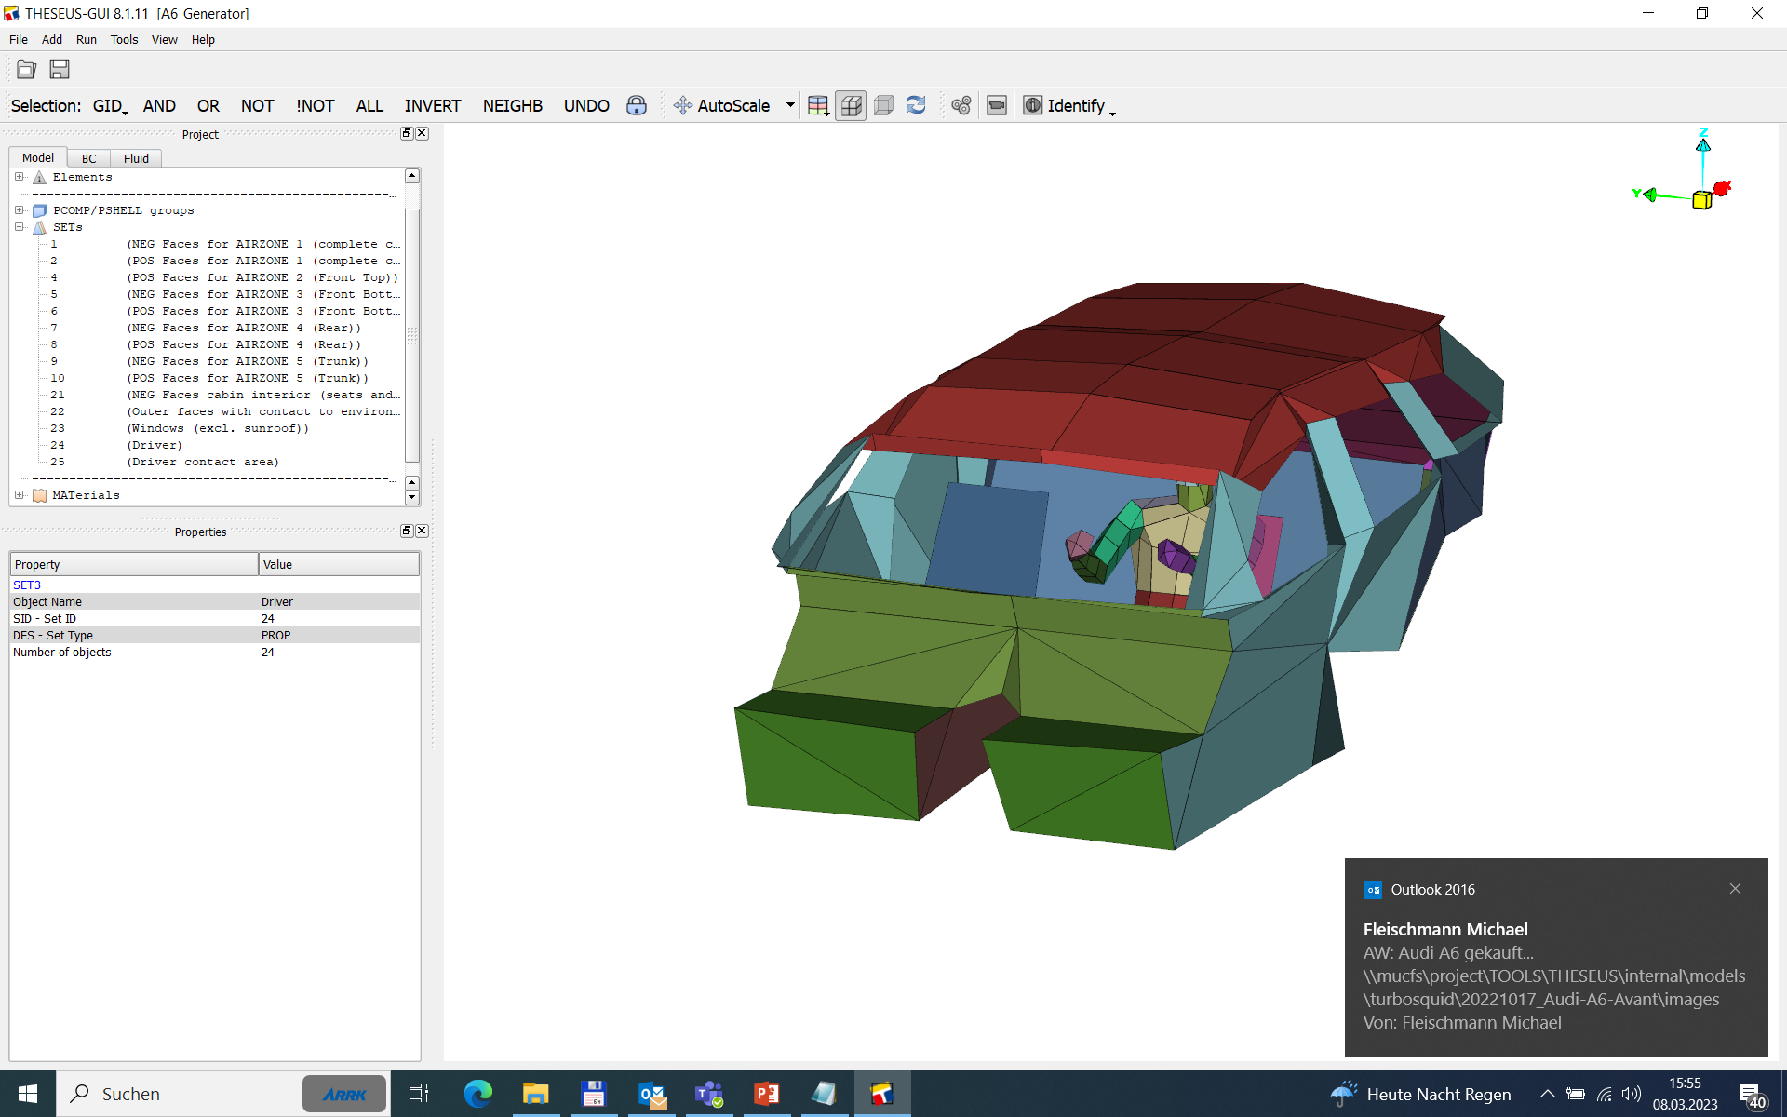



Different Types Of Cabin Models
Roof section
Simplified roof
composite model
air gap
steel (0.8mm)
damping mat
air gap
ceiling
$$≈$$
air gap
1 000 000 shell elements
200 000 shells
548 shells
Complete model
fine mesh, 3D heat conduction
Reduced model
fine mesh, 3D heat conduction， recommended for coupled CFD
Generator model
coarse mesh , 1D heat conduction
recommended for coupled 1D
$$≈$$
$$≈$$

Slide 8
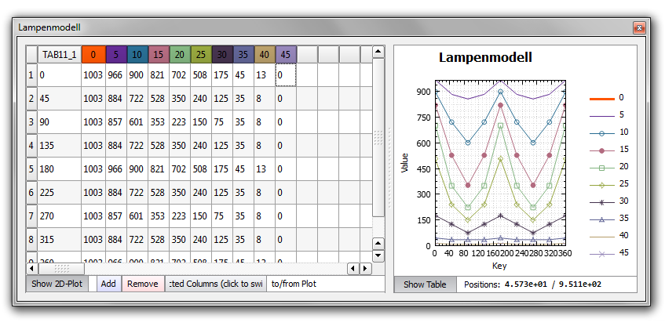
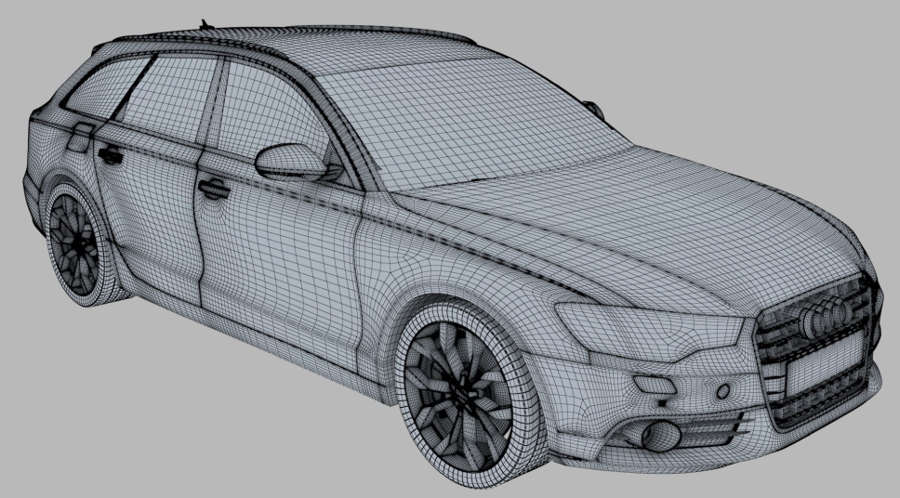
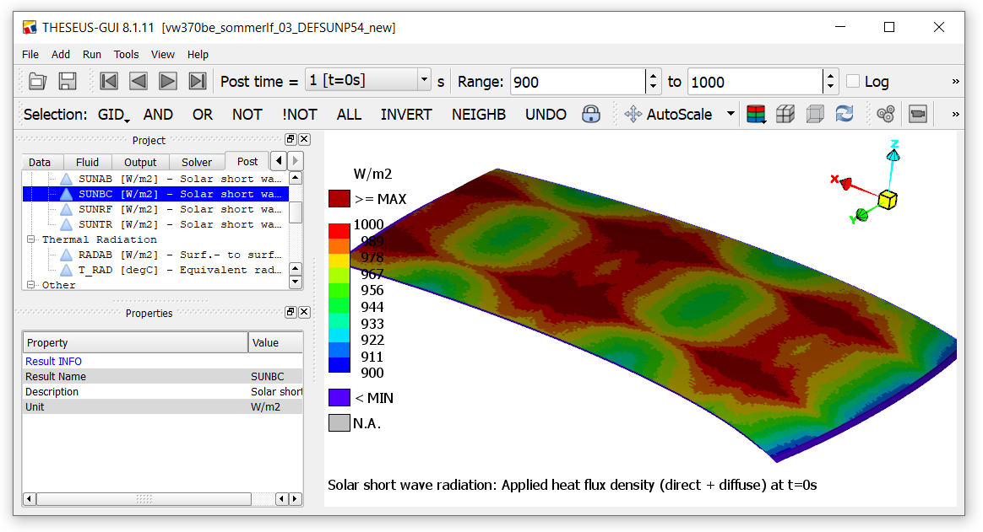
Climate Chamber Lamp Model
Original VW lamp model
54 lamps
Solar radiation

Slide 9
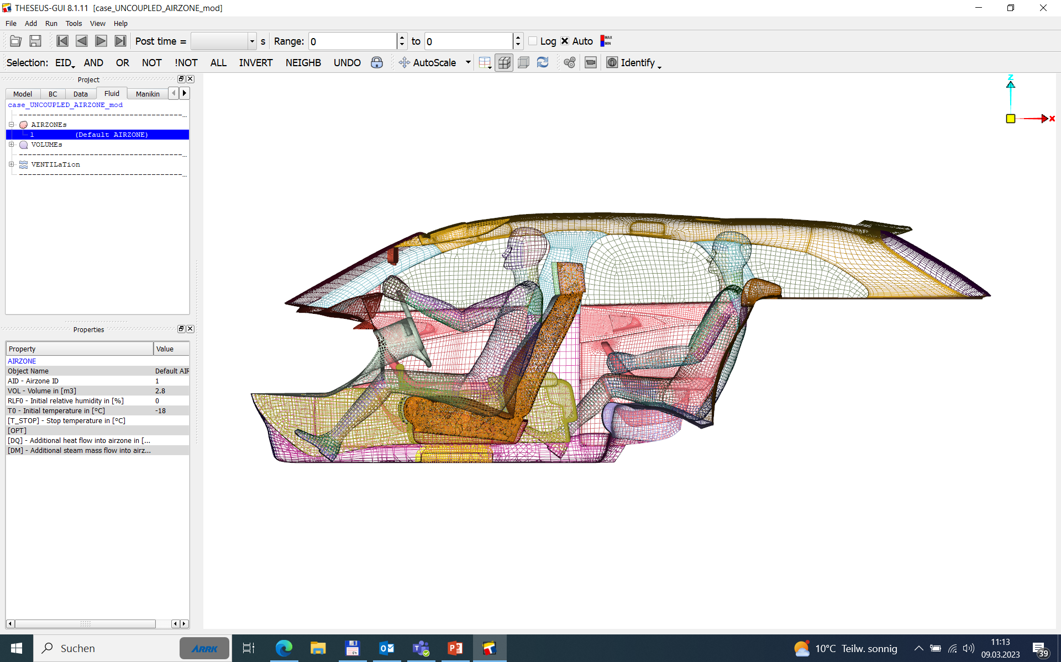
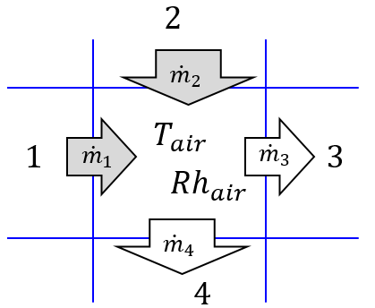






Models For Air Zones & Ventilations
Multi-airzone model (version 9):
THESEUS-FE
Single airzone model:
1hr CPU time
CFD
1
$$\dot{m}$$
avg. air temp. $T_{air}=?$
rel. humidity ${Rh}_{air}=?$
Ventilations
Coupled CFD:
1
2
Days of CPU time
$$\dot{m}$$
4-airzone model
$$T_{shell}$$
3
4
CFD
THESEUS-FE
$$h,T_{fluid}$$

Slide 10
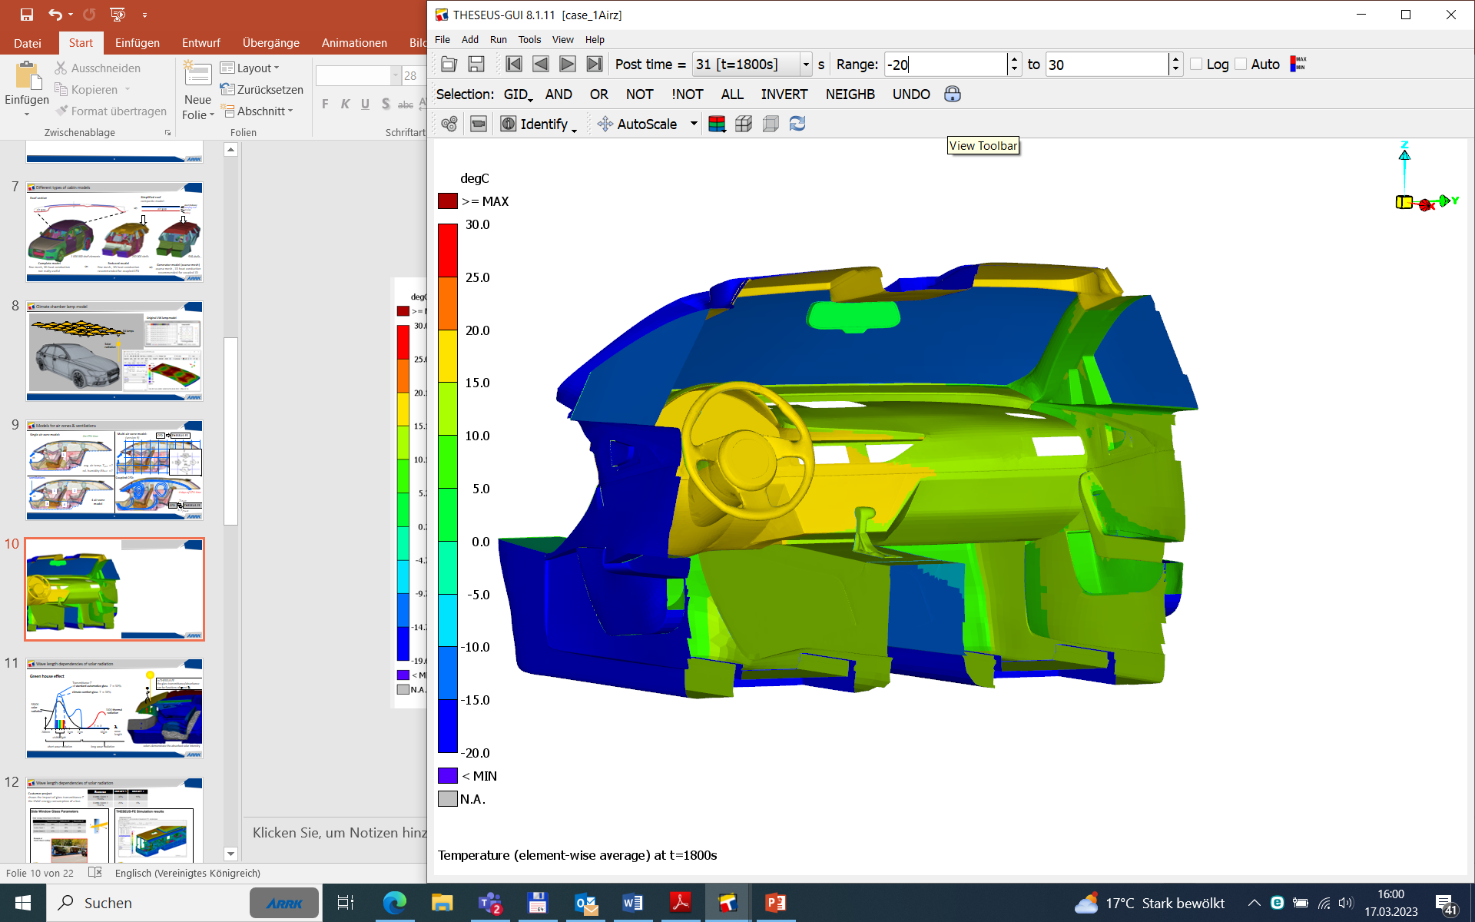
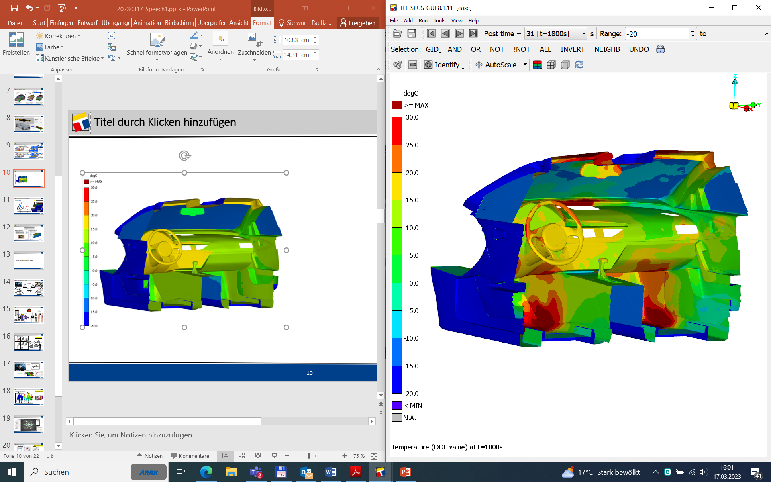
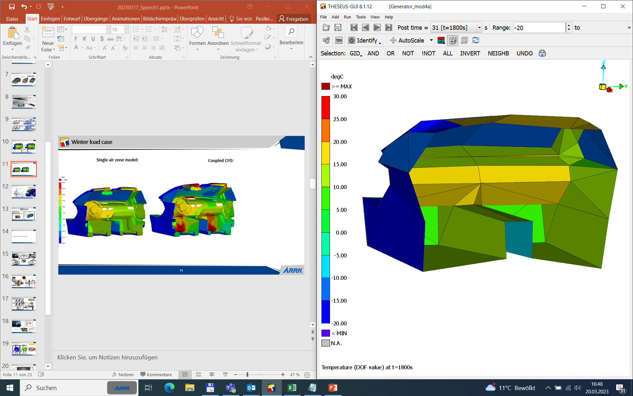
Winter Load Case
Coupled CFD:
Single airzone model:
CPU time: Days
CPU time:
Minutes
surface temperature 表面温度
Driver air temperature:
Generator model:
coupled CFD
CPU time:
Seconds
Single airzone model
Generator

Slide 11
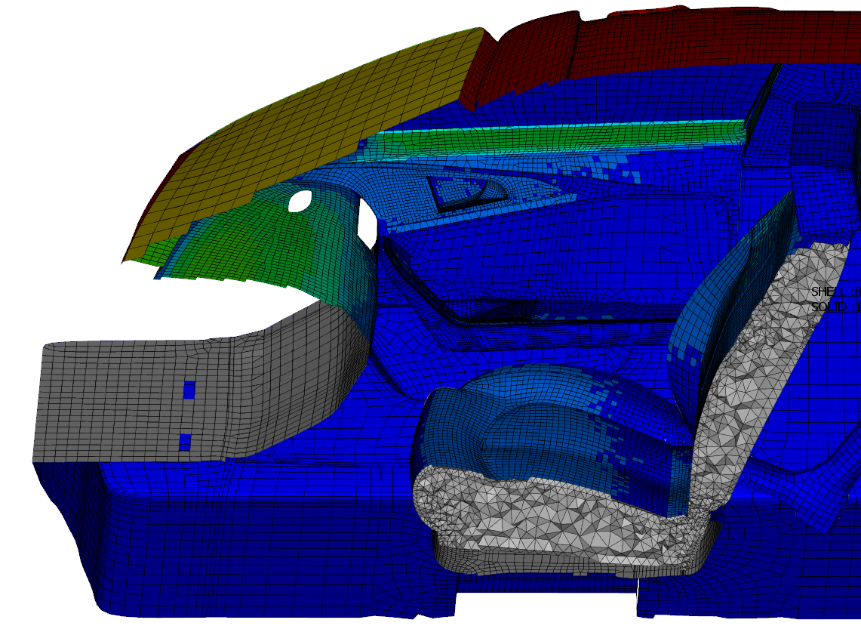



Wave Length Dependencies Of Solar Radiation
In THESEUS-FE, the glass transmittance/absorbance can be functions of ϕ and λ
Green house effect
Transmittance T
of standard automotive glass
$$T≈50\%$$
ϕ
Climate comfort glass
$$T≈30\%$$
5800K
solar
radiation
330K thermal
radiation
$$T≈0$$
λ
200nm
1μm
2μm
10μm
wave length
visible light
short wave radiation
long wave radiation
colors demonstrate the absorbed solar intensity

Slide 12
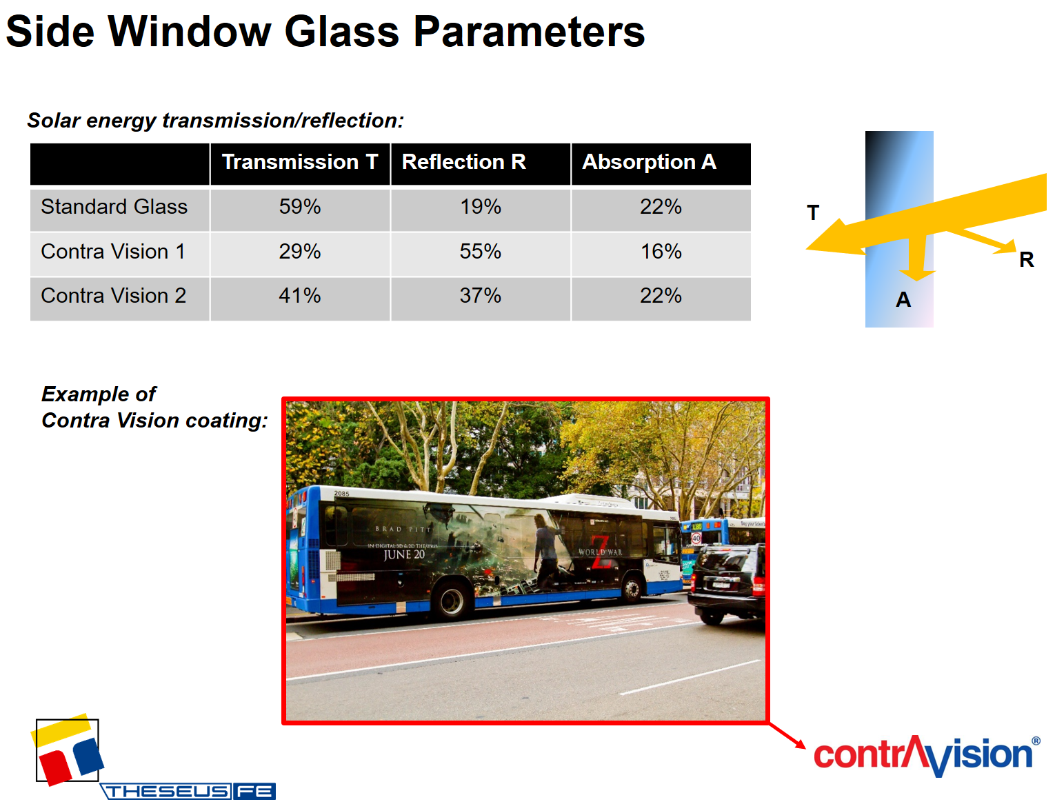
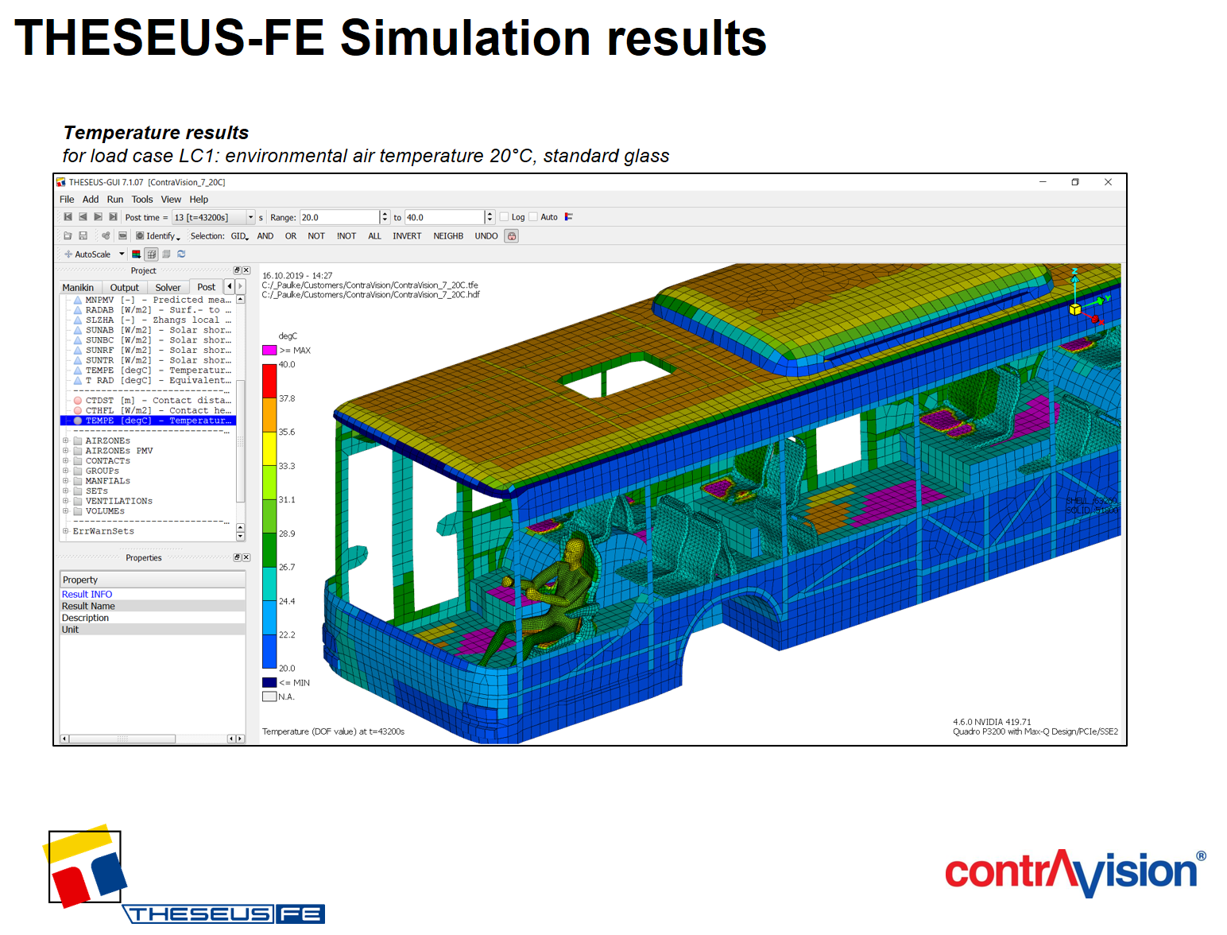
Wave Length Dependencies Of Solar Radiation
Summer | load case 1 | load case 2
Contra Vision 1 T=29% | 35% | 11%
Contra Vision 2 T=41% | 23% | 6%
Customer project
shows the impact of glass transmittance T on the HVAC energy consumption of a bus

Slide 13
Thermal manikins and comfort models

Slide 14
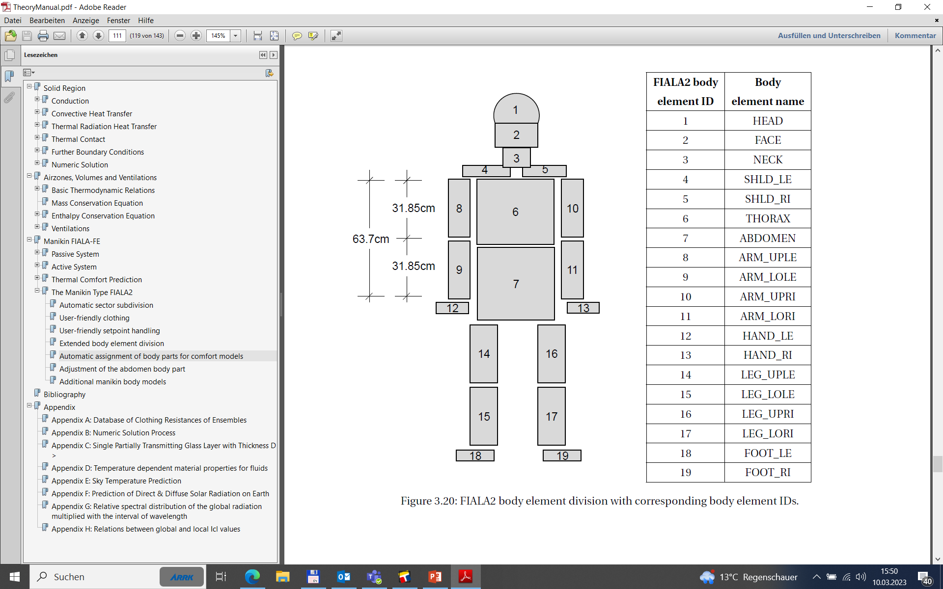
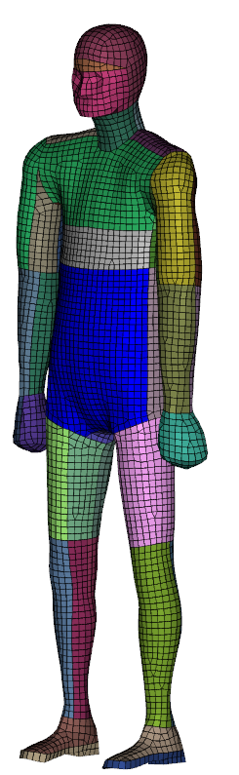
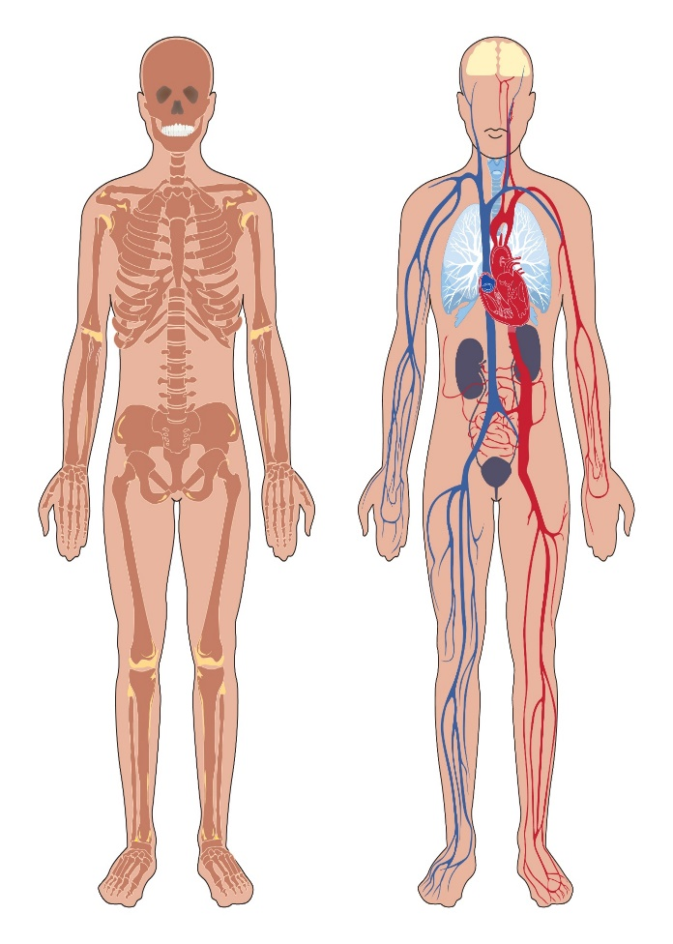




Fiala’s Thermal Manikin Model (1998)
Typical body element:
Active system regulations:
sweating, shivering, vasoconstriction, ...
Clothed section:
$$φ$$
clothing
face
temperature
reality
shell
Model
$$φ$$
internal model
$$T_{sk}$$
$$T_{cloth}$$

Slide 15
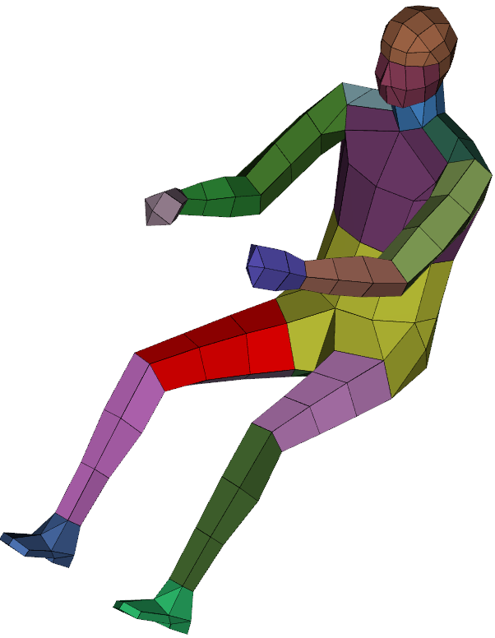
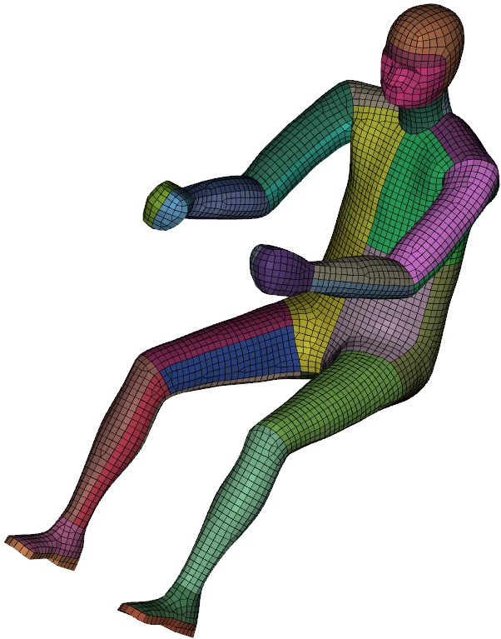
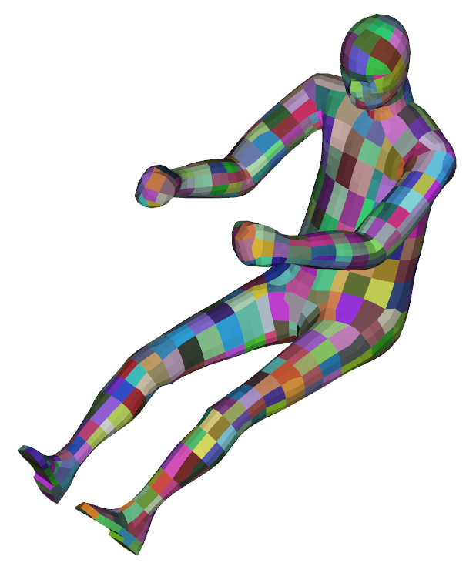
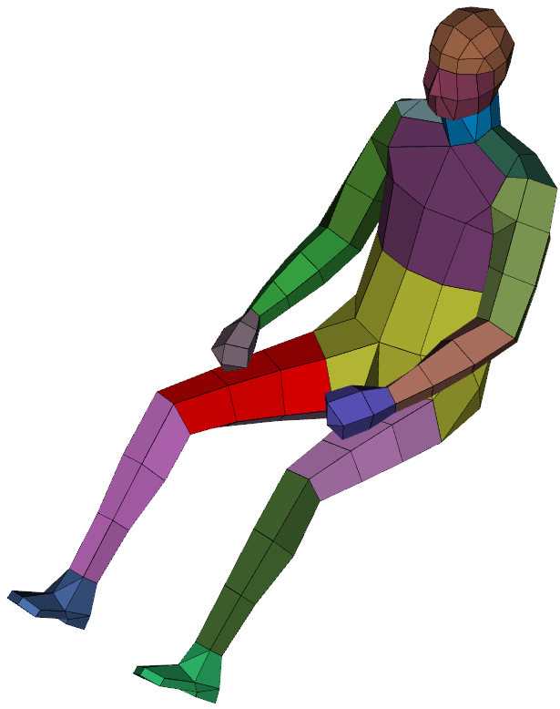
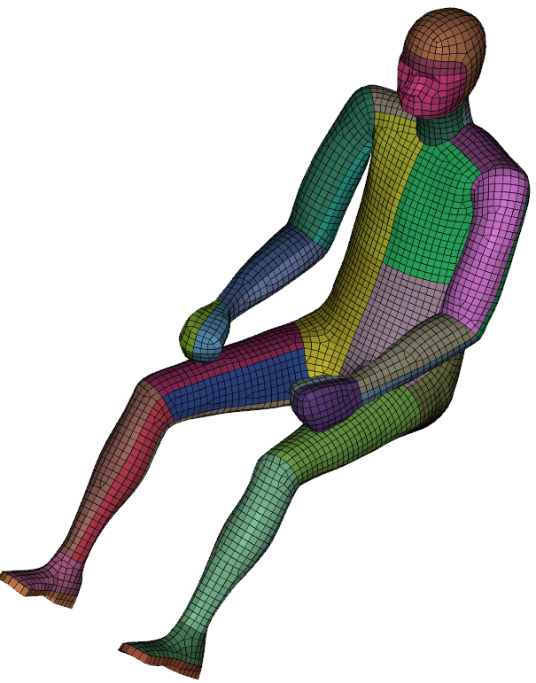
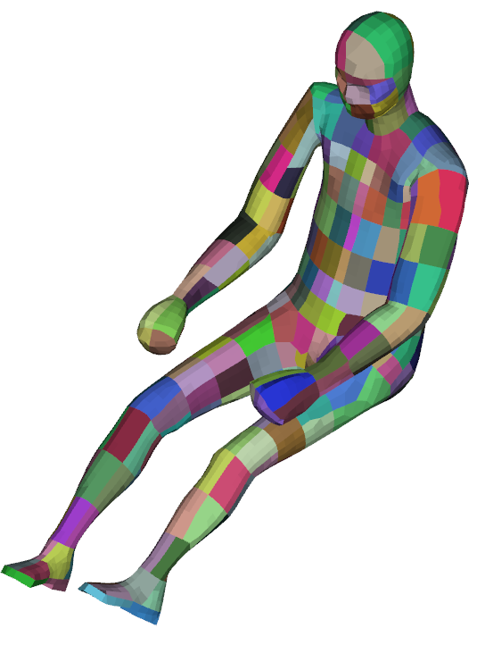
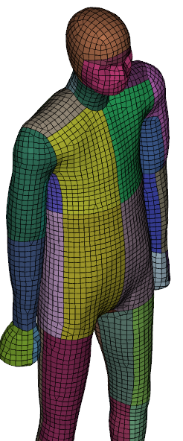
Fiala’s Thermal Manikin Model (1998)
Manikin meshes from the install. folder
User-def. meshes
Modular system
=672 combinations of models
sitting
driver
#Meshes
7
#Body models
4
- Fiala original
- European male
- European female
- Asian male
MANIKIN FIALA2
sitting
passenger
#Clothing ensembles
6
E.g.
summer
clothing ensemble
#Comfort Models
4
standing
PMV/PPD
DTS
Zhang/Berkeley
Teq/ISO 14505

Slide 16
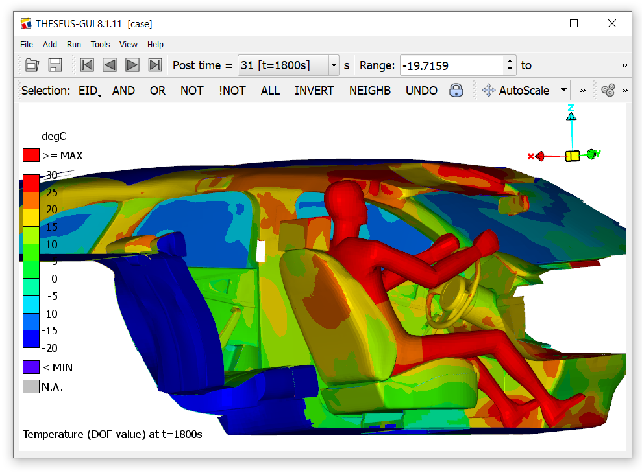
Winter Load Case: “Heat Up”
Requirements from DIN-1496:
T_{cabin, air}
20°C
t
target time
< 30min
-20°C
Ambient air temp. : -20°C
Ambient air velocity: 50km/h
Simulated cabin air temperature:
20°C
Surface temperatures, t = 30min
(from coupled CFD)
t [min]
coupled CFD: avg. driver air temp.
single airzone model

Slide 17
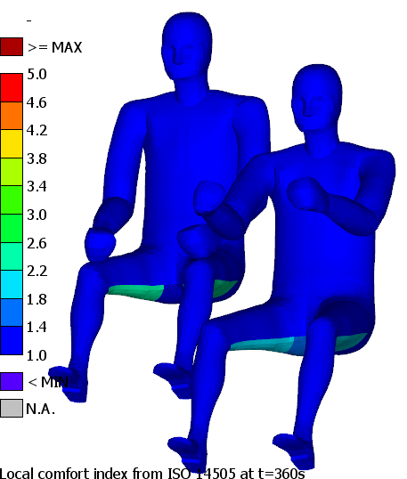
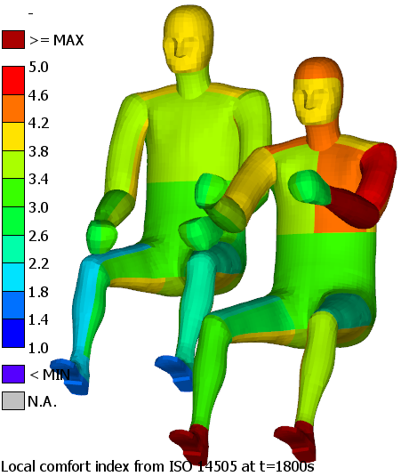
Winter Load Case: “Heat Up”
Discussion of local thermal comfort results:
1 : too cold (uncomfortable)
2 : cold, but comfortable
3 : neutral
4 : warm, but comfortable
5 : too warm (uncomfortable)
t = 6min
t = 30min
Passenger
Driver
Passenger (I_{cl}=1.1clo)
Driver (I_{cl}=1.3clo)

Slide 18
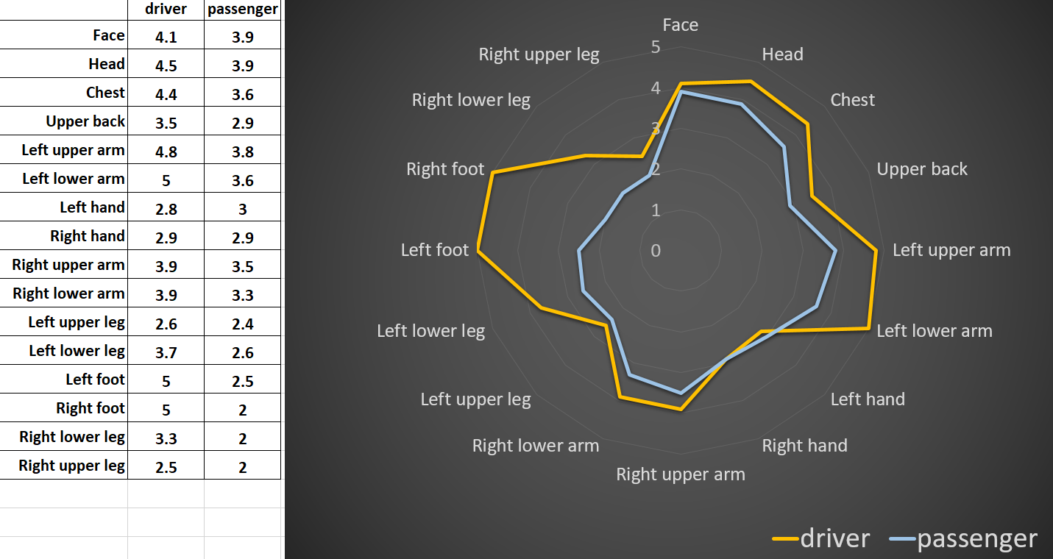

Winter Load Case: “Heat Up”
Local comfort index from ISO 14505:
Winter clothing:
1 : too cold (uncomfortable)
2 : cold, but comfortable
3 : neutral
4 : warm, but comfortable
5 : too warm (uncomfortable)
warm
cold
Global ISO:
$$t[sec]$$
overall ISO: 4.4 “warm”, 3.2 “neutral”

Slide 19
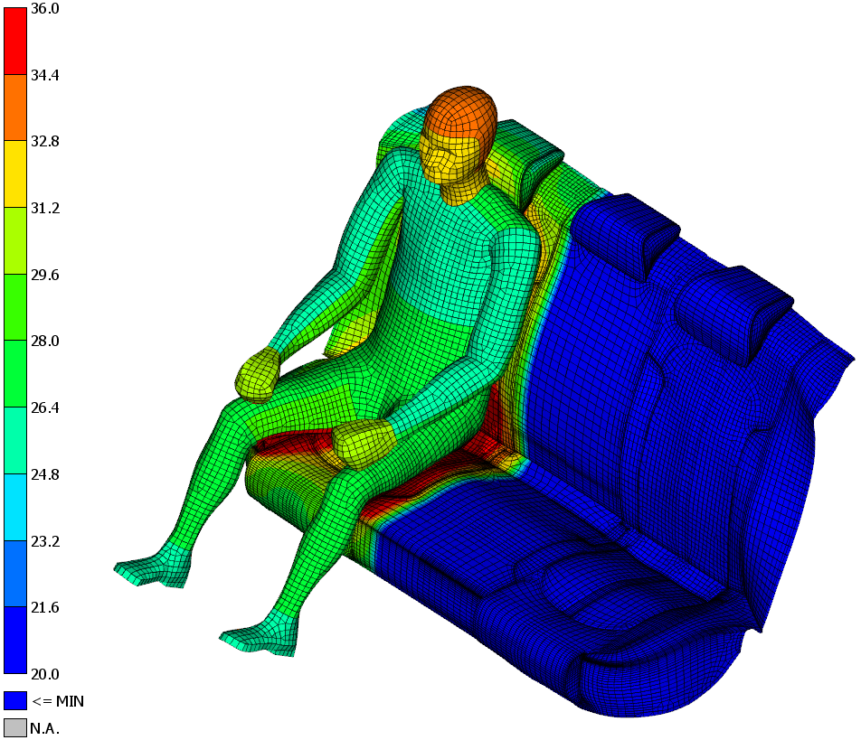






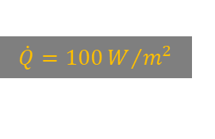

Winter Load Case: “Heat Up”
Zhang/Berkeley local thermal comfort evaluation for seat heating optimization
Variants of seat heating power:
$$\dot{Q}\left[\frac{W}{m^{2}}\right]$$
$$T\left[°C\right]$$
$$t[sec]$$
Local thermal comfort index:
very comfortable:
comfortable:
neutral:
uncomfortable:
very uncomfortable:
optimized
$$\dot{Q}=100W/{m^{2}}$$
$$t[sec]$$
$$\dot{Q}=0$$
$$\dot{Q}=100$$
$$\dot{Q}=200$$

Slide 20

Contact ARRK ENGINEERING
ARRK Engineering GmbH
Frankfurter Ring 160
80807 Munich
Germany
www.arrk-engineering.com
Simon Wegmann
Vice President Thermal Management
Mobil: +49 (0) 176 31857 421
Simon.wegmann@arrk-engineering.com
www.theseus-fe.com

