Slide 1





Thermal comfort-conscious air-conditioning system control for electric vehicles using model predictive control under transient climate condition
Myungkyu, Hongik Univ
Jaewoong Kim, Hyundai-Kia Motor Company
Hosung Lee, Korea Automotive Technology Institute
Sungjin Park, Hongik Univ

Slide 2
Outline
Background
Objectives
Development of VTMS plant model with high fidelity physics
Development of control-oriented HVAC system model
Development of modified PMV-based thermal comfort model
Introduce the Model predictive control approach
Simulation results and discussions
Summary and conclusions

Slide 3
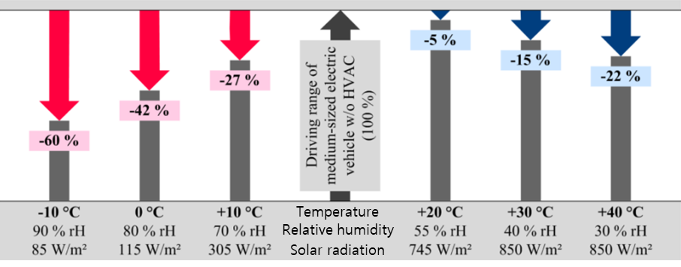
Background
The energy consumption of the HVAC system significantly influences the driving range of electric vehicles.
More efficient system and control logic is essential for EV to minimize the energy consumption.
Driving range reduction of a medium-sized EV in cold and hot weather conditions (ref)
Ref) Kapeller, H., Dvorak, D., & Simic, D. (2020). Improvement potentials for user centrically designed electric vehicles:
The QUIET Project. Proceedings of the 8th Transport Research Arena TRA.

Slide 4
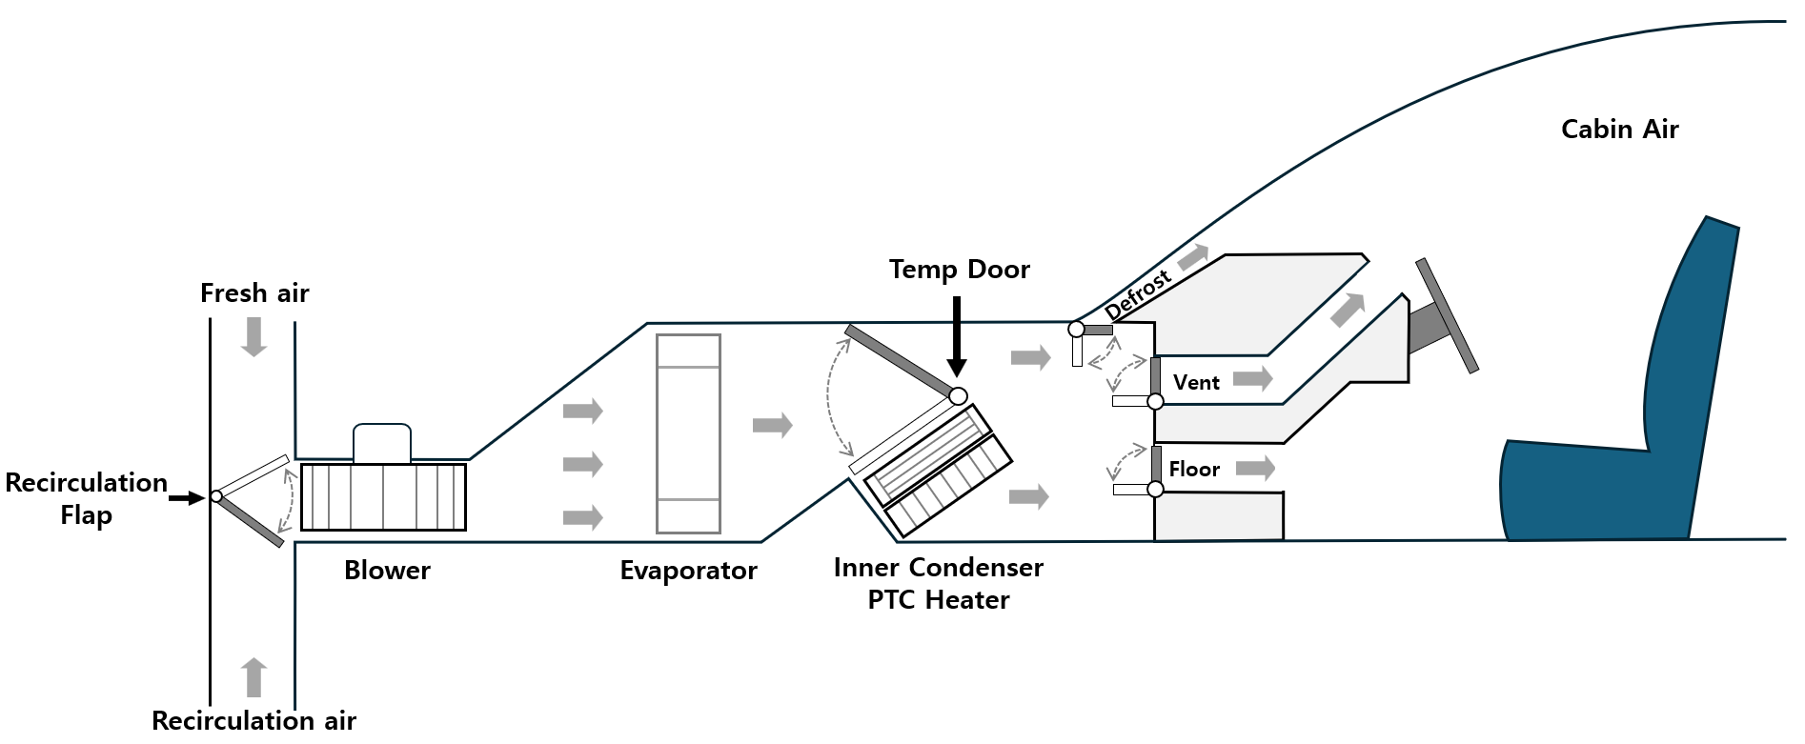
Background
During A/C operation, the evaporator outlet air is often too cold,
so reheating is required to prevent over-cooling and maintain passenger comfort.
Optimal control of HVAC system that simultaneously considers both A/C and reheating operations is essential for maintaining comfortable cabin environments.
Schematic Diagram of HVAC and Cabin System
Ref) Shin, Y., Ham, J., & Cho, H. (2019). Investigation on thermal comfort using driver’s bio-signals depend on vehicle cabin and vent exit air temperature. Journal of Mechanical Science and Technology, 33, 3585-3596.

Slide 5
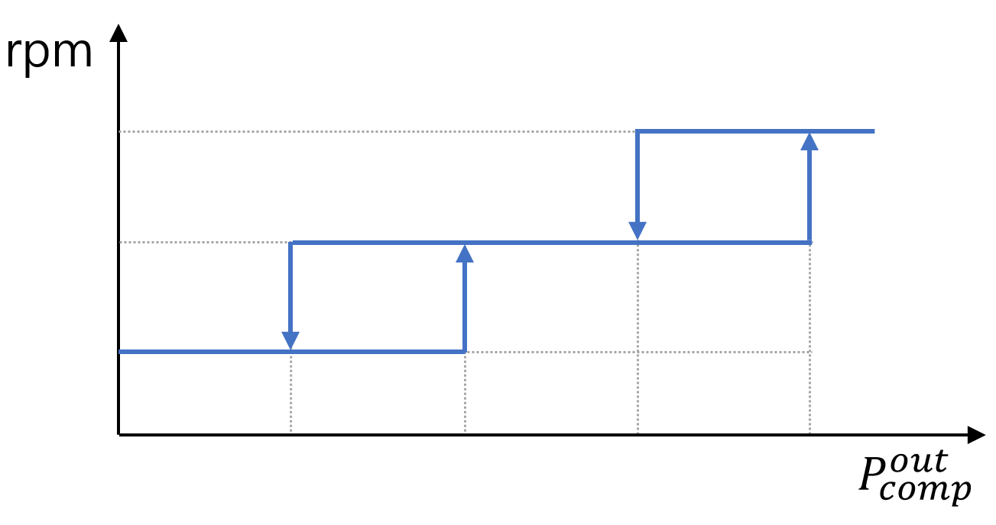
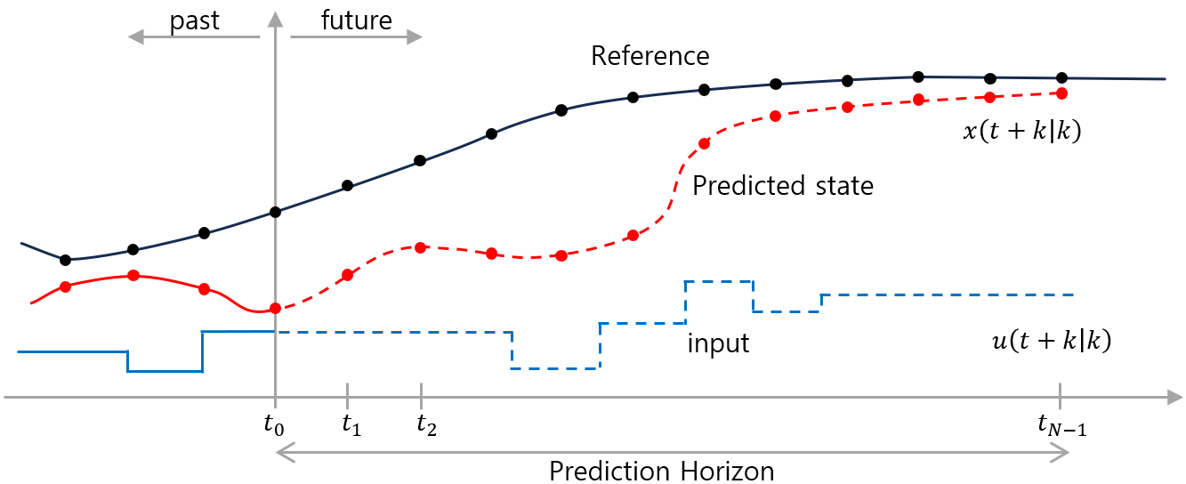
Background
Conventional thermal management strategies usually adopt finite-state-machine(FSM), proportional-integral-derivative(PID), fuzzy control(FC); derived from experience.
These rule-based approaches struggles to adapt to complex driving scenarios .
Recently, Model Predictive Control (MPC) has been widely used in vehicle HVAC system, as it optimizes control actions to minimize a cost function over a prediction horizon.
Rule based logic
Model predictive control
Ref ) Chen, Y., Kwak, K. H., Kim, J., Jung, D. D., & Kim, Y. (2024). Integrated Thermal Management of Electric Vehicles Based on Model Predictive Control with Approximated Value Function. IEEE Access.

Slide 6
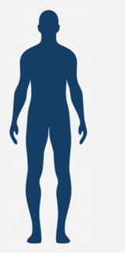
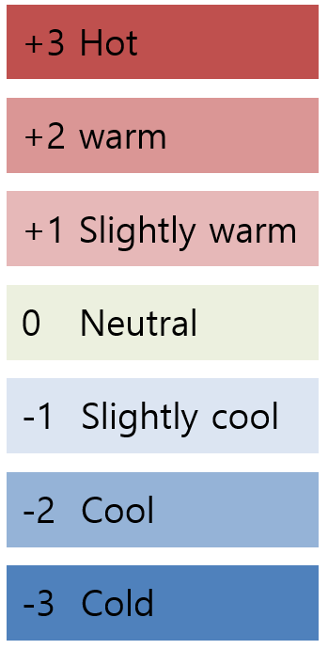
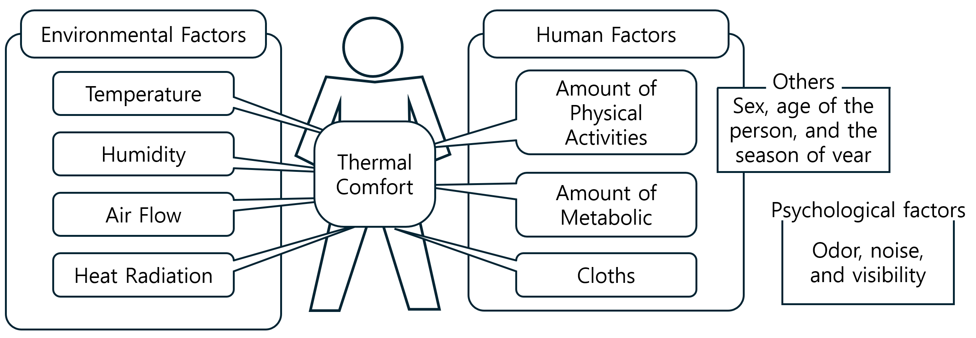
Background
Moreover, the role of the HVAC system is to ensure passenger thermal comfort .
To maximize energy savings while achieving desirable passenger thermal comfort,
an MPC-based controller requires a model that can explicitly evaluate thermal comfort.
A predictive mean vote (PMV) model is one of the most popular indices for evaluating thermal environmental conditions.
Factors influencing thermal comfort for passengers
Thermal sensation scale based on PMV
Ref ) ANSI ASHRAE Standard 55 (2017). Thermal environmental conditions for human occupancy. ASHRAE.

Slide 7
Background
Many recent studies have used the PMV model in their MPC-based control design
to improve HVAC system efficiency while maintaining passenger comfort.
However, previous studies have often assumed a static driving environment,
whereas in reality, the performance of the EV thermal management system (TMS) is affected by complex and varying environmental conditions.
To overcome the limitations of previous MPC-based approaches and fully realize the optimal performance of HVAC system control in electric vehicles, this study proposes a novel MPC-based HVAC control strategy that incorporates reheating using an internal condenser during A/C operation and considers passenger thermal comfort.
The proposed control strategy aims to analyze the impact of various environmental factors, such as ambient temperature and solar radiation, on overall system performance.

Slide 8
Objectives
Thermal comfort-conscious air-conditioning system control for electric vehicles using model predictive control under transient climate condition
  Development of VTMS plant model with high fidelity physics using simscape.
  Development of the control-oriented HVAC system model based ideal vapor-compression cycle and a modified PMV-based thermal comfort model.
  Development of the model predictive controller.
  Evaluation of the proposed HVAC control strategy through simulations under transient climate conditions, including varying ambient temperature and solar radiation, in complex driving scenarios.

Slide 9
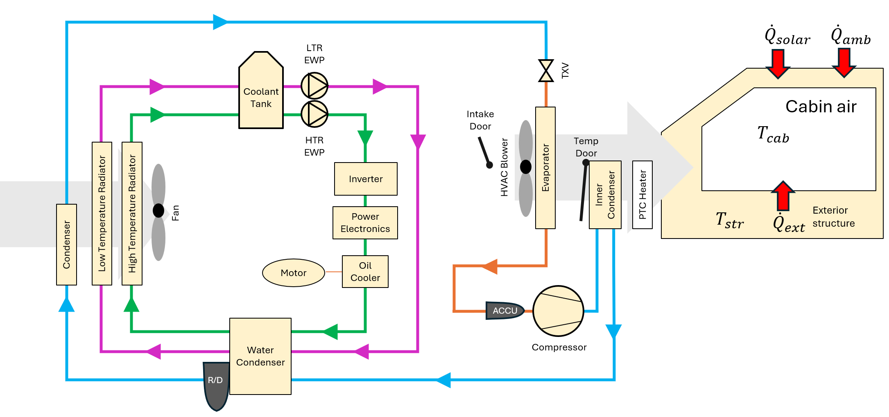
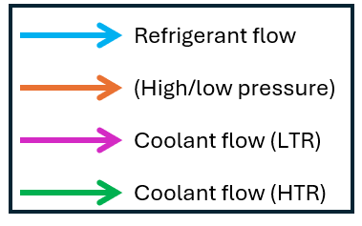
Development of VTMS Plant Model with High-Fidelity Physics
A VTMS plant model with high- fidelity physics is developed in Simscape, based on performance map and geometry data of each component, used as the plant model.
Electric vehicle Specifications
Component | Type | Specification
Vehicle | Battery electric vehicle | 1900 kg
Battery | Lithium-ion pouch cell | 73kWh
Motor | Permanent magnetic | 160 kW
VTMS | Electric compressor | 45 cc
Architecture of HVAC system with R1234yf

Slide 10
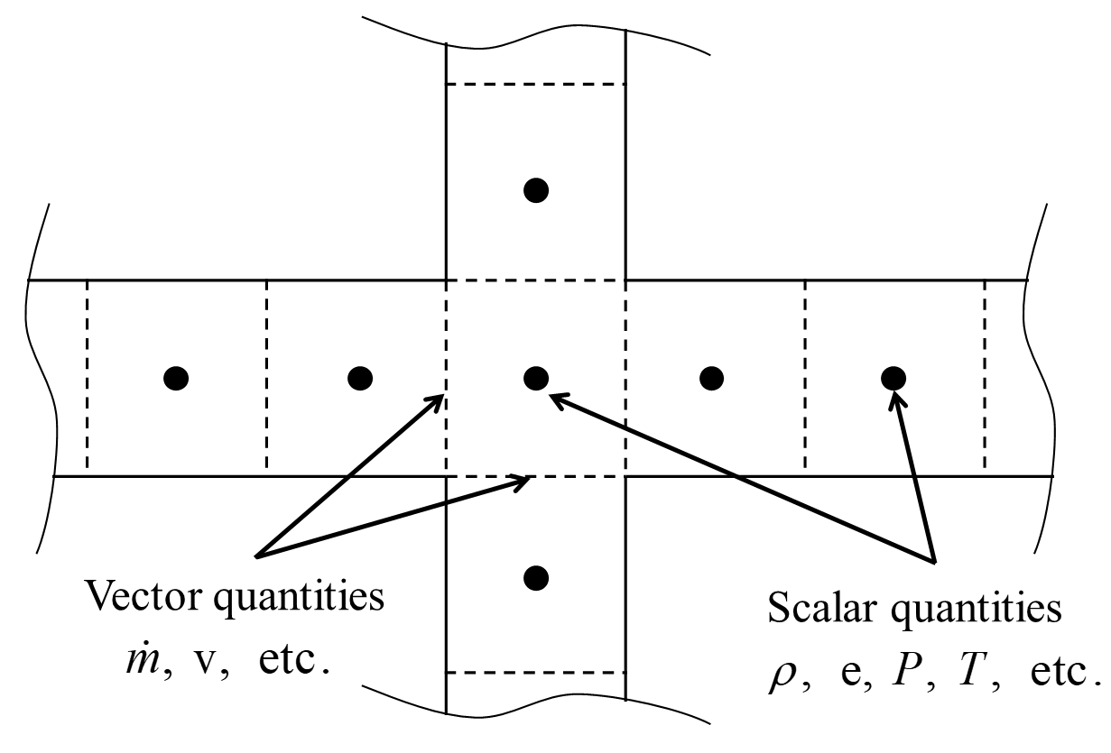
Development of VTMS Plant Model with High-Fidelity Physics
The flow model involves the solution of the Navier-Stokes equation.
The flow is divided into one or more volumes which are connected by boundaries.
The flow components such as pipe, valve, pump, fan, blower, and compressor are developed based on governing equation of fluid dynamics.
Continuity :
Energy :
Enthalpy :
Schematic of staggered grid approach
Momentum :

Slide 11
Development of VTMS Plant Model with High-Fidelity Physics
In the VTMS, the type of heat exchanger is usually composed of louvered fin tube type and plate type.
The heat transfer coefficient and the friction factor vary depending on the type of heat exchanger and geometry.
 |  | Tube-fin type heat exchanger |  | Plate type heat exchanger
 |  | Tube side | Fin side
Heat transfer coefficient | Single Phase | Gnielinski | Chang | Dittus-Boelter
 | Two Phase | Cavallini-Zecchin | N/A | Cavallini-Zecchin
Friction factor | Single Phase | Pipe flow | Chang | Pipe flow
 | Two Phase | Friedel | N/A | Friedel

Slide 12
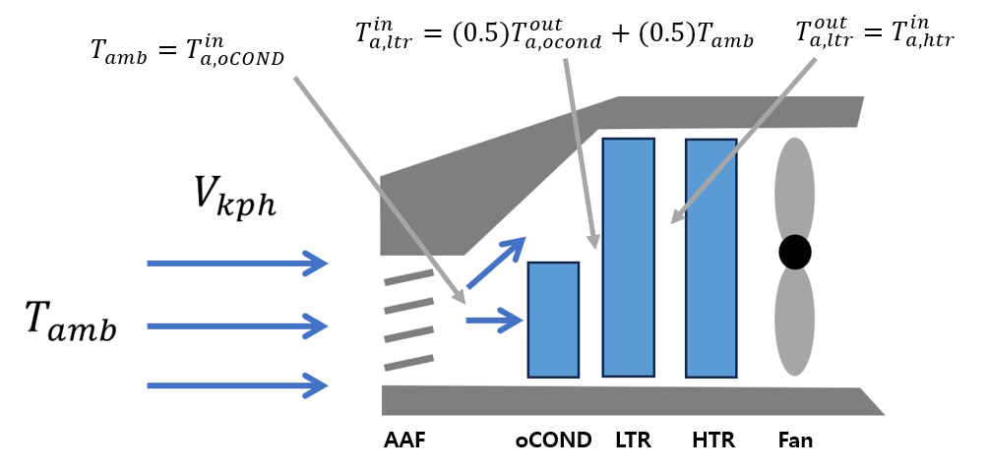
Development of VTMS Plant Model with High-Fidelity Physics
The air flow in the underhood modeling
Ambient air enters through the vehicle's front grille and then passes sequentially through the outdoor condenser, LTR, HTR, and Fan.
Architecture of the air flow in the underhood

Slide 13
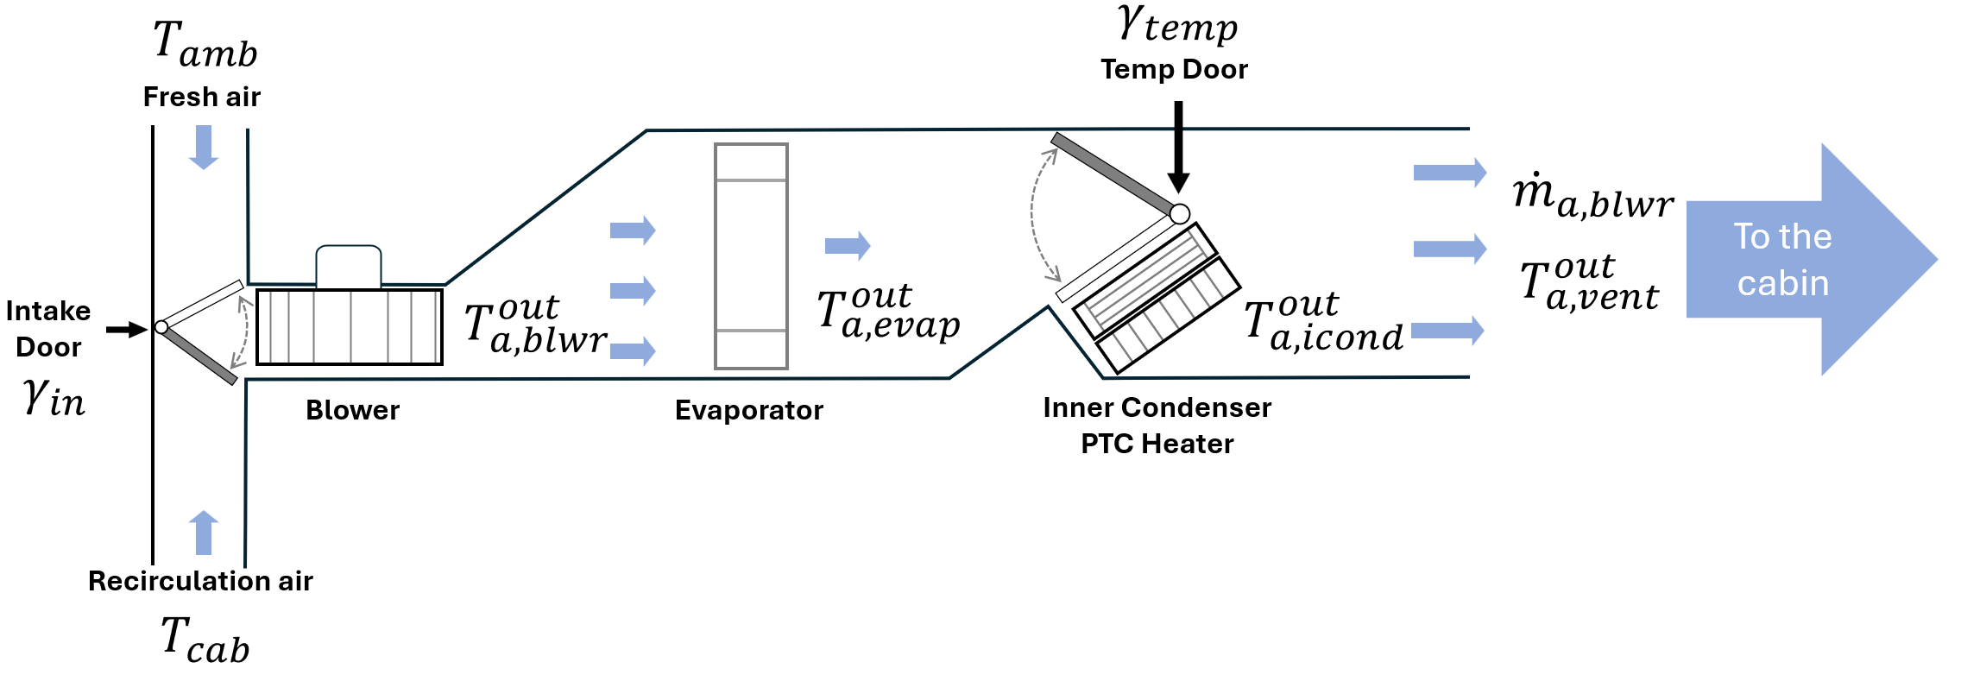
Development of VTMS Plant Model with High-Fidelity Physics
The air flow in HVAC system modeling
Depending on the Tempdoor operation, the chilled air from the evaporator is warmed by passing through the internal condenser and heater before it is supplied to the cabin.
Architecture of the air flow in HVAC system model

Slide 14
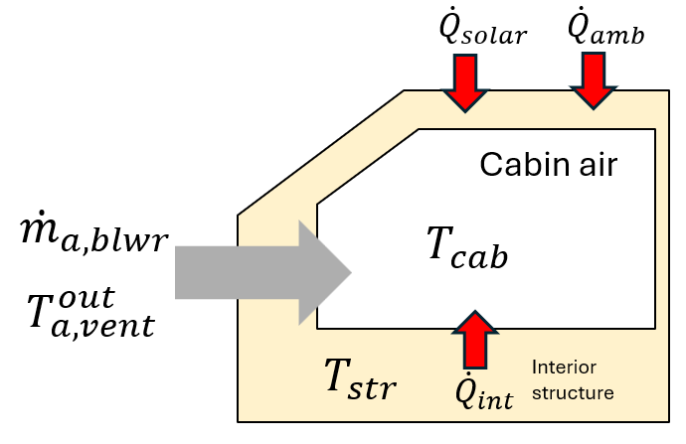
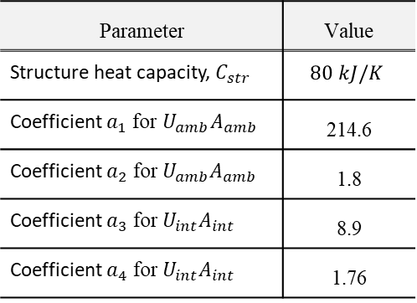
Development of VTMS Plant Model with High-Fidelity Physics
To analyze the temperature change and heat load of cabin,
The single-zone cabin and structure model is developed.
Calibrated reduce-order cabin model parameters
Parameter | Value
Structure heat capacity, $C_{str}$ | $$80 kJ/K$$
Coefficient $a_{1}$ for $U_{amb}A_{amb}$ | 214.6
Coefficient $a_{2} \text{for} U_{amb}A_{amb}$ | 1.8
Coefficient $a_{3} \text{for} U_{int}A_{int}$ | 8.9
Coefficient $a_{4} \text{for} U_{int}A_{int}$ | 1.76
Architecture of cabin air and structure model

Slide 15
Development of VTMS Plant Model with High-Fidelity Physics
A VTMS plant model is validated with experimental data during dynamic situation

Slide 16
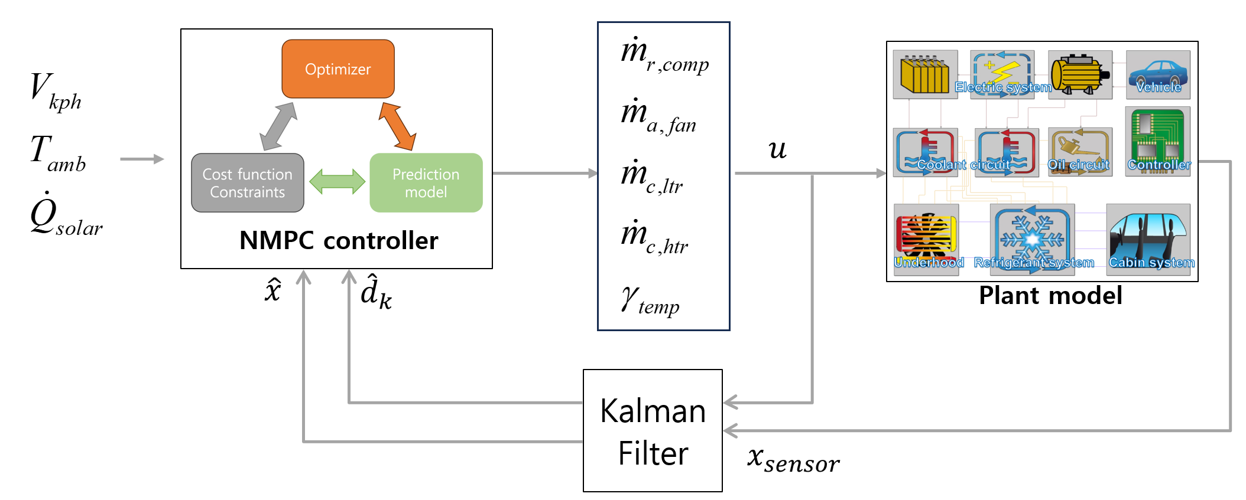
Model predictive control
MPC optimizes control actions to minimize a cost function over a prediction horizon while satisfying constraints.
To design an MPC controller, it is necessary to provide a control-oriented model and an optimization strategy including the cost function and constraints for future prediction.
A schematic diagram of model predictive control

Slide 17
Model predictive control – Cost function
The cost function is formulated to achieve three main goals.
  Minimize power consumption by each of the HVAC system.
  Regulate the PMV to a neutral thermal sensation for optimal thermal comfort.
  Regulate to the target temperature set by the passenger.

Slide 18
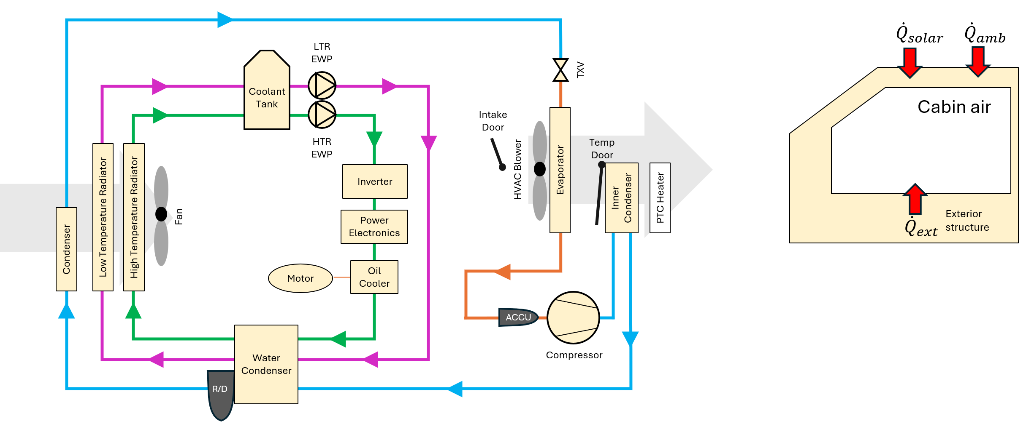










Model predictive control - Control-oriented Model
The modeling approaches used to capture the dynamic behavior of the integrated TMS.
This study focuses on cabin climate control so powertrain thermal management with an HVAC system is not considered.
$${\dot{m}}_{a,blwr}$$
$$T_{cab}$$
$${\dot{m}}_{a,fan}$$
$$T_{a,vent}^{out}$$
$$T_{str}$$
$$T_{amb}$$
$$T_{re,sat}$$
$$T_{rc,sat}$$
$$T_{c,wCltr}^{in}$$
$$T_{c,wChtr}^{in}$$
A schematic diagram of the thermal management system

Slide 19
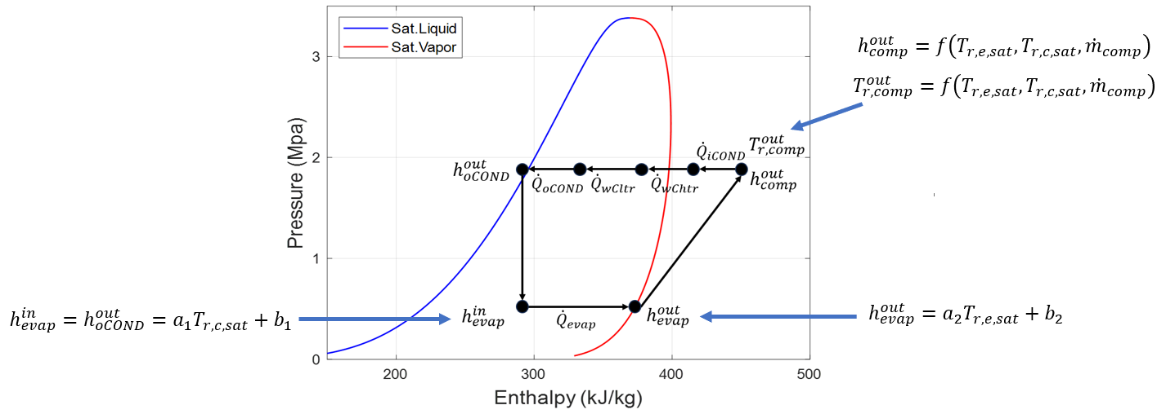
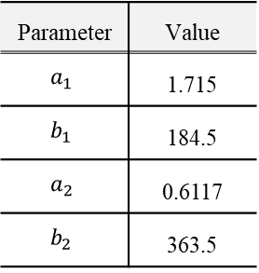
Model predictive control - Control-oriented Model
Refrigerant cycle modeling
The refrigerant is assumed to operate on an ideal vapor-compression(VC) cycle,
to reduce computational demands while effectively capturing the essential dynamics of the refrigerant.
Regressed parameter
(R1234yf as refrigerant)
Parameter | Value
$$a_{1}$$ | 1.715
$$b_{1}$$ | 184.5
$$a_{2}$$ | 0.6117
$$b_{2}$$ | 363.5
P-h diagram of idea vapor-compression cycle (R1234yf as refrigerant)

Slide 20
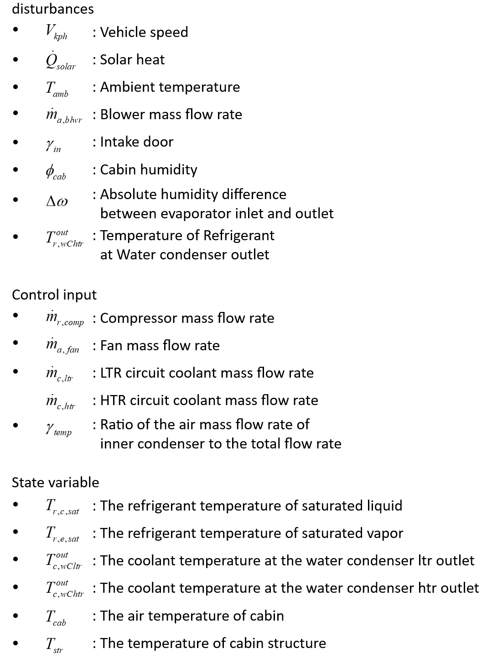
Model predictive control - Control-oriented Model
The reduced model comprises 6 state variables, 5 control variables, 6 disturbances.

Slide 21
Model predictive control - Control-oriented Model
Validation results of reduced-order discretized-time model
- Ambient : 27°C
- Ambient : 35°C
- Ambient : 45°C
Normalized by ${\dot{m}}_{r,comp}=0.1kg/s$, ${\dot{m}}_{a,fan }=1kg/s$, ${\dot{m}}_{c,htr }=0.3kg/s$, ${\dot{m}}_{c,ltr }=0.3kg/s\text{, }γ_{temp}=100\%$

Slide 22
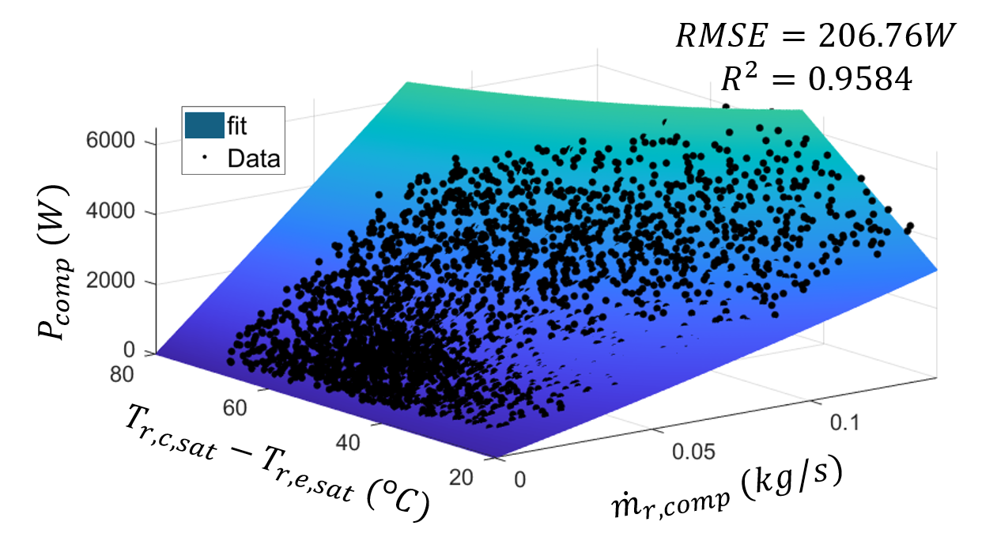
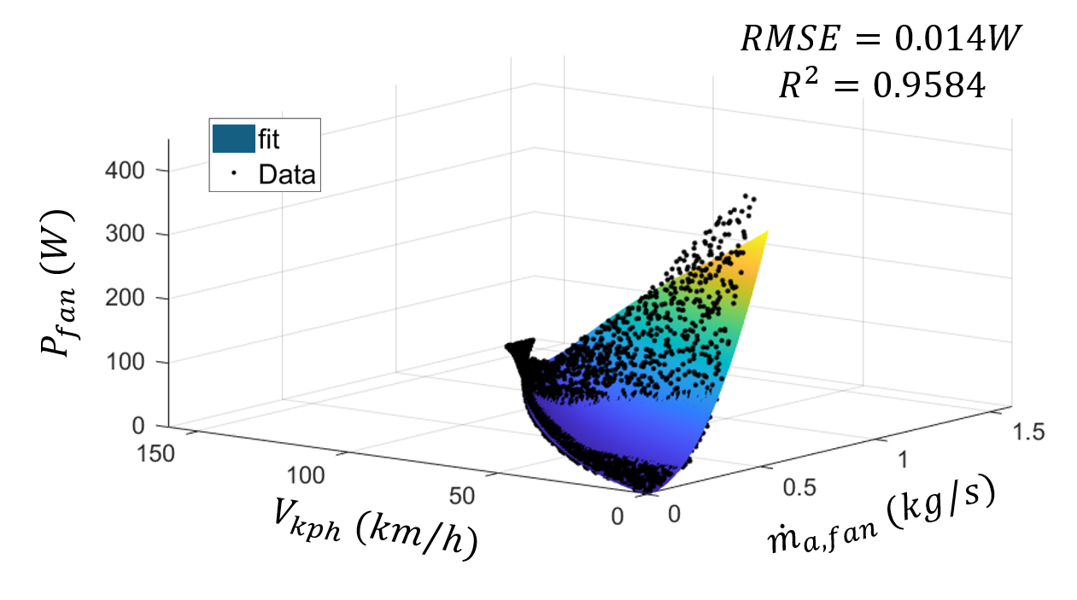
Model predictive control - Control-oriented Model
To minimize the energy consumption of thermal management components,
power consumption model in a discretized time form were developed.
Regressed power consumption model of compressor and fan

Slide 23
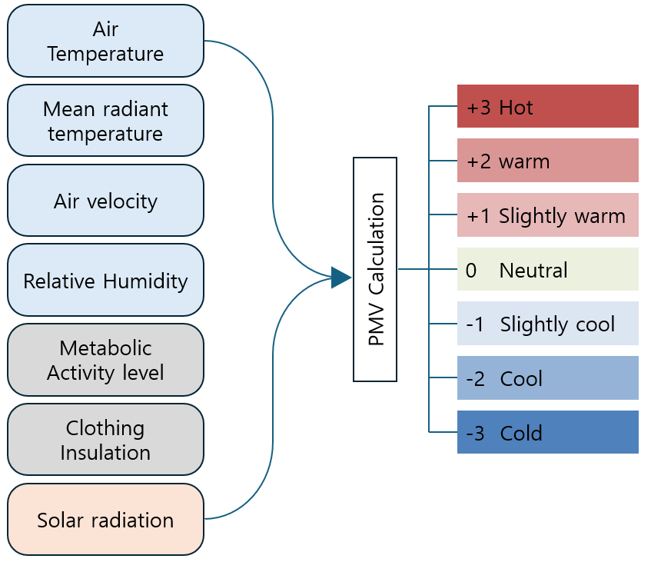

Development of modified Thermal comfort model
In the PMV model, the passenger thermal comfort is evaluated based on heat generation of the human body and various heat loss terms$\left(∅\right)$.
The calculation of $T_{cl}$ was performed using the method proposed in reference.
Ref *) Chen, Y., Kwak, K. H., Kim, J., Kim, Y., & Jung, D. (2023). Energy‐efficient cabin climate control of electric vehicles using linear time‐varying model predictive control. Optimal Control Applications and Methods, 44(2), 773-797.

Slide 24
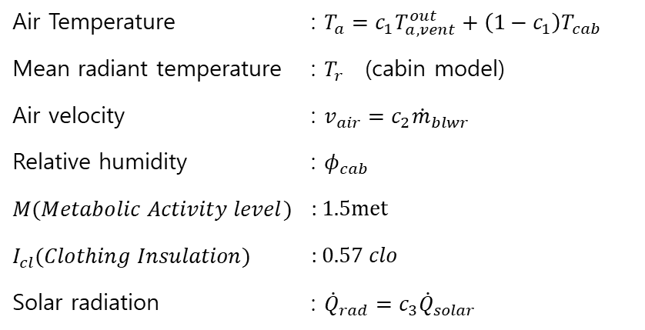
Development of modified Thermal comfort model
The PMV (Predicted Mean Vote) model integrates factors such as temperature, humidity, airflow, and clothing insulation to evaluate thermal comfort.
Solar radiation has a greater impact in vehicles than in buildings, so it is additionally considered.
Air Temperature | : $T_{a}=c_{1}T_{a,vent}^{out}+\left(1−c_{1}\right)T_{cab}$
Mean radiant temperature | : $T_{r}$ (cabin model)
Air velocity | : $v_{air}=c_{2}{\dot{m}}_{blwr}$
Relative humidity | : $φ_{cab}$
$M(Metabolic Activity level)$ | : $1.5met$
$I_{cl}(Clothing Insulation)$ | : $0.57 clo$
Solar radiation | : ${\dot{Q}}_{rad}{=c_{3}\dot{Q}}_{solar}$

Slide 25
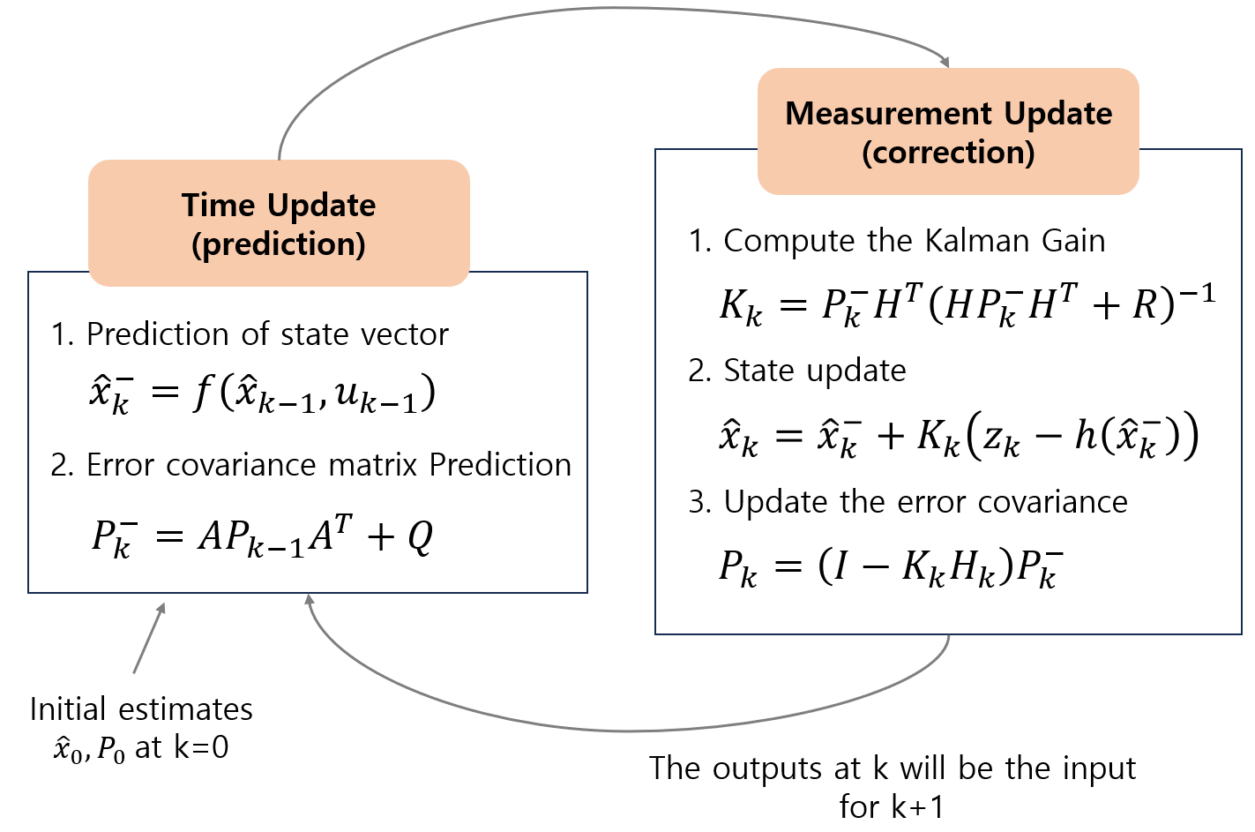
Model predictive control – Kalman filter
In this study, the EKF (Extended Kalman Filter) is used as the state estimator.
The state observer is designed to estimate unmeasurable state and disturbances that account for offsets caused by the mismatch between the VTMS plant model and the control-oriented model.
Estimated state
Estimated disturbance
Architecture of Extended Kalman filter

Slide 26
Model predictive control condition
Prediction horizon 60s, sample time : 1s
Optimization of cost function : Interior-point method (nonlinear)
It is assumed that the vehicle speed, ambient temperature, and solar radiation
are known precisely over the prediction horizon.
Model predictive control(MPC) loop

Slide 27
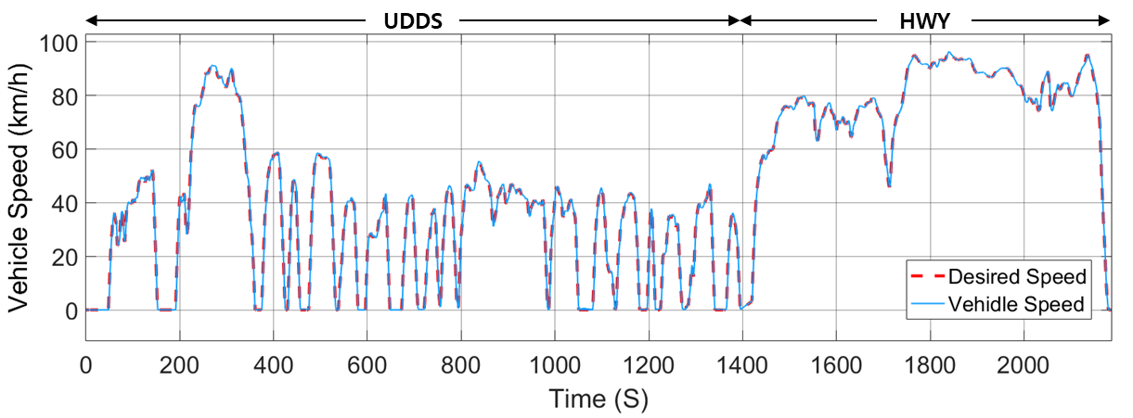
Simulation condition – steady climate profile
Simulation condition for validating controller effectiveness in steady climate conditions, without considering thermal comfort.
Simulation condition
- Ambient temperature : 35 ℃ , Solar radiation : 750 W/m²
- Both controller is designed to maintain the cabin temperature at 22℃
- Total time of driving cycle : 35min (UDDS+HWY)
Climate condition

Slide 28






Simulation results – steady climate profile
Comparison of results based on control logic
- Both controllers maintain the cabin temperature at 22℃,
but the thermal sensation is slightly warm.
$T_{a,evap}^{out}$ (℃)
$$PMV$$
Constraint : 2℃$≤T_{a,evap}^{out}≤8\text{℃}$
Comfort Zone
$T_{cab}$ (℃)
22℃ $T_{cab}$ target
$T_{a,vent}^{out}$ (℃)
Normalized by ${\dot{m}}_{r,comp}=0.1kg/s$, ${\dot{m}}_{a,fan }=1kg/s$, ${\dot{m}}_{c,htr }=0.3kg/s$, ${\dot{m}}_{c,ltr }=0.3kg/s\text{, }γ_{temp}=100\%$
Rule-based
MPC
Normalized
control input
Normalized
control input
Simulation result of controlled VTMS

Slide 29





Simulation results – steady climate profile
Comparison of energy consumption based on control logic
-MPC controller considers the ram air effect based on vehicle speed,
optimizing the mass flow rate of fan and pump to minimize energy consumption.
$${\dot{m}}_{r,comp }(kg/s)$$
$${\dot{m}}_{a,fan }(kg/s)$$
Fan bound
$${\dot{m}}_{c,ltr }(kg/s)$$
$${\dot{m}}_{c,htr }(kg/s)$$
$$γ_{temp}(\%)$$
Energy (Wh)
11% energy saving with MPC
Comparison of auxiliary power consumption

Slide 30
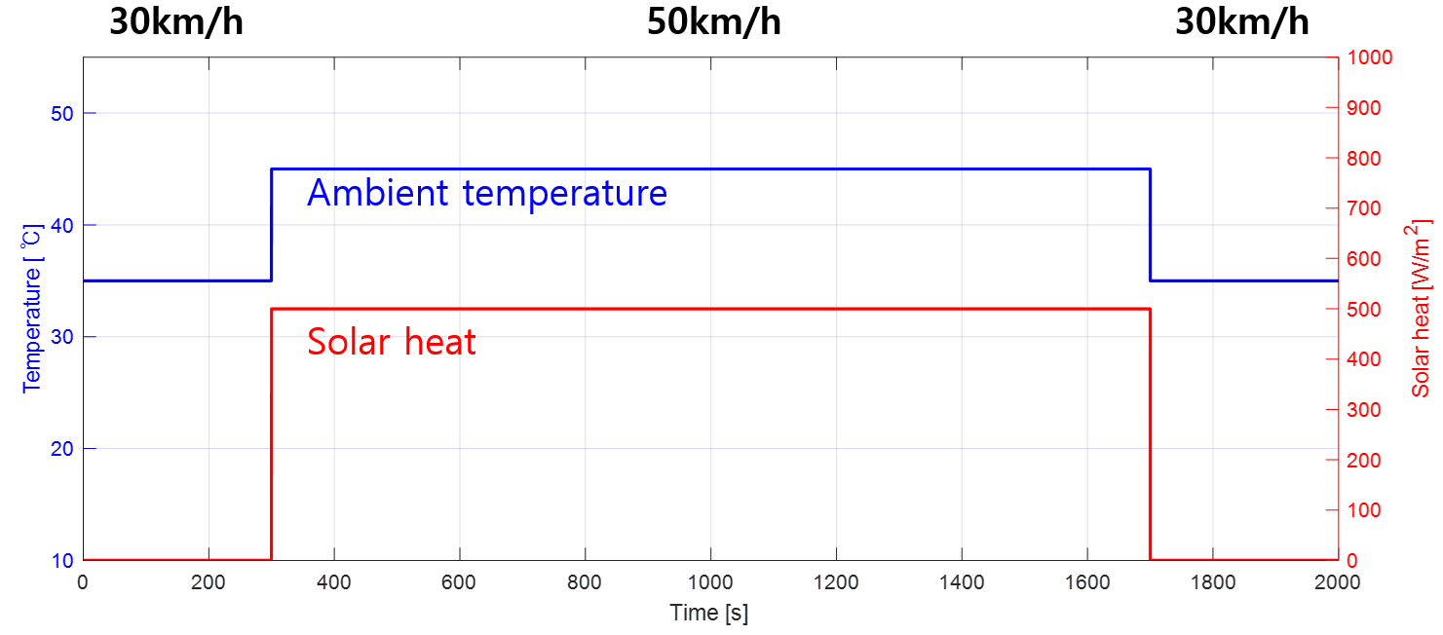
Simulation results – step change climate profile
Simulation condition for validating controller effectiveness in transient climate.
Assume that, driving condition is underground parking lot – urban driving – parking lot.
Soaking temperature : 35℃
Climate condition

Slide 31
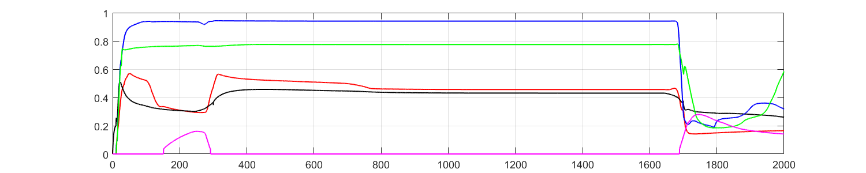


Simulation results – step change climate profile
Comparison of results based on control logic
-The RB controller maintains the at 22°C, not considering thermal comfort.
-The MPC controller maintains the PMV index within the comfort zone.
$T_{a,evap}^{out}$ (℃)
$$PMV$$
$T_{a,vent}^{out}$ (℃)
$$T_{cab} \text{(}\text{℃}\text{)}$$
22℃ $T_{cab}$ target
Normalized by ${\dot{m}}_{r,comp}=0.1kg/s$, ${\dot{m}}_{a,fan }=1kg/s$,${\dot{m}}_{c,htr }=0.3kg/s$, ${\dot{m}}_{c,ltr }=0.3kg/s\text{, }γ_{temp}=100\%$
Normalized
control input
Normalized
control input
Rule-based
MPC
Simulation result of controlled VTMS

Slide 32





Simulation results – step change climate profile
Simulation results
- When exiting the parking lot (300s)
- When entering the parking lot (1700s)
MPC responds 20s earlier
$${\dot{m}}_{r,comp }(kg/s)$$
$${\dot{m}}_{r,comp }(kg/s)$$
MPC responds 20s earlier
$T_{a,evap}^{out}$ (℃)
$T_{a,evap}^{out}$ (℃)
$$γ_{temp}(\%)$$
$$γ_{temp}(\%)$$
$$PMV$$
$$PMV$$
Comparison of proactive responses to future variations

Slide 33



Simulation results – step change climate profile
Comparison of energy consumption based on control logic
-MPC controller considers the ram air effect based on vehicle speed,
optimizing the mass flow rate of fan and pump to minimize energy consumption.
$${\dot{m}}_{r,comp }(kg/s)$$
$${\dot{m}}_{a,fan }(kg/s)$$
Fan bound
$${\dot{m}}_{c,htr }(kg/s)$$
$${\dot{m}}_{c,ltr }(kg/s)$$
$$γ_{temp}(\%)$$
Energy (Wh)
8% energy saving with MPC
Comparison of auxiliary power consumption

Slide 34
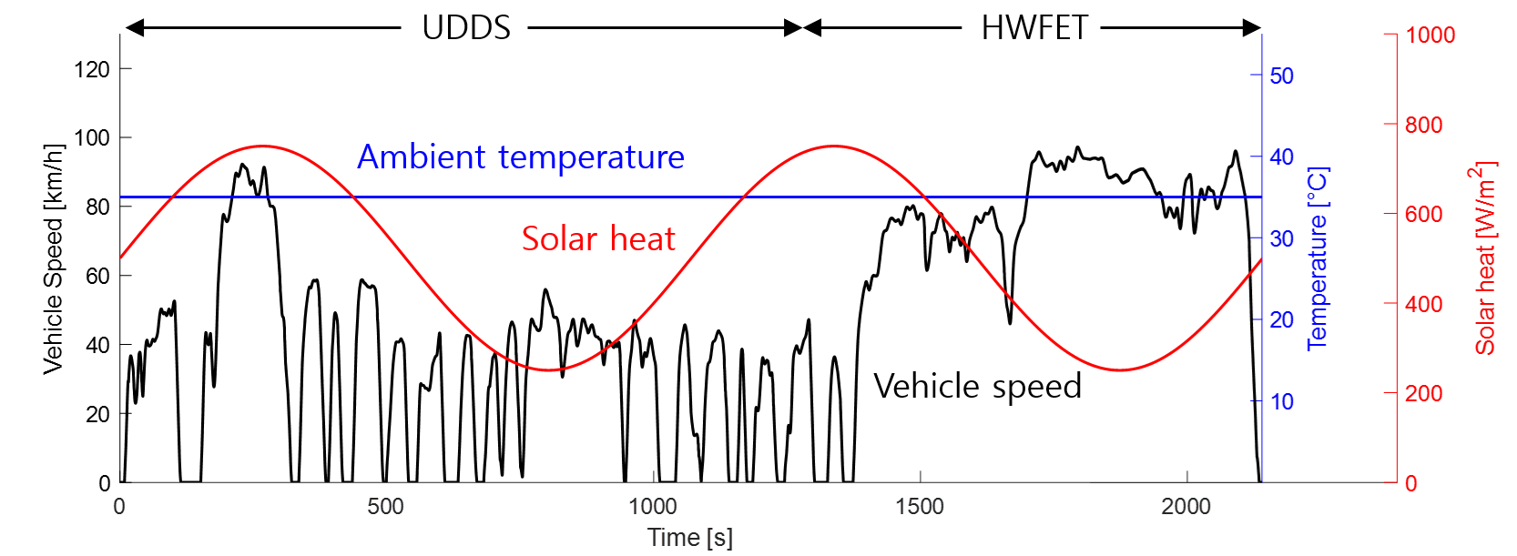
Simulation condition – periodic variation in solar radiation
Simulation condition
- Ambient temperature : 35℃
- Solar heat : 250~750W/m² sine wave
- Total time of driving cycle : 35min (UDDS+HWY)
Climate condition

Slide 35

Simulation results – periodic variation in solar radiation
Comparison of results based on control logic
-The MPC controller maintains desirable passenger thermal comfort considering variations in solar radiation.
$T_{a,evap}^{out}$ (℃)
$$PMV$$
$T_{a,vent}^{out}$ (℃)
$$T_{cab} \text{(}\text{℃}\text{)}$$
22℃ $T_{cab}$ target
Normalized
control input
Normalized
control input
Rule-based
MPC
Simulation result of controlled VTMS

Slide 36



Simulation results – periodic variation in solar radiation
Comparison of energy consumption based on control logic
-The MPC controller accounts for variations in solar radiation and vehicle speed,
enabling energy savings.
$${\dot{m}}_{a,fan }(kg/s)$$
$${\dot{m}}_{r,comp }(kg/s)$$
Fan bound
$${\dot{m}}_{c,ltr }(kg/s)$$
$${\dot{m}}_{c,htr }(kg/s)$$
$$γ_{temp}(\%)$$
Energy (Wh)
13% energy saving with MPC
Comparison of auxiliary power consumption

Slide 37
Summary and Conclusions
Develop the VTMS plant model with high fidelity physics using simscape.
Develop the control-oriented HVAC system model based ideal vapor-compression cycle and a modified PMV-based thermal comfort model.
To evaluate the performance of the proposed HVAC control strategy in complex driving scenarios, simulations were conducted under various driving scenarios.
The MPC controller considers the ram air effect based on vehicle speed, achieving higher energy efficiency compared to the RB controller.
The MPC controller predict future variations in solar radiation and ambient temperature, enabling proactive responses such as pre-cooling and pre-heating.
The MPC controller adapts more effectively to complex driving conditions than RB controller, enabling maximum energy savings while maintaining desirable passenger thermal comfort.

Slide 38
Speaker Information
Thank you
      Myungkyu Lee
      Hongik Univ
      Ph.D. Candidate
      Vehicle powertrain & Thermal management system analysis
      dlaudrb143@gmail.com
Paper # (if applicable)

