Slide 2

Enhanced R290 System
IL YOUNG PARK

Slide 3
Contents
Indirect Thermal Management System
Precedent Research
Rationales of Enhanced Approach
Test Facility Schematic
Components Information
Test Result
Wrap-up

Slide 4
Indirect Thermal Management System
With increasing of electrical parts in vehicle, Indirect Thermal Management System would be more suitable way to handle it
simplified refrigerant cycle with secondary loop of coolant
Direct System | Indirect System
Economizer
IHX - H
VI - H
I.Cond
LCC
Coolant
Loop
Chiller
Coolant
Loop
Evap
Chiller
OHX
Evap
Chiller
I.Cond
Chiller
VI-M
LCC
Coolant
Loop
LCC
Coolant
Loop
IHX - L
Comp
Comp
Comp
Comp
- IHX Cycle -
- VI Cycle -
Complex refrigerant loop, relatively simple coolant loop
Costly due to more refrigerant components
Cooling performance designed to meet traditional A/C control
Some reliability risk from complex refrigerant system and control
Not always to achieve optimal performance
Simple refrigerant loop, complex coolant loop
Cost saving at vehicle level
Similar cooling performance with new control strategy
Low reliability risk due to simple refrigerant system and control
Easier to reach optimal COP
The Economizer cycle also use Internal Heat Exchanger. To distinguish two concepts,
in this study, IHX using for economizer is referred to as “VI cycle”

Slide 5
Proper Refrigerant for Indirect System
From the perspective of low GWP and operating envelop, R290 would be suitable fluid having higher energy efficiency
Property | R134a (HFC) | R1234yf (HFO) | R290 (HC)
Status of Application | Being phased out | Current Standard | Growing adoption
GWP | 1,430 | 4 (or <1 in some sources) | 3
Flammability (Class) | None (A1) | Mild (A2L) | High (A3)
Toxicity | Non-toxic | Low toxicity | Non-toxic
Energy Efficiency | Moderate | Comparable to R134a | High
Td = 84C
Td = 99C
Tc = 70C, P = 2044 kPa
Tc = 70C, P = 2586 kPa
Pr = 5.99
Pr = 7.17
Te = -3C, P = 284 kPa
Te = -3C, P = 432 kPa
Δh = 199 kJ/kg
Δh = 74 kJ/kg

Slide 6
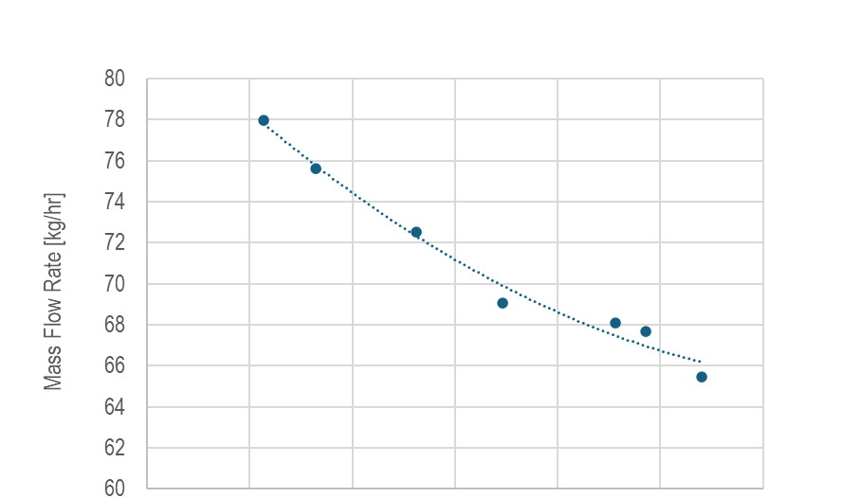
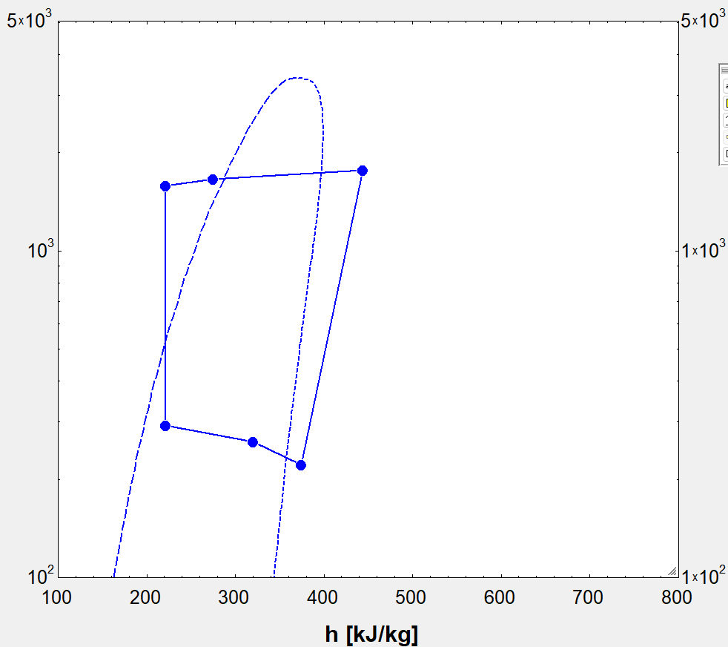
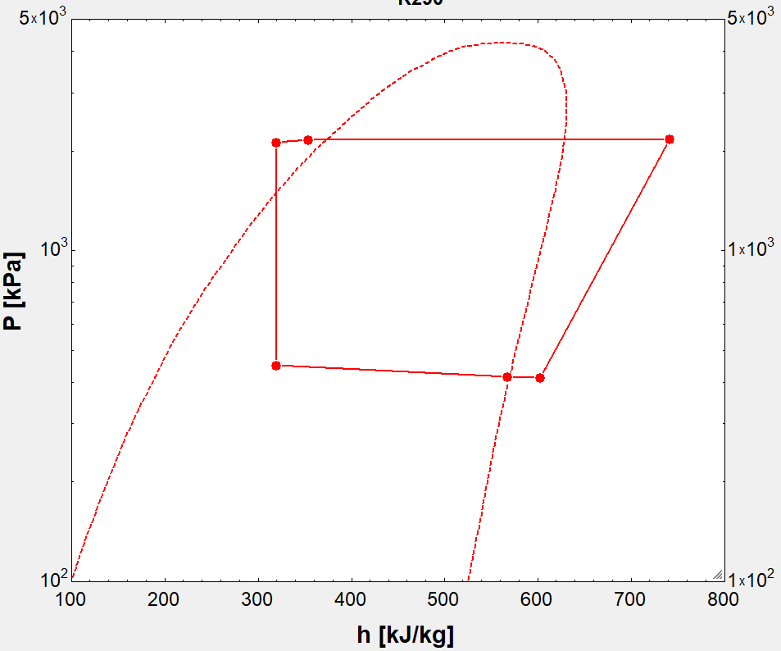
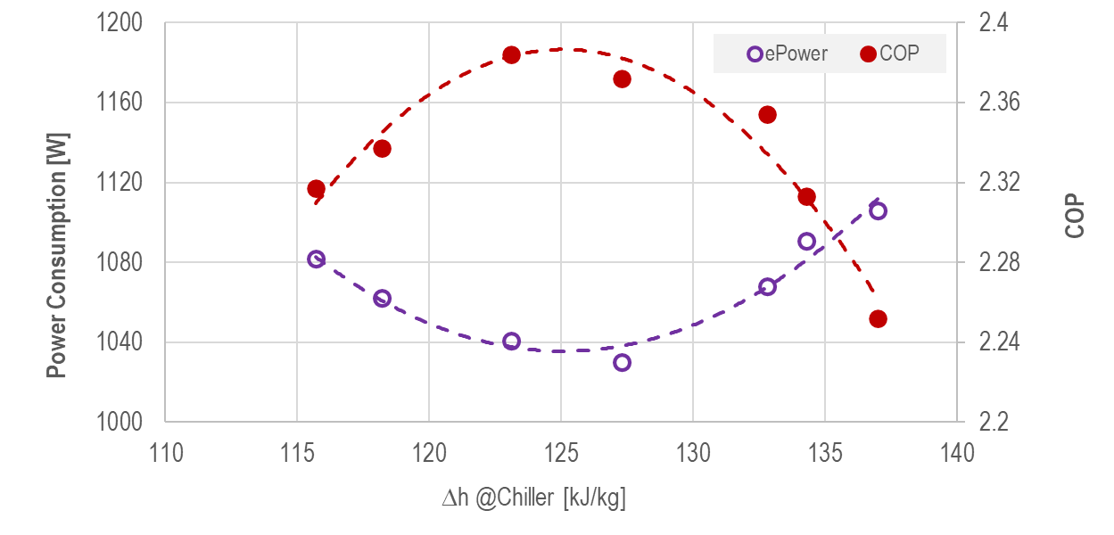


Precedent Research
Sanhua US internal test result
R1234yf vs. R290
Optimal Operation (w/ R1234yf)
: Find best COP points with sub-cool control
Refrigerant | COP | Liquid Cool Condenser |  | Chiller |  |  | Qc [kW]
 |  | Tw_in [C] | Vol. Flow [LPM] | Tw_in [C] | Tw_out [C] | Vol. Flow [LPM]
R1234yf | 1.20 | 53 | 16 | 4.0 | -0.7 | 20 | 5.6
R290 | 1.67
Q_{c}1
Q_{c}1 = Q_{c}2 = Q_{c}3
Q_{c}2
Q_{c}3
R1234yf
R290
SC7K
Td 105.5C
SC7K
Td 99.4C
Pd 2230 kPaA
Pd 1770 kPaA
$\dot{m}$66.0g/s
$\dot{m}$ 22.4g/s
Pr 8.0
Pr 5.5
Pressure [kPaA]
ePower 4.69kW
ePower 3.26kW
-2.0C
-4.2C
Ps 410 kPaA
-2.5C
-4.5C
Optimal
Operation
Ps 220 kPaA
Enthalpy [kJ/kg]
Better refrigerant property (large phase change) leads similar chiller
performance even if running with lower refrigerant mass flow rate(34%)

Slide 7
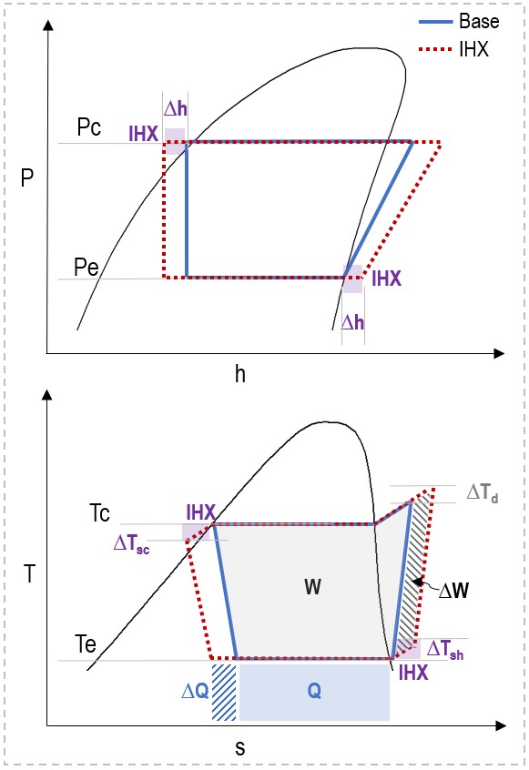
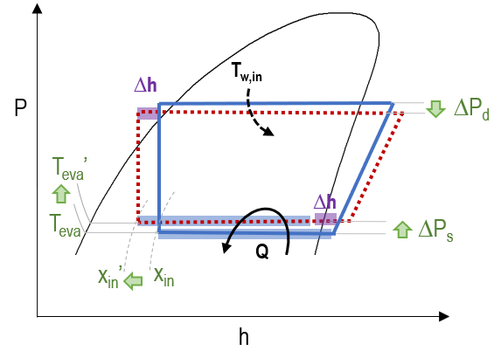






Rationales of Enhanced Approach by IHX cycle
Theoretical Review
* A/C control with required Q @ limited T_{w,in} of heat sink
actual operating status
LCC
IHX HP
Comp
EXV
IHX LP
Chiller
- ∆T_{SC} increases potential capacity of chiller(∆h)
: can get more cooling capacity (= ∆Q)
- Higher inlet(∆T_{Sh}) & discharge temp of compressor
: may need additional input comp work (= ∆W)
- Increased ∆T_{d} extends heating capacity
w/o increasing condensation pressure
- H/X starting from lower quality (x_{in}’) @chiller-in
allows to get the same Q_{c} with higher T_{eva} (or P_{s})
- Lower Pr(compression load) reduces input work
(∆W < 0)
$$\frac{Q}{W}$$
$$\frac{Q+∆Q}{W+∆W}$$
$$COP :$$
vs
$$\frac{Q}{W}$$
+ IHX
$$\frac{Q}{W−α}$$
$$∴COP↑$$

Slide 8
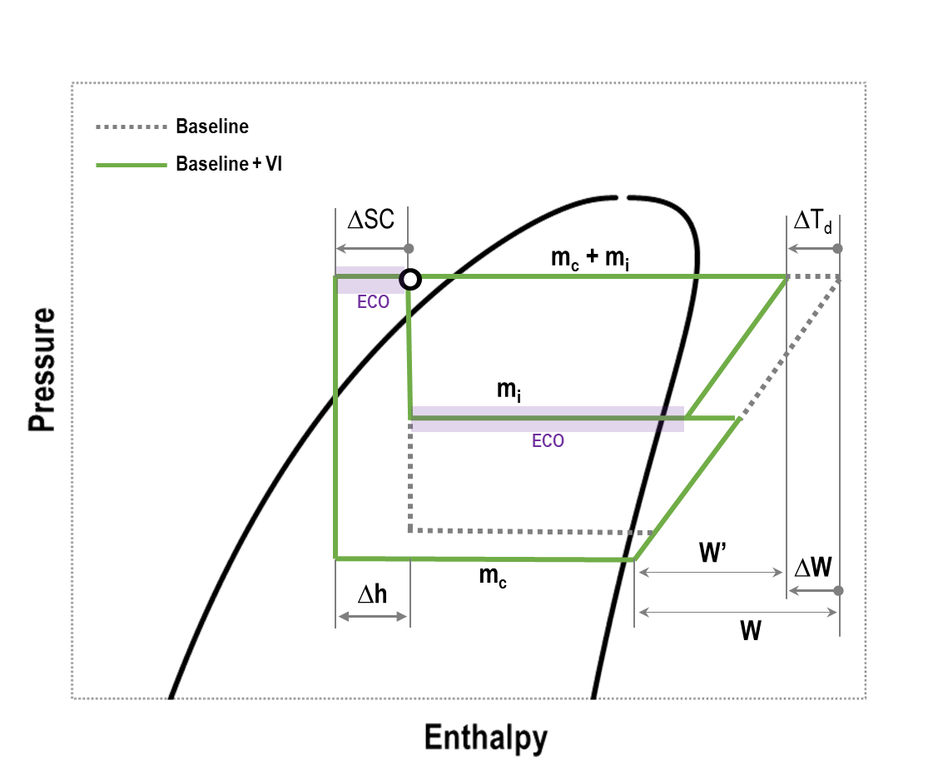
Rationales of Enhanced Approach by VI cycle
VI (vapor injection) Cycle
LCC
EXV 1
Economizer
EXV 2
Comp
Chiller
1) Additional Sub.cool(∆SC) increases potential capacity of chiller(∆h)
2) Additional mass flow rate (m_{i}) increases heating capacity
3) Reduced input power (W - W’ = ∆W) increases COP
4) Reduced discharge temp (∆T_{d}) enlarges operating envelop

Slide 9
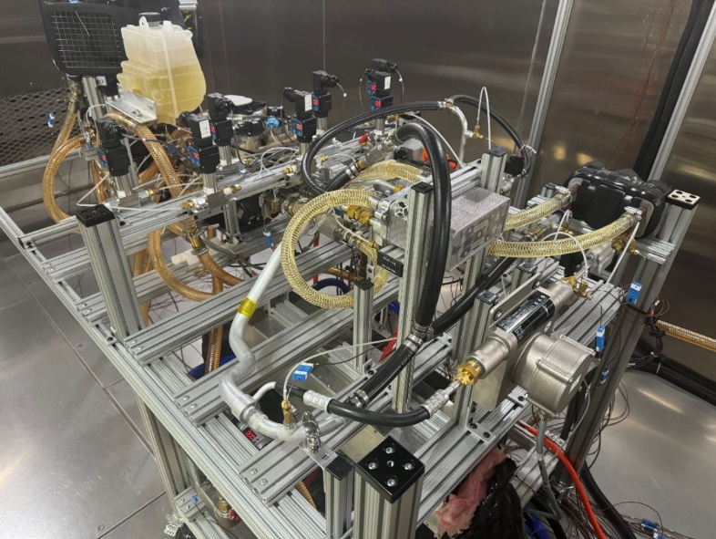
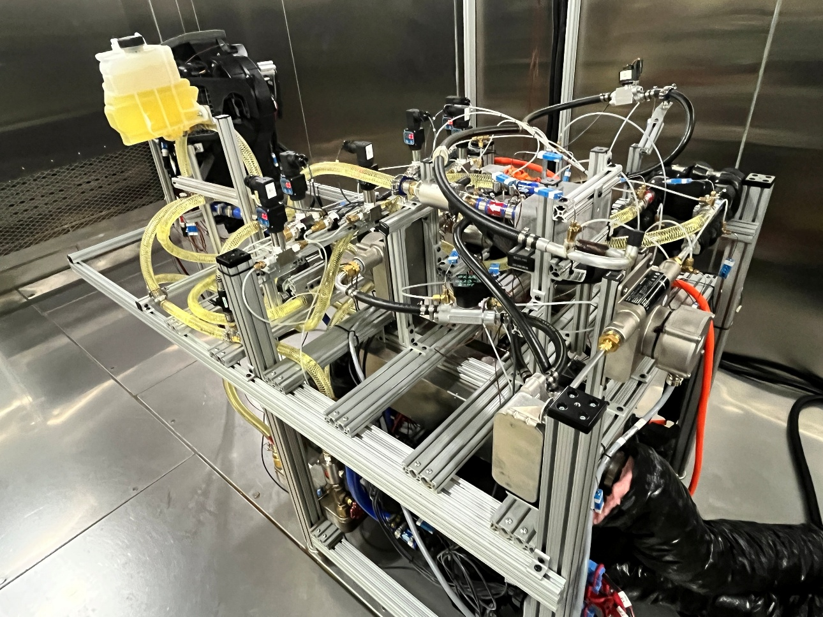
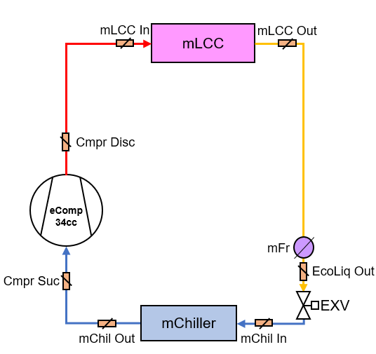
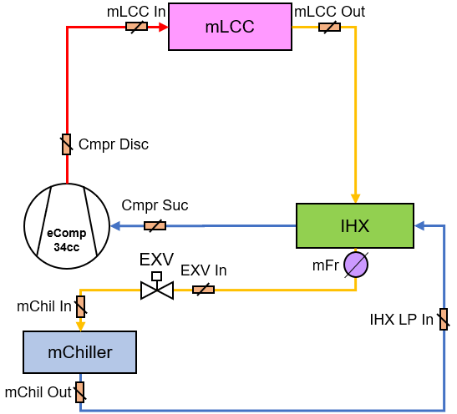
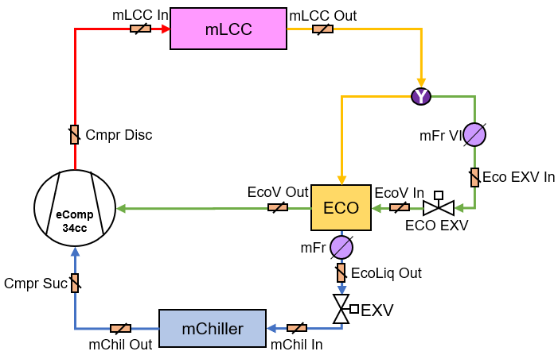
Indirect Thermal Management System
Baseline
IHX System
VI System
IHX
ECO

Slide 10
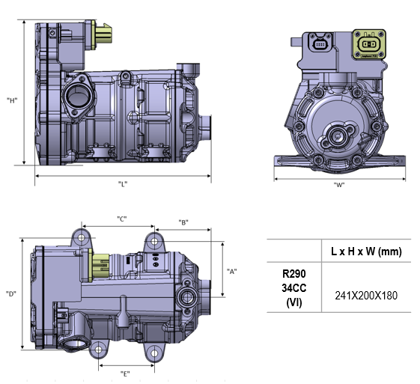
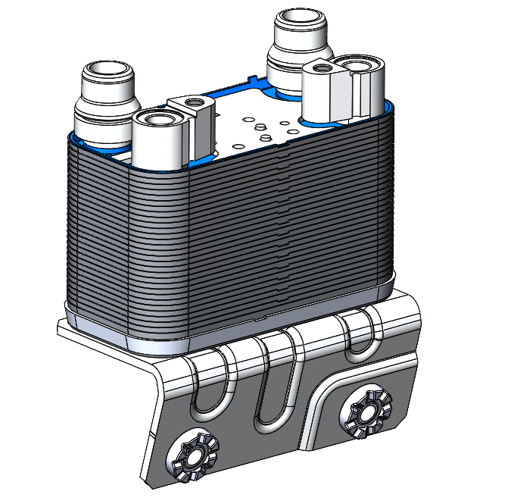
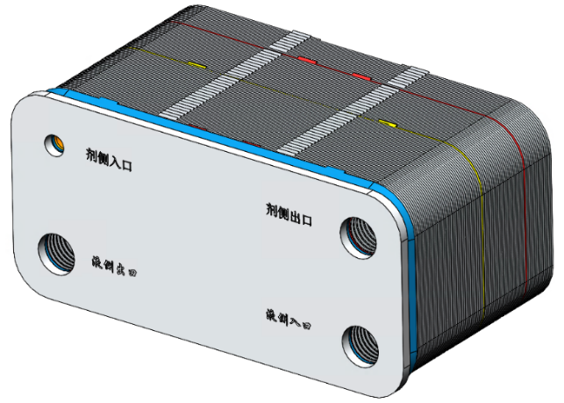
Components Information
Liquid Cool Condenser
Chiller
Vapor Injection Compressor
Displacement [cc] | 34
Refrigerant | R290
Package (D X L) [mm] | 241 x 200 x 180
Weight [kg] | 7.15
Max. ePower [kW] | 10
Input Voltage [Vdc] | 180 ~ 470V 400 ~ 900V
Speed Range [rpm] | 800 ~ 8500
Oil | PAG RFL68EP
Leakage [g/yr] | 5
Size [mm³] | 141 x 70 x 84 (L x W x H)
Refrigerant Side | Dimple
 | I-flow
 | 1Path 30R
Coolant Side | Fin
 | I-flow
 | 1Path 31W
Size [mm³] | 168 x 78 x 89 (L x W x H)
Refrigerant Side | Fishbone
 | I-flow
 | 3 Path 8,13,21R
Coolant Side | Fishbone
 | I-flow
 | 1 Path 43W

Slide 11
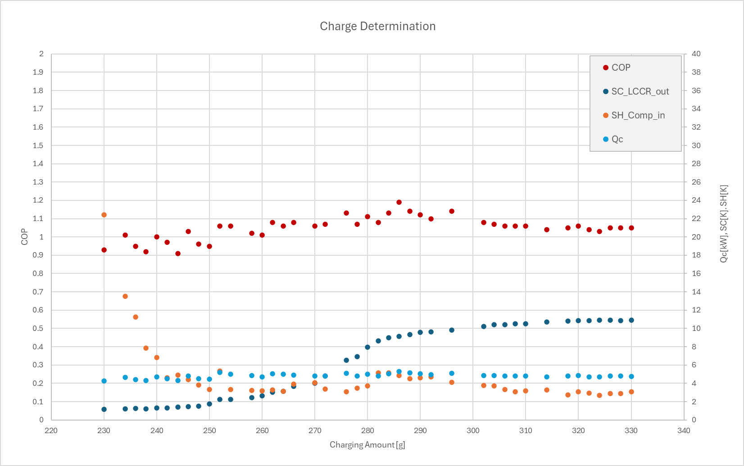
Charge Determination Test
Charge Determination Test
- Test condition
. Max. Cabin Cooling Condition
. R290 Charging : 150 to 350g
. 34cc eComp running with PAG Oil
. Temp @LCC out : 53 ~ 60 degC
. Pressure @Comp out : 19 ~ 24 barA
e.g) Vapor Injection Case
Proper Charging
 | Refrigerant
Baseline | 178g
IHX Cycle | 200g
VI Cycle | 310g

Slide 12
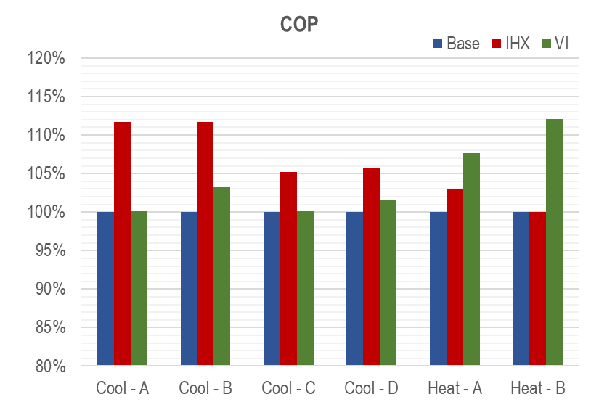
Test Result Summary
Test Condition
 | Liquid Cool Condenser |  |  | Chiller |  | Capacity
 | Mode | Flow Rate | Temp In | Flow Rate | Temp In
 |  | [LPM] | [°C] | [LPM] | [°C] | [kW]
Cooling Mode | A | 20 | 45 | 20 | 5 | 3.5
 | B |  | 35 |  | 10 | 7.6
 | C |  | 53 | 23 | 8.3 | 8.3
 | D |  | 60 |  |  | 8.0
Heating Mode | A | 16 | 48 | 12 | -20 | 6.3
 | B |  | 65 |  | -8 | 7.9
Cooling Mode
Heating Mode

Slide 13
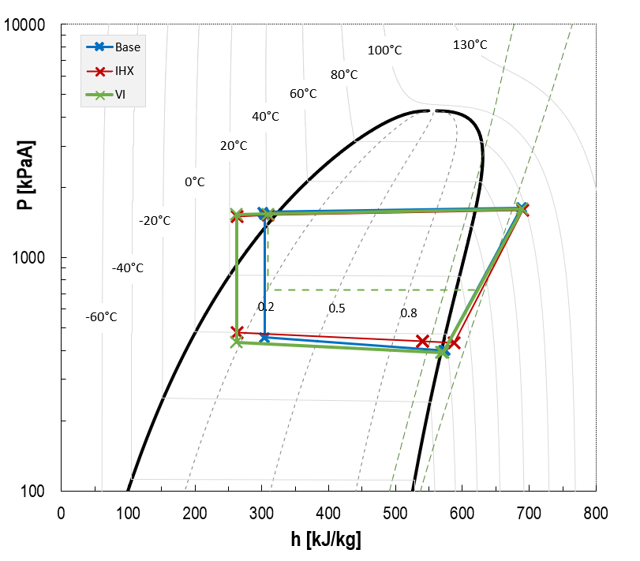
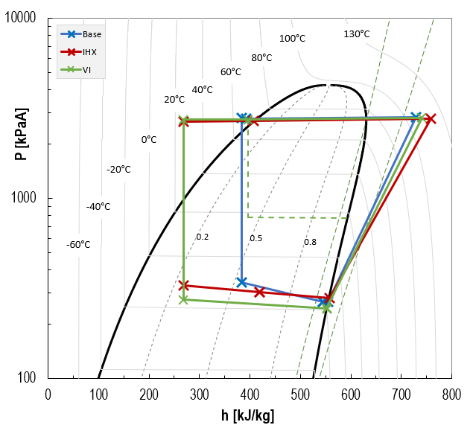
Test Result – 1) IHX vs VI
Cooling “B” Mode
Heating “B” Mode
COP 100%
COP 100%
COP 112%
COP 100%
COP 103%
COP 112%
ePower 100%
Q_{heat} 7.9 kW
ePower 100%
ePower 90%
ePower 101%
ePower 97%
ePower 90%
100% rpm
100% rpm
91% rpm
91% rpm
101% rpm
Q_{cool} 7.6 kW
74% rpm
- Heat transfer from heat source to refrigerant with lower inlet quality @chiller,
would be more helpful to improve cycle performance than VI function
→ @ A/C mode, IHX seems better option to enhance performance.
- Additional mass flow rate of VI function would be helpful to meet required
heating capacity at LCC even if running with lower comp speed
→ @ H/P mode, VI performance seems better than IHX behavior

Slide 14
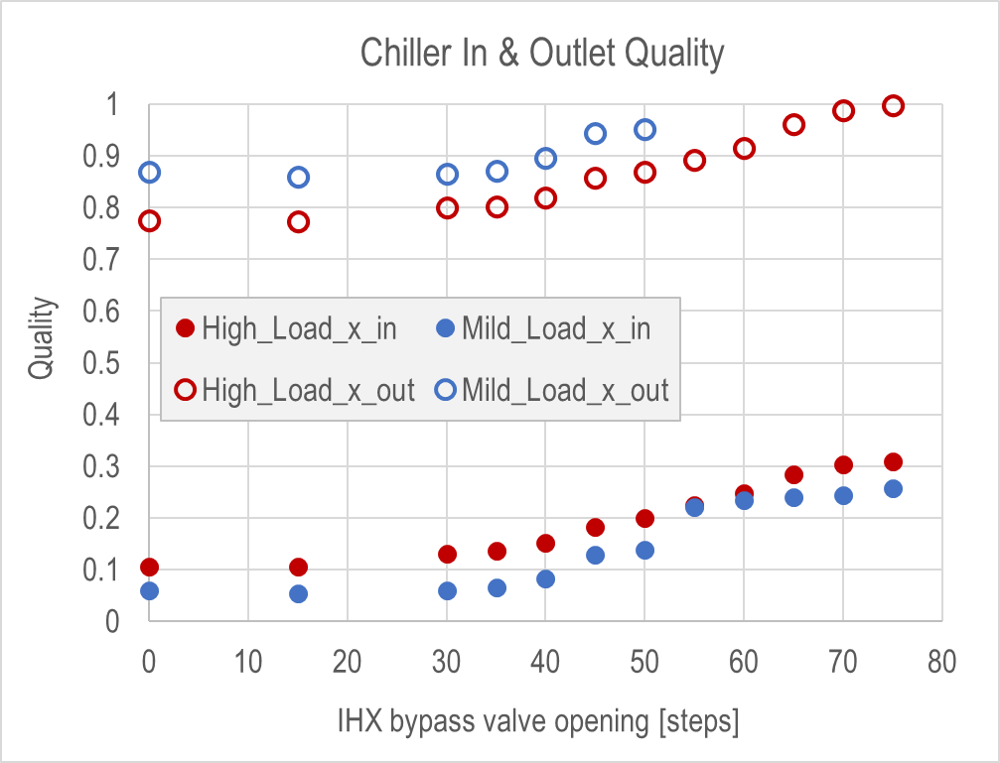
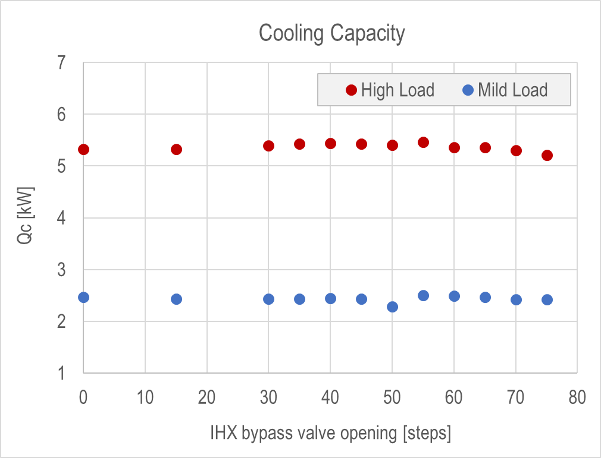
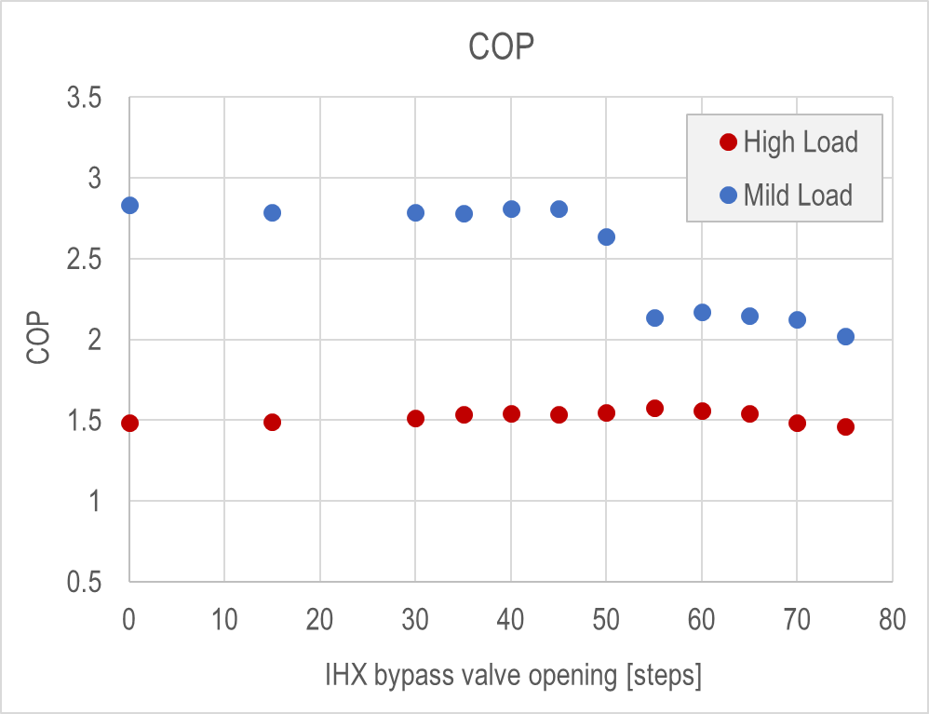
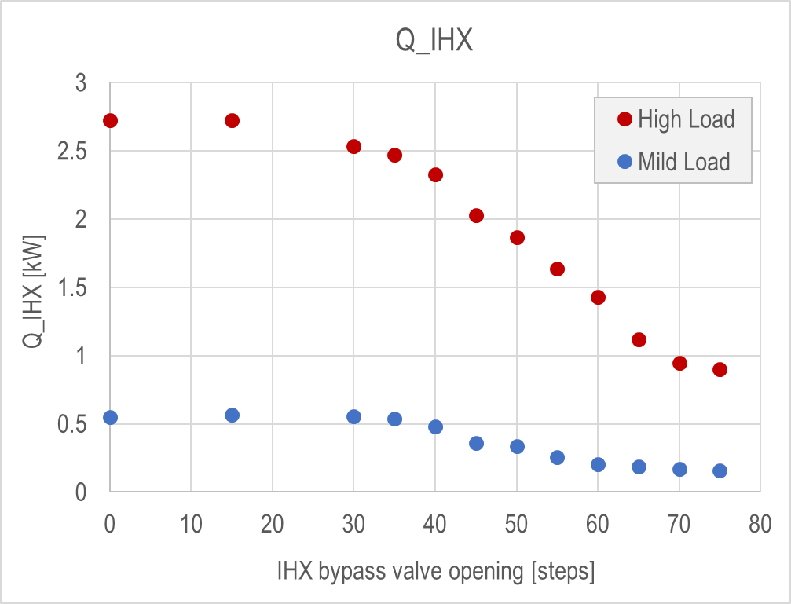
Test Result – 2) IHX sizing effect
Test Configuration
: Testing for IHX Sizing effect with controlling IHX bypass flow
@Mild Load, after 55 steps, Chiller exit changed to gas out
All of data points make same cooling capacity
Gas phase out
LCC
IHX HP
Comp
Large IHX
Small IHX
EXV
IHX LP
Gas phase exit leads degradation of cooling cycle efficiency
Proper IHX sizing @Mild Load:0.5kW, @High Load : 2.0kW ↑
Optimal operation
Chiller

Slide 15
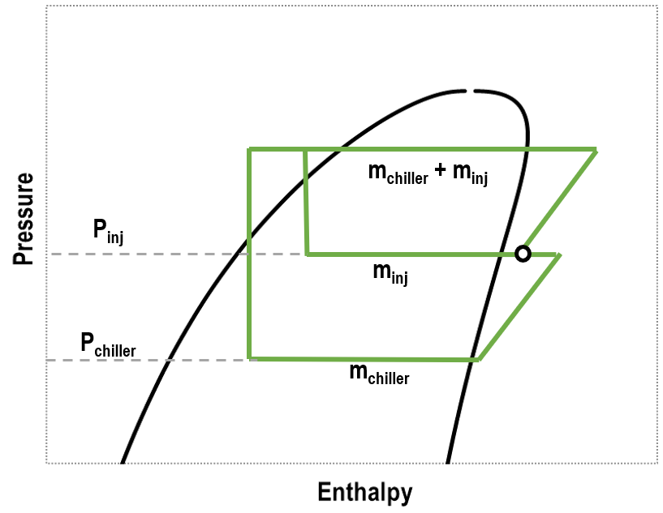
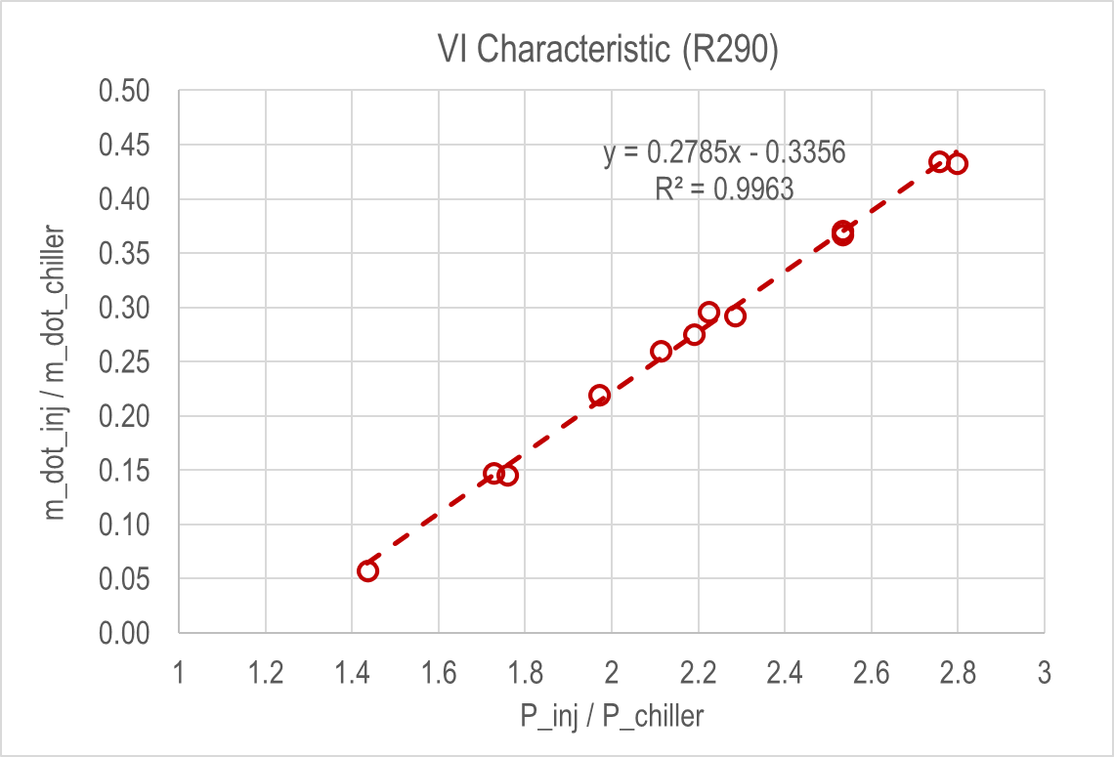
Test Result – 3) VI Characteristic
Finding vapor injection point property in the cycle by correlated parameters*
$$\frac{{\dot{m}}_{inj}}{{\dot{m}}_{chiller}} =0.2785\left(\frac{P_{inj}}{P_{chiller}}\right)−0.3356$$
Injection point property can be estimated by regression formular of pressure ratio and mass flow ratio
* 2016, Purdue University, International Compressor Engineering Conference, A Methodology for Characterization of Vapor injection Compressors

Slide 16
Wrap-up
* Review
Enhanced approach of IHX and VI in R290 secondary loop cycle were evaluated and compared quantitively
- Cooling Mode : IHX cycle would be better application for enhancing performance
- Heating Mode : VI cycle would be better application for enhancing performance
Through the evaluation of the IHX sizing effect, it would be able to propose suitable IHX sizing for the system
Based on the VI evaluation with various conditions, VI characteristics in the cycle can be estimated with formula of injection pressure ratio and mass flow rate
* Future Work
Considerations on how to reduce R290 refrigerant charging amount
Operating Envelop Testing of R290 Cycle

Slide 17
Contact Info
      Name : ILYOUNG PARK
      Company : Sanhua Automotive
      Address : 3729 Auburn Rd, Auburn Hills, MI,US, Zip:48360
      Phone : 248-402-3328
      EMail : young.park@sanhuagroup.com
Paper # (if applicable)

