Slide 2
R744 Chiller Design optimization
Dawid Szostek, Michał Bełzowski

Slide 3
New Organisation Valeo Power Division
THermal Systems
THERMAL IS EVERYWHERE
Global thermal energy
management & simplification
PowerTrain Systems
SOLUTIONS FOR ALL ELECTRIC MOBILITY & ECOSYSTEM
Standardization & scalability
VALEO POWER
GREENER MOBILITY
by
combined THERMAL & POWERTRAIN solutions

Slide 4
Valeo Group Organisation
ELECTRIFICATION ACCELERATION
ACCELERATION OF ADAS
& SOFTWARE
DEFINED VEHICLE
-
REINVENTION OF INTERIOR
EXPERIENCE
LIGHTING EVERYWHERE
POWER
BRAIN
LIGHT
4
3 Divisions instead of 4 Business Groups

Slide 5
EU PFAS BAN regulation EIF expected planning
EU Commission / ECHA
PFAS BAN in Q1 2029 - Type approval BAN (Entry into Force Q3 2027 with 18 months of transition)
OEM PF switch
2023
2024
2025
2026
2027
2028
2029
2030
2031
---
2035
---
2045
Entry in Force
TA BAN
2029
ICE BAN
Old
ECHA RAC SEAC
xEV
18m transition
NATURAL
TODAY
ECHA opinion
EU Commission / ECHA
PFAS BAN in Q1 2034 - VIN BAN (Entry into Force Q3 2027 with 18 months of transition + 5 years derog)
OEM PF switch
2023
2024
2025
2026
2027
2028
2029
2030
2031
---
2035
---
2045
Entry in Force
VIN BAN
Q1 2034
ICE BAN?
New
ECHA RAC SEAC
ECHA opinion
EV
18m transition
DEROGATION 5 years
NATURAL
TODAY
xHEV, ICE
18m transition
DEROGATION 12 years
Direction seems to be VIN BAN with 5 years derogation for BEV and 12 years for xHEV and ICE
5

Slide 6
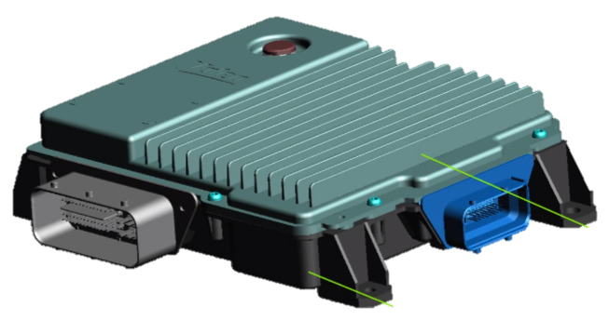
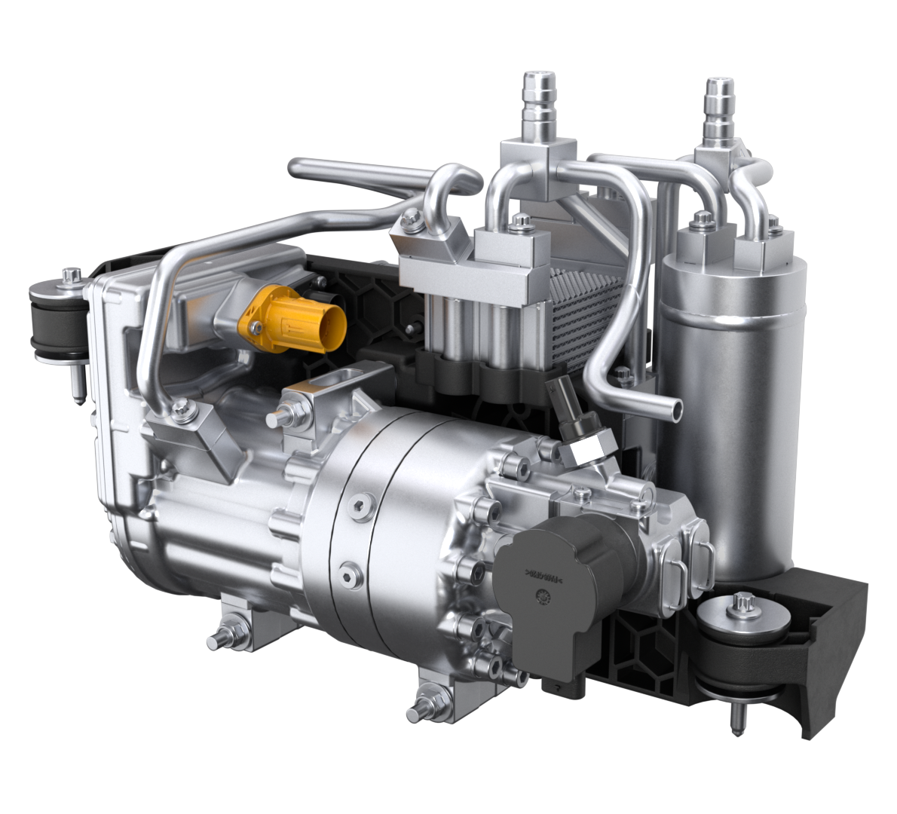
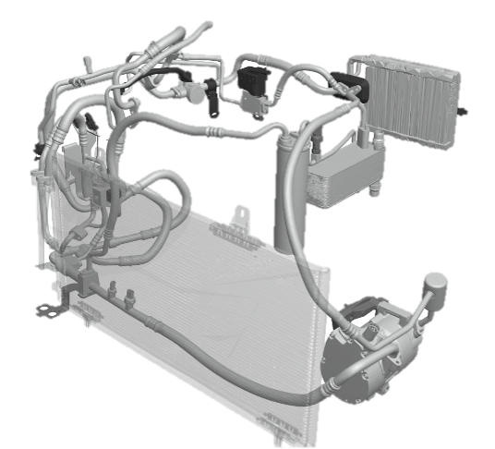
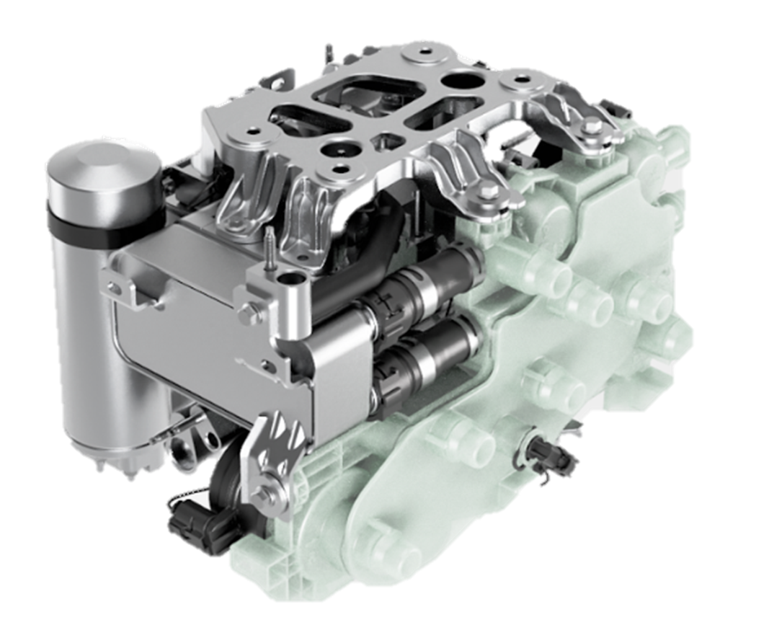
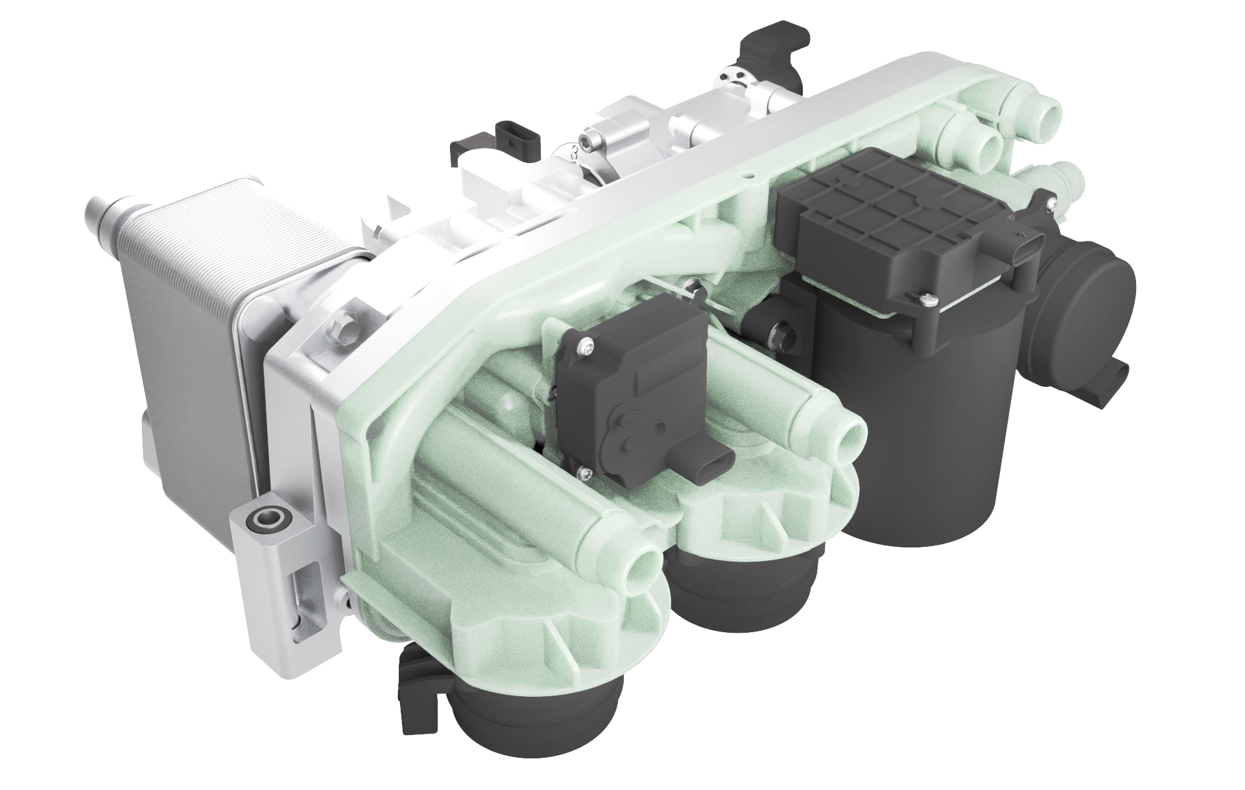
Valeo Heat Pump Roadmap
EV START - BETTER RANGE
TODAY - COMPACT MODULE
TOMORROW - PFAS FREE
P-FAS FREE Smart Heat Pump
Heat Pump System
(R1234/R744)
Smart Heat Pump Module
Dual or Refri/Coolant module
R744
R290
SERIAL
SERIAL
BENEFITS: natural, efficient & compact
R744 with better performances than 1234yf
With Ambient HP:
R744 @-7°C -> 11 kW
(7 kW Cabin / 4 kW Battery) @ COP 2.5
R744 @-20°C -> 8kW Heating
R290 with Dual Refri/Coolant Module : Less connections / No jumper lines (lower leaks) & reduced internal Volume
BENEFITS:
Packaging by integration and manifold
Cost Competitiveness with multifunctional valves
Efficiency and recovery with best exchangers
BASELINE
2024
2025
2026
2027
2028
Towards compact, efficient, smart modules with natural refrigerants

Slide 7
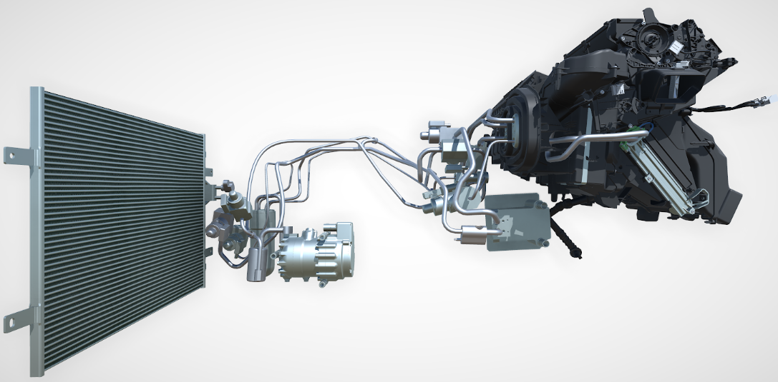
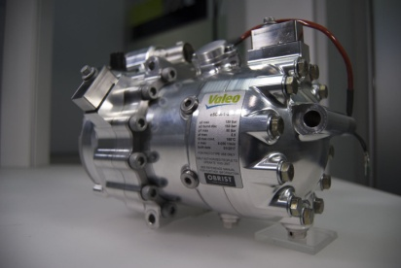
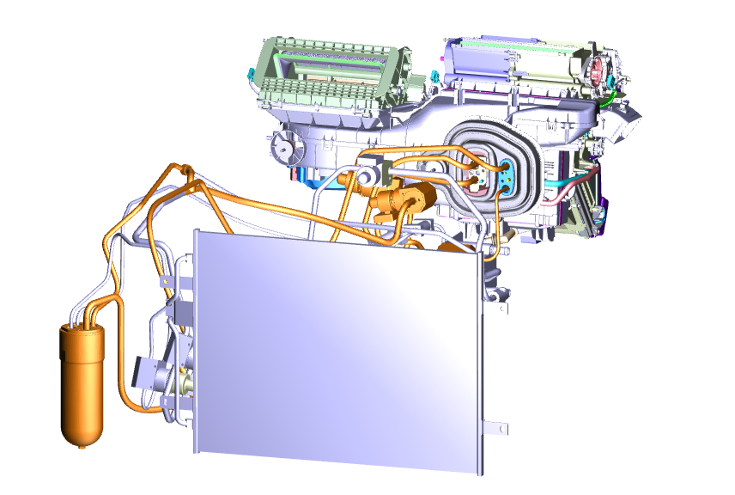
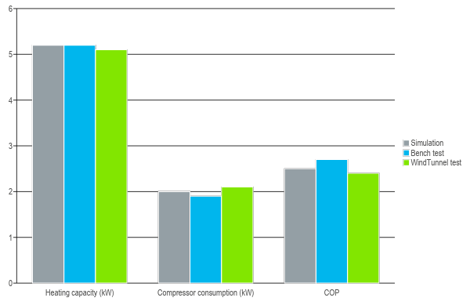
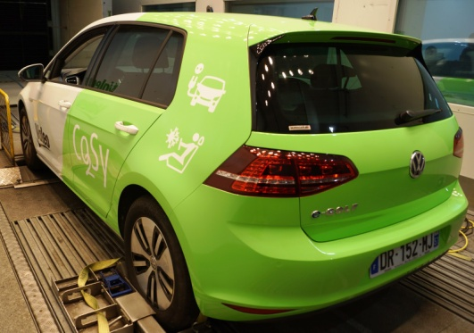
R744 A/C and HP Heat Pump development
From Simulation to test bench to lab car
2013-2015
2022- 2025
A/C system development
System definition / validation
Component specification
Simulation & Patents
2016
2019
E-class SOP System, HVAC, Evapo, Gas cooler
MEB SOP Evapo & IGC
Chiller
HP R744 System & components
2015
2016
2017
HP Architecture definition
Component specification
Simulation - Patents
Simulation
Compressor design
Mock up preparation
First compressor prototype
Bench Test
Lab car equipment
Wind tunnel
-10°C
First wind tunnel end of July 2017
Patented Architecture

Slide 8
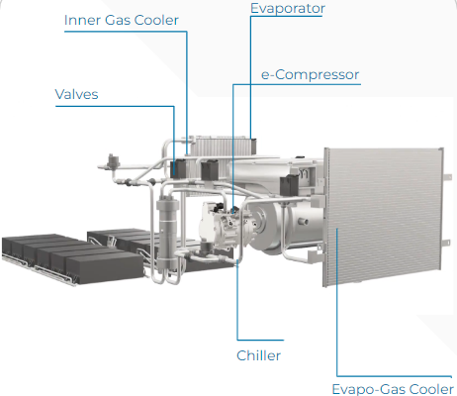
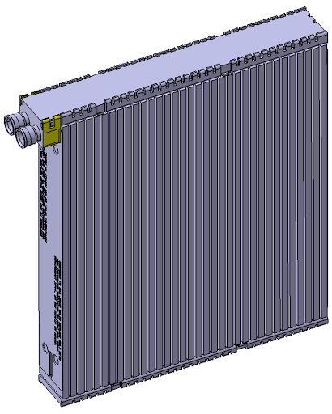
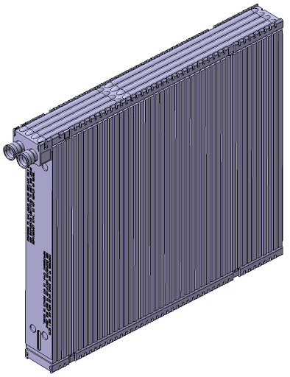
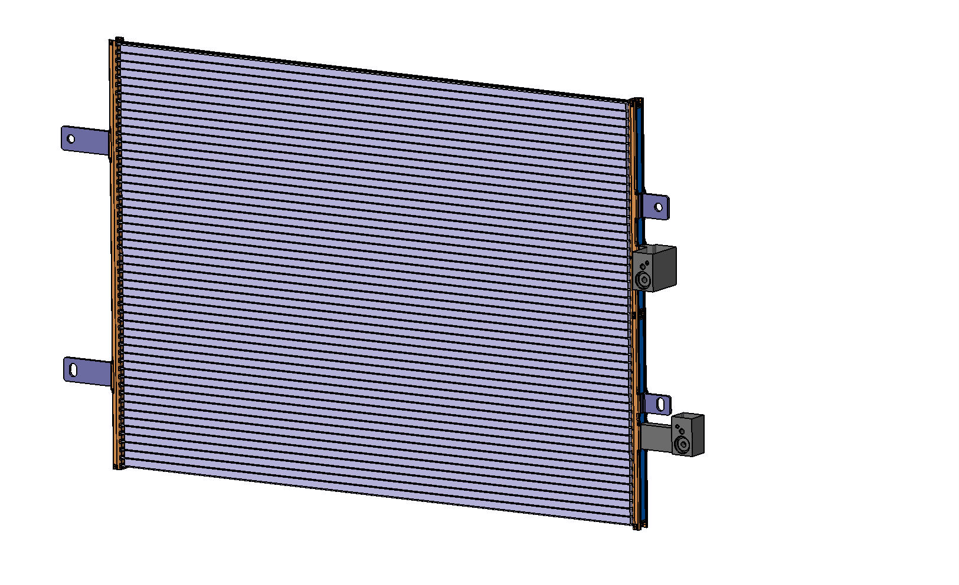
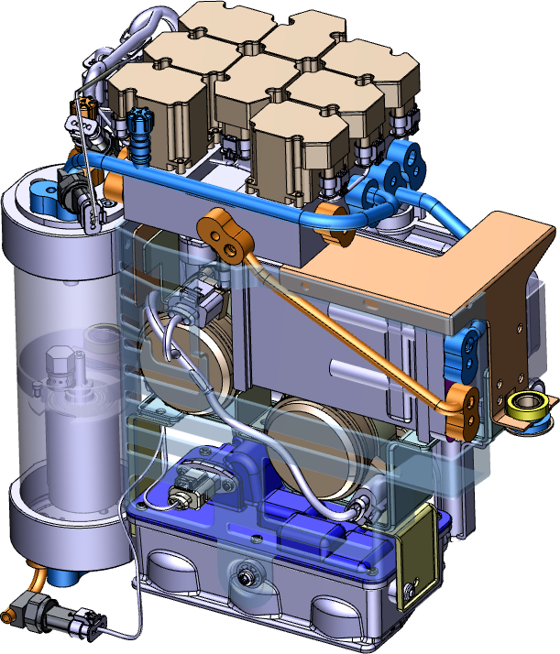
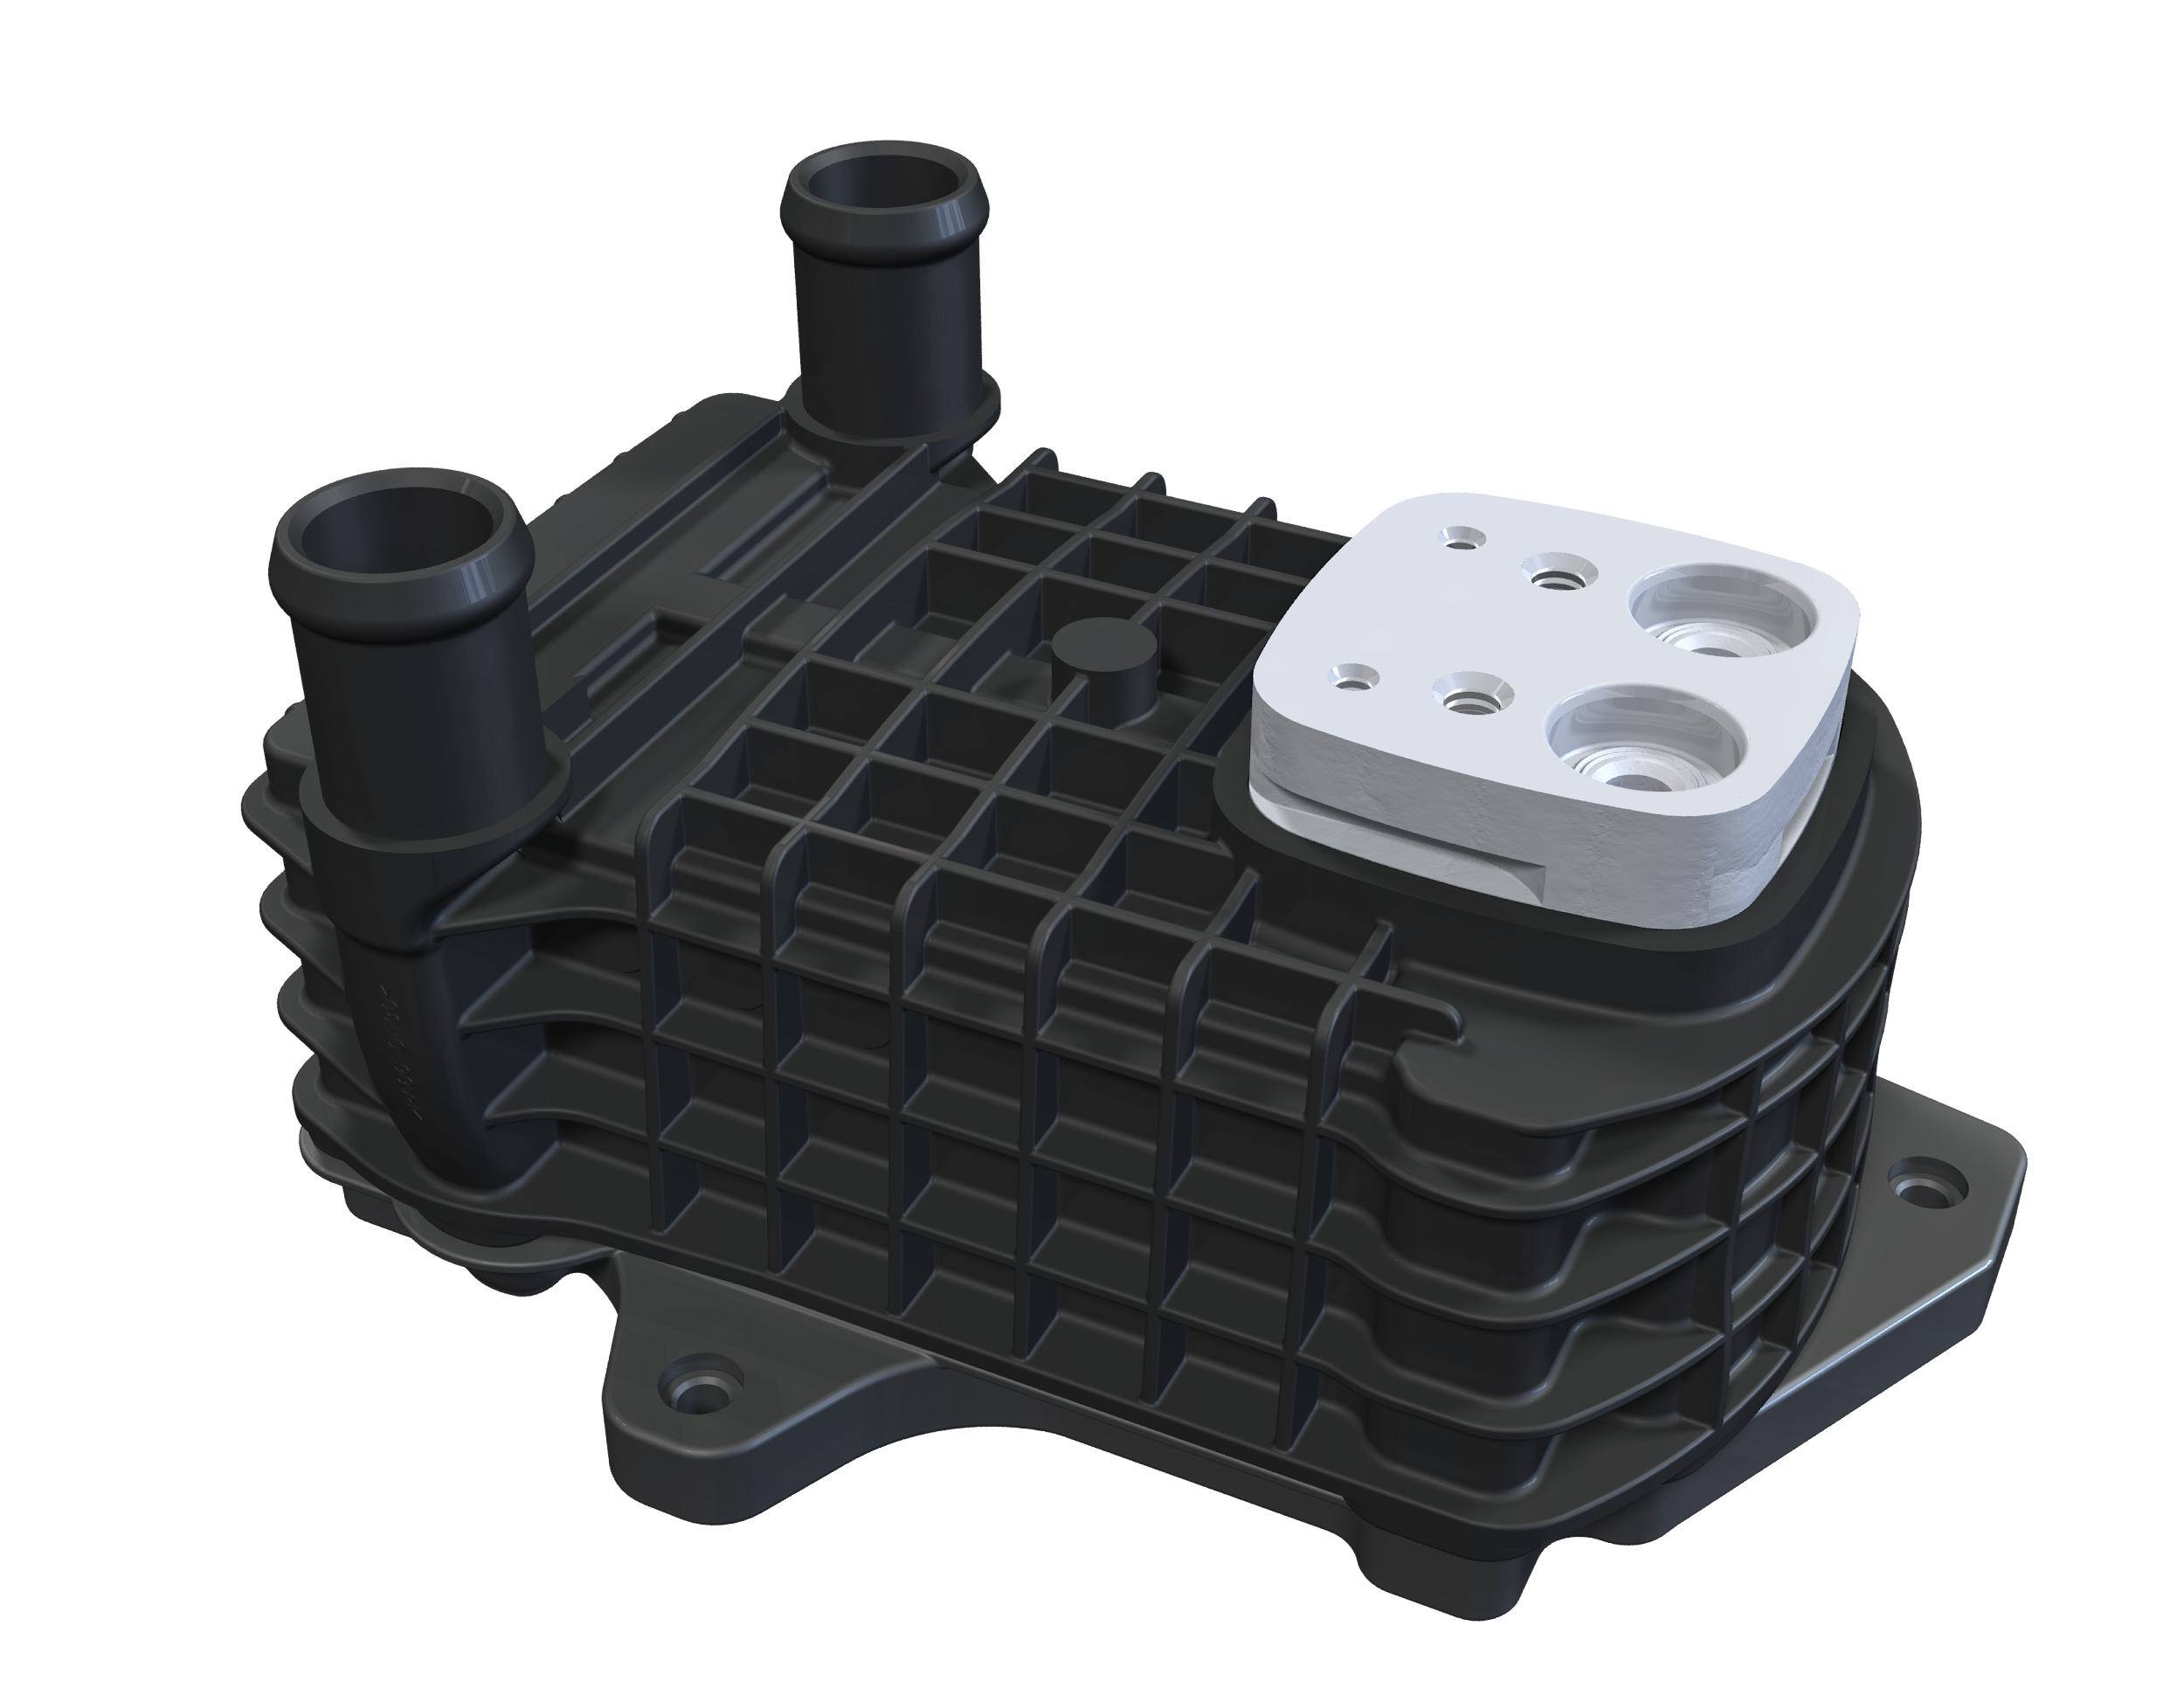
R744 system Valeo Portfolio
Inner Gas cooler Gen1 (Serial)
Gen2 (Adv. Dev.)
Valeo develop R744 HP program including
1 system (+ control logics)
3 modules (Smart HP/ Front Cooling/ HVAC)
9 Components
Evaporator
Gen1 (Serial)
Gen2 (Adv. Dev.)
HVAC Module (Serial)
CO₂ sensors
EDC R-744 8cc (Co-Adv. Dev.)
Valves (Adv. Dev.)
Water gas cooler (Adv. Dev.)
P,T Sensors
Why Valeo ?
System approach considering Battery and FCM roadmap
Experience (in production since 2016 OHX, evapo, IGC, chiller)
Full portfolio
Control logics (Adv. Dev.)
R-744 lines
Accu & IHX or Accumix (Co- Adv. Dev.)
Chiller (Serial)
OHX
Evapo - gas cooler (Adv. Dev.)
Front Cooling Module (Serial)
To adapt to PFAS ban regulation and lead the race,
somes OEMs have officialized the switch to 100% R-744
Smart HP (Adv. dev)

Slide 9
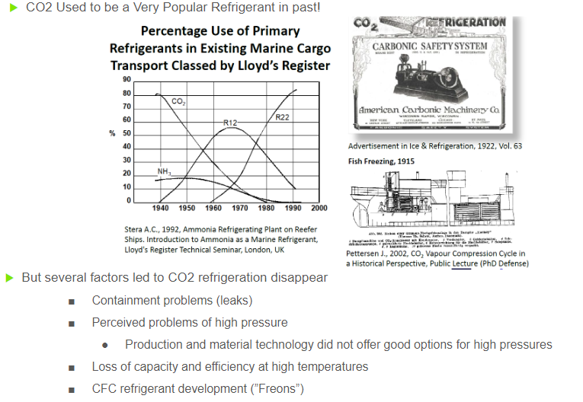
New Perspective R744 historical overview

Slide 10
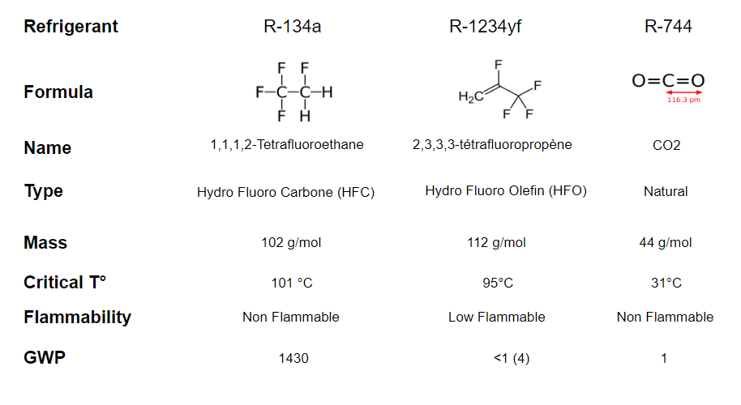
Refrigerant comparison

Slide 11
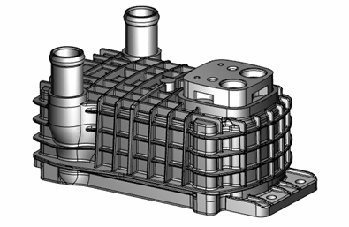
R744 Valeo components portfolio
Components in serial production:
R744 Outer gas cooler in AC system (serial production)
R744 Evaporator (serial production) and innovative Inner Gas Cooler in heat pump application (serial production)
Innovative R744 Water chiller for battery thermal management (serial production)
Components under developed for serial production in 2026:
R744 EDC, R744 Evapo-gas cooler, EXV & valves
R744 Outer gas cooler
R744 Evaporator
R744 Inner Gas Cooler
R744 Water Chiller

Slide 12
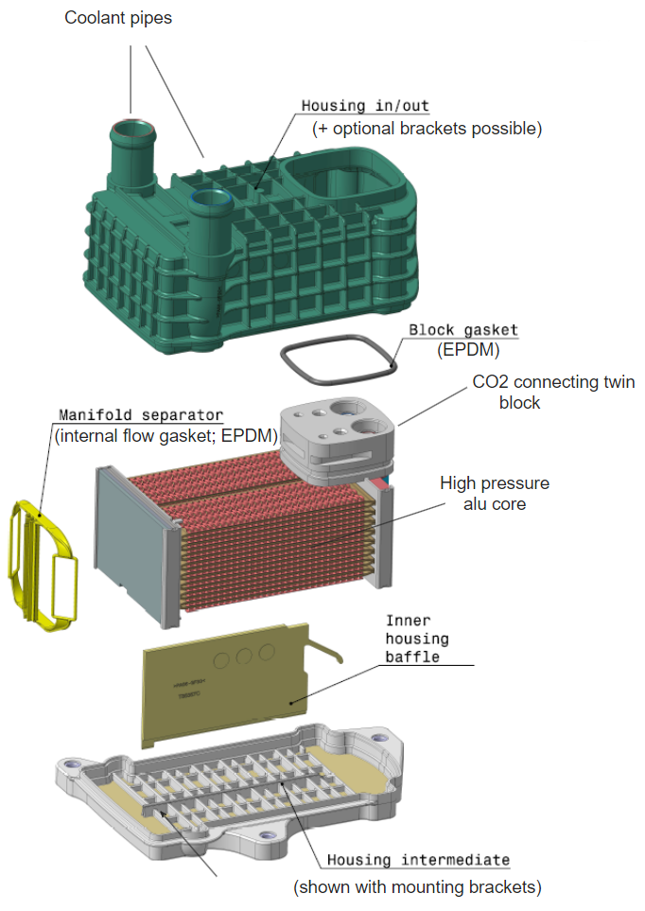
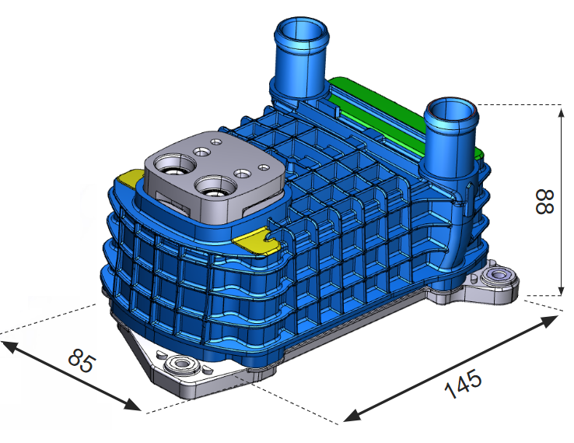
R744 Water chiller
R744 core built from turbulators inside plastic housing
32 active multiport tubes/16 layers/HH=103mm ;
Tube: multiport, extruded
Turbulator 1,4mm;
U-flow circulation for coolant & 4 pass for refrigerant;
Weight : 850g

Slide 13
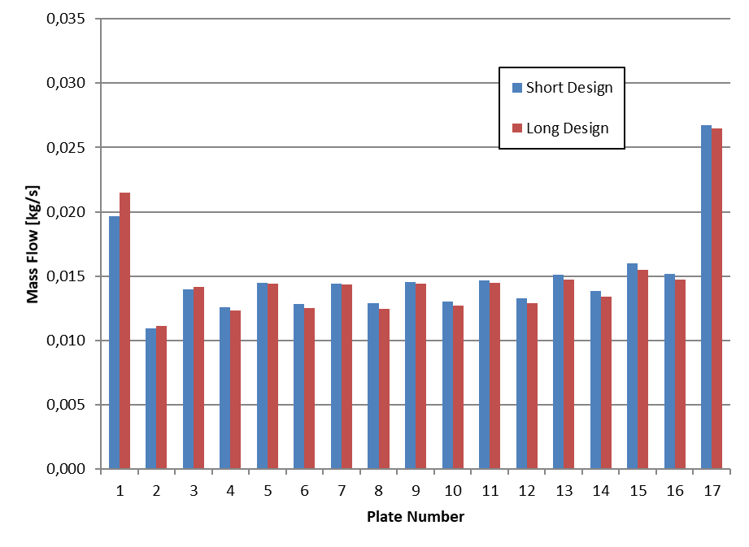
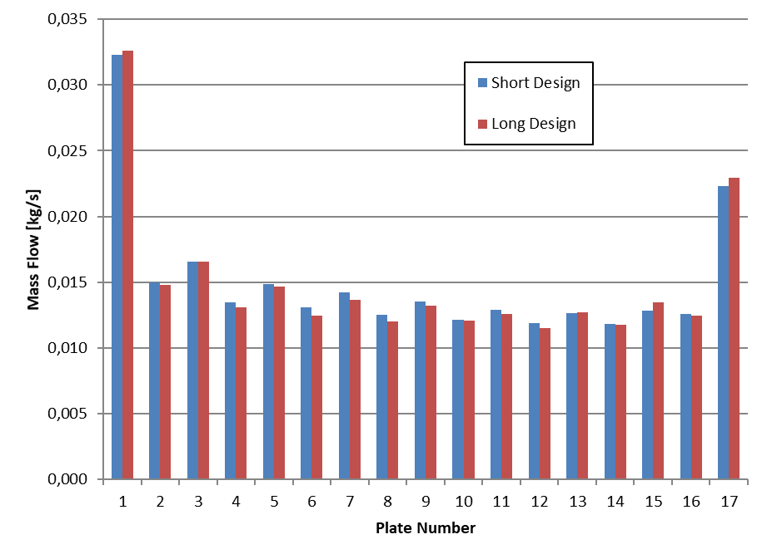
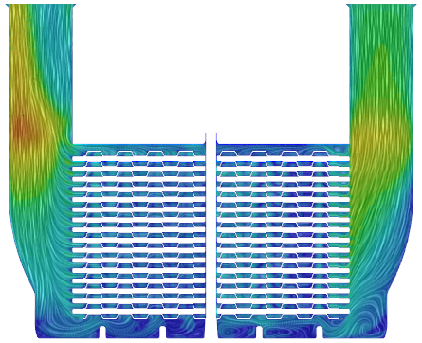
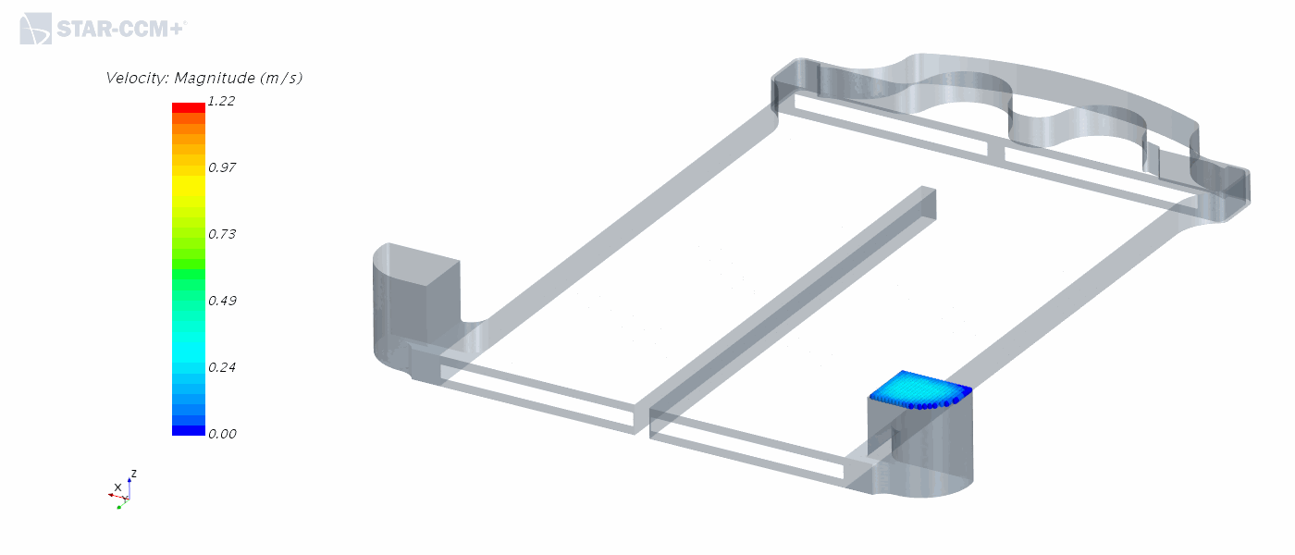
R744 Water chiller - internal coolant flow
OUTLET
INLET
1st coolant pass
2nd coolant pass
Innovative concept creates new challenges:
Significantly to high flow through top and bottom section
Potential gaps between water turbulator and housing (due to tolerances)
But also create new opportunities!
Power | 100%
Pressure drop at coolant side | 100%

Slide 14
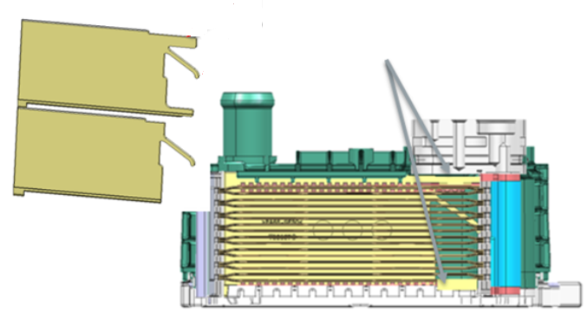
R744 Water chiller - “C-shape baffle”
Area where flow is restricted
Standard design of the baffle “A” creates same cross section for flow between 1st and 2nd pass for
New design of the baffle “B” creates smaller cross section for flow between 1st and 2nd pass at area where some restrictions are needed
Different sophisticated flow restrictions can be implemented in easy and cost efficient way!
B
A
Power | +4%
Pressure drop at coolant side | +11%

Slide 15
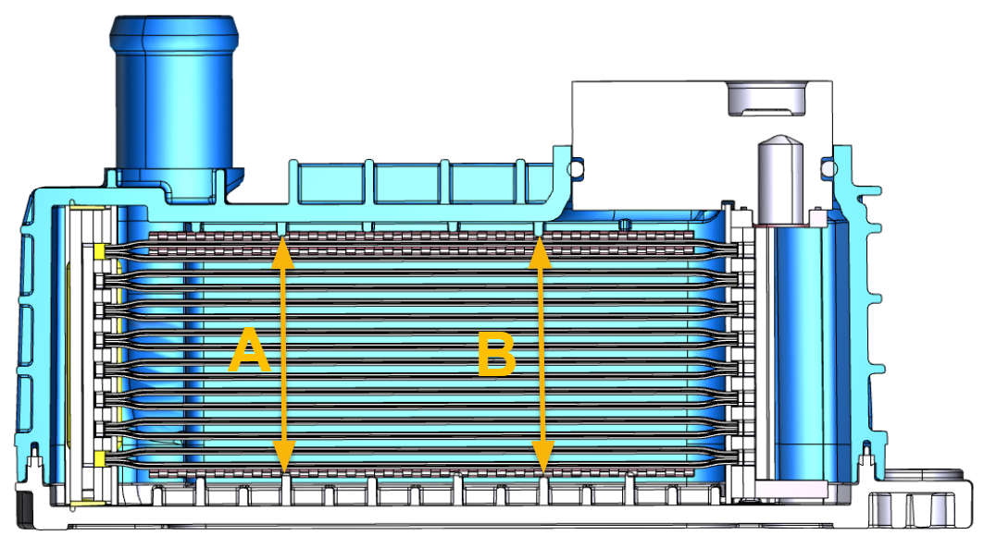
R744 Water chiller - length of ribs from plastic housing
 | Standard design | Design with collision
Mean distance between ribs | 41,6 [mm] | 40,9 [mm]
Power | 100% | 107%
Pressure drop at coolant side | 100% | 110%
Standard design considered small gaps between ribs restricting the flow and core
New design is considering small collision between ribs from housing and water turbulator
During ultrasonic welding for two parts of the plastic housings force and oscillations are applied in longitudinal direction of rib

Slide 16
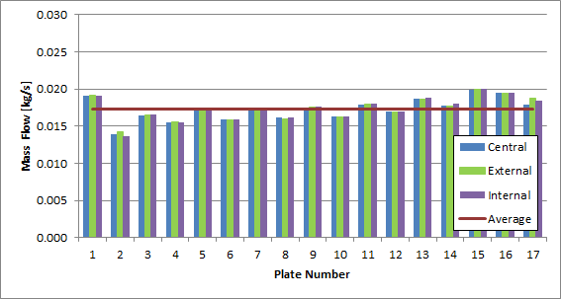
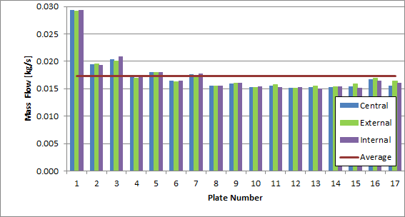
R744 Water chiller - length of ribs from plastic housing
1st coolant pass
 | Power | Pressure drop
New ribs length | +7% | +10%
C-baffle | +4% | +11%
2nd coolant pass
Closing of overflow through top and bottom section of the core gives significant improvements in terms of heat exchange efficiency
Increase of pressure drops on coolant side is a side effect of closing of by-passes

Slide 17
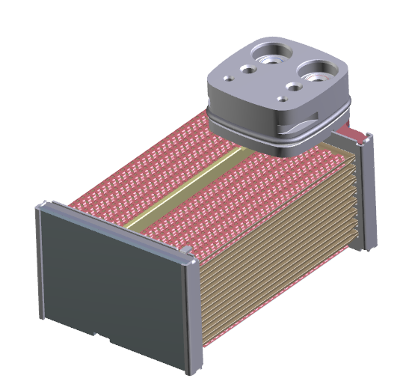
R744 Water chiller - refrigerant flow optimizations
 | R744 | R1234yf
Working pressure | 35[bar] | 3.2[bar]
Temperature of phase change for working pressure | 0,2[C] | 0,4[C]
Temperature of phase change for working pressure +1[bar] | 1,2[C] | 8,7[C]
Initially core was designed for two pass configuration on refrigerant side
Results from coolant side shows, that better flow uniformity = increased efficiency
Theoretical study shows that R744 chiller should be less sensitive on pressure drops (than chemical chiller) and multipass configuration can be interesting development path

Slide 18
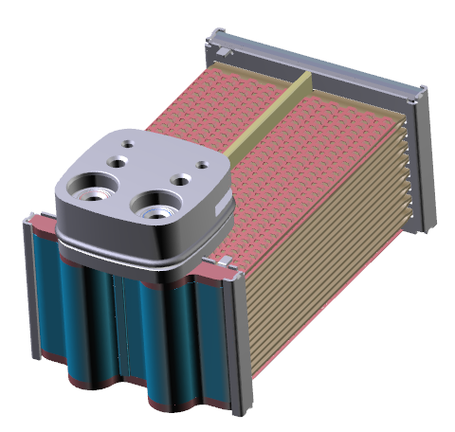
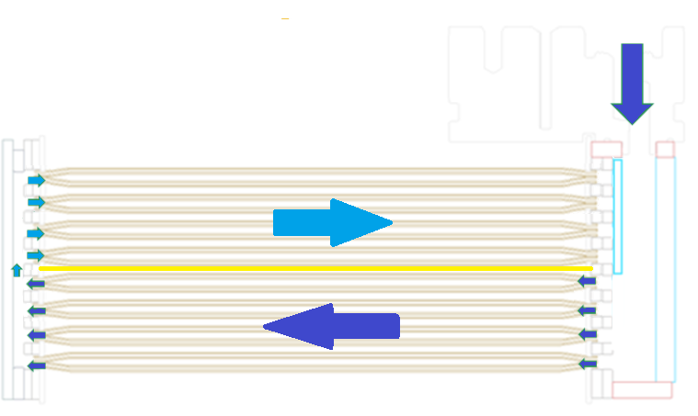
R744 Water chiller - 4 pass on refrigerant side
2 rows 4/4 configuration
Power | +10%
Pressure drop at coolant side | +80%

Slide 19
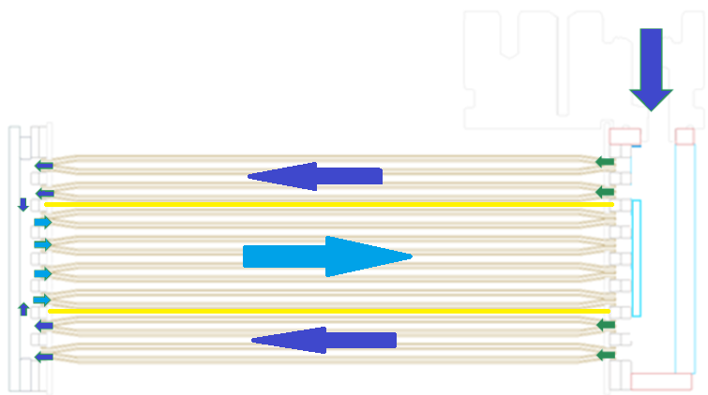
R744 Water chiller - 4 pass on refrigerant side
2 rows 2-4-2 configuration
 | 2x 2-4-2
Power | +1%
Pressure drop at refrigerant side | -20%

Slide 20
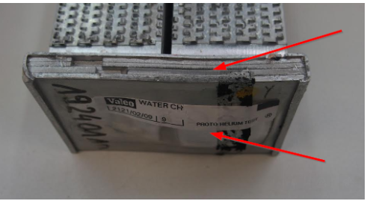
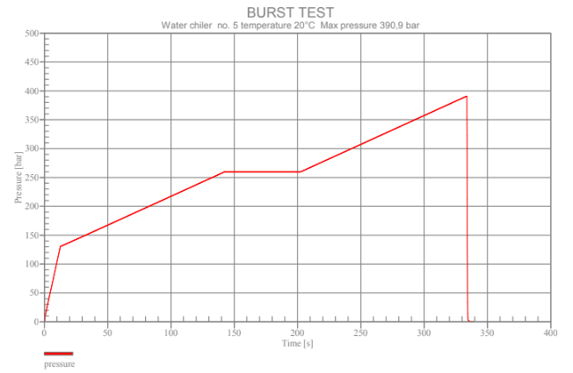
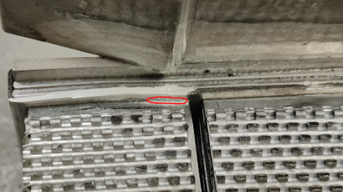
R744 tube technology for HP side applications
Typically failures of chiller during burst test were observed between >320[bar] (acc. SAE target for chiller: 260[bar])
After adaptation burst pressure >390[bar] (SAE target for HP side: 340[bar]
Test shows that same core can works effectively like a chiller and water gas cooler WGC - potential usage of core for battery heating!

Slide 21
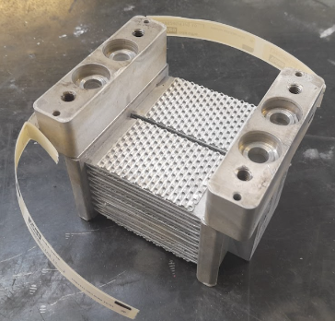
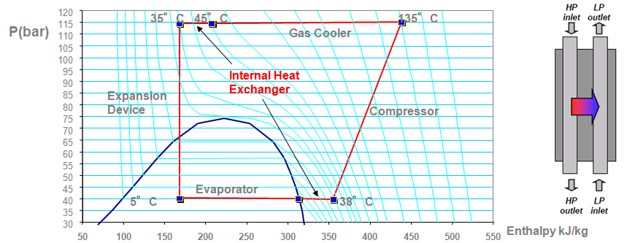
R744 tube technology Internal heat exchanger (IHX) concept
HP
LP
IHX main function:
In high thermal load conditions,
IHX is necessary to cool the fluid under the temperature of the GC air inlet
Increase of the COP
Insure the superheat after the evaporator
Heat exchange between HP & LP sides

Slide 22
Conclusions
R744 refrigerant is a great alternative to answer PFAS requirements. Specific component development including product optimization needs to be applied
The right compromise between performance and pressure drops on coolant and refrigerant and the cost needs to be set. Coolant side is more critical for the pressure drops optimization
R744 Chiller with multiport tubes thanks to high mechanical resistance offers a great alternative to be used for another applications cases:
Water Gas cooler (WGC) for battery heating or indirect HP system
Internal Heat Exchanger to improve system performance

Slide 23
Contact Info
Thank you!
Dawid Szostek Michał Bełzowski
Valeo Power Thermal Division
Przemysłowa 3
32-050 Skawina
Poland
Mobile +48 728 402 193 +48 539 902 223
Email: dawid.szostek@valeo.com michal.belzowski@valeo.com

