Slide 2

Learnings from R290
System Development
Dana Nicgorski
Thermal Systems Engineering Director
Robert Bosch LLC

Slide 3
Learnings from R290 System Development
Bosch thermal system portfolio for R290
Thermal Systems Research Lab - Waltham, MA USA
Oil circulation & solubility vs performance
Importance of thermal isolation with compact systems
Influence of vapor injection
Vapor injection vs hot gas at -30°C
Single vs dual-chiller systems
Paper # (if applicable)

Slide 4
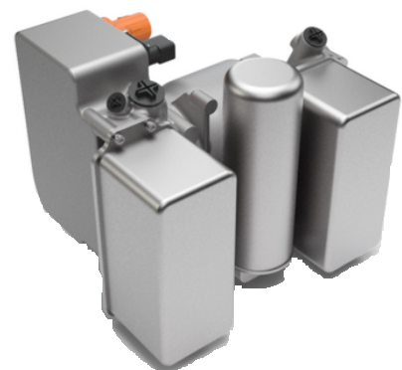
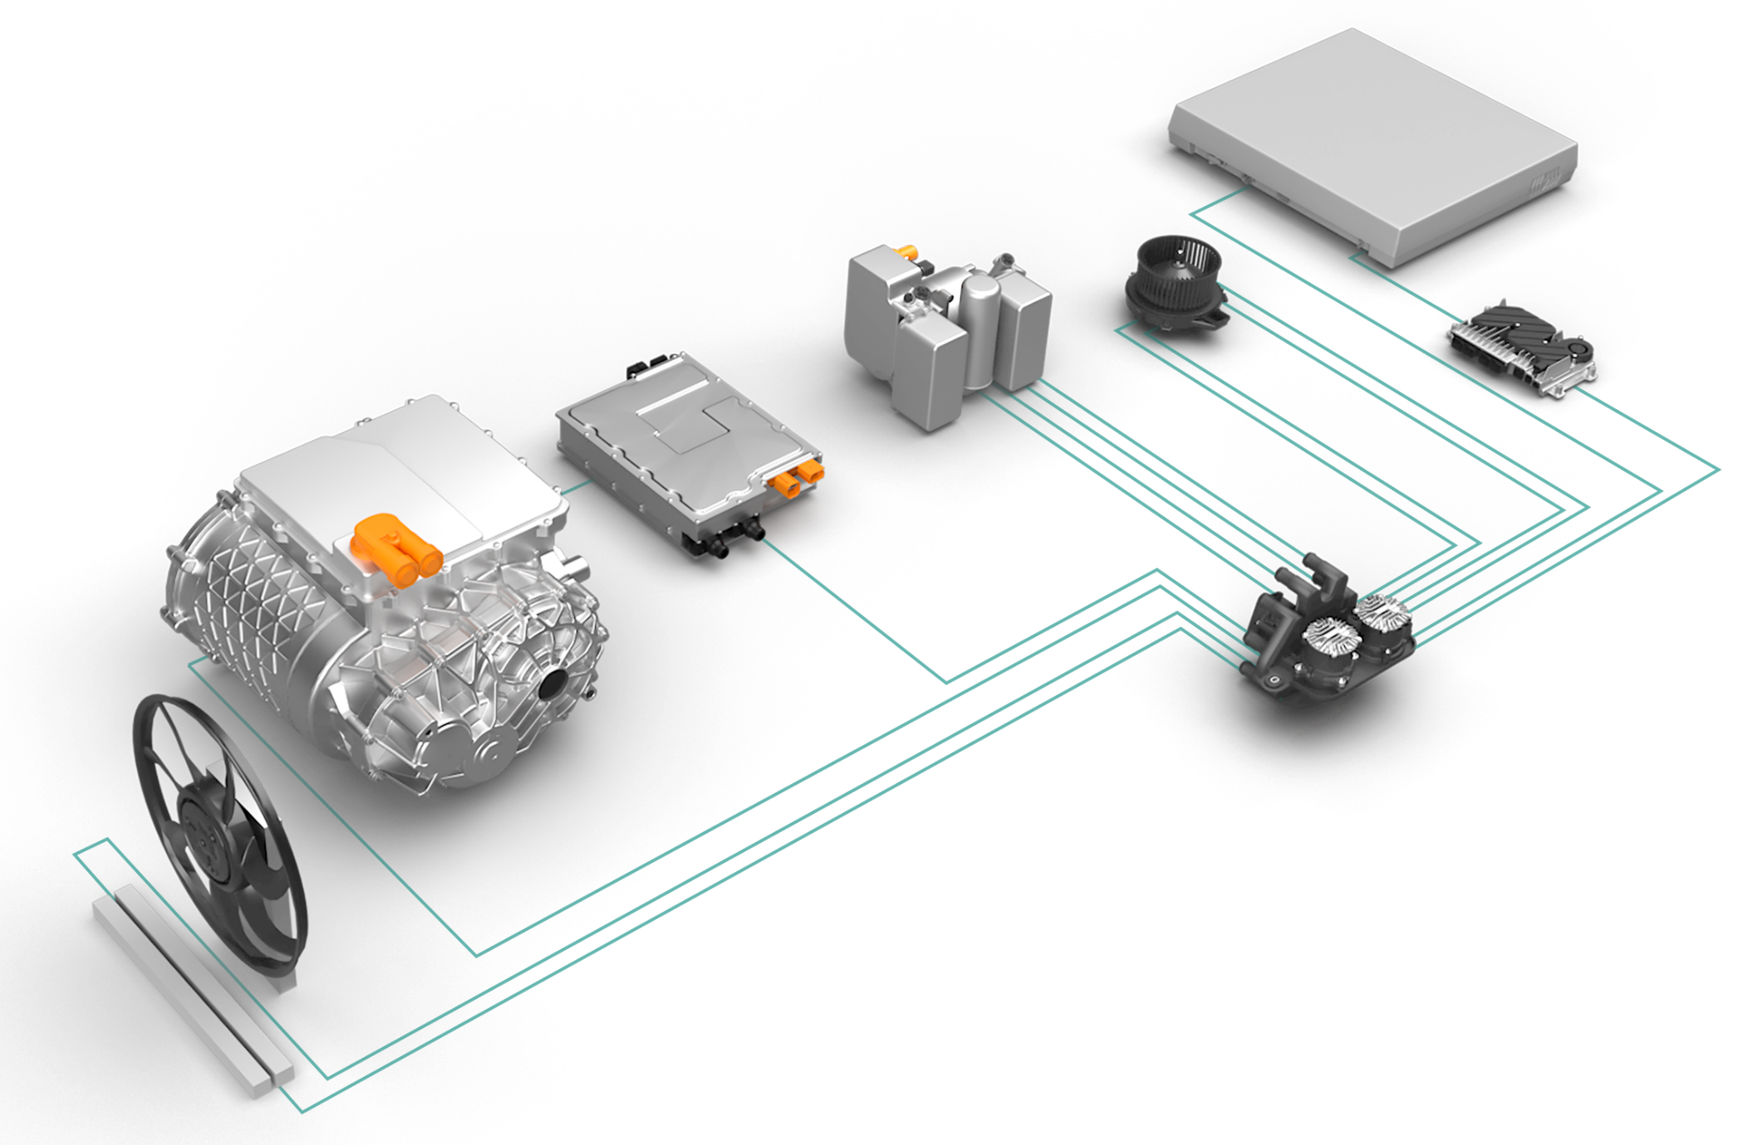
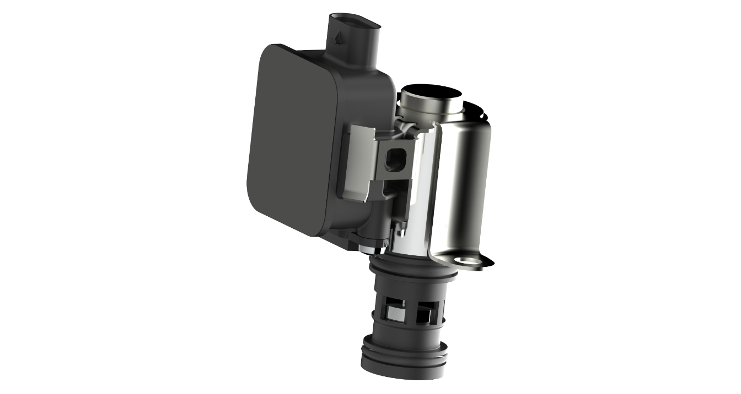
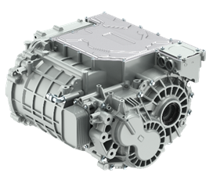
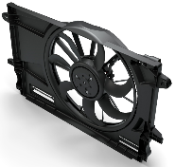
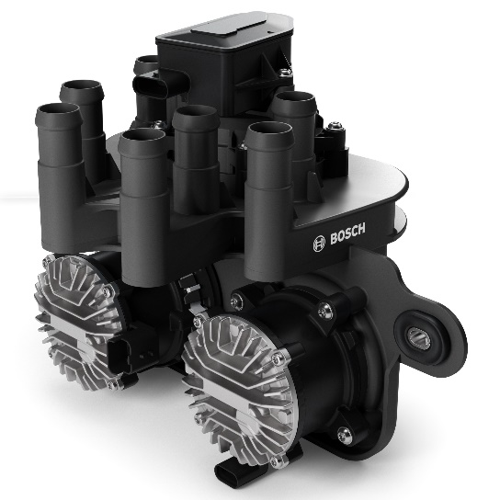
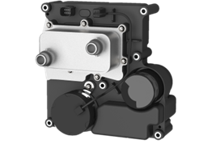
Bosch Thermal System Portfolio for R290
Heat Pump Unit (HPU)
Integrated heat pump for R290
Safety-oriented integration concept
Smart Oil Actuator (SmA )
Oil flow rate control
Sensor-less and
self-locking
Cooling Fan
12 or 48V
Best in class NVH
TMC (TM Software Controller)
Thermal management controls for coolant, refrigerant, and cabin
Innovative predictive features
Flexible Thermal Units for Coolant (FTU-C)
Flexible packaging and functionality supports customer specific integration
Scalable hydraulic power
FTU-O (eAxle oil cooling system)
Efficient waste heat recovery
Incl. all devices for oil cooling circuit
HPU
SmA
TMC
FTU-C
Cooling Fan
FTU-O
Today’s presentation will focus on learnings from R290 HPU system development
Paper # (if applicable)

Slide 5
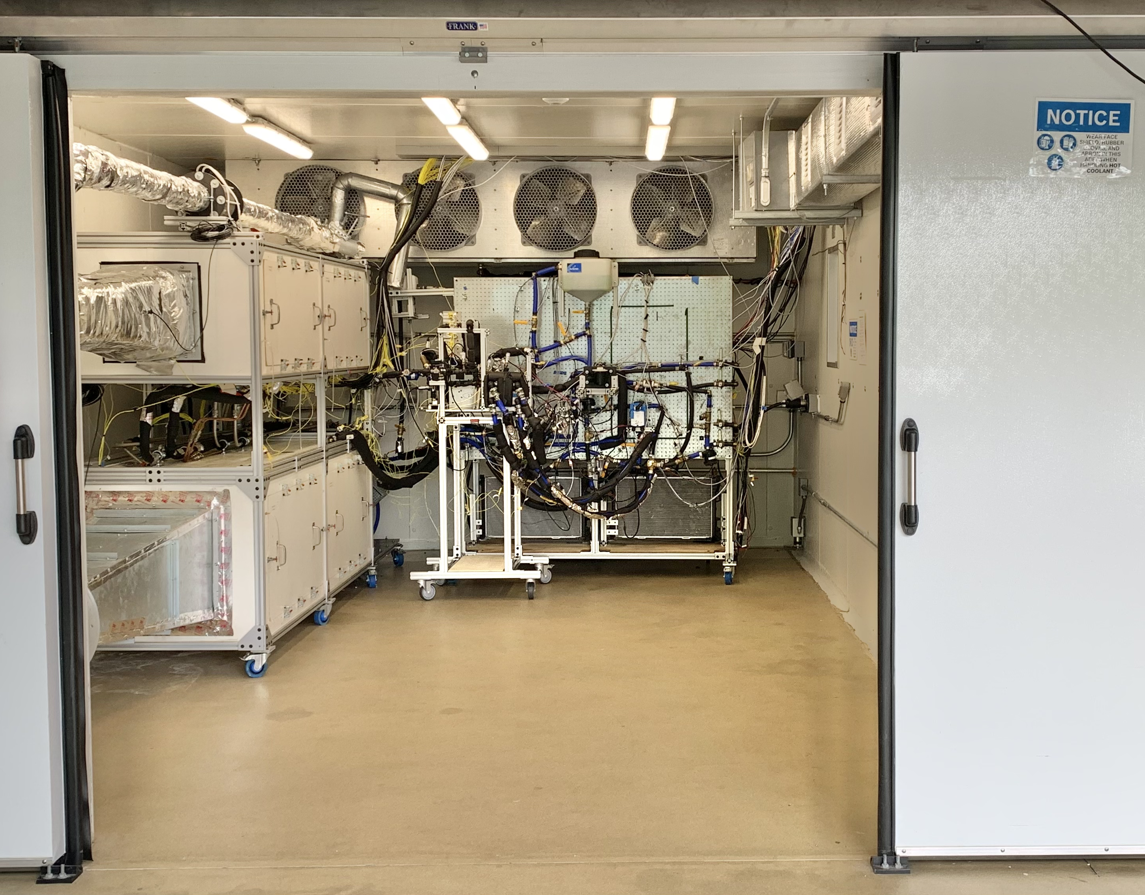
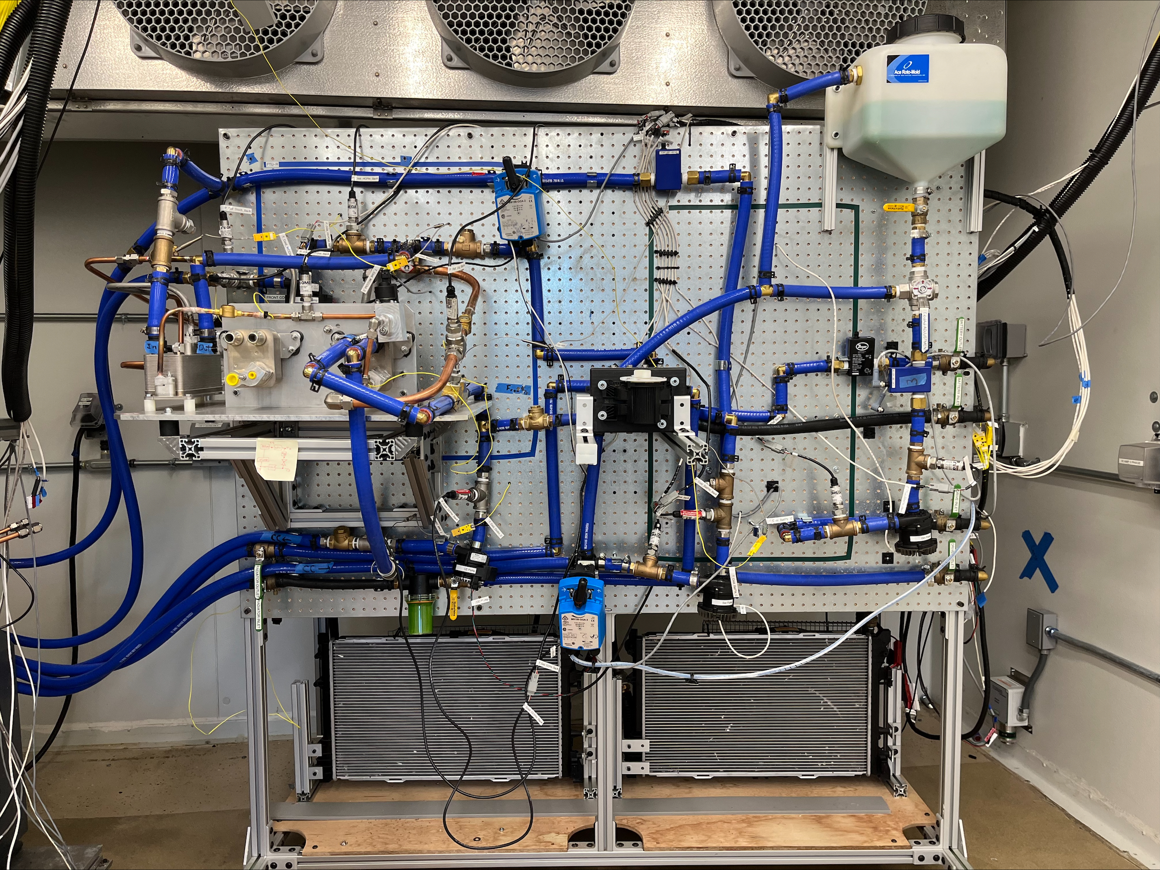
Thermal Systems Research Lab – Waltham MA
Temp. range | -30°C to 55°C
Max chamber cooling | 20 kW
HVAC
ECF
Bat, eAxle
Simulators
System
Interactions
R290 System
(Before Insulation)
Climate Chamber in Vehicle Lab
Wallboard w/ R290 System & Coolant Topology
Thermal System Lab in climate chamber enables fundamental investigations of system design and performance / controls impacts
Paper # (if applicable)

Slide 6
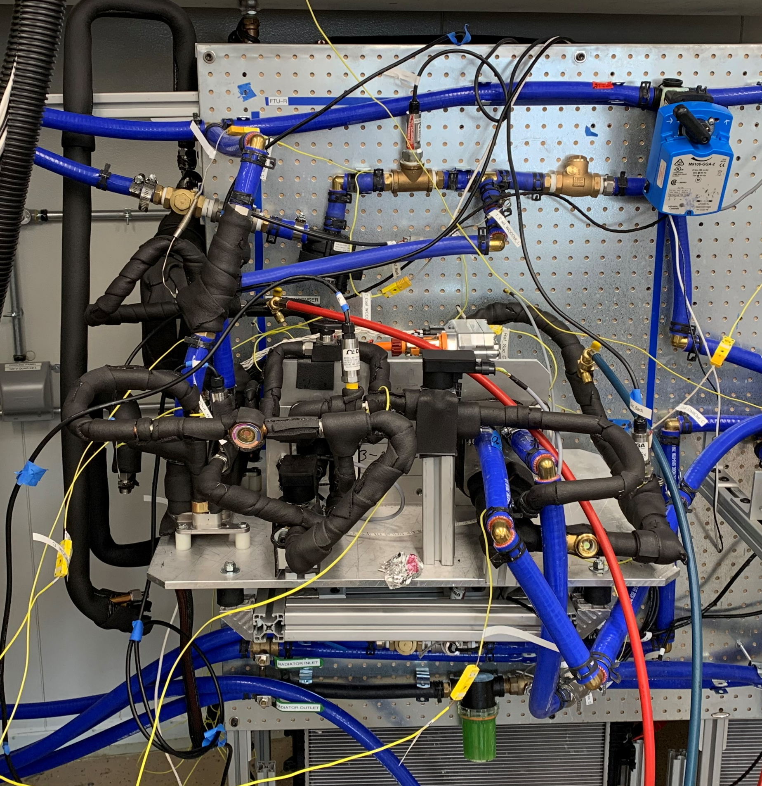
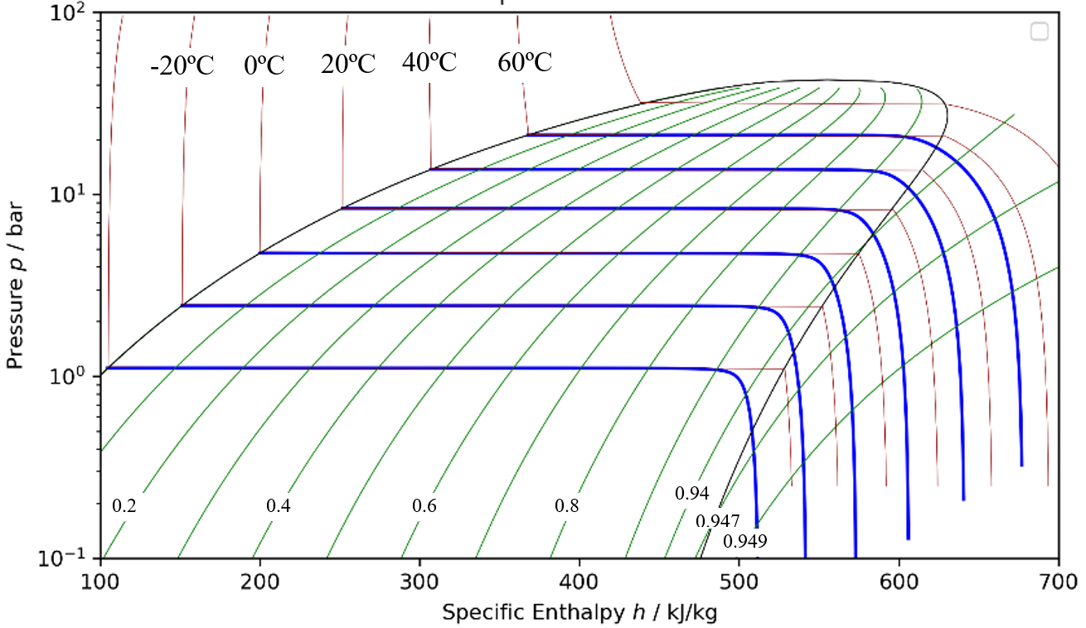
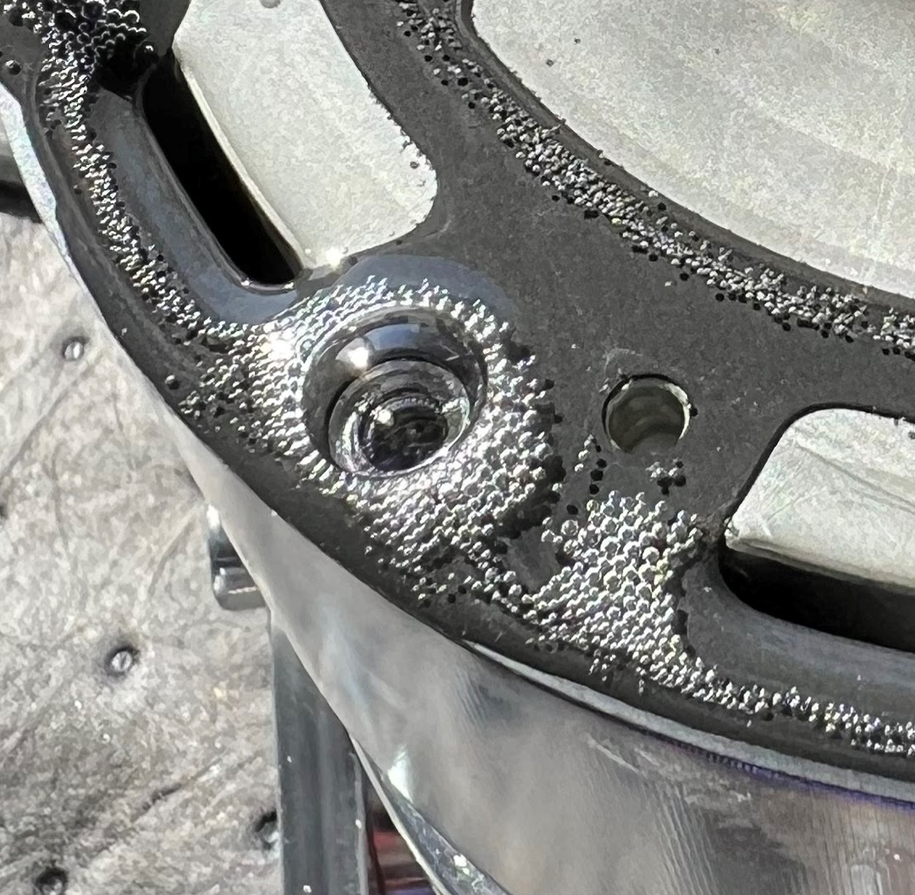
Oil Circulation & Solubility vs Performance
1) Ossorio et. al, Impact of Lubricant in the in the Evaporator as a Function of Oil Circulation Rate in Variable Speed Heat Pumps working with R290, 2022
Coriolis Massflow Sensor
P-h-X diagram of R290 and POE68 (OCR=5%)¹
R290 Boiling Out of PAG
Pure R290
w/ oil
Early energy balance studies showed a ~8% performance reduction due to oil circulation rate (OCR) vs analysis done with pure R290 → OCR must be considered in all analysis to produce realistic predictions
In simplest terms, when calculating enthalpy w/ pure R290 based on 10 K superheat:
  a 2% oil circulation rate “steals” 7.9 kJ/kg of enthalpy in the superheat region
  A 4% oil circulation rate “steals” 16.8 kJ/kg of enthalpy in the superheat region
Paper # (if applicable)

Slide 7
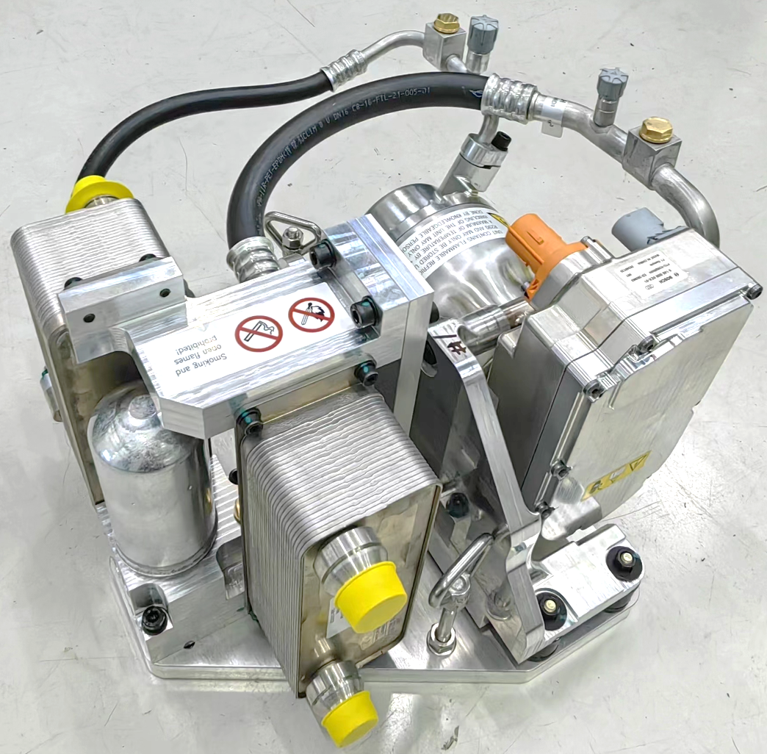
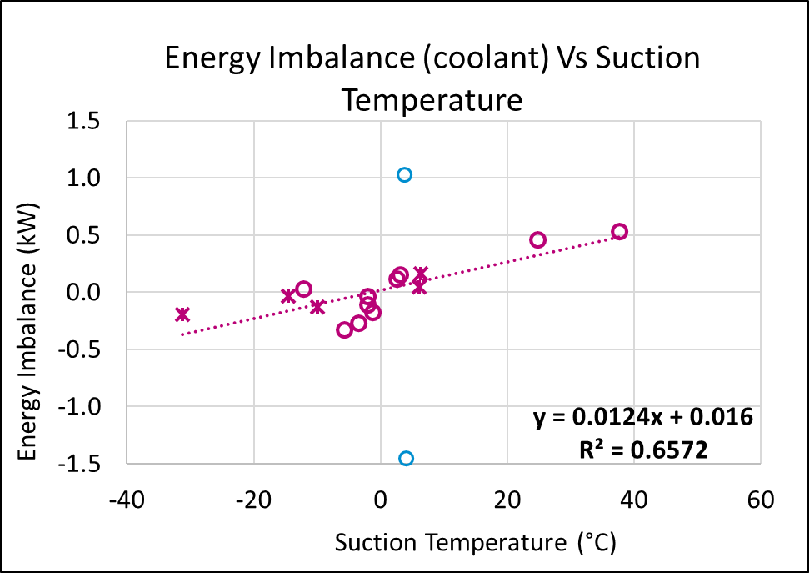

Importance of Thermal Isolation
2x outliers ignored
LCC
Chiller
Heat
flows
~12 regressions of test data explored
Only parameters related to chiller temp showed a trend
${\dot{∆Q}}_{loss}=P_{Comp_elec}+{\dot{Q}}_{chiller}−{\dot{Q}}_{lcc}$
Energy balance checks of early samples showed ~500 W of imbalance correlating best with chiller temp. → Care must be taken to avoid thermal short-circuits during system development
Paper # (if applicable)

Slide 8
Influence of Vapor Injection (VI)
Inlet T | -30°C |  | -20°C |  | -10°C |  | 35°C |  | 53°C
System | Base | VI | Base | VI | Base | VI | Base | VI | Base | VI
RPM | n/a | 8408 | 6863 | 5727 | 6379 | 5562 | 5988 | 5494 | 6245 | 5495
Speed | n/a |  | -17% |  | -13% |  | -8% |  | -12%
Noise (dBA) | n/a |  | -1.1 |  | -2.5 |  | -2.3 |  | -1.9
Q Heat / Cool (kW) | 5.5 |  | 5.5 |  | 7 |  | 10 |  | 10
+7%
Vapor Injection
Base System
+5%
+8%
+5%
Too High Discharge Temps
eComp
Chiller
LCC
-30
-20
-10
35
53
Economizer
R/D
Chiller/Condenser Inlet Temp (°C)
VI enables system operation at -30°C and produces a ~8% to ~15% lever on speed or capacity
TCO of VI vs increasing eCom cc, hot gas cycle or HV heater will be OEM and use-case dependent
Paper # (if applicable)

Slide 9
Vapor Injection vs Hot Gas Cycle at -30°C (-22°F)
 | Vapor Injection | Hot Gas
Time to 43°C LCC Coolant Inlet Target | 15.6 min | 17.3 min
Preheat Pump Off Time | 6.7 min | 8.7 min
% Time Heating Coolant | 59% | 45%
Avg HT Delivered to Coolant (Pump On) | 3.72 kW | 4.37 kW
Calculated Energy delivered to Coolant | 570 Wh | 570 Wh
Avg start-up COP incl. Preheating | 0.56 | 0.24
eComp
Chiller
LCC
*
*
Economizer
R/D
R290 “Dryness”
Governed
eComp
Chiller
LCC
R/D
Vapor Injection outperformed Hot Gas time to 43°C LCC inlet from -30°C for all Bosch tests
eCom load is developed sooner with VI, allowing system to begin heating the coolant/cabin sooner despite lower peak heating capacity. COP ~2.3x higher with VI over entire startup
Paper # (if applicable)

Slide 10
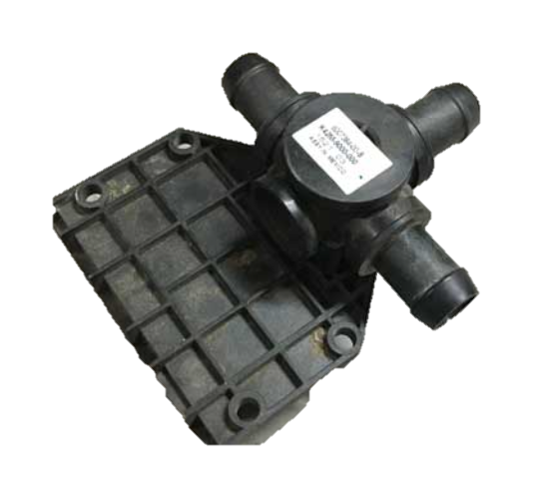
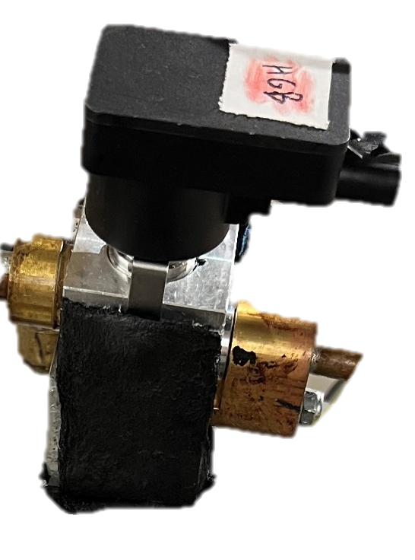
Single vs Dual Chiller Systems (1/2)
R290 Circuit
Coolant Circuit
Chiller Coolant Mixing Valve
Single Chiller
Parallel Heat Sources
(Cabin + Batt)
from a Tesla Model X
90° travel, 90 discrete steps
Two Evap. EXVs
Dual Chiller
Isolated Heat Sources
(Cabin + Batt)
536 discrete steps
➔ Single and dual chiller systems were studied with a focus on the battery + cabin dual cooling use case
Paper # (if applicable)

Slide 11
Single vs Dual Chiller Systems (2/2)
7.8 kW system capacity
(10.3 kW w/ VI)
10.7 kW system capacity
Single Chiller
Dual Chiller
…576
90°= 90 Steps
➔ Both systems are controllable to the limit of the refrigerant system capacity. Coolant valve had 11 mixing control steps and the EXV had 25 steps
➔ Dual-chiller system had 2x chiller coolant flow and heat transfer area, which raised cooling capacity
System | ΣQ (kW) | ΣFlow (LPM) | Delta T (K) | Total COP | Volume
Single | 7.8 | 21.3 | 5.9 | 1.06 | 100%
Single w/ VI | 7.6 | 21.2 | 5.8 | 1.19 | 100%
Dual | 7.6 | 40 | 3.4/2.7 | 1.22 | 200%
Paper # (if applicable)

Slide 12
Contributors
Special thanks to:
Brandon Dryer
Elliot Ko
Parry, Eleanor, Gianna, Max and the many NEU Co-Ops that supported building and operating the Thermal Systems Research lab
Paper # (if applicable)

Slide 13
Contact Info
Thank you
      Dana Nicgorski
      Robert Bosch LLC
      101 1st ave. Waltham MA 02451
      +1-781-684-5325
      Dana.Nicgorski@us.bosch.com
Paper # (if applicable)

