Slide 1
Enhancing Electric Vehicle Efficiency: A Comparative Study of R-474A, R-1234yf, and R-744 using Digital Twin Simulation
Thermal Management Systems Symposium
October 14 -15, 2025 | Ypsilanti, Michigan
Christian Macrì, Álvaro de León, Felix Flohr, Tim Snyder, Janet Maxwell
1*
Oct
2025

Slide 2
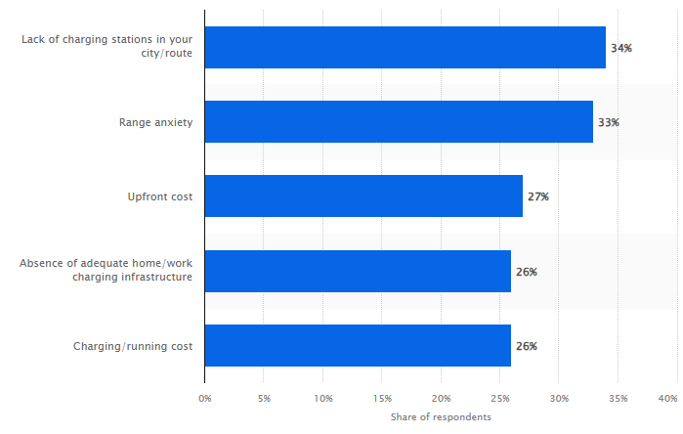
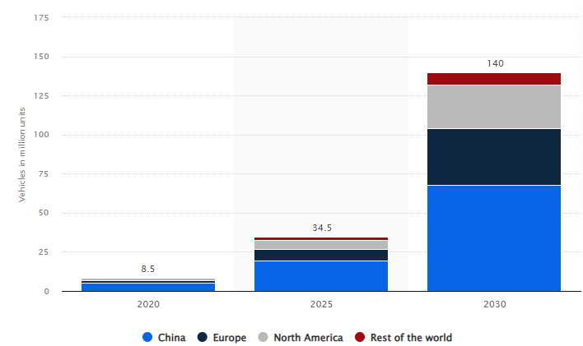
Global Market Perspective of Electric Vehicles
Leading reasons inhibiting the purchase of electric vehicles according to consumers worldwide
Projections for the first-owned zero emission vehicles fleet size worldwide between 2020 and 2030, by region (in million units)
^{Vehicles in million units}
^{Share of respondents}
Details: Worldwide; Statista estimates; ICCT; 2020
Source: Statista estimates; ICCT
Details: Worldwide; March 2022; 12,714 responders
Source: EY Mobility Consumer Index 2022 study, page 5
Among various statistical figures, the data shown above implies the necessity of high-efficient technologies:
The market demand depends on an acceptable driving range under all driving conditions.
The industry’s efforts to reduce CO₂eq emissions for electrified vehicles.

Slide 3
Our Motivation – Perfect Balance of Efficiency & Performance
OEM requirements:
Thermal Management Performance
Thermal Management Efficiency
Energy Source
Regulatory
Compliance

Slide 4
New Refrigerant Concept

Slide 5
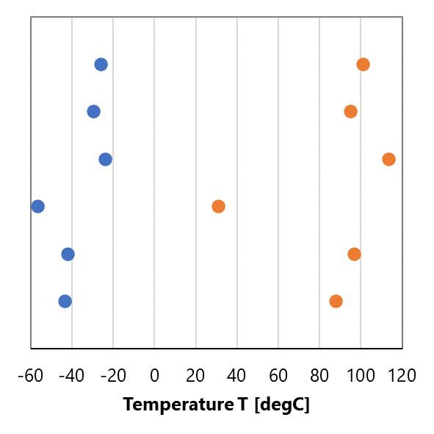
Refrigerant Concept for Battery Electric Vehicle (BEV) Heat Pump
Daikin’s next-gen refrigerant technology
Supporting the HVAC & refrigeration industry to transition to lower environmental impact products
Ultra-low GWP
Mildly flammable
Across all application spaces: Mobile Air Conditioning (MAC), Residential, A/C, Refrigeration, etc.
Phase Change Temperature
(Low temp. limit of R-744 is derived from triple point.)
R-134a
R-1234yf
Cooler
R-152a
Core Concept of R-474A
Refrigerant blend of R-1132(E) and R-1234yf
Environmental Impact: GWP<1
Safety: Flammability rating is the same as R-1234yf (A2L)
Performance:
Pressure suitable for Heat Pump
Expand heat pump low-temp operating range by 10K
Heat Pump
R-744
R-290
R-474A
Heat pumps are becoming the new standard, and Daikin's new fluid can deliver all the benefits.
Daikin has created R-1132(E) based on an extensive experience in refrigerant development.

Slide 6
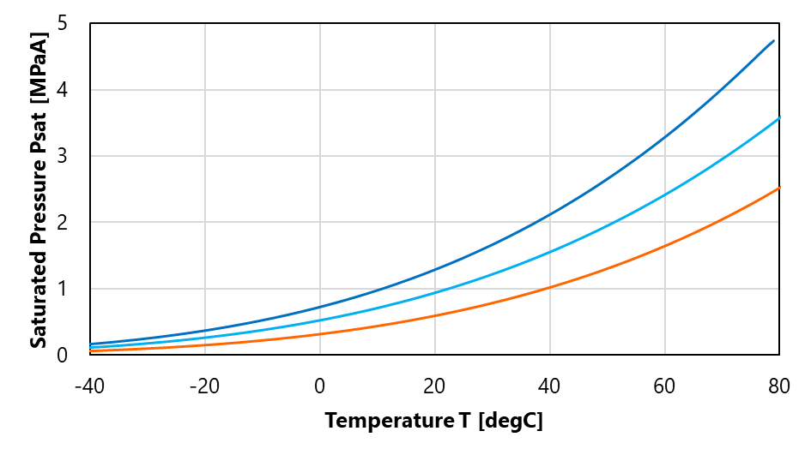
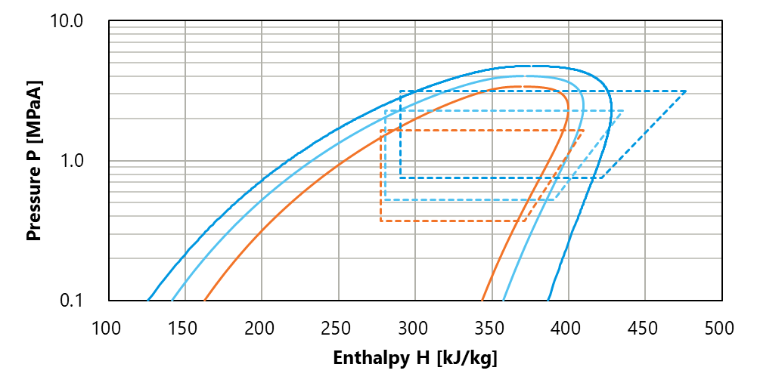
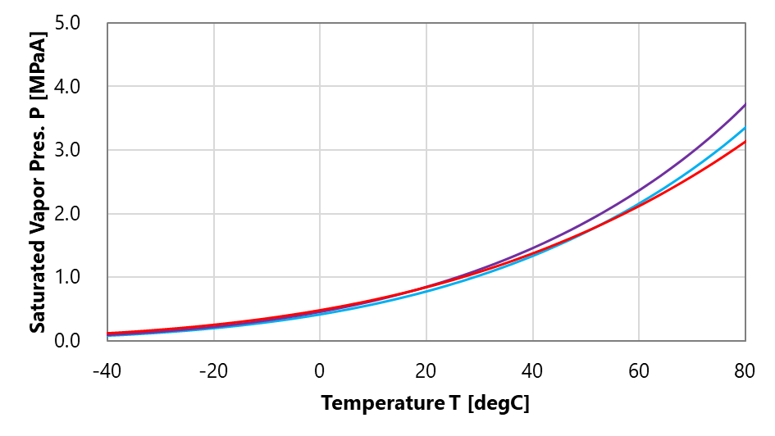
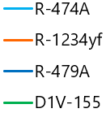
Basic Fluid Properties based on R-1132(E) Chemistry
Candidate | GWP | Safety ASHRAE Class | Performance
 |  |  | COP | Capacity | Glide Eva/Cond | Disch. Temp. | Condensing Pressure | Evaporating Pressure | Boiling Point | Critical Temp.
 |  |  | R1234yf=100 | R1234yf=100 | [K] | [degC] | [MPaA] | [MPaA] | [degC] | [degC]
R-474A* | <1 | A2L | 99 | 140 | 3.6/5.0 | 80 | 2.29 | 0.52 | -43 | 88
R-479A** | <150 | A2L | 97 | 198 | 3.9/3.7 | 93 | 3.16 | 0.75 | -51 | 81
R-1234yf | 1 | A2L | 100 | 100 | 0/0 | 70 | 1.64 | 0.37 | -30 | 95
R-290 | 3 | A3 | 105 | 146 | 0/0 | 81 | 2.12 | 0.55 | -42 | 97
R-152a | 124 | A2 | 114 | 110 | 0/0 | 96 | 1.50 | 0.31 | -24 | 113
Condition:
Te=5[degC], Tc=60[degC], SH=5[K], SC=5[K], Comp Efficiency=70[%]
* R-1132(E)/R-1234yf = 23/77% ** R-1132(E)/R-1234yf/R-32 = 28/50.5/21.5%
R-474A (GWP<1) improves performance vs. R-1234yf with a close profile to R-290.
R-479A (GWP<150) as high-capacity blend for commercial vehicles and higher GWP allowable regions.

Slide 7
Thermal Management Benchmark & Efficiency Assessment

Slide 8
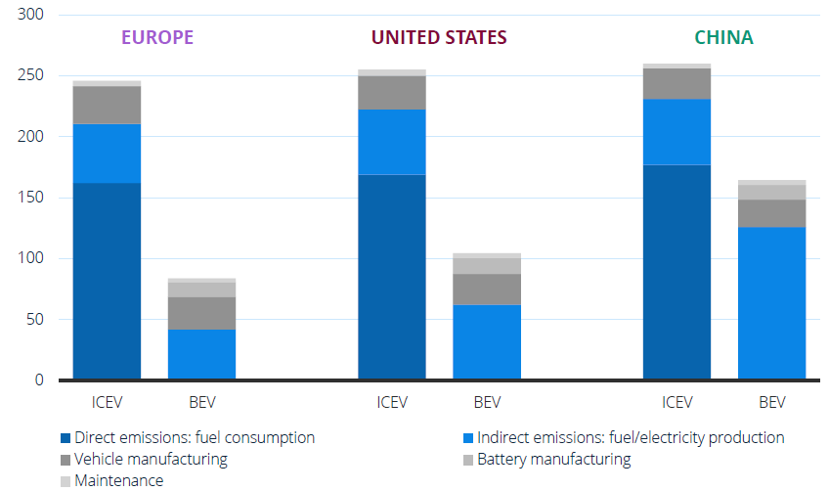
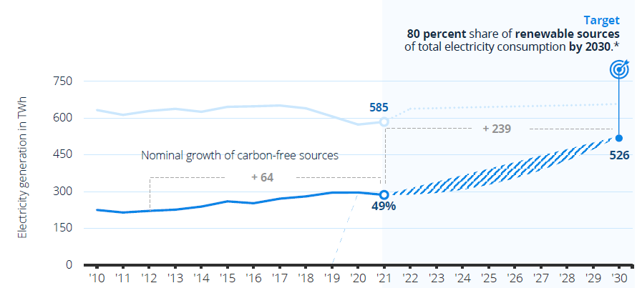
Background of CO2eq Emissions for Battery Electric Vehicles (BEVs)
CO₂ emissions per passenger car vary between regions – Life cycle GHG emissions (gCO2/km) of medium size gasoline internal combustion engine vehicles (ICEVs) and Battery Electric Vehicles (BEVs)
Germany’s targeted energy mix by 2030 – Energy production, share of renewables, forecast, and political targets
Details: *2030 total electricity production according to Enerdata on an announcement of the German Federal Ministry of Economics; November 2021
Sources: BP; Enerdata; German Federal Ministry of Economics; Statista
^{Details: Worldwide; July 2022}
^{Source: Statista; ICCT}
Battery electric vehicles (BEVs) do not produce direct emissions during the operation. The indirect emissions of BEVs are related to the CO₂ emissions include the production of electricity.
Carbon footprint of BEVs greatly depends on the energy consumption of the thermal system.

Slide 9
Project Background and Objectives
Project Description
Demonstrate the performance and efficiency gains of R-474A refrigerant when incorporated into current electric vehicle thermal systems (specifically, air/air heat pump systems designed to use either R-1234yf and R-744 (CO₂) refrigerant)
Simulate a Hyundai Kona R-1234yf heat pump system – adapted to R-474A – integrated into an VW ID.3 calibrated vehicle model
Project Objectives
Phase 1:
Identify the hardware changes required by OEMs/Tier-1s to adopt the R-474A refrigerant using the baseline VTMS (Vehicle Thermal Management System).
Demonstrate the R-474A benefits in terms of system level performance in steady-state conditions.
Identify the need for changes in thermal control strategies related to any hardware modifications.
Phase 2:
Integrate an adapted R-474A thermal system to the HORIBA MIRA ID.3 Digital twin.
Phase 3:
Demonstrate the holistic R-474A benefits at a vehicle level with tangible metrics such as “improvement of EV range”.

Slide 10
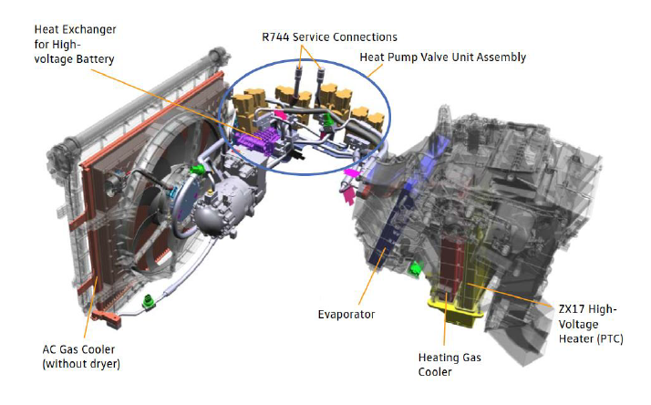
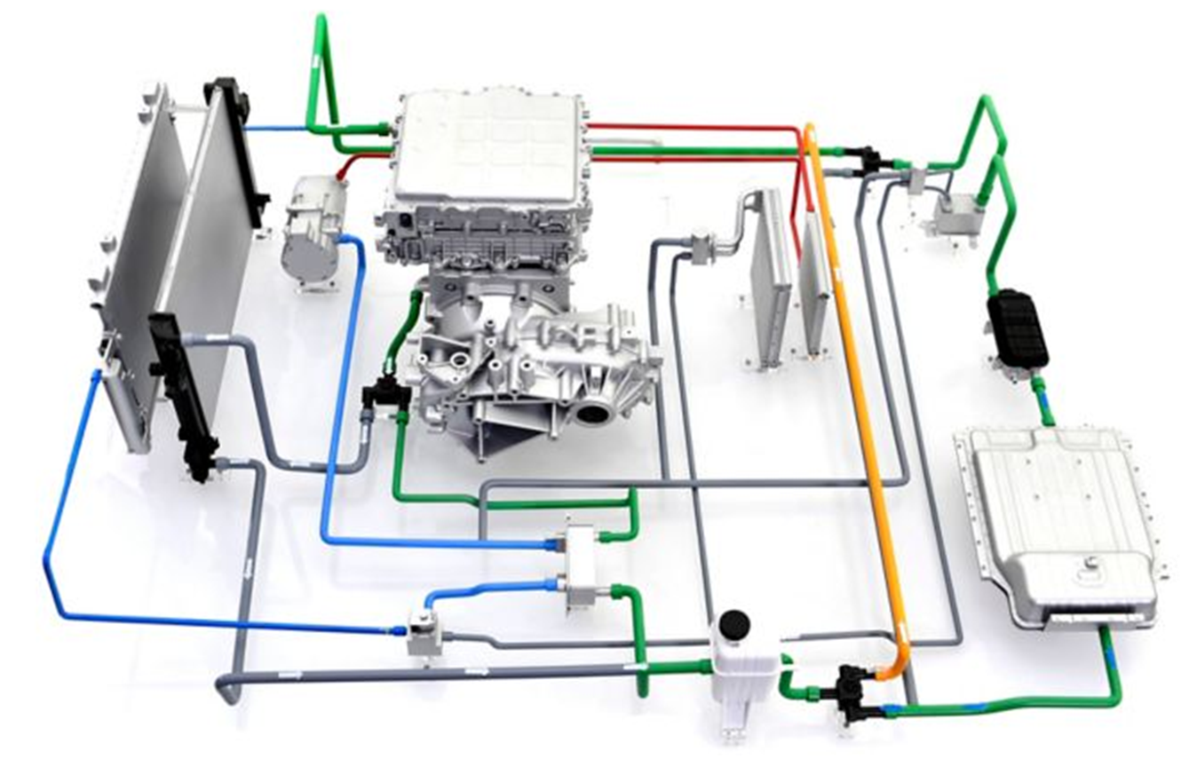
Project Schedule of the Overall Simulation Project
Q4/2024
Q2/2025
Q4/2025
PHASE 1
R-474A System level assessment
Phase 1 Key Deliverables:
System level comparative report summarising the baseline performance of R-744, R-1234yf & R-474A in a heat pump application.
PHASE 2
R-474A virtual vehicle integration
Phase 2 Key Deliverables:
Vehicle model validation report taking the Hyundai Kona heat pump model and integrating it into an VW ID.3 vehicle model, along with a bespoke climate control system.
R-744 heat pump system
R-1234yf/R-474A heat pump system
PHASE 3
R-474A Comparative analysis
Phase 3 Key Deliverables:
Comprehensive assessment report for a detailed analysis and energy efficiency optimisation, based on the refrigerants R-744, R-1234yf & R-474A.

Slide 11
Phase 1 Assessment: Model Simulation Setups & Steps
Definition of operation modes upon SAE J2765
Simulation procedure on system level
System modifications as basis for further vehicle assessment
Key parameters for the evaluation of simulation results:
Total power (cooling and/or heating)
Air off temperature of active heat exchanger in the HVAC
Compressor power consumption
System COP (without PTC heat load for heat pump cases)
Three stages to assess the system modifications’ impact on system efficiency:
Removing the de-superheater
Resizing the OHX:
Increase of tube length
Reduction of stack dimension
Resizing the inner condenser:
Increase core depth
Increase number of passes
Cooling mode for the hot ambient, which involves Evaporator only or Evaporator plus Battery Chiller
Charge determination of R-1234yf vs. R-474A (acc. to SAE J2765)
Model confirmation through correlation with test data
Baseline evaluation of Kona heat pump system for both refrigerants R-1234yf and R-474A
Comparative simulation of R-474A, R-1234yf and R-744 using CO₂ based GT-Suite model (digital twin) of VW ID.3
Heat Pump mode for cold ambient, which involves the inner condenser, OHX and heat pump chillers
Re-heat mode for Dehumidification, which involves the Evaporator, inner condenser & OHX

Slide 12
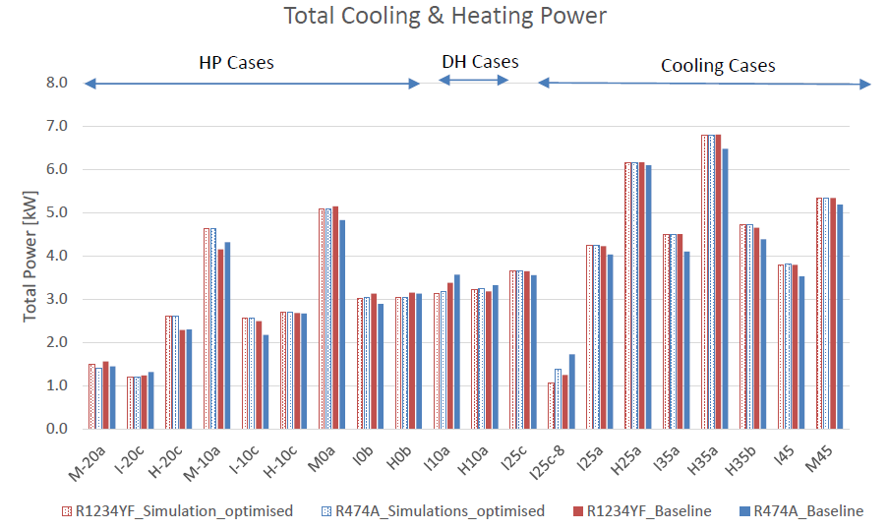
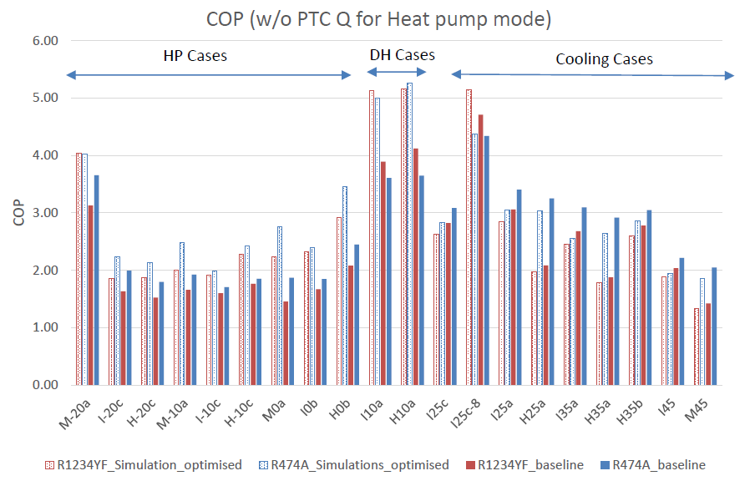
Phase 1 Assessment: Comparative Results R-474A vs. R-1234yf
For total cooling and heating power, the model controllers remained unchanged for both refrigerants to ensure capacity matching, which allows a direct comparison in terms of COP
In terms of the COP of the system, R-474A showed a clear advantage for cooling modes.
For dehumidification cases, the original baseline model showed that R-474A had a COP disadvantage of -0.7 compared to R-1234yf (about -17.4% less COP than R-1234yf). However, with the implemented modifications, the overall COP of R-474A improved significantly.
Finally, for heat pump cases, R-474A showed a consistent advantage in both models, with the optimized model yielding the highest COP results

Slide 13
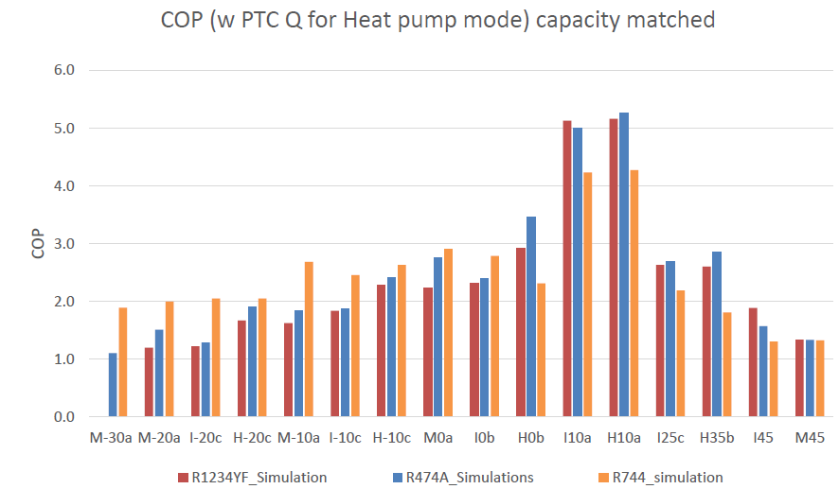
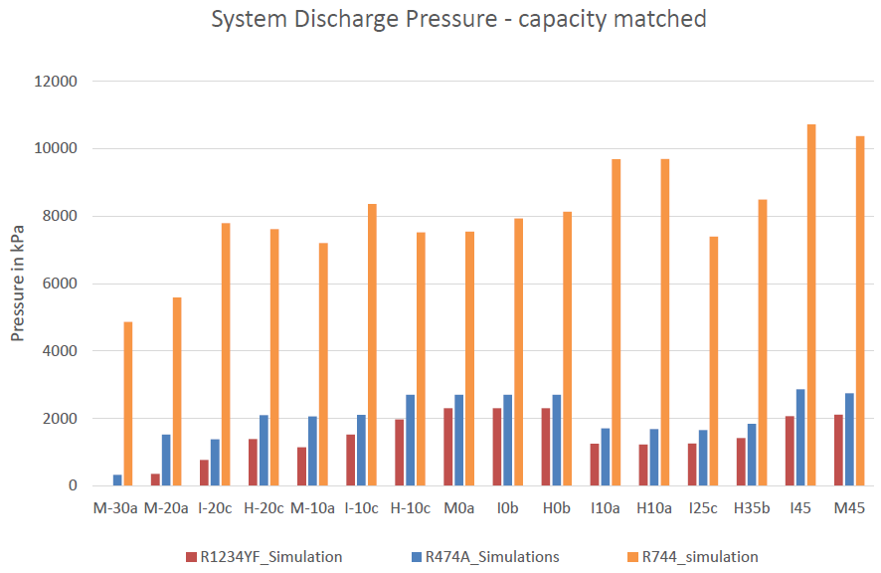
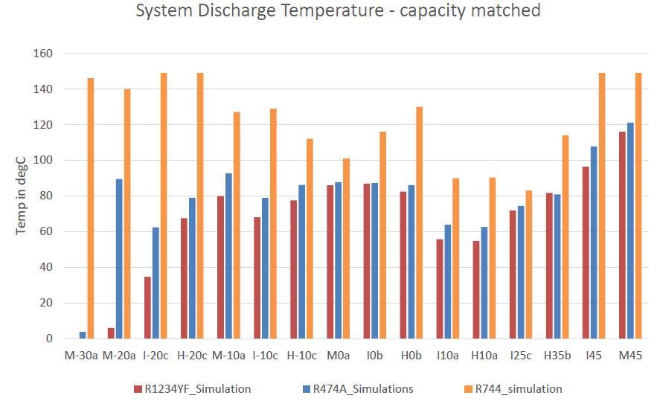
Phase 1 Assessment: Benchmark R-474A vs. R-1234yf vs. R-744
In cooling modes, R-474A demonstrated superior performance compared to R-1234yf and R-744 in certain test cases (such as H35b and I25c, with +12% vs. R-1234yf)
In heat pump modes, the R-474A had a slightly lower COP than R-744 at moderate cold conditions (0°C to -10°C), with an average difference of 15%.
Discharge pressures and temperatures highest for R-744 while R-474A remains within the rang of c. +15-20% compared to R-1234yf.

Slide 14
Phase 2 Assessment: Model Simulation Methodology
Goal of Phase 2: GT-Suite system model developed for R-474A and R-1234yf in Phase 1 is integrated into the “MIRA Digital Twin” of the VW ID.3 to enable high-fidelity co-simulation of thermal management systems on vehicle level under transient conditions.
Load cases for Phase 2 assessment
Controller Development and Calibration
Climate control modes:
Cooling
Heating
Heating with dehumidification
Controller development:
Refrigerant circuits
Coolant circuit
Cabin air management
Vehicle powertrain
Main VTMS control parameters:
Compressor speed
Evaporator temperature
Cabin temperature
Set temperature
Inner condenser temperature
Battery chiller temperature
Expansion valves
Safety controls (refrigerant-specific)
Maximum discharge pressure
Maximum discharge temperature
Minimum Suction Pressure
Transient Test scenarios:
Pull-Down
Pull-Up
Dehumidification
WLTP
Driving cycles
Pull-Up and Pull-Down Cycles: Each cycle includes three driving speeds, each lasting 30 minutes
WLTP Cycle (Worldwide Harmonized Light Vehicles Test Procedure): A standard driving profile used for emissions and energy consumption testing
Solar load:
0 < solar load < 1000W/m²
(depending on ambient temperature)
The biggest challenge of Phase 2 was the modelling of proper vehicle controllers for the various sub-systems such as front module fan, battery PTC, and coolant massflow.
This also includes strategies for radiator by-pass and fresh air / recirculation door positioning.

Slide 15
Phase 3 Assessment & Results
TO BE UPDATED FOR FINAL VERSION (results not available yet)

Slide 16
EU PFAS

Slide 17
EU ECHA Restriction Process for PFAS *
* as of 11/2024
ECHA COMMITTEES PROCESS
TENTATIVE TIMELINE!
Q1 2023
Q2 2023
Q3 2023
Q4 2023
Q1 2024
Q2 2024
Q3 2024
Q4 2024
2025
2026
PUBLIC CONSULTATION
Update of PFAS restriction proposal ²⁾
EP & COUNCIL SCRUTINY? (REDUCED ROLE)
September
RAC and SEAC discussions on first draft opinion
Plenaries 2024
TO BE UPDATED FOR FINAL VERSION (placeholder EU PFAS content)
13 January 2023 Restriction Dossier Submitted
+ 30 Days Conformity Check
June 2025 ?? EU COM proposal
December 2026 ??
Entry into force
December
RAC & SEAC 2024 workplan
March - December
RAC & SEAC plenaries
December ??
RAC opinion
SEAC draft opinion
March 2025 ?? final opinion
RAC & SEAC PLENARIES 2024
Dates | Sectors discussed ¹⁾
11-15 March | Consumer mixtures, cosmetics and ski wax Hazards of PFAS (only by RAC) General approach (only by SEAC)
3-14 June | Metal plating and manufacture of metal products Additional discussion on hazards (only by RAC)
9-20 Sept | Textiles, upholstery, leather, apparel, carpets (TULAC) Food contact materials and packaging Petroleum and mining
25 Nov – 5 Dec | Textiles, upholstery, leather, apparel, carpets (TULAC) Food contact materials and packaging Construction *NEW
2025 ³⁾ | F-Gases *NEW/POSTPONED Transport *NEW/POSTPONED Energy *NEW
Late 2024 ?? SEAC consultation
All 5642 comments submitted are now available on the ECHA website!
Big delay expected
¹⁾ “Hazards” might include TFA as topic
²⁾ https://www.reach-clp-biozid-helpdesk.de/SharedDocs/Meldungen/DE/REACH/2024-04-12_Rolle_Aktivit%C3%A4t_PFAS.html
³⁾ Tentative
Source: https://echa.europa.eu/-/next-steps-for-pfas-restriction-proposal

Slide 18
CONCLUSION

Slide 19
Summary
Summary
Kona model was developed and correlated for R-474A and R-1234yf, allowing for a comprehensive evaluation of R-474A against R-1234yf and R-744 across cooling, dehumidification, and heat pump modes.
R-474A generally demonstrated superior performance over R-1234yf in all modes, showing higher cooling power and COP, and outperforming R-744 in dehumidification and some cooling/moderate heat pump conditions, while R-744 excelled in extreme cold heat pump operations.
Complex control strategies were developed and tested for the refrigerant, coolant, and airflow circuits across various scenarios like cooling, dehumidification, and heating.
The validation confirmed the control strategies' effectiveness in maintaining thermal comfort, optimizing energy efficiency, and ensuring system safety, providing a basis for future dynamic load case analysis and comparative studies of R-474A.
PHASE 3 conclusion

Slide 20
Outlook
Next steps
Use data to complete SAE’s Life Cycle Climate Performance (LCCP) tool for different climatic regions in a bottom-up approach from system to fleet to evaluate the total environmental footprint in comparison to other refrigerant solutions.
Extend investigation scope to full secondary loop (FSL) system aiming the use of MIRA’s ID.3 digital twin.
Proceed investigations on refrigerant blends outside the PFAS scope (referring to the ECHA PFAS dossier draft).
"Best balance" A2L GWP<1
“MAX ratio”
A2L limit GWP<1
“Best performance”
A2L GWP<150
“Safer than R-290”
A2 R-290 drop-in
 | R-474A | R-474B | R-479A | R-491A
Blend composition | R-1234yf/R-1132(E) 77/23 wt.% | R-1234yf/R-1132(E) 68.5/31.5 wt.% | R-1234yf/R-1132(E)/R-32 50.5/28/21.5 wt.% | R-152a/R-1132(E) 65/35 wt.%
PFAS status | R-1234yf affected | R-1234yf affected | R-1234yf affected | Non-PFAS
GWP | <1 | <1 | <150 | 81
Safety class | A2L | A2L | A2L | A2

