Slide 2
Alternative Refrigerant and Refrigeration/Heat Pump Systems
JAEMIN LEE, BONGHO KANG, JISEONG NOH, HYERI KIM
SK innovation

Slide 3
Contents
Background
SK refrigerants
System performance test
SK Oil solution for stability
SAE CRP Process
Conclusion

Slide 4
Background
Environmental Regulations
Heat pump capacity for EV
Low temp.
Thermal
management
Gen. 3 Refrigerant
Gen.4 Refrigerant
Next Gen.
R-134a
R-1234yf
New Refrigerant
HP capacity
F-gas
Regulation
Insufficient
refrigerant
PFAS
Regulation
Amb. Temp
Applying heat pumps
for efficiency
Reduced heat pump performance at low temp.
Need for improvement
High GWP
PFAS Concerns
Meet all regulation
Need for new refrigerants

Slide 5
SK Refrigerants
New Refrigerants Meeting Market Needs
① Regulations
② Toxicity/Flammability
③ System compatibility
④ System performance
Comparison of Alternative Refrigerants for Automobile HVAC
● Good ● Acceptable ● Concerns
Category | R-1234yf | R-744 (CO₂) | R-290 (Propane) | R-494B | R-4101A
Composition | Single | Single | Single | Ternary | Ternary
① Regulations | ● (PFAS concerns) | ● | ● | ● | ●
② Toxicity/Flammability | ● | ● | ● (flammability) | ● | ●
③ System compatibility | ● | ● (High pressure system) | ● (in-direct system) | ● | ●
④ System performance | ● | ● | ● | ● | ●

Slide 6
SK Refrigerants
Property | R-494B | R-4101A | R-1234yf
Composition (wt%) | CF3I / R-152a / R-744 (58 / 38 / 4) | CF3I / R-152a / R-32 (58.5 / 30.5 / 11) | -
GWP | 48 | 113 | ~1
Environmental | Non-PFAS | Non-PFAS | PFAS TFA concerns
ASHRAE Classification | A2L | A2L | A2L
Boiling point (℃) (@1barA) | -48.5 | -39.2 | -29.5
Dew Point (℃) (@1barA) | -29.5 | -31.7 | -29.5
Critical Temperature (℃) | 107.6 | 102.9 | 94.7
Temp. Glide (@20bar) | 12.2 | 5.9 | 0.0
Both refrigerants are A2L replacements for R-1234yf MVAC system allowing existing system architectures
No refrigerant ignition observed when exposed to various automotive electrical ignition sources
Risk assessment expected to show lower risk of fire due to refrigerant ignition compared to R1234yf
SK refrigerants have suitable properties to offer superior heating performance in low ambient

Slide 7
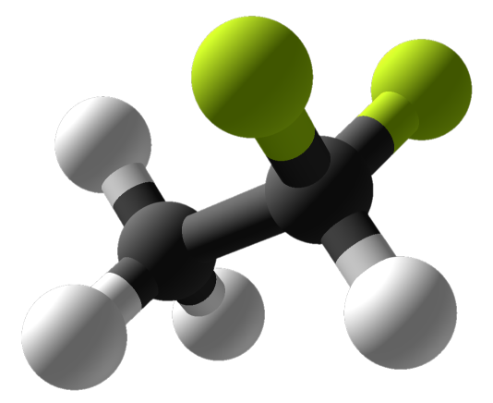
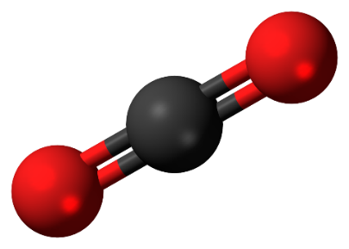
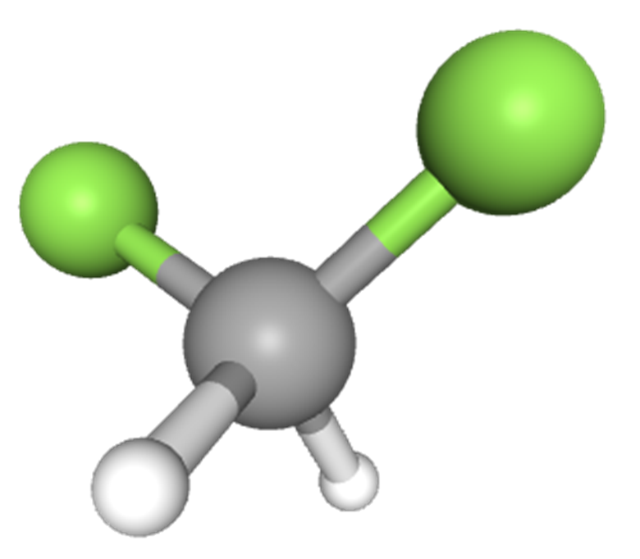
SK Refrigerants - PFAS
SK Refrigerants are PFAS-Free.
Definition of PFAS
EU&OECD : “Any substance that contains at least one fully fluorinated methyl (CF3-) or methylene (-CF2-) carbon atom without any H/Cl/Br/I attached to it.”
US State (Maine and Minnesota) : one fully fluorinated carbon molecule (Includes HFOs and most other F-gases except few such as R32, R152a, CF3I)
R-152a (Not PFAS)
CF3I (Not PFAS)
R-744 (Not PFAS)
R-32 (Not PFAS)
Name : 1,1-Difluoroethane
Chemical Formula : C₂H₄F₂
CAS No. : 75-37-6
Name : Trifluoroiodomethane
Chemical Formula : CF₃I
CAS No. : 2314-97-8
Name : Carbon Dioxide
Chemical Formula : CO₂
CAS No. : 124-38-9
Name : Difluoromethane
Chemical Formula : CH₂F₂
CAS No. : 75-10-5
Non-Fluorine

Slide 8
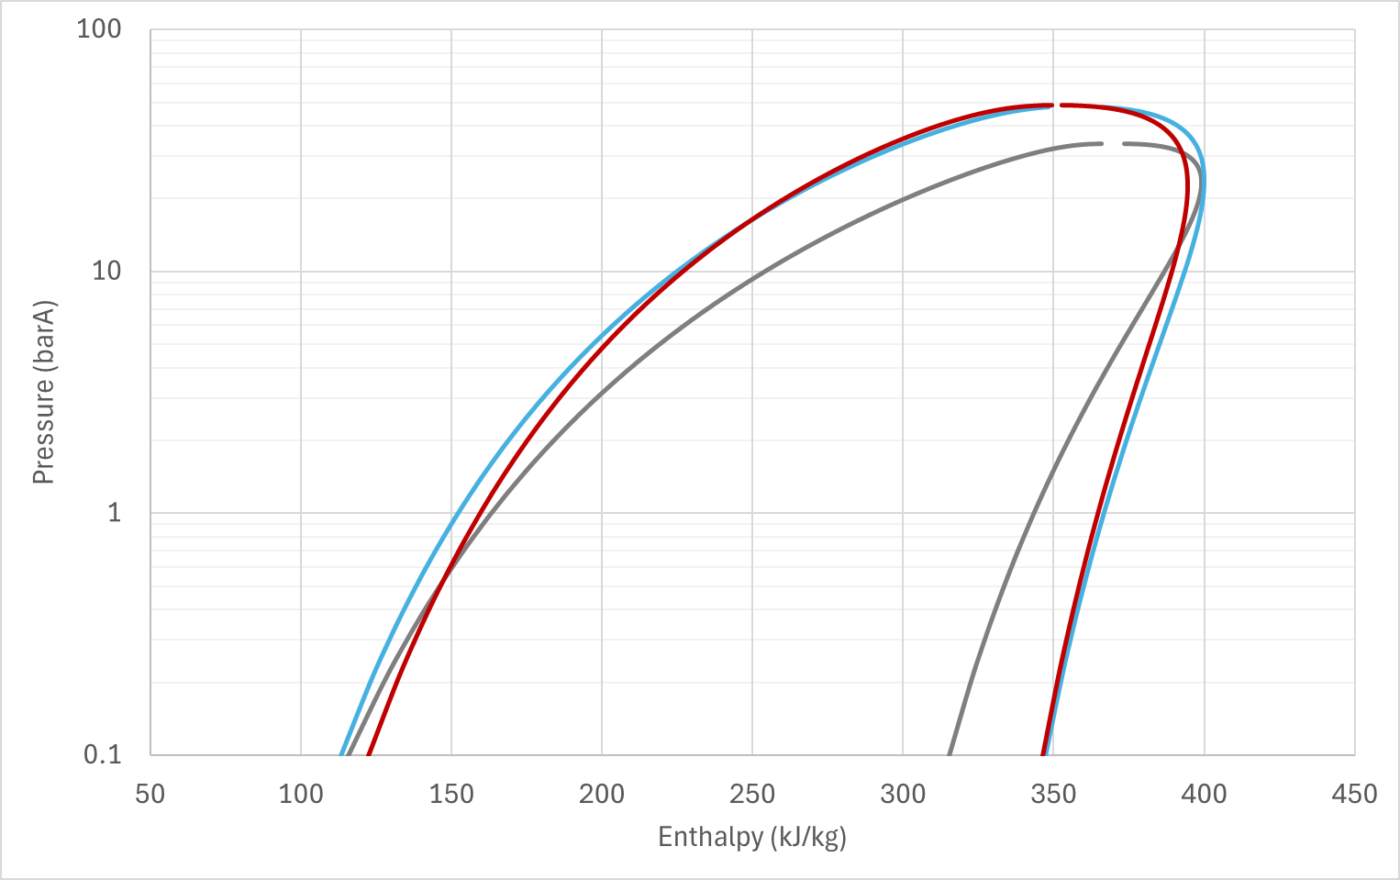
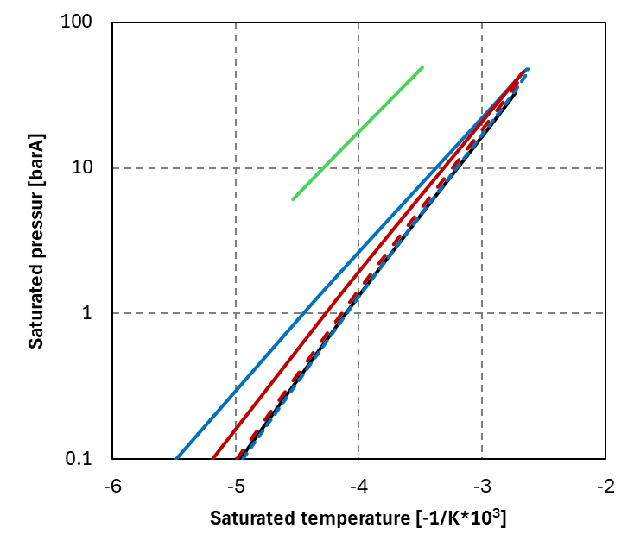
SK Refrigerants - Properties
Designed properties for System Performance Improvement
Operating range
Enthalpy properties
Saturation Curve
Temperature(℃)
R-1234yf
R-1234yf
R-494B
R-494B
120
Cooling
Cooling
R-4101A
R-4101A
80
R-744
Add R4101A
Plan to be update
40
Dew point
0
△enthalpy ↑
Bubble point
-40
Heating
-80
Heating
R-1234yf
R-494B
R-4101A
Extension of
heating operating range
Designed with similar saturation curve to R1234yf for system compatibility
Extension of enthalpy range

Slide 9
SK Refrigerants – thermodynamic performance simulation
Name | Class | GWP (AR4) | Cap Cooling | COP Cooling | Cap Heating | COP Heating | P_{disch} | Full Glide (K) | Evap. Glide (K) | Cond. Glide (K)
R-1234yf | A2L | <1 | 100% | 100% | 100% | 100% | 100% | 0.0 | 0.0 | 0.0
R-494B | A2L | 48 | 133% | 107% | 139% | 113% | 119% | 17.6 | 4.9 | 12.8
R-4101A | A2L | 113 | 139% | 108% | 150% | 113% | 120% | 7.2 | 4.2 | 6.1
Cooling: Tcd=55 ℃, Tev=-2 ℃, Subcooling:5 ℃, Superheat:10 ℃, Isentropic Eff: 70%
Heating: Tcd=65 ℃, Tev=-30 ℃, Subcooling:5 ℃, Superheat:10 ℃, Isentropic Eff: 70%
R-494B and R-4101A show superior performance compared to R-1234yf
Discharge pressure within 20% of R1234yf suggesting no change required in design of components
R494B and R4101A are expected to offer superior performance compared to R1234yf under drop-in conditions

Slide 10
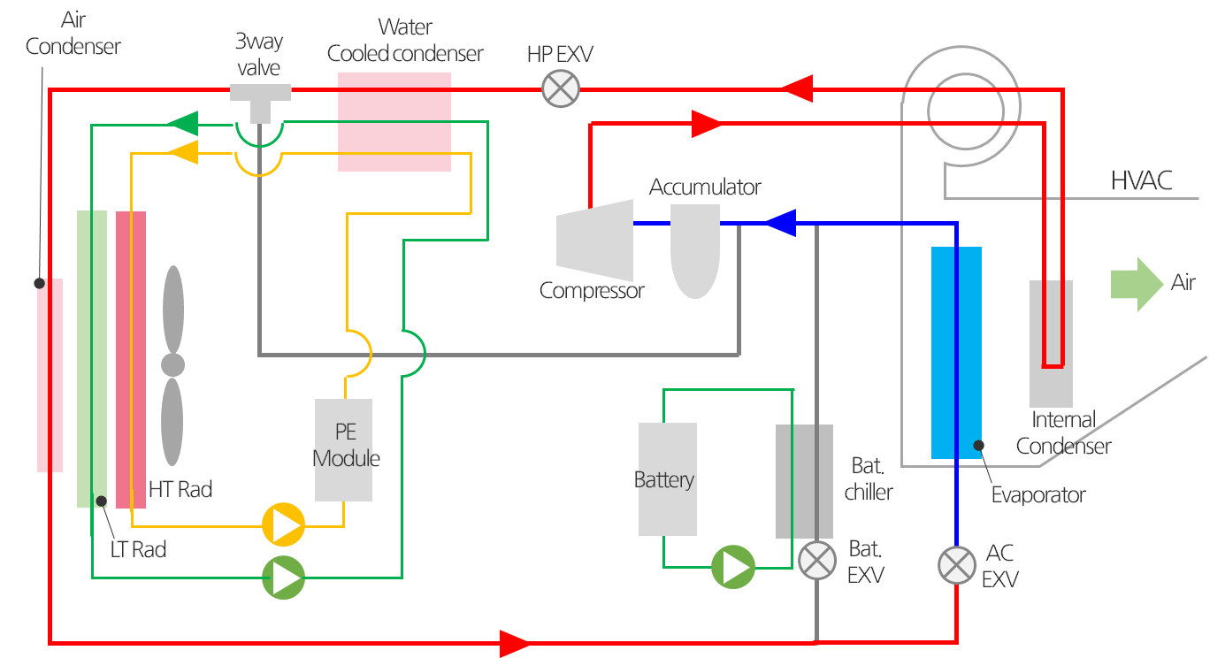
System performance test- hyundai ioniq5 model
Test equipment
Test conditions
SK internal system assessment equipment
Test specimen : Hyundai Ioniq 5 heat pump system and component.
e-Compressor : Scroll type, 45cc volume
Mode | Amb. Temp (℃) | Veh. Speed (kph) | Air flow rate (CMH)
Cooling | 45 | 50 | 530
Heating | -20 | 50 | 350
 | -7 | 50 | 350
Refrigerant | Oil | Ref. mass (g) | Oil mass (g)
R-1234yf | ENEOS POE | 1200 | 240
R-494B | SK Oil | 1420 | 190
R-4101A | SK Oil | 1450 | 200
Heat pump schematic
※ Oil mass is determined based on an OCR¹⁾ of 3-5%
1) Oil Circulation Rate : Oil content in the refrigerant/oil mixture

Slide 11
System performance test- hyundai ioniq5 model
Cooling mode
Improved cooling performance with SK refrigerants
Ambient temperature (45℃)
Same capacity
53%↑
59%↑

Slide 12
System performance test- hyundai ioniq5 model
Heating mode
Reduced heating power consumption through improved heating performance
Heating (-20℃)
Increase Comp. RPM until the low-side pressure reaches atmospheric.
1%↓
2%↓
4%↓
5%↓
Same capacity
23%↑
10%↑
41%↑
28%↑
1)
1)
1) Total PTC power consumption for target discharge temperature of 60°C

Slide 13
System performance test- hyundai ioniq5 model
Heating mode
Reduced heating power consumption through improved heating performance
Heating (-7℃)
Increase Comp. RPM to match R1234yf
3%↓
4%↓
7%↓
9%↓
Same capacity
20%↑
20%↑
17%↑
12%↑
1)
1)
1) Total PTC power consumption for target discharge temperature of 50°C

Slide 14
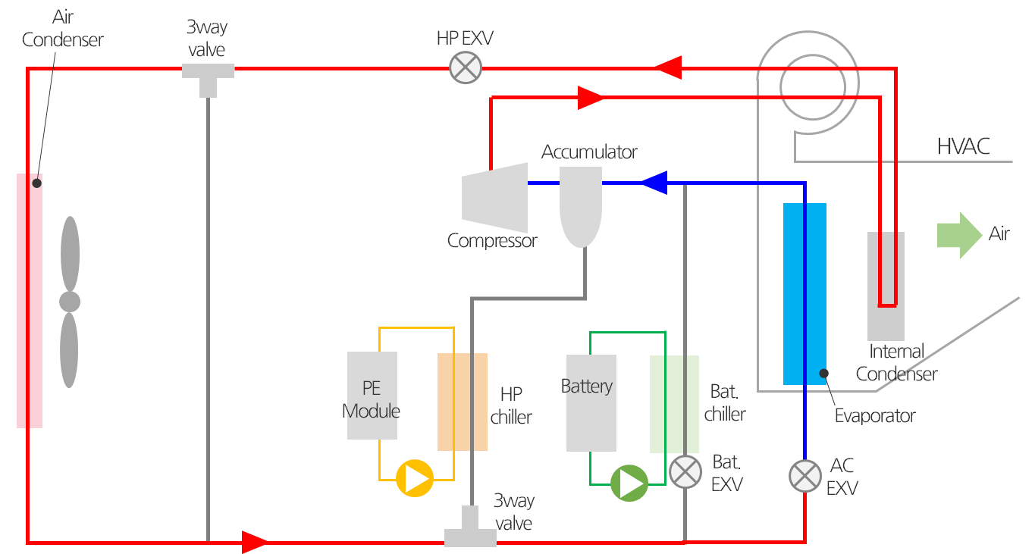
System performance test- hyundai KONA EV model
Test equipment
Test conditions
Evaluation conducted at Creative Thermal Solutions (CTS) (partner of SAE CRP)
Test specimen : Hyundai KONA heat pump system and component.
e-Compressor : Scroll type, 33cc volume
SAE J 2765 Reduced Matrix
Cooling and heating mode was conducted respectively
Refrigerant | Oil | Ref. mass(g) | Oil mass(g)
R1234yf | ENEOS POE | 1675 | 300
R-494B | SK Oil | 2095 | 325
Heat pump schematic
※ Oil mass is determined based on an OCR¹⁾ of 3-4%
1) Oil Circulation Rate : Oil content in the refrigerant/oil mixture

Slide 15
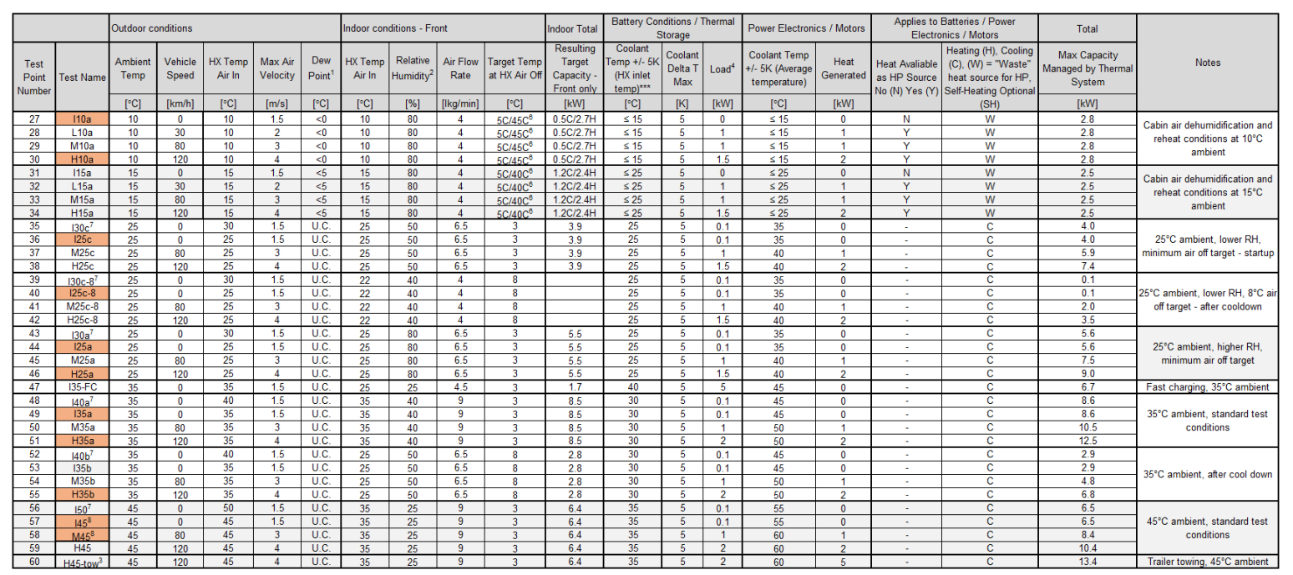
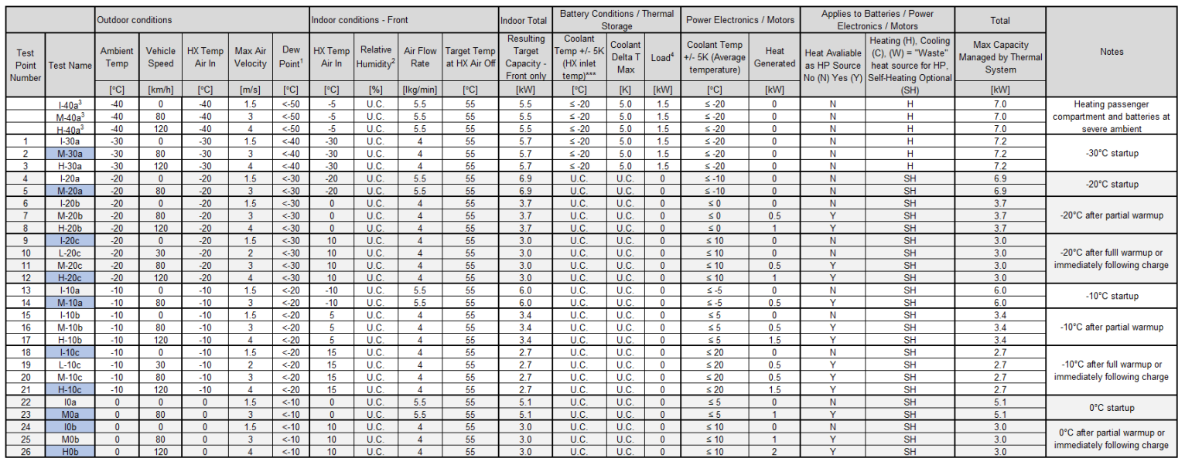
System performance test- hyundai KONA EV model
SAE Full test matrix
Cooling
Reduced test matrix
Heating

Slide 16
System performance test- hyundai KONA EV model
Reduced test matrix
Cooling (11 conditions)
Heating (9 conditions)
No. | Test Name | Outdoor |  | indoor |  |  | Bat.
 |  | Amb. Temp | Veh. speed | HX Temp Air in | RH | Target Temp. HX Air Out | Target Load
 |  | ℃ | Km/h | ℃ | % | ℃ | kW
1 | I10a | 10 | 0 | 10 | 80 | 5C/45C | 0
2 | H10a | 10 | 120 | 10 | 80 | 5C/45C | 1.5
3 | I25c | 25 | 0 | 25 | 50 | 3 | 0.1
4 | I25c-8 | 25 | 0 | 22 | 40 | 8 | 0.1
5 | I25a | 25 | 0 | 25 | 80 | 3 | 0.1
6 | H25a | 25 | 120 | 25 | 80 | 3 | 1.5
7 | I35a | 35 | 0 | 35 | 40 | 3 | 0.1
8 | H35a | 35 | 120 | 35 | 40 | 3 | 2
9 | H35b | 35 | 120 | 25 | 50 | 8 | 2
10 | I45 | 45 | 0 | 35 | 25 | 3 | 0.1
11 | M45 | 45 | 80 | 35 | 25 | 3 | 1
No. | Test Name | Outdoor |  | indoor
 |  | Amb. Temp | Veh. speed | HX Temp Air in | RH | Target Temp. HX Air Out
 |  | ℃ | Km/h | ℃ | % | ℃
1 | M-20a | -20 | 80 | -20 | - | 55
2 | I-20c | -20 | 0 | 10 | - | 55
3 | H-20c | -20 | 120 | 10 | - | 55
4 | M-10a | -10 | 80 | -10 | - | 55
5 | I-10c | 10 | 0 | 15 | - | 55
6 | H-10c | -10 | 120 | 15 | - | 55
7 | M0a | 0 | 0 | 0 | - | 55
8 | I0b | 0 | 0 | 10 | - | 55
9 | H0b | 0 | 120 | 10 | - | 55

Slide 17
System performance test- hyundai KONA EV model
Cooling test results
Improves COP at the same AC capacity as R1234yf.
COP of R494B (equivalent AC capacity to R1234yf)
Grater capacity relative to yf
Ambient increase

Slide 18
System performance test- hyundai KONA EV model
Heating test results
Achieves higher heating capacity than R1234yf in HP mode.
Reduces COP for heating at the same heating capacity as R1234yf.
COP of R494B (equivalent AC capacity to R1234yf)
Ambient increase

Slide 19
SAE CRP Process
【 SAE CRP Process】
2023
2024
1Q
2Q
3Q
4Q
2025
1Q
2Q
3Q
4Q
2026
Phase#1
Phase#2
Phase#3
Initial screening
SNAP Submission
0d Calculation
System Testing
Thermal stability
LCCP analysis
To be completed after the LCCP tool release
Risk assessment
FTA (Fault Tree Analysis)
Target date : ‘25.3Q

Slide 20
Conclusion
Regulation
Compliant with GWP and PFAS environmental regulations
Toxicity
Flammability
R-494B,R-4101A ASHRAE A2L Approval
(Not flammable in nominal composition and WCF¹⁾ condition)
SK Ref.
System compatibility
Operational compatibility confirmed in Kona EV and Ioniq 5.
Long-term compressor durability testing in progress
Performance enhancement
Increased cooling and heating performance for HP system with R1234yf.
R494B and R4101A offer low GWP and non PFAS alternatives for automotive applications

Slide 21
Conclusion – Tech. road map
Development of alternative refrigerants and oils for Vehicles
Short term
Expansion of Applications
Residential and Industrial HVAC applications
Data Centers and ESS applications
Mid term
Development of new refrigerants materials
Long term
Total refrigerants solution company

Slide 22
Contact info.
Name : JAEMIN LEE
Company : SK Innovation
Address : 325 Expo-ro, Yuseong-gu, Daejeon, South Korea 34124
Phone : +82-010-2352-2686
Email : jmin2@sk.com

Slide 23
Thank you

