Slide 1
Research on improving safety of using R290 refrigerant in future xEVs 2nd report
Kunihiko Hayashi, Yoshiaki Miyazato,
Tomoki Shimizu

Slide 2
Contents
Background and Motivation
Study scenario
Result
3-1. Garage concentration test
3-2. Cabin intake test
3-3. Behavior and effects of gas leak into cooling loop
Conclusion

Slide 3
Contents
Background and Motivation
Study scenario
Result
3-1. Garage concentration test
3-2. Cabin intake test
3-3. Behavior and effects of gas leak into cooling loop
Conclusion

Slide 4
Background and Motivation
Potential EU PFAS ban may require alternative Natural refrigerants
 | Refrigerant | EU PFAS definition | Heating |  | Cooling |  | Standard (for Auto) | Flammability | System cost
 |  |  | Performance | COP | Performance | COP
Current | R1234yf | × | 〇 | 〇 | 〇 | 〇 | 〇 | A2L | 〇
Natural Refrigerant | CO2 (R744） | 〇 | 〇+ | 〇+ | 〇 | 〇ーー | 〇 | ー | 〇ー ～×
自然冷媒 | Propane （R290） | 〇 | 〇 | 〇+ | 〇+ | 〇ー | N/A | A3 | 〇ー
This study will focus on propagation of R290 (Propane) in event of a leak.

Slide 5
System Safety Approach
Minimize Risk by controlling ignition sources, flammable mixtures, and frequency
Risk factor
SAE CRP activities
Flammable
mixture
Align with SAE CRP activities (team entropy), support SNAP applications and J-Std.
Risk
OEM/Supplier
Ignition
source
Frequency
Based on standards like ISO26262, make safety systems fail-safe.
Considering risk and safer system solutions, this study focuses on flammable mixture.

Slide 6
Contents
Background and Motivation
Study scenario
Result
3-1. Garage concentration test
3-2. Cabin intake test
3-3. Behavior and effects of gas leak into cooling loop
Conclusion

Slide 7
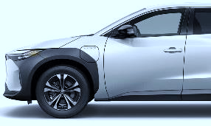
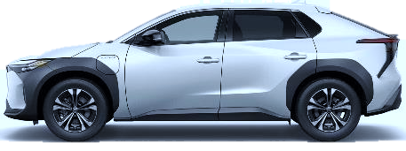
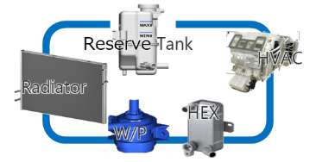
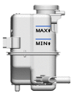
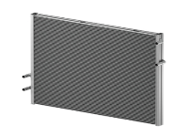
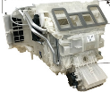
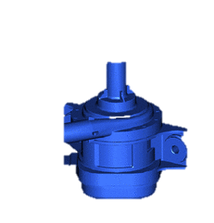
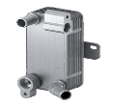
Study scenario
安全性：故障時のFHリスク
Considered: ① Vehicle outside and ②Cabin, ③Cooling loop leak scenarios
Bulkhead
◆Possible gas leak route
Under-hood
Cabin
Assumption: Parked in the small garage
Condenser
R/T
Heater core
Refrigerant cycle
Chiller #1
R/T
Cooler core
Chiller #2
R/T
battery
②Into the Passenger Cabin
①Outside of the vehicle
Reserve Tank
HVAC
Radiator
③Into the Cooling loop
HEX
W/P

Slide 8
Contents
Background and Motivation
Study scenario
Result
3-1. Garage concentration test
3-2. Cabin intake test
3-3. Behavior and effects of gas leak into cooling loop
Conclusion

Slide 9
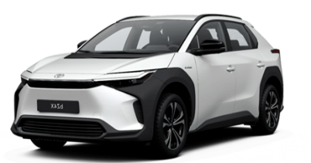
Consideration point
Verified CFD/vehicle test about leakage gas concentration in the small garage
Understanding the behavior and impact of leaked gas in the small garage
Verification of the radiator e-fan effect to mitigate concentration gas
Environmental conditions: small garage
1. Measure concentration
Concentration [Vol.％]
9.5％
Flammable
concentration
5700mm
2.1％
2. e-Fan effect
2900mm
Target area
Concentration
Leaked gas
Notes:
検討では、停車時の厳しめ環境として、米国で一般的な密閉空間である、小型ガレージを設定しております。
ガレージは横2900×高さ5700の車両1台が入る小型のもので、後方にシャッターを想定し、隙間を設定します。
検討項目はガレージ内の漏洩ガス挙動と濃度把握に加え、
漏洩時の安全基準確率に役立つよう、ラジエータファン駆動による効果を検証します。
漏洩ガス濃度としては、可変範囲下限なる、2.1%が基準となります。

Slide 10
CFD/Vehicle testing conditions
CFD and actual vehicle tests are conducted.
At the 2nd report, slow leak situation is added.
CFD | Vehicle test | Charge amount [g] | Leak Rate [g/s] | Leak Location | Radiator e-Fan
〇 | 〇 | 150 | 13.5 (Fast leak) | Center | Off
〇 | 〇 | 150 | 13.5 | Center | On(max)
〇 | 〇 | 300 | 13.5 | Center | Off
〇 | 〇 | 300 | 13.5 | Center | On(max)
〇 | 〇 | 600 | 13.5 | Center | Off
〇 | 〇 | 600 | 13.5 | Center | On(max)
〇 | 〇 | 600 | 0.034 (Slow leak) | Center | Off
〇 | 〇 | 600 | 0.034 | Center | Off
1st
report
2nd
report

Slide 11
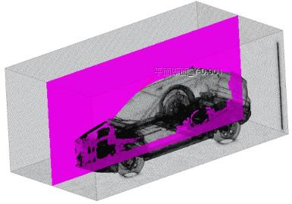
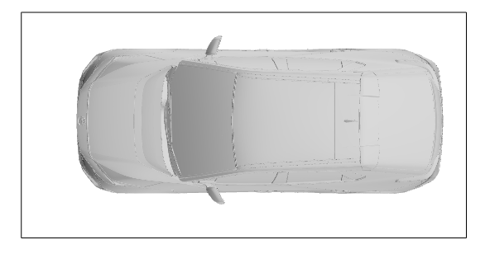
CFD condition
Verifying gas diffusion in the Garage using 3D-CFD
Garage door alternative slit
（3mm×2025mm)
Garage size: 5.7×2.9×2.5m
Verifying surface
(Vehicle center)
5.7m
0.3m
2.5m
Vehicle: bZ4X
Vehicle front
【CFD condition】 Star CCM+
Analysis method: Multicomponent gas CFD
(Transient analysis)
Analysis period：0～300 s
Initial: Air 100 %
Propane inflow: 13.51 g/s
e-fan speed：0 or max Speed
0.61m

Slide 12
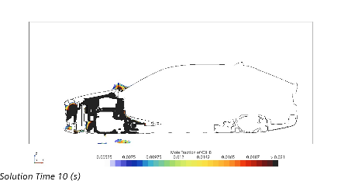
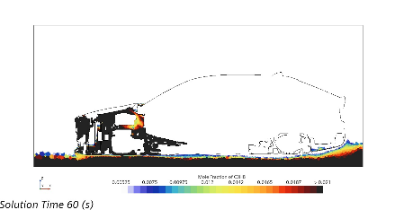
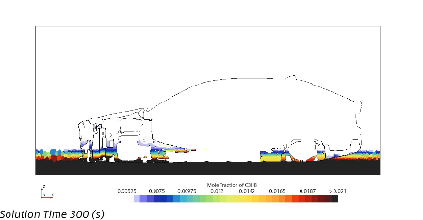
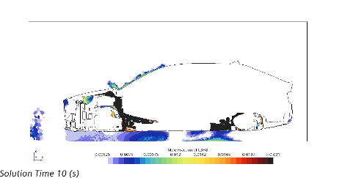
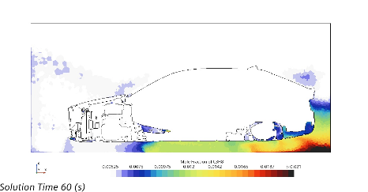
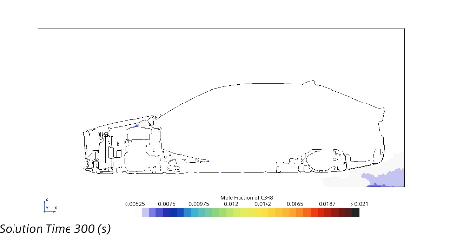
CFD Result: Gas leak comparison with/without e-Fan
With e-fan, the flammable gas is diffused, and the flammable range is reduced.
No Fan, Refrigerant: 300g
Colored: Above 1/4 LFL、 Black: Above LFL
Leakage after 10sec
60sec
300sec
with e-Fan: Max , Refrigerant: 300g
Leakage after 10sec
60sec
300sec

Slide 13
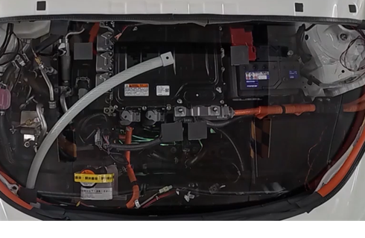
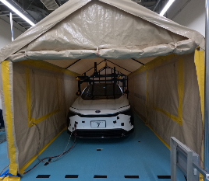
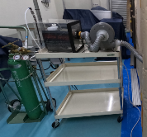
Vehicle test condition
(*) sensor making and validation conducted by SOKEN inc.
Garage leakage scenario evaluation based on SAE setting
◆Test condition
◆Camera/Sensor location
item | condition
Leak location | Above the eAxle
Test gas | CO2
Gas Direction | Upper direction
Leak amount | 150,300,600g
Leak rate | 13.5、0.034g/s
e-Fan | Off, On(max speed)
Camera
◆Gas leaked position
(Under-hood)
5700mm
Leak point
CO₂Gas supply device
2900mm
Sensor
#6
#5
#4
#3
#2
#1
Blower
CO₂
④
③
②
①
×10 Speed
bZ4X
CO2 Cylinder
(*) sensor: 100mm height from floor level
Notes:
車両設置条件を示します。
CFD同様、PCUユニット上方にガスを上向きに噴出、漏洩量は150,300,600gとし、
漏洩速度は事故相当の、非常に速い漏洩量となります。
右の動画でガス漏洩状況を透明にしたボンネットで示します。
ガスはボンネットに当り、下方に流れます。
この挙動を、車両中心に設置した濃度センサと、側面に設置したカメラで確認します。
About gas leakage to outside, we had conducted garage concentration test.
This is the test condition.
We used a tent as garage for this verification.
Space size is same as CFD.
For this verification, CO2 gas is used because of safety.

Slide 14
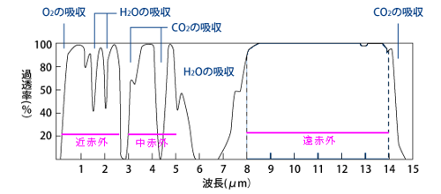
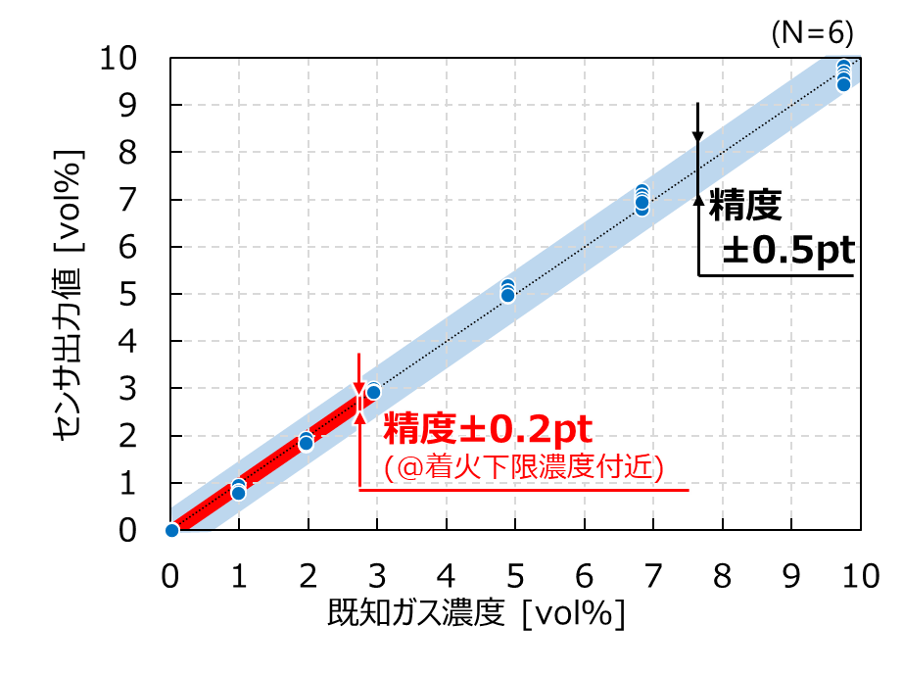
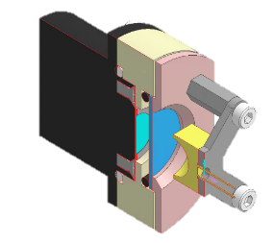
Concentration sensor
(*) sensor making and validation conducted by SOKEN inc.
・Use of CO2 as an alternative gas
・Building a gas concentration sensor to understand gas behavior
◆Gas concentration sensor: NDIR
Detection accuracy: ±0.5pt
(Non-Dispersive InfraRed)
Gas concentration detection using infrared absorption method
中赤外 LED
Photo Sensor
Mid-infrared LED
Accuracy:
ガス濃度に応じて減衰
H46
赤外線
D34
Sensor output
CO2
W56
Accuracy: ±0.2pt
(@LFL)
CO2 波長のみ限定
Band Pass Filter
4300ー200nm
BPフィルタ
Gas flow
Known Gas Concentration[vol%]
CO2波長の吸収量違いを
測定⇒濃度算出
受光部
(フォトセンサ)
Notes:
実車評価では、冷媒ガス挙動の可視化に加え、冷媒ガス濃度の計測が必要になります。
計測機器はSOKEN様開発のシステムを活用しております。
左に示す可視化装置では、代替ガスとなるCO2ガスにスモーク発生器トレーサを混ぜる装置を使用しました。
トレーサはプロピレングリコールを活用し、ストークス数を基準に、ラジエータファン作動範囲で流れに追従できることを確認しております。
右に示すガス濃度測定では、赤外線吸収法を活用したセンサを新たに開発いただき、
検出精度としては、想定する上限の最大10%濃度までで±0.5pt、着火下限の2%付近では0.2ptの精度を確立いただいております。
For the concentration testing, we used NDIR sensor made by SOKEN.
Using mid-infrared LED and Band Pass Filter limited to only CO2 wavelength, the light receiving section can measure the difference in CO2 wavelength absorption.
About this sensor, max measurement variation is less than 0.5% concentration.

Slide 15
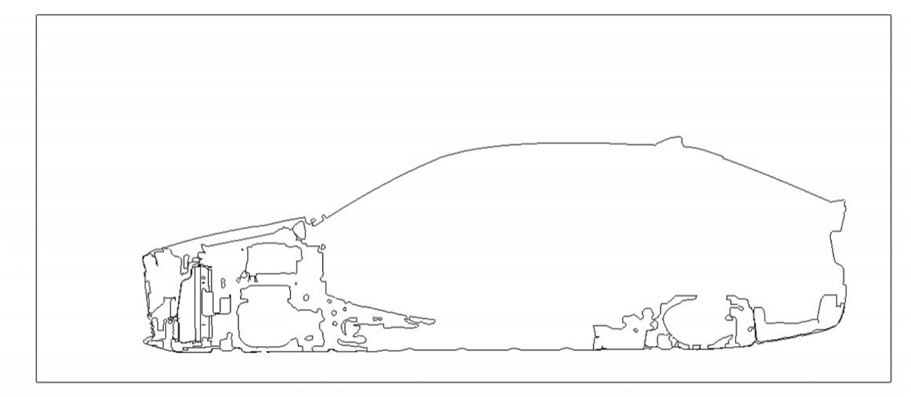
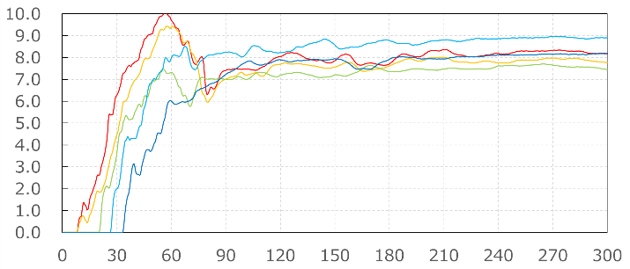
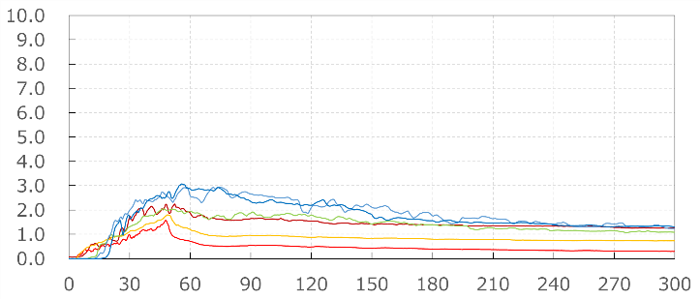
Result: Gas leakage in the Garage (with/without e-Fan)
With e-fan, 600g flammable gas is diffused to below LFL at 300sec.
Gas concentration (under the Vehicle, 100mm Hight)
Gas amount: 600g, No Fan
Gas amount: 600g, Fan ON
Fan ON (entire time)
Stop
Stop
Rear
Vehicle front
Leak
Leak
Sensor
⑥
⑤
④
③
②
100mm
①
Concentration[Vol%]
Concentration[Vol%]
LFL
LFL
Time[s]
Time[s]
Above LFL after leak.
Rear sensor measure above LFL after 30sec, then diffused to below LFL at 300sec.

Slide 16
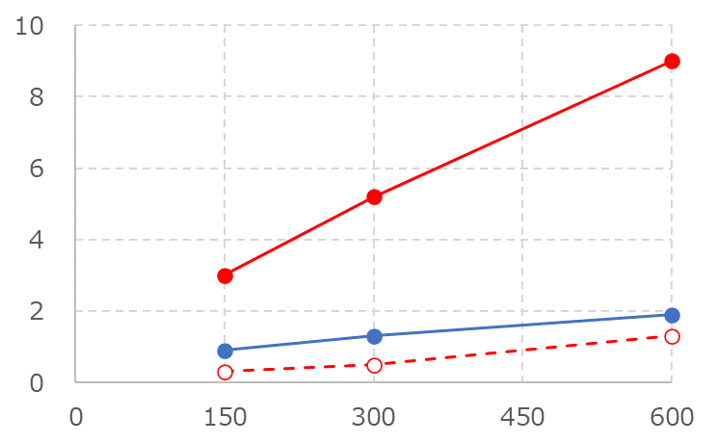
Charge amount vs. Concentration (Vehicle test)
With fan ON and less than 600g charge, Concentration is below LFL at leak 300s
At slow leak condition, until 600g do not exceed LFL limit with no fan
【Leak speed】
Fast leak: 15.3g/s
Slow leak: 0.034g/s
Fast Leak : Leak After 300sec
Slow Leak : Leak stop timing
Height = 100mm
(*)Highest concentration point
Fast
No fan
No Fan(Fast leak)
Leak
speed
effect
e-Fan
effect
Concentration[Vol%]
LFL
Slow
No Fan(Slow leak)
fan ON
Fan ON(Fast leak)
Charge Amount[g]

Slide 17
Contents
Background and Motivation
Study scenario
Result
3-1. Garage concentration test
3-2. Cabin intake test
3-3. Behavior and effects of gas leak into cooling loop
Conclusion

Slide 18
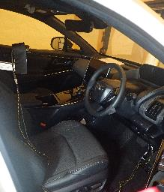
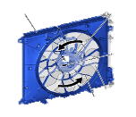
Vehicle test condition (Cabin intake test)
Verified Cabin intake after gas leakage in under-hood
 | Condition
Leak location | Above the eAxle
Test gas | CO2
Sensor | NDIR
Gas Direction | Upper direction
HVAC | Fresh/Recirc,(Blower ON)
Vehicle: Toyota bZ4X
Garage size: 5.7×2.9×2.5m
NDIR sensor
Photo Sensor
Mid-infrared LED
Passenger
Cabin
Leaked gas
Fresh
Sensor Location
HVAC
Band Pass Filter
Gas flow
Radiator
e-Fan
Recirculation
(*) made by SOKEN inc.
Concentration [Vol.％]
9.5％
① Face
Flammable
concentration
2.1％
② Foot
Target area
Concentration
measurement
Notes:
検討では、停車時の厳しめ環境として、米国で一般的な密閉空間である、小型ガレージを設定しております。
ガレージは横2900×高さ5700の車両1台が入る小型のもので、後方にシャッターを想定し、隙間を設定します。
検討項目はガレージ内の漏洩ガス挙動と濃度把握に加え、
漏洩時の安全基準確率に役立つよう、ラジエータファン駆動による効果を検証します。
漏洩ガス濃度としては、可変範囲下限なる、2.1%が基準となります。

Slide 19
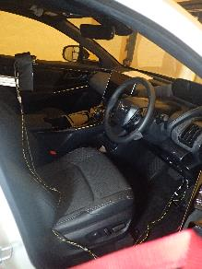
Vehicle testing conditions
Understanding gas intake to cabin at under-hood leak situation
Sensor Location
 | Charge amount [g] | Leak Rate [g/s] | Leak Location | Radiator e-Fan | HVAC
 |  |  |  |  | Mode | Direction | Blower
1 | 150 | 13.5(Fast) | Center | Off | Fresh | Foot | High
2 | 150 | 13.5 | Center | On(max) | Fresh | Foot | High
3 | 300 | 13.5 | Center | Off | Fresh | Foot | High
4 | 300 | 13.5 | Center | On(max) | Fresh | Foot | High
5 | 600 | 13.5 | Center | Off | Fresh | Foot | High
6 | 600 | 13.5 | Center | On(max) | Fresh | Foot | High
7 | 600 | 13.5 | Center | Off | Recirc | Foot | High
8 | 600 | 13.5 | Center | On(max) | Recirc | Foot | High
9 | 600 | 0.034(Slow) | Center | Off | Fresh | Foot | High
10 | 600 | 0.034 | Center | On(max) | Fresh | Foot | High
11 | 600 | 0.034 | Center | On(max) | Recirc | Foot | High
① Face
② Foot
(*)Test gas: CO2
NDIR sensor
Photo Sensor
Mid-infrared LED
Gas and smoke
Delivery system
Test Vehicle
(bZ4X)
Band Pass Filter
Gas flow
(*) made by SOKEN inc.

Slide 20
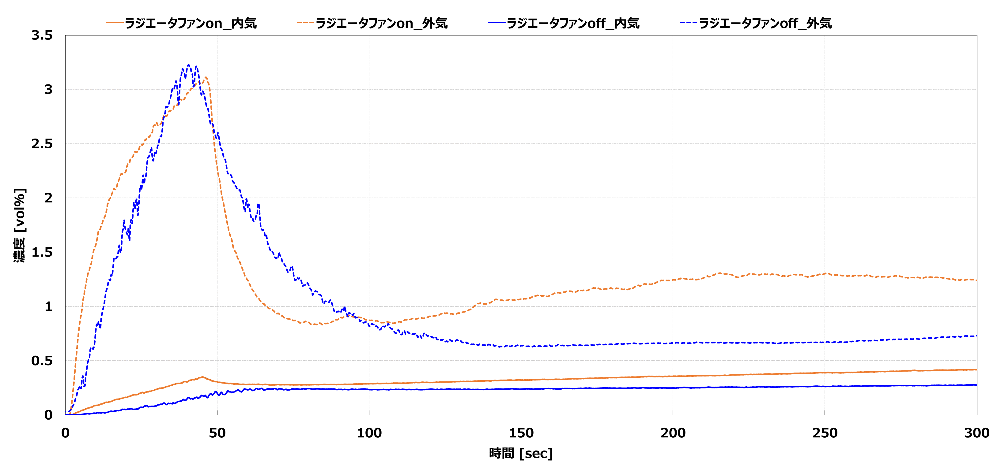
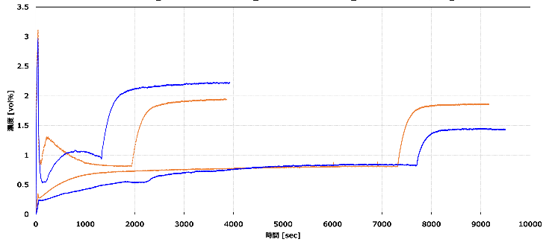
① Comparison : Fresh/Recirc , and Fan On/Off (Fast Leak)
・Fresh: Peak is above LFL at 600g leak. Fan Off increase higher concentration after Blower Off.
・Recirc: Peak is below LFL at same leak. After stopping HVAC blower, Fan On is higher than Off.
600g, Foot sensor
～300sec
Overall
Fan On(Fresh)
Fan Off(Fresh)
LFL
Fan Off(Fresh)
LFL
Blower
Stopped
Concentration[vol%]
Concentration[vol%]
Fan On(Fresh)
Blower
Stopped
Fan On(Recirc)
Fan Off(Recirc)
Fan On(Recirc)
Fan Off(Recirc)
Time[sec]
300
10000
Time[sec]

Slide 21
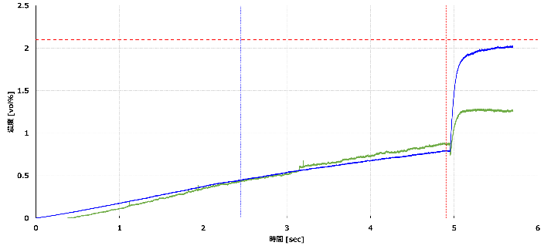
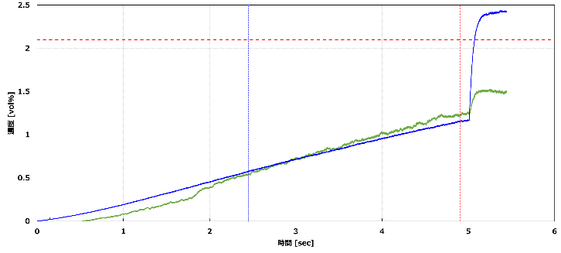
② Comparison : Fresh/Recirc (Slow Leak, Fan On)
At up to 600g leak, Recirc mode can prevent from above LFL, even if after Blower stopping
600g, 0.034g/s(Slow Leak)
Recirc
Fresh
300g
600g
300g
600g
LFL
LFL
foot
foot
face
Concentration[vol%]
Concentration[vol%]
face
Blower
Stopped
Blower
Stopped
Time[Hr]
Time[Hr]

Slide 22
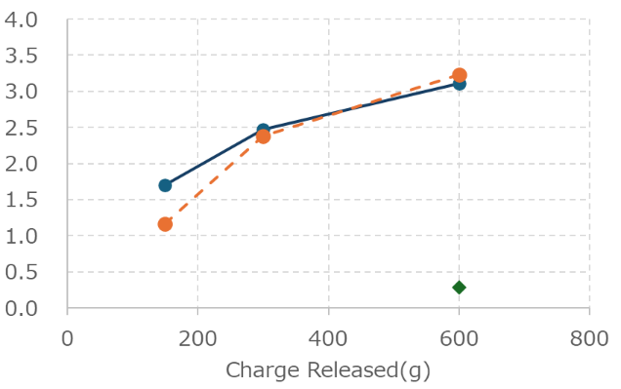
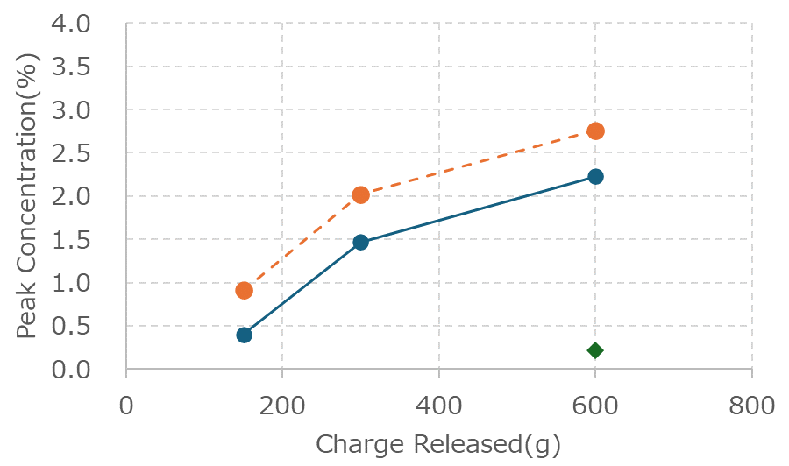
Charge vs. concentration in the Cabin
・More then 150g fast leak with Fresh mode, Concentration Peak around floor level is above LFL.
・Recirc mode prevent above LFL.
・Increased Concentration after blower stopped is needed to take care.
Foot sensor
Face sensor
(Fresh)
(Fresh)
Fan On
Peak Concentration[vol%]
LFL
Peak Concentration[vol%]
Fan Off
LFL
Blower stopped
Fan Off
Fan On
(Recirc)
Fan On
Blower stopped
Fan On
(Recirc)
Fan On
(Recirc)
～300s
Fan On
～300s

Slide 23
Contents
Background and Motivation
Study scenario
Result
3-1. Garage concentration test
3-2. Cabin intake test
3-3. Behavior and effects of gas leak into cooling loop
Conclusion

Slide 24
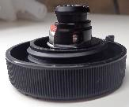
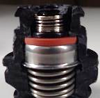
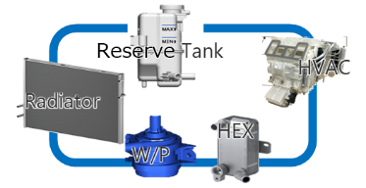
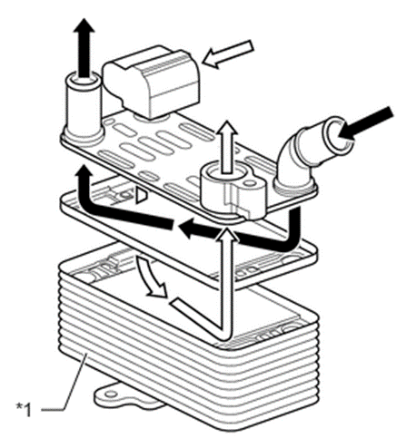
Gas leakage into cooling loop
Consideration point: Verifying hose burst or destruction, frozen because of the leak
Cooling Loop
Leak amount
Assumption:
Relief valve prevent over pressure
Hose burst
Relief valve structure
Spring
Plate type heat exchanger does not usually occur large leak into coolant side
Reserve tank cap
（image）
Valve Seal
Corrosion pinhole
High probability case
Worst
Case
Relief Valve
Gas flow
Liquid Phase
Refrigerant ratio
Refrigerant
Gases Phase
Refrigerant Leak
Liquid Phase
refrigerant Leak
Coolant
Coolant
Coolant
too much refrigerant leak could affect frozen because of the latent heat
Refrigerant
Refrigerant
Gases Phase
Gases Phase
Liquid Phase
Liquid Phase
This study
(Future work)

Slide 25
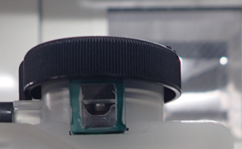
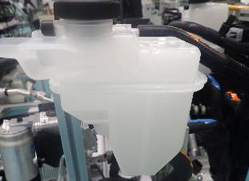
Gas leakage into cooling loop
Based on visualization of relief valve, vilifying whether frozen would be happen or not.
Visualization of Relief valve
Initial(0kPa)
Valve lift(108kPa)
 |  | Condition
Environment | Initial temperature | -30,-20,-10,0,20,40
Coolant | Concentration ratio | Ethylene Glycol/Water 50％
 | Flow rate | 5L/min
Relief valve
13pixel
1mm
Added
Window
Cap
Valve seal
Coolant loop and visualization point
Relief valve
Reserve tank
Camera
Cite glass
Heater
core
Reserve tank
Camera
Flow mater
W/P
HEX
Pressure
sensor
Refrigerant
leak

Slide 26
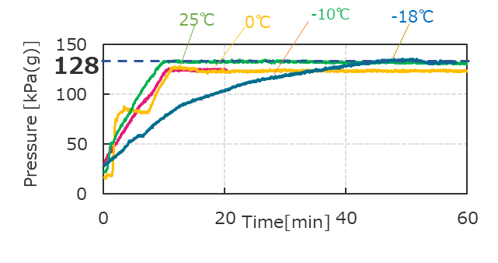
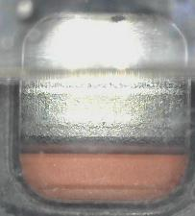
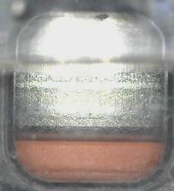
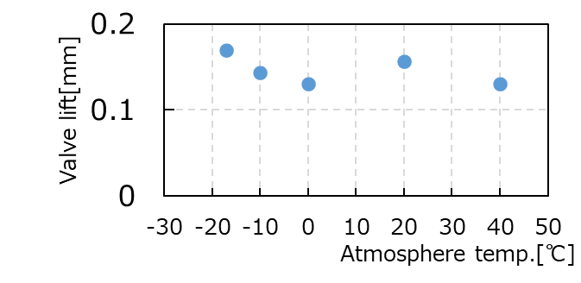
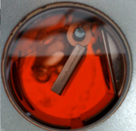
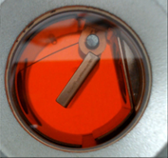
Result: Gas leakage into cooling loop
At gases phase leak situation, relief valve frozen, hose burst and disruption do not occur
①Pressure
No abnormal rise, normal operation
②Valve lift (-18℃)
+10kPa
-10℃
During relief(108kPa)
Initial(0kPa)
5mm
0.17mm
Atmosphere/Refrigerant/Coolant temp. vs. valve lift
Visualization of Cite glass
0℃
-18℃
Reserve tank
Heater core
No frozen
Cite glass
W/P
HEX
Pressure sensor
Low temp.
Refrigerant
leak
High leak
Extremely
Small amount

Slide 27
Contents
Background and Motivation
Study scenario
Result
3-1. Garage concentration test
3-2. Cabin intake test
3-3. Behavior and effects of gas leak into cooling loop
Conclusion

Slide 28
Conclusion
(1) Garage concentration test
・With fan on and less than 600g charge, Concentration is below LFL at fast leakage.
・Concentration is below LFL at slow leakage condition without fan.
(2) Cabin intake test
・Recirculation mode prevent from higher intake of leakage gas from under-hood.
・Concentration increased after blower turning off.
(3) Bench test of gas leakage into cooling loop
・There was no frozen situation based on gases phase refrigerant leak into cooling loop.
・The cooling loop relief valve prevents potential hose disconnections or bursts from gas leaks under test conditions.

Slide 29
Contact Info
Thank you!
Name : Kunihiko Hayashi
Company : TOYOTA MOTOR CORPORATION
Address : Mishuku 1200, Susono-shi, Shizuoka-ken
Phone : (+81)50-3166-9408
Email : kunihiko_hayashi@mail.toyota.co.jp

