Slide 1

Development of a Digital Twin of aN R-1234yf Heat Pump for the Evaluation of New Refrigerants
  Dr David Bridge, HORIBA-MIRA Ltd.
  Dhananjay Deshmukh, HORIBA-MIRA Ltd.
  Jack Cheung, HORIBA-MIRA Ltd.
  Christian Macri, Daikin Chemical Europe GmbH

Slide 2
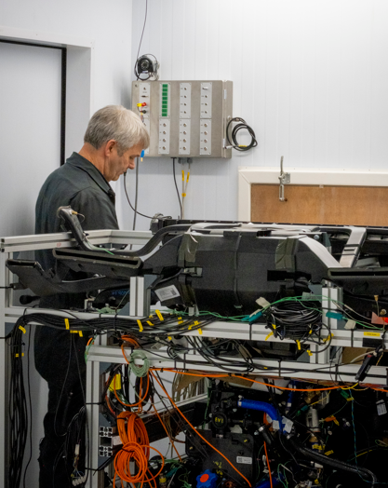
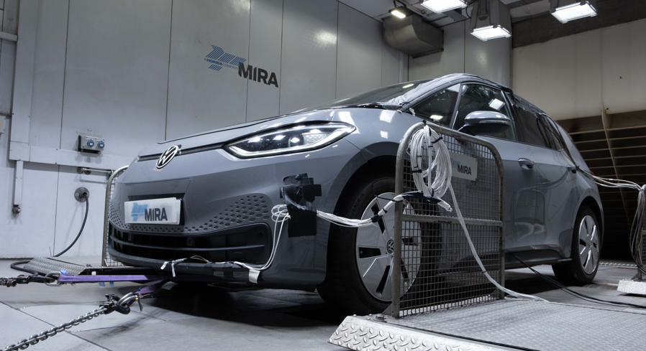
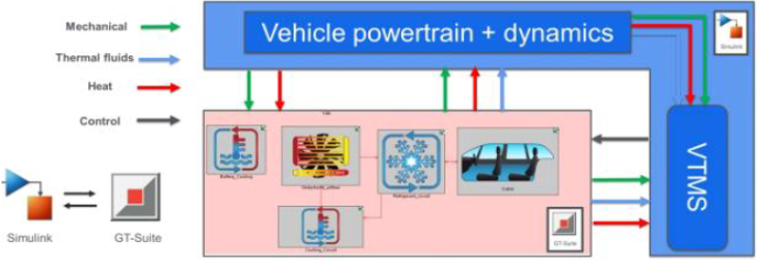
Presentation
Overview
Content
    Context
    Why do we need a digital twin?
    Component verification
    Base system verification
    Implementation to ID3 virtual platform
    Controls development
      Compressor
      EXVs
      Air handling
      Coolant circuit
    Vehicle validation

Slide 3
Context
    Current automotive refrigerants
    have some advantages, but also limitations
    R-1234yf
      Expensive
      Low temperature performance
    R-744
      High operating pressures
      High temperature performance
    Advent of heat pump systems in BEV’s points to the need of alternative refrigerants that compete in terms of capacity and CoP but have a broader operating window
?
?
Notes:
1234yf fine for ICE applications, as heating was provided from the engine. In BEV there is greater reliance on PTC heating at lower temperatures
CO2 requires a complete carve up of the hardware and struggles at the very top end of the vehicle operating range

Slide 4
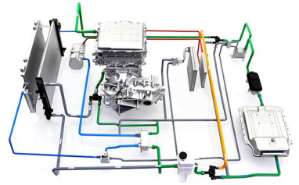
Context
Content
    SAE TMR setup to provide an industry forum where refrigerant companies could develop new alternatives in the context of automotive expectations and requirements
    Hyundai Kona R-1234yf heat pump system chosen as the ‘standard’ system
      System parameters ‘baselined’ for R-1234yf
      Used to compare against alternative refrigerants

Slide 5
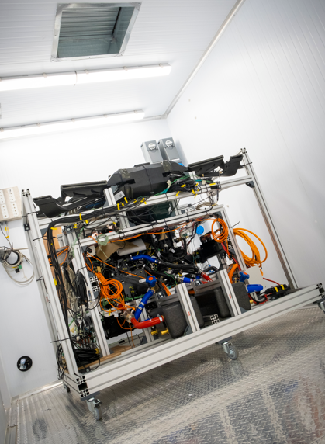
Context
Benefits of bench testing
    System performance determined for a wide range of representative boundary conditions & temps
    Instrumentation easily added and accessible
      OCR
      Refrigerant mass flow meters
    Capacity determined on the refrigerant and airsides
    Same hardware and test conditions for everyone
    Reliance on PTC at low temps can be quantized
    Determines the theoretical not actual performance
    With a standardised approach, little opportunities for development (hardware)
    Steady state

Slide 6
Development of a Digital Twin
Why?
    Baseline twin model can be calibrated against test data
      Replica of bench set-up for heat pump system
      Confidence in model
    Changes to control can be easily implemented
    Changes to hardware can be easily implemented
    System can then be integrated into a virtual vehicle platform
      ‘Real world’ performance
        Capacity and CoP over a wide range of ambient temperatures
        Impact on range
        Standard and actual drive cycles
Theoretical
performance
Actual
performance

Slide 7
Development of a Digital Twin – System Level
General approach
    Component modelling
      Build of individual components from physical measurement
        Plus engineering judgment!
      Refinement & calibration of individual components against test data
    System model
      How is the refrigerant system put-together
      Coolant system simplified as inlet flow conditions (chillers, LTR)
    Controller Integration
      Expansion valves
      Compressor response
    Operational modes
Notes:
Coolant system not modelled as it is not required when comparing against bench data, just inlet temperature and flow rate is needed

Slide 8
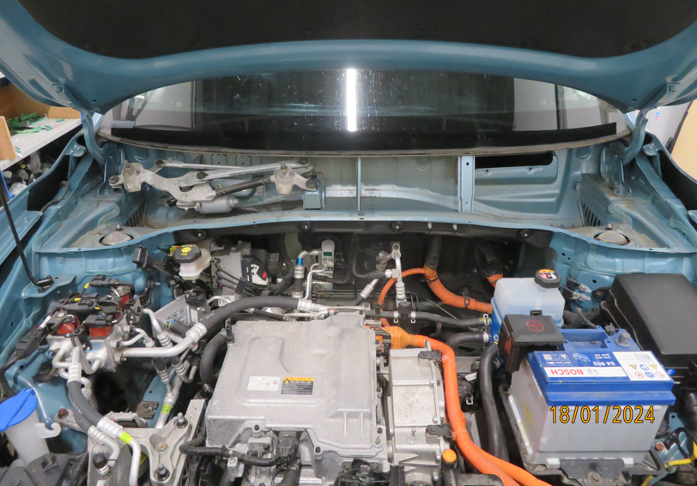
Presentation
Development of the System Level Digital Twin
Individual Components
    Physical dimensions (of what we can see)
      E.g. pipe lengths and diameters
      E.g. heat exchanger sizes, number of tubes etc
      Unknown parameters (what we can’t see or don’t know) ‘refined’ based on the bench test results
      Final result is a plot of model output versus test data at same condition
    Examples for evaporator and battery chiller

Slide 9
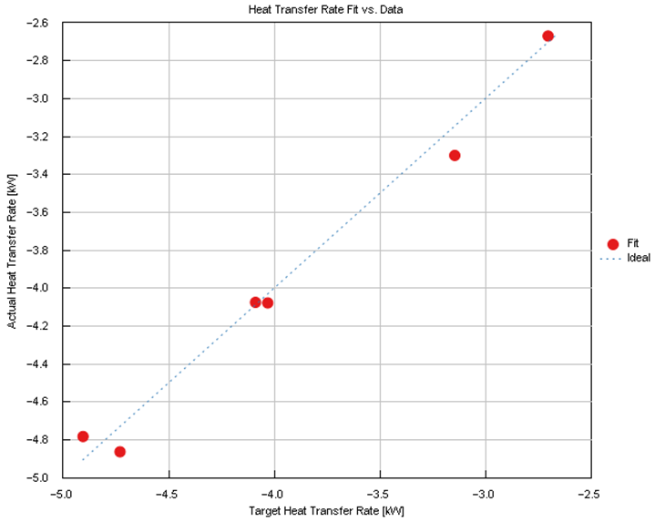
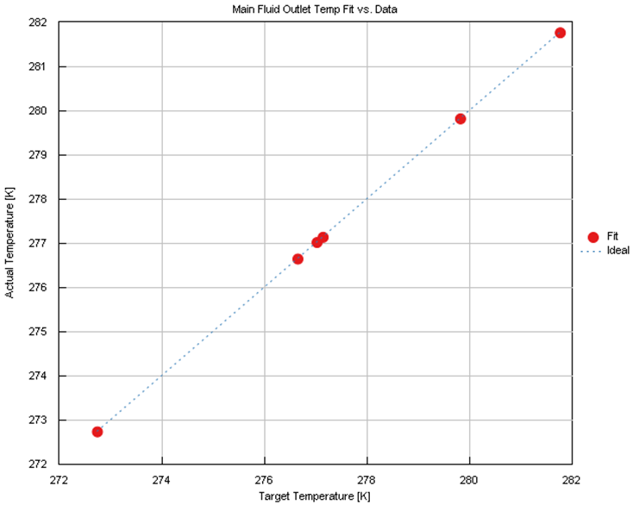
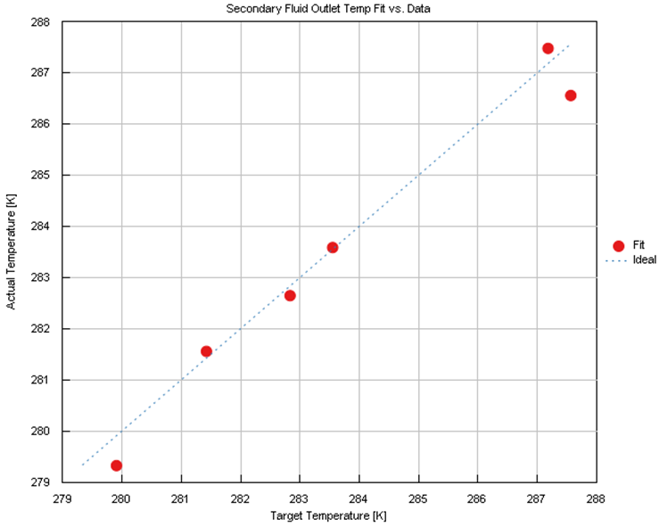
Development of the System Level Digital Twin
Evaporator Results
Refrigerant Outlet
Temperature:
Model vs Bench Test
Heat Transfer Rate:
Model vs Bench Test
Air Outlet Temperature:
Model vs Bench Test

Slide 10
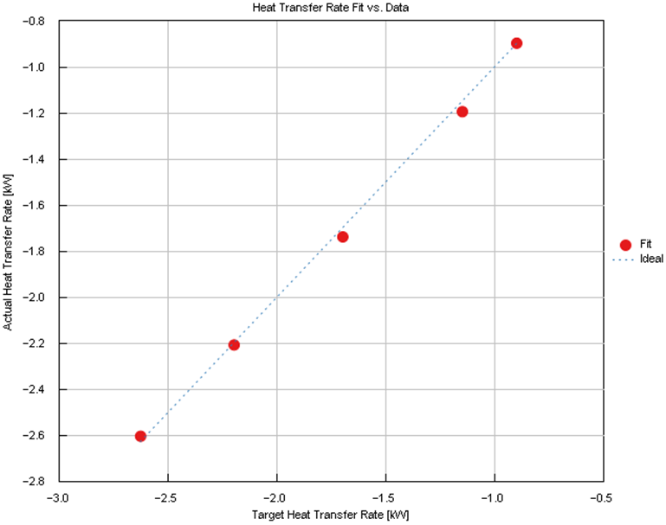
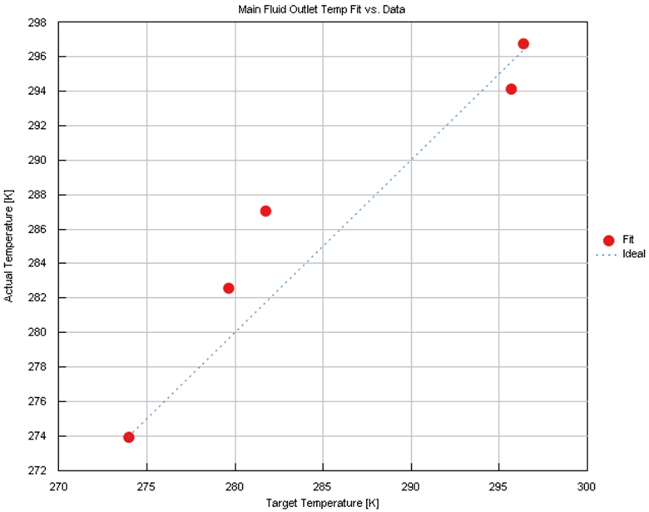
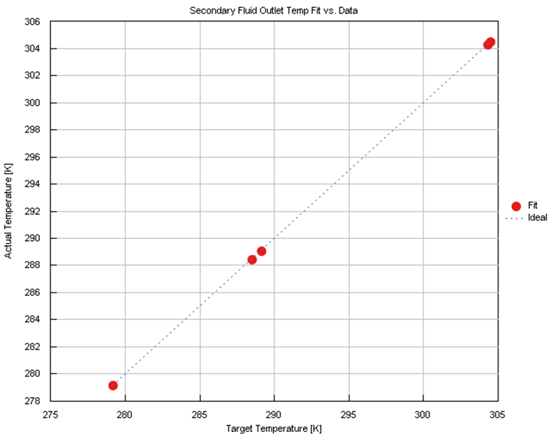
Development of the System Level Digital Twin
(Battery) Chiller Results
Refrigerant Outlet
Temperature:
Model vs Bench Test
Coolant Outlet
Temperature:
Model vs Bench Test
Heat Transfer Rate:
Model vs Bench Test

Slide 11
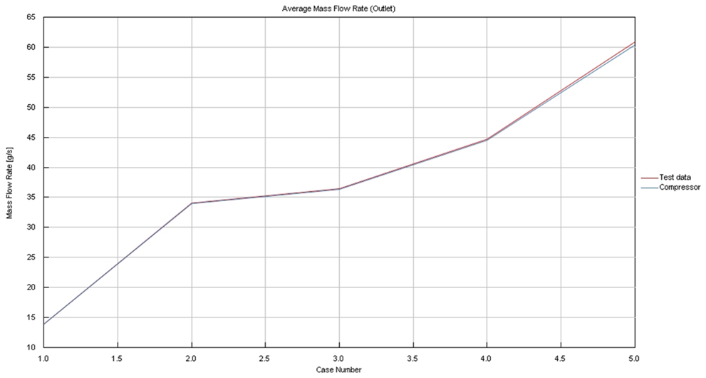
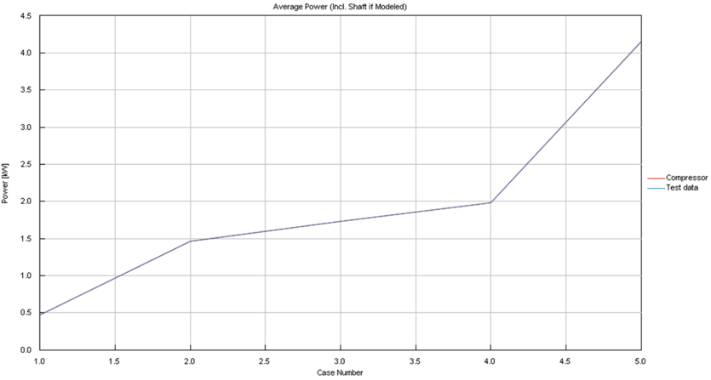
Development of the System Level Digital Twin
Compressor Results
    Compressor requires special consideration due to it’s complexity
    Model reverse engineered from a wide range of test data
      Speed, mass flow and shaft power
      Suction & discharge pressures and temperatures
Average Mass Flows – Model vs Test
Average Power– Model vs Test

Slide 12
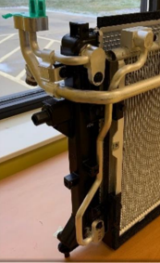
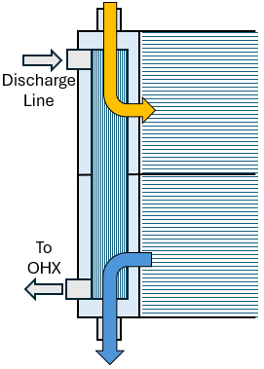
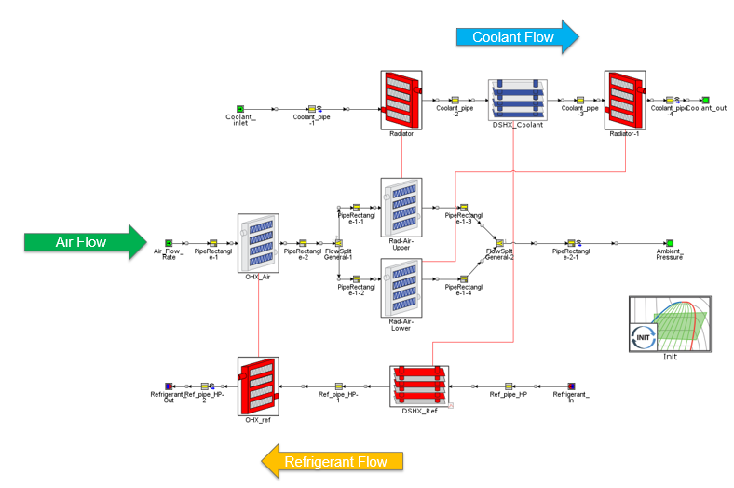
Development of the System Level Digital Twin
LTR De-Superheater (DSH)
    LTR modelled in two parts
      Upper section and lower section
      In parallel on the airside and in series for the coolant side
    DSH modelled as a plate heat exchanger sitting in the end tank
      Size determined iteratively
        L x W x H
        Number of plates
        Impacts Q and component ΔP
Notes:
Two components were particularly tricky:
The De-supeheater inside the LTR end-tank – unknown geometry & partial lack of data
The IHX due to lack of specific test data

Slide 13
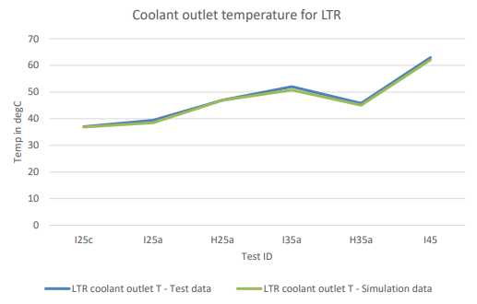
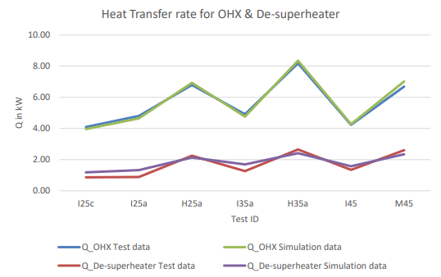
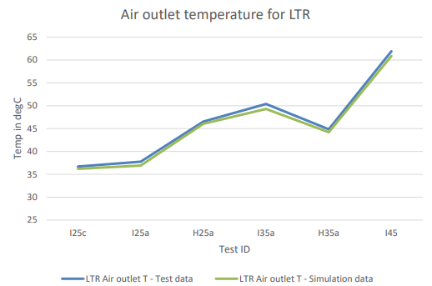
Development of the System Level Digital Twin
LTR De-Superheater (DSH)

Slide 14
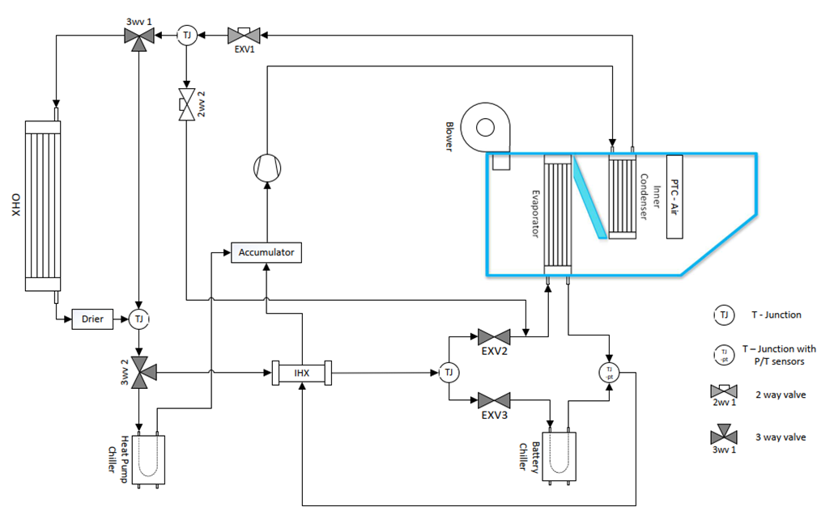
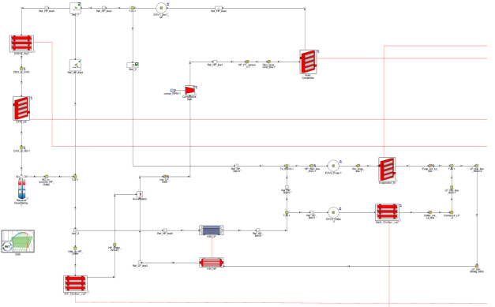
Development of the System Level Digital Twin
Final System
Refrigerant System Schematic
Refrigerant Equivalent in GT-Suite
Airside
P/T
Emulation
Battery
Emulation
Notes:
Components were then compiled into a refrigerant circuit based on the schematic

Slide 15
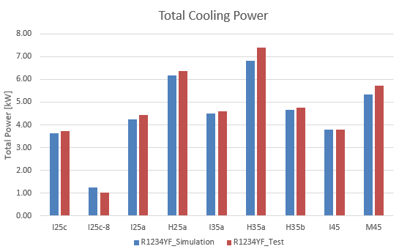
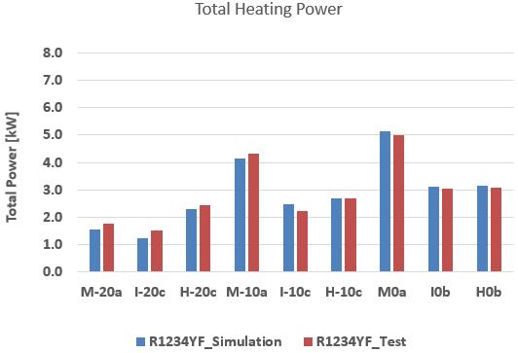
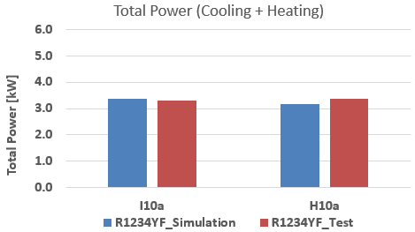
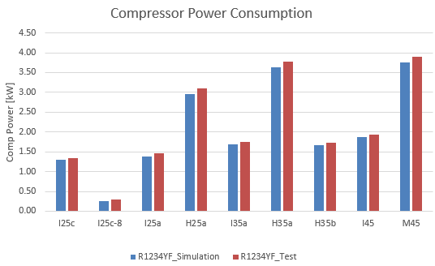
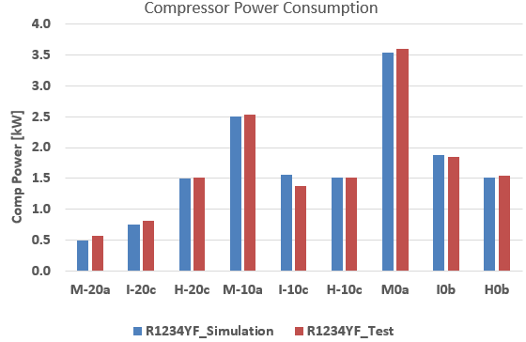
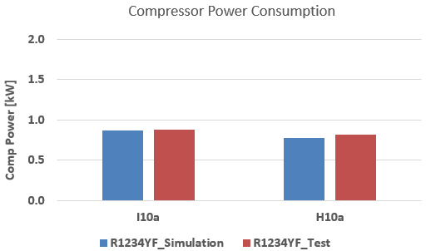
Development of the System Level Digital Twin
System Level Calibration Results
Cooling Modes
De-Humidification Modes
Heating Modes
Notes:
We also plotted out CoP and Air Off temperatures

Slide 16
Development of the Vehicle Level Digital Twin
MIRA ID3 Model
Content
    To accurately compare real world impact of refrigerants, the VTMS model needs to sit within a representative vehicle model
    The digital twin plant model models all relevant vehicle components, including the motor, transmission, battery and additional auxiliary loads
      Battery characteristics including internal resistance (as a function of SoC and temperature), voltage change under load and thermal parameters are all modelled
      The electric motor model includes efficiency losses and inertia
      The vehicle model takes the powertrain torque and models the longitudinal characteristics of the vehicle. This includes wheel and tyre models which simulate slip

Slide 17
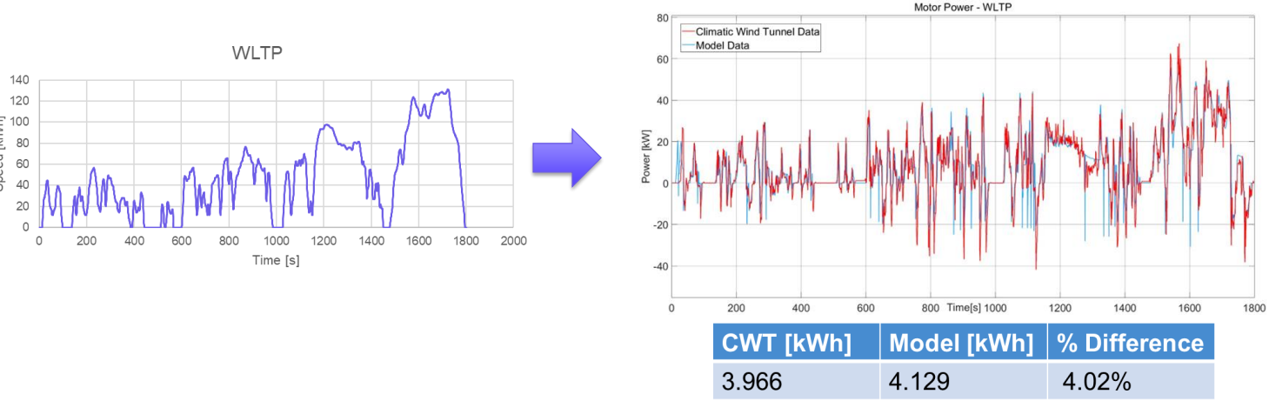

Development of the Vehicle Level Digital Twin
MIRA ID3 Model - Validation
Focus Area

Slide 18
Development of the Vehicle Level Digital Twin
Context
    Customer wanted to compare vehicle metrics for heat pumps with R-744 (VW) & R-1234yf or their blend (Kona) for the same vehicle platform
    Common control philosophy with common controls for the Kona system (where appropriate)
    Control implementation gives realistic performance outputs
      Time to develop versus realism
      We are comparing refrigerant performance, not developing an OEM vehicle
    Change to ID3 coolant circuit (see next slide)

Slide 19
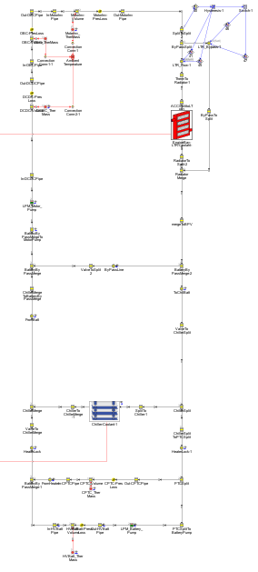
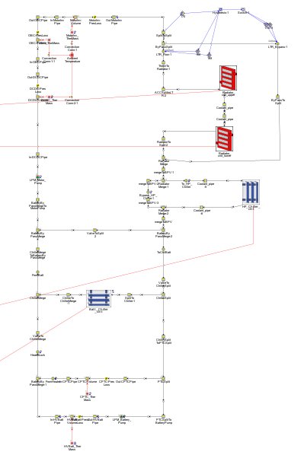
Development of the Vehicle Level Digital Twin
Cooling System Adaptation (Kona Variant)
    In the VW ID.3, the coolant circuit battery chiller can also be used as Heat Pump Chiller
    For the Kona system two different components are used for the battery and Heat Pump chillers

Slide 20
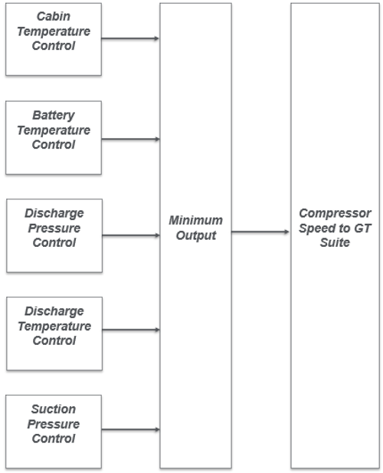
Development of the Vehicle Level Digital Twin
Controls Development – Focus Areas
    Compressor Control
      Cabin air temperature feedback to effect evaporator (cooling) and inner condenser (heating) ‘air-off’ response
      Battery chiller feedback to effect coolant inlet temperature
      Cabin and battery control/priorities at higher ambients & loads
      Maximum discharge pressure and temperature limits observed
      Minimum suction pressure (heat pump mode)
      Compressor shut off (hysteresis) around cabin temperature target set-point

Slide 21
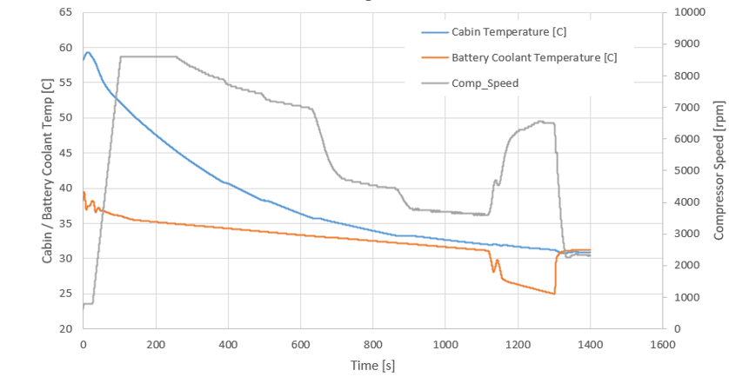
Development of the Vehicle Level Digital Twin
Compressor Speed Control Example
    Cabin and battery both hot
    Cabin has priority and cools quickly, with minimal bleed to battery
    At 32C full battery cooling activated
    Compressor speed increases to compensate for increased demand
    Compressor speed drops as final demand decreases
1
2
4
3
5

Slide 22
Development of the Vehicle Level Digital Twin
Controls Development – Focus Areas
    Electronic Expansion Valves
      EXV2 prior to evaporator to control S/H (cooling only) – Kona system
      EXV2 prior to evaporator to control S/H (cooling only) or expansion prior to OHX to control inlet temperature – R-744 system
      EXV3 (battery chiller) to control coolant inlet temperature – Kona system
      EXV3 (battery chiller) to control coolant inlet temperature (cooling only) or as a HP chiller to control refrigerant inlet temperature – R-744 system
      EXV1 (HP chiller) fully open (cooling mode) or fixed orifice in HP mode – Kona system
      EXV1 (dehumidification) to control refrigerant inlet temperature at the OHX or HP Chiller – R-744 system
Notes:
In the R744 system, EXV2 is bidirectional depending on mode of operation

Slide 23
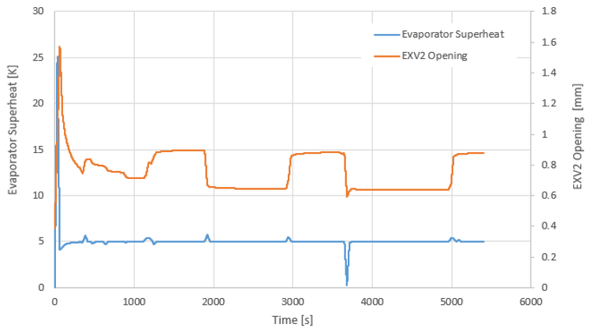
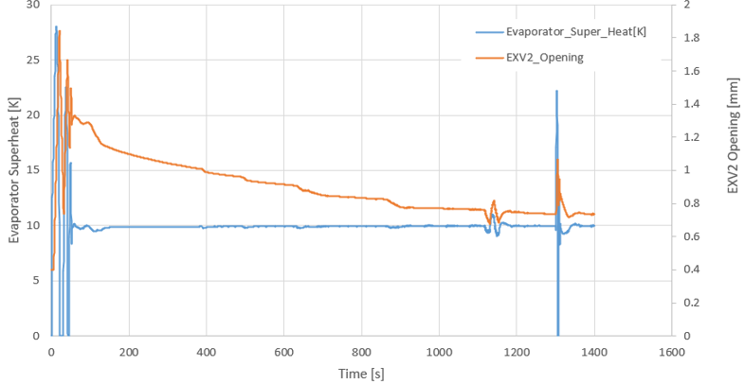
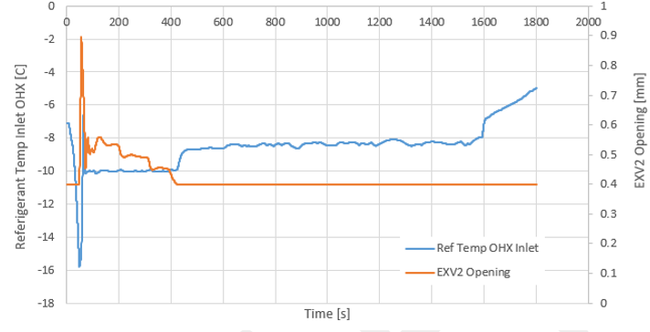
Development of the Vehicle Level Digital Twin
EXV2 Control Example
R-744 System – EXV varies to keep
a constant S/H value (cooling)
Kona System – EXV varies to keep
a constant S/H value
Controlled refrnt. temp value (heating)

Slide 24
Development of the Vehicle Level Digital Twin
Controls Development – Focus Areas
    Air handling
      1D cabin model taking into account
        Thermal inertia
        Internal (air) volume
        Internal and external convective heat transfers (f vehicle/blower speeds)
        Glazing
        Solar loading (0W/m² <20C up to 1000W/m² 39 to 43C)
      Fresh/recirc door position – humidity handling and energy management
      Air PTC operation to supplement initial cabin heating in cold conditions
      HVAC blower control to achieve and maintain cabin temperature
      Cooling pack fan control – varies with vehicle speed and mode of operation; heating mode - fan operates in cold ambients (heat extraction) or cooling mode – f compressor pressure temperature and eMotor (>50C)

Slide 25
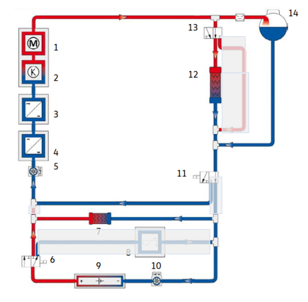
Development of the Vehicle Level Digital Twin
Controls Development – Focus Areas
    Coolant Circuit
    Several modes possible through two valves and a thermostat
    LTR by-passed – battery passive
    LTR by-passed – P/T contributes to cabin heating and battery heated by PTC
    LTR by-passed – battery PTC heating
    LTR by-passed – battery heated by P/T
    LTR active – battery cooled by chiller
    (as shown here)
To be
updated

Slide 26
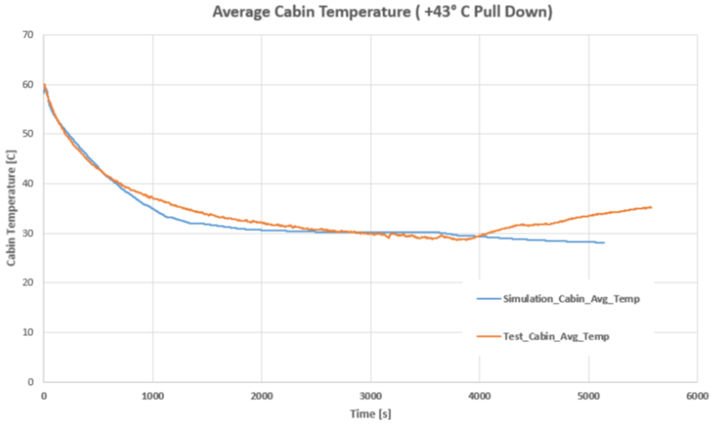
Development of the Vehicle Level Digital Twin
Example Pull-Down Scenario
    Good match in cabin temperatures for dynamic phases
    Good match at start of idle phase
    In the test the battery chiller then kicks in and cabin temperature drifts up
    In simulation battery remains cooler and there is sufficient capacity despite adverse exterior conditions
Notes:
Idle phase: exterior htc decreases dramatically at idle (more cabin load) and OHX air inlet goes from 43 towards 49C
Reason is that in test battery cooling was on therefore limited capacity to cool cab. In sim batt cooling was off, and the system had sufficient capacity to cool the cabin despite the more adverse exterior BC conditions

Slide 27
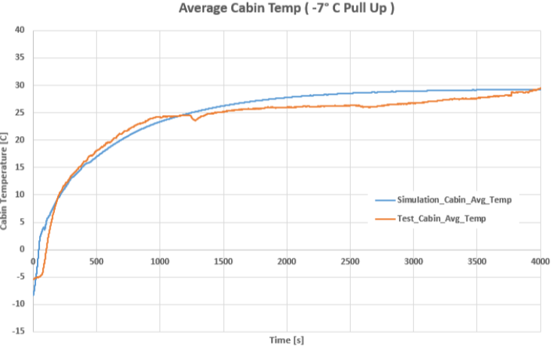
Development of the Vehicle Level Digital Twin
Example Warm-Up Scenario
    Good match in cabin temperatures for dynamic phases, especially kph, 30minutes.
    Better match at start of idle phase
    Test aborted at 4000s
    (went into de-icing?)
Notes:
De-icing but never came out and vent temps started dropping

Slide 28
Development of the Vehicle Level Digital Twin
Conclusions
    Individual components in an R-1234yf heat pump system have been reversed engineered through the use of physical measurements, test data and engineering judgment
    Calibrated components were joined into complete system and showed very good correlation to J2675 cooling, heat and dehumidification bench test cases
    Virtual bench system allows for refrigerant development
    Heat pump system reversed engineered into ID3 platform model
    Required a lot of controls development around the ‘new’ VTMS
    Done to compare R-744 (ID3) against R-1234yf and customers refrigerant
    Virtual developments at the bench can be easily integrated into the virtual vehicle to investigate impact on vehicle parameters, such as range improvements for more realistic driving scenarios.

Slide 29
Development of the Vehicle Level Digital Twin
Contributors
    R1234yf heat pump model development: Jack Cheung – MIRA
    Vehicle platform modifications & development: Dhananjay Deshmukh - MIRA
    Technical oversite: Christian Macri (Daikin) and Tony Vespa

Slide 30
Development of the Vehicle Level Digital Twin
Lead Author
Thank you
      Dr David Bridge
      HORIBA-MIRA
      Watling Street, Nuneaton UK
      +44 (0)7799786946
      david.bridge@horiba-mira.com

