Slide 1


Sensitivity Analysis of Various Cooling Methods for Battery Thermal Management
Under Fast Charging Conditions Using CFD Simulation
Sangyeop Lee¹⁾, Cheolsoo Park²⁾, and Kyoungdoug Min¹⁾
Seoul National University, Seoul, South Korea¹⁾
Hyndai Motor Company²⁾

Slide 2
Outline
Introduction
Objective
Methodology
Results
Summary

Slide 3
Introduction

Slide 4
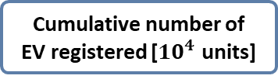
Introduction - Growth of EV Adoption
EV: Electric Vehicle
GHG: Greenhouse gas
Greenhouse Gas Reduction Goals
EV Registration Status
98.1 million tons
Proportion of
eco-friendly vehicles [%]
61.0 million tons
▼ 37.8%
Cumulative number of
EV registered [${10}^{4}$ units]
Greenhouse gases
in the transportation sector
[Government 2050 CNC, 2023]
[Automobile registration status report, Ministry of Land, Infrastructure and Transport, 2025]
EV adoption expansion and charging infrastructure enhancement for GHG reduction
Increase in EV presence and market share in the auto industry

Slide 5





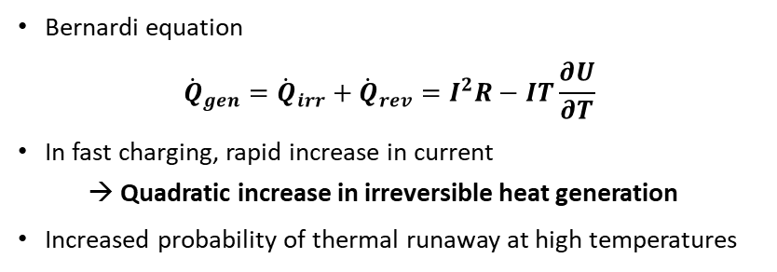
Introduction - Operating Temperature Range for Li-ion Batteries
Lithium plating
Capcity loss
Ionic conductivity decrease
Fast degradation
Transition metal dissolution
Thermal runaway
Optimal range
-20℃
20℃
40℃
60℃
[Korthauer, Springer, 2018] [H. Liu, Energy Conversion and Management, 2017]
3 hours
45 minutes
7 minutes
Bernardi equation
$${\dot{Q}}_{gen}={\dot{Q}}_{irr}+{\dot{Q}}_{rev}=I^{2}R−IT\frac{∂U}{∂T}$$
In fast charging, rapid increase in current
→ Quadratic increase in irreversible heat generation
Increased probability of thermal runaway at high temperatures
Increasing Current
Public
charging pile
Fast
charging pile
Ultra-high power
charging station
→ The Necessity of an Advanced Cooling System
[Guchen electronics, 2023]

Slide 6
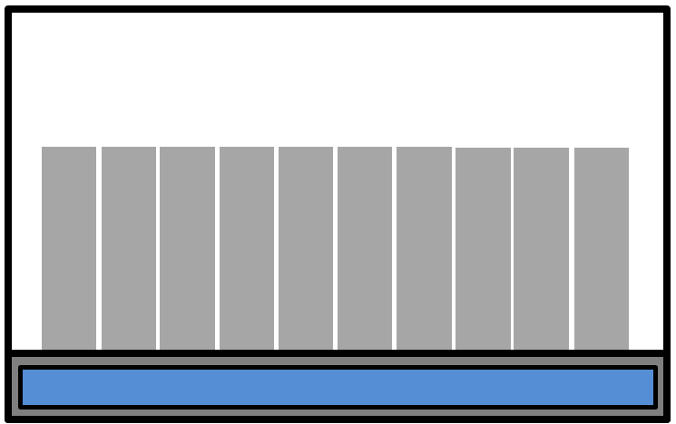
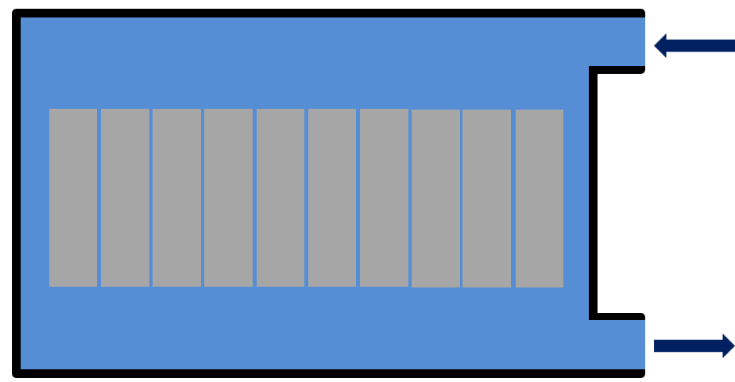
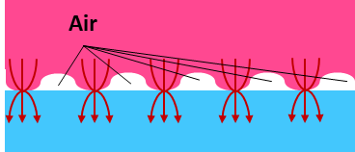

Introduction - Review of Previous Studies
Cooling Systems
Thermal Interface Management
Sensitivity Analysis
Various cooling systems
(Air cooling, Indirect cooling, Immersion cooling, PCM cooling)
Research on advanced cooling strategies combining multiple techniques
Necessity of gap filler application for contact resistance reduction between cells and cooling plate
Cooling asymmetry caused by the top folding section in pouch cells
Focus of existing sensitivity analyses on coolant conditions such as inlet temperature and flow rate
Definition of objective functions for cooling performance evaluation as maximum temperature and temperature deviation
Immersion cooling
Indirect cooling
Without gap filler
With gap filler
[Offer et al., Nature, 2020]
[Wang Z et al., Journal of Energy Storage, 2023]
[Xin Ge et al, Royal Society of Chemistry, 2022]
[Lee et al, KSAE, 2024]
[M. S. Patil et al, Int J Energy Res, 2020]
[M. Akbarzadeh et al, Applied Thermal Engineering, 2021]
Necessity of sensitivity analysis of cooling systems and module components
under various cooling methods

Slide 7
Objective

Slide 8
Objective
ANOVA: Analysis of Variance
Main Objective
Sensitivity Analysis of Various Battery Cooling System under Fast Charging Conditions
Design of experiments using the orthogonal array method
Sensitivity analysis through statistical methods such as range analysis and ANOVA
Comparison of key factors according to different cooling methods
Battery thermal management
Li-ion battery
Single-sided/Double-sided cooling
Orthogonal array test
Computational Fluid Dynamics
Sensitivity analysis

Slide 9
Methodology

Slide 10
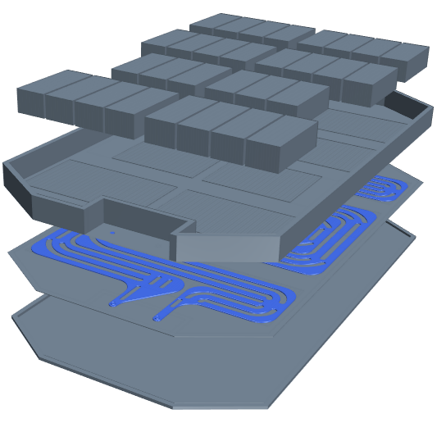
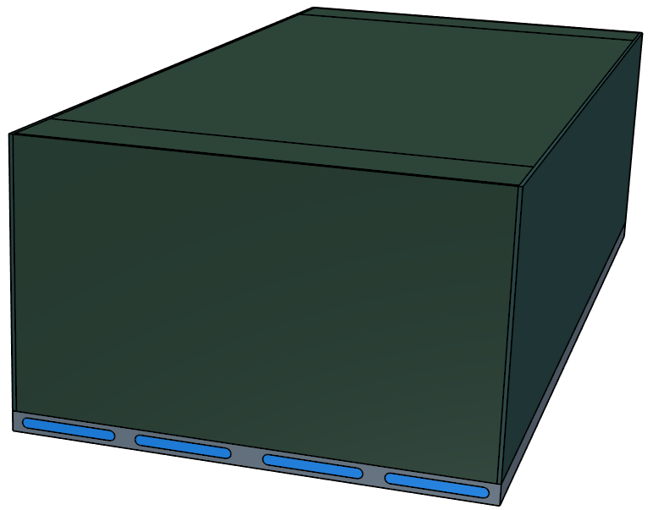
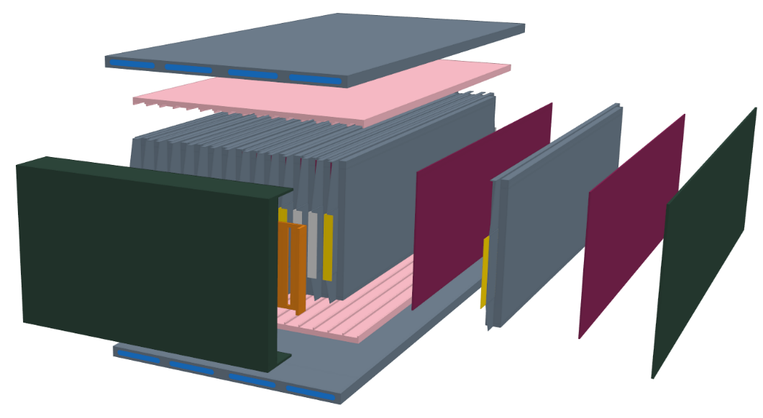
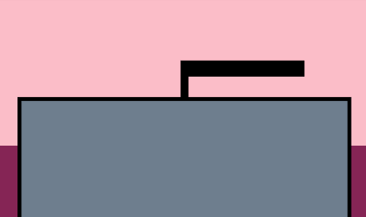
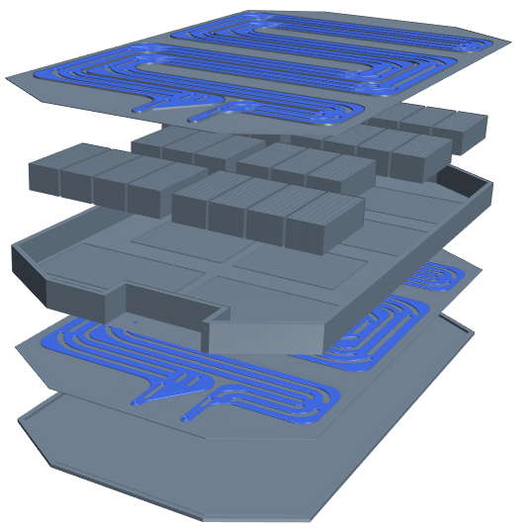
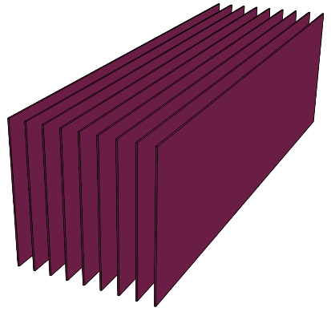
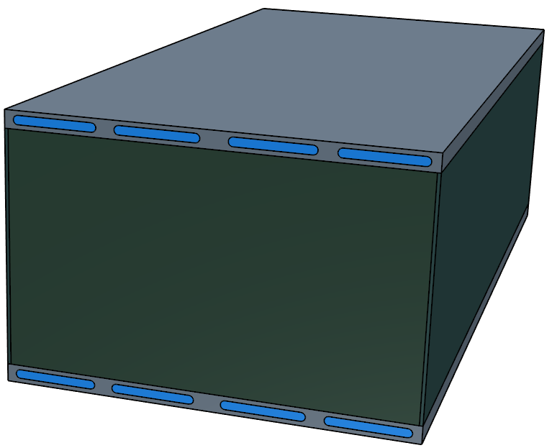
Methodology - Battery Module Cooling System & Parameters
Single-sided cooling system
Module Configuration
Battery | NMC Pouch Cell
Cell connection | 2P - 8S
Cooling type | Single/Double-sided
Coolant | Ethylene Glycol-Water mixture
Parameters
Coolant inlet temperature
Coolant mass flow rate
Pad/Al plate ratio
Gap filler thickness
Coolant
Cooling Plate
Gap filler
Thickness
Double-sided cooling system
Module placed in the straight path
Cell
Pad
Pad/Al plate
Al plate
End plate

Slide 11
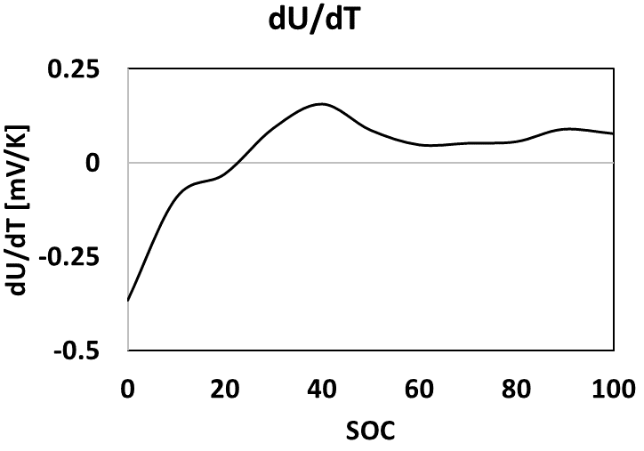
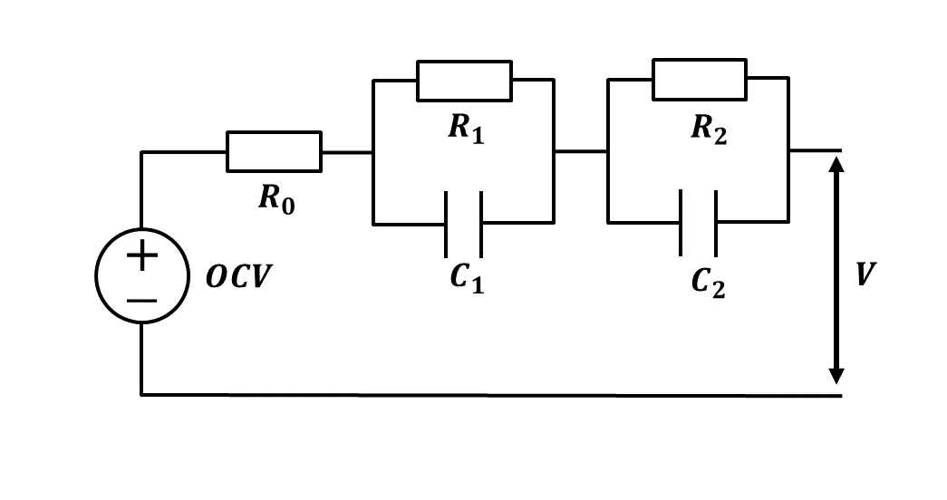
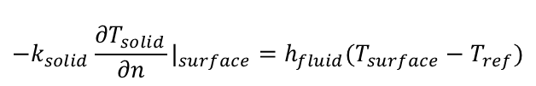







ECM: Equivalent-Circuit Model
OCV: Open Circuit Voltage
Methodology - Thermal & Battery Modeling
Coolant
Battery
Turbulence Model | SST K-omega
Flow Model | Segregated Flow
Energy Conservation
$$ρ_{b}C_{b}\frac{∂T_{b}}{∂t}=∇∙\left(k_{b}∇T_{b}\right)+{\dot{Q}}_{gen}$$
Conservation Equations
$$∇∙\vec{v}=0$$
Bernardi Equation
$$ρ_{c}\frac{d\vec{v}}{dt}=−∇p+ μ∇^{2} \vec{v}$$
$${\dot{Q}}_{gen}={\dot{Q}}_{irr}+{\dot{Q}}_{rev}=I(OCV−V)−IT\frac{∂U_{oc}}{∂T}$$
$$ρ_{c}C_{c}\frac{∂T_{c}}{∂t}+∇∙\left(ρ_{c}C_{c} \vec{v} T_{c}\right)=∇∙(k_{c}∇T_{c})$$
Voltage
Conjugate Heat Transfer
$$T_{solid|surface}=T_{fluid|surface}$$
$$q_{solid|surface}=q_{fluid|surface}$$
$${{−k}_{solid}\frac{∂T_{solid}}{∂n}|}_{surface}=h_{fluid}(T_{surface}−T_{ref})$$
2RC ECM model

Slide 12
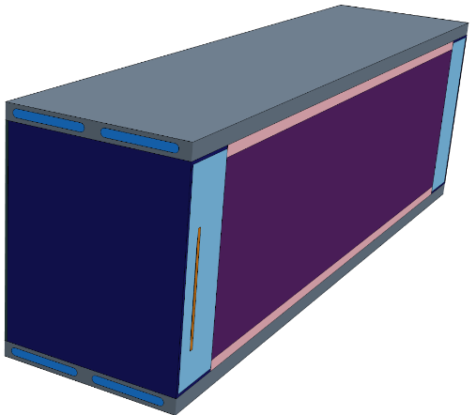
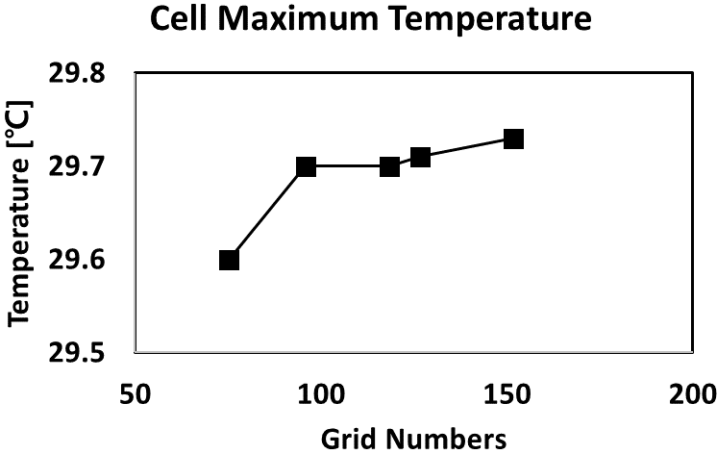
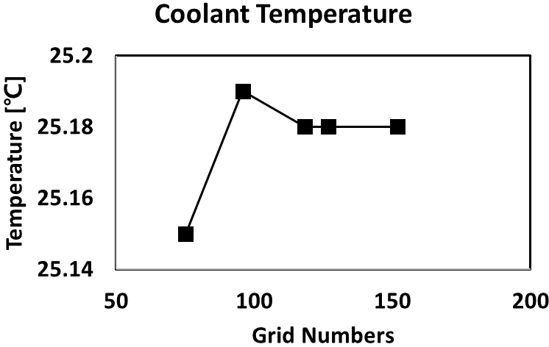

Methodology - Simulation set up
SOC: State of Charge
Half – Module Analysis
Grid Setting & Independence Test
Material | Grid numbers
Solid | 6,900,000
Fluid | 2,700,000
Optimal grid number
→ 9,600,000
Coolant in
Cut plane
→ Adiabatic
Coolant out
Load | 2C-rate charge
Cell capacity | 55.6 Ah
SOC range | 20% - 80%
Total time | 1080 s
Ambient/Initial temperature | 25℃
[$×{10}^{5}$]
[$×{10}^{5}$]
Mesh type | Polyhedral mesher
Solid (Cover, Tab) | Thin mesher
Fluid | Prism layer
Time step | 1 s

Slide 13
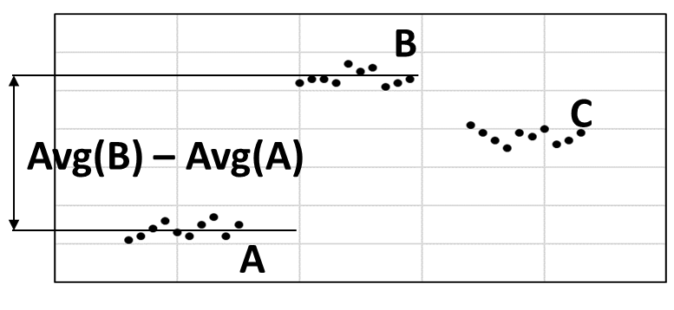
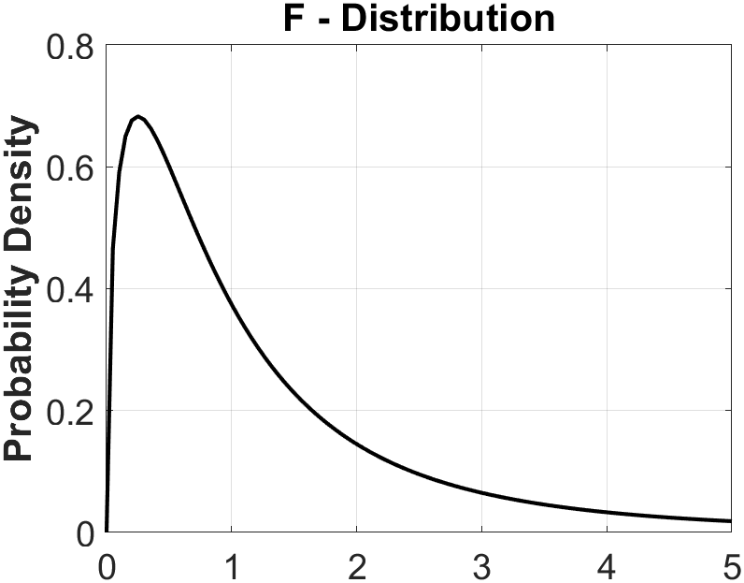
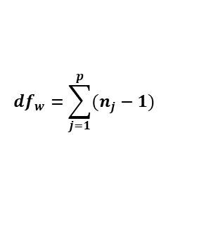
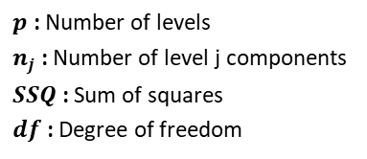

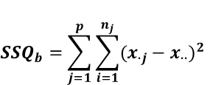
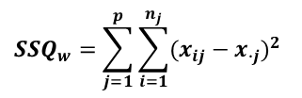
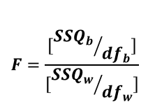

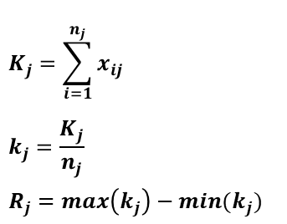
Methodology - Key Equations for Analysis Methods
Orthogonal Array
Range Analysis
Analysis of Variance
4 Factors x 4 Levels
→ L16 Orthogonal Array
$${SSQ}_{b}=\sum_{j=1}^{p}{\sum_{i=1}^{n_{j}}{{(x_{∙j}−x_{∙∙})}^{2}}}$$
Avg(B) – Avg(A)
$$K_{j}=\sum_{i=1}^{n_{j}}{x_{ij}}$$
$$k_{j}=\frac{K_{j}}{n_{j}}$$
$$R_{j}=max\left(k_{j}\right)−min(k_{j})$$
$${SSQ}_{w}=\sum_{j=1}^{p}{\sum_{i=1}^{n_{j}}{{(x_{ij}−x_{∙j})}^{2}}}$$
$${df}_{b}=p−1$$
$${df}_{w}=\sum_{j=1}^{p}{(n_{j}−1)}$$
$$F=\frac{[{{SSQ}_{b}}/{{df}_{b}}]}{[{{SSQ}_{w}}/{{df}_{w}}]}$$
$p$ : Number of levels
$n_{j}$ : Number of level j components
$SSQ$ : Sum of squares
$df$ : Degree of freedom
Minimal case number
Focus on main effect
Statistical independence of factor combinations
$p$ : Number of groups
$n_{j}$ : Number of level j components
[M. Patil et al, Int J Energy Research, 2020]
[L. Stahle et al, Chemom. Intell. Lab. syst., 1989]
Relative influence evaluation
Absolute influence evaluation

Slide 14
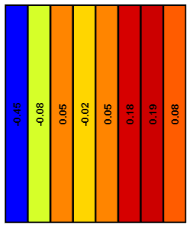
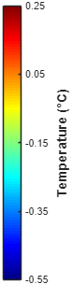
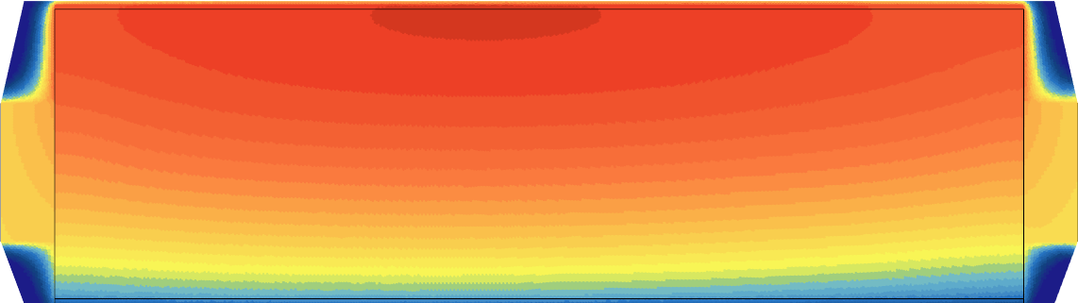
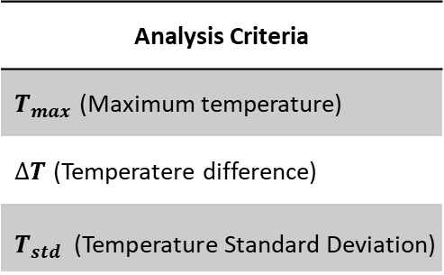



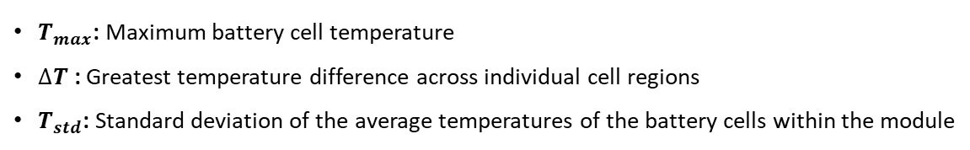
Methodology - Research Flow
Parameter |  | Value
Coolant | Inlet temperature [℃] | 15, 20, 25, 30
 | Mass flow rate [LPM] | Single: 2.5, 5, 7.5, 10
 |  | Double: 1.25, 2.5, 3.75, 5
Pad : Al plate | Ratio | 9:0, 6:3, 3:6, 0:9
Gap filler | Thickness [mm] | 2, 3, 4, 5
Analysis Criteria
$T_{max}$ (Maximum temperature)
$∆T$ (Temperatere difference)
$T_{std}$ (Temperature Standard Deviation)
$$T_{max}$$
$∆T$
$T_{max}$: Maximum battery cell temperature
$∆T$ : Greatest temperature difference across individual cell regions
$T_{std}$: Standard deviation of the average temperatures of the battery cells within the module
$$T_{std}$$

Slide 15
Results

Slide 16
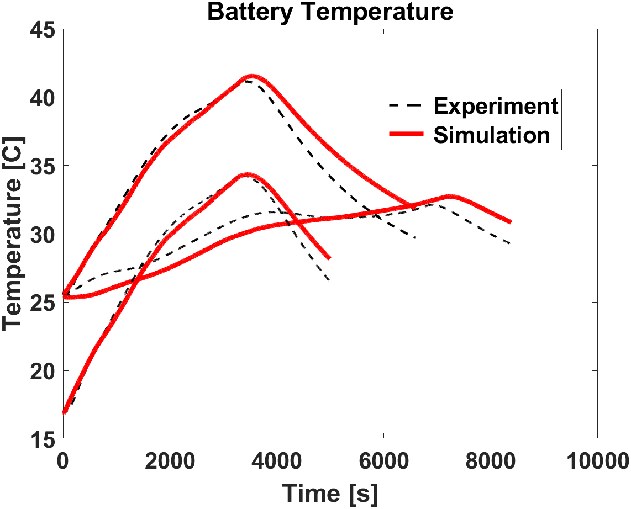
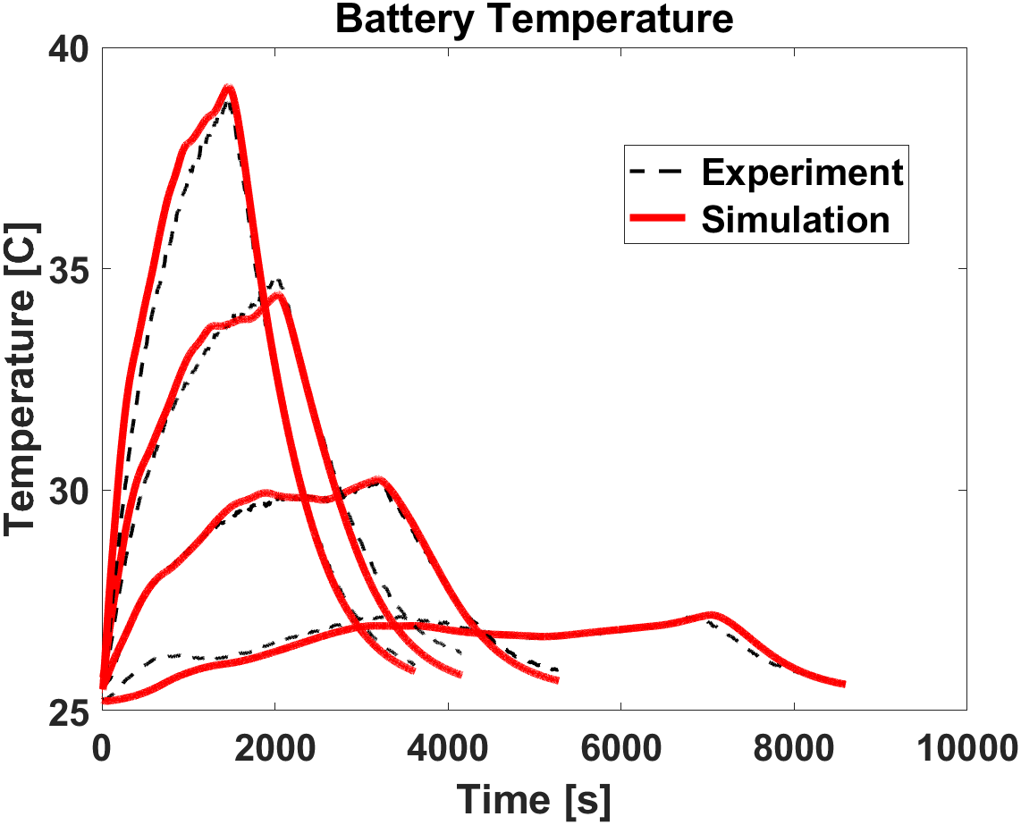
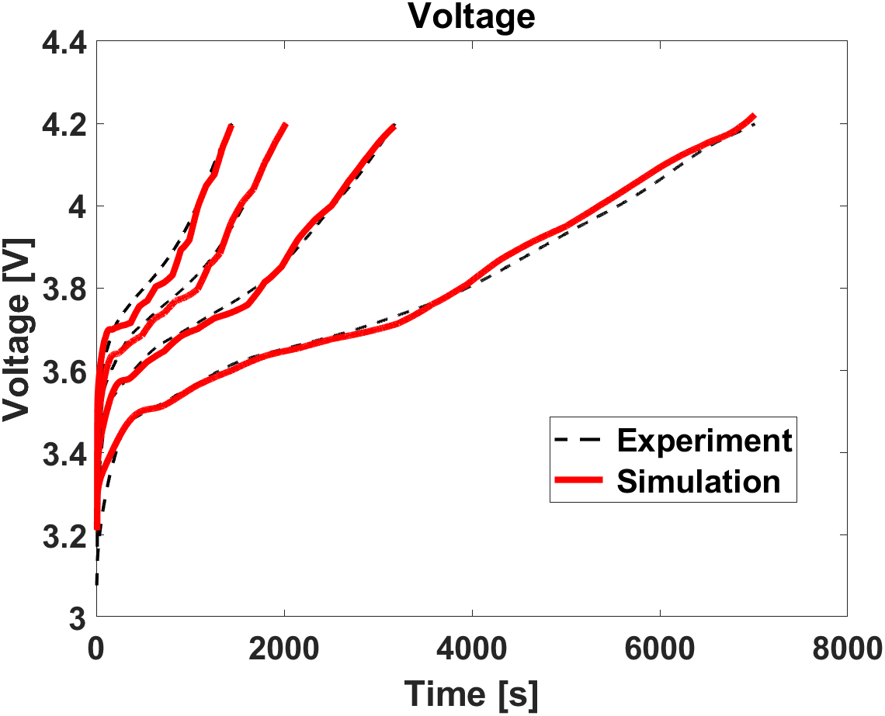
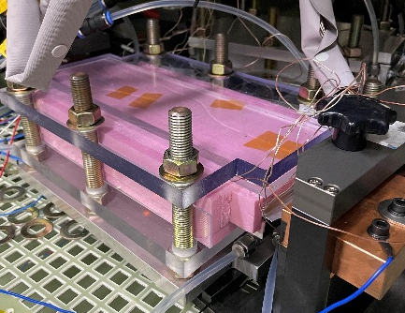
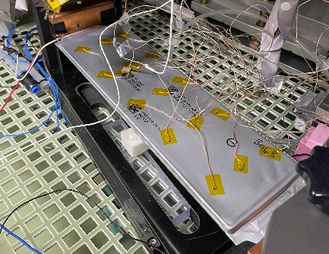
Results - Model Validation with Experiemental Results
Experiment Cases
Insulation Condition
Ambient Condition
Insulation Condition
15℃, 1C rate
25℃, 0.5C/1C rate
Ambient Condition (25℃)
0.5C/1C/1.5C/2C rate
1C, 25℃
2C
2C
1.5C
1C
0.5C
1.5C
0.5C
1C
1C, 15℃
0.5C
Validation of battery temperature prediction under insulated conditions for heat generation model
Temperature estimation validation under ambient conditions with convective heat transfer
3% temperature and 1% voltage error, indicating model validity
▲Insulation Condition
▲Ambient Condition
[Jianqin Wang et al, Applied Thermal Engineering, 2019]

Slide 17
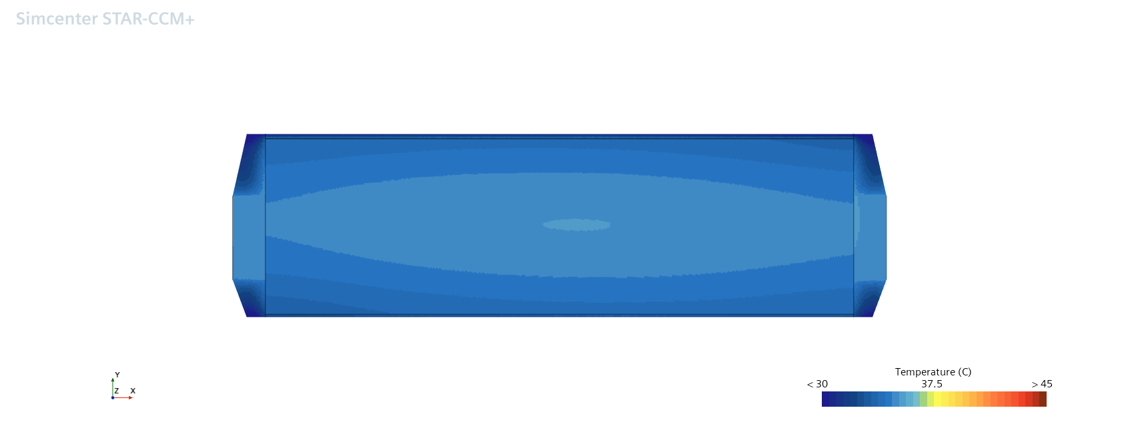
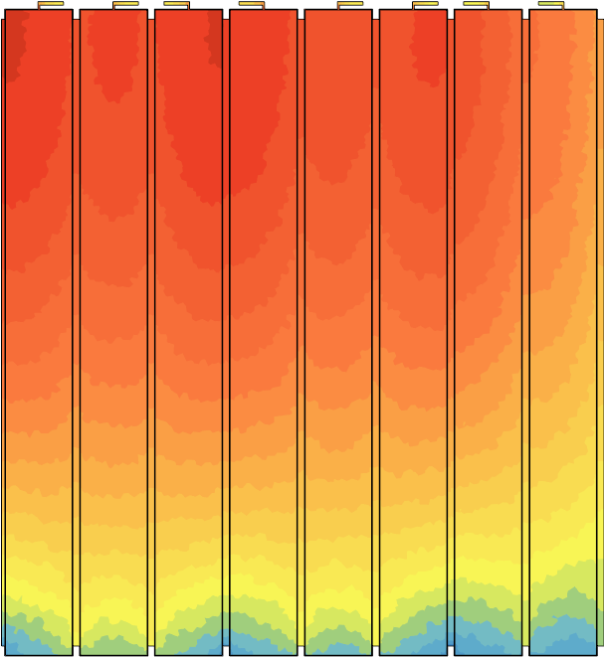
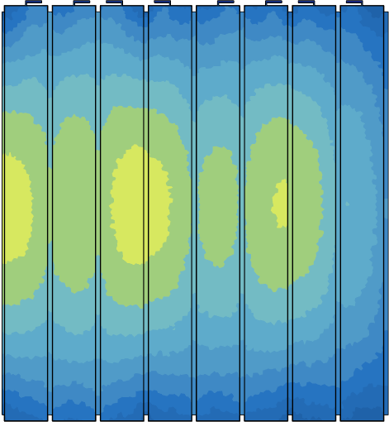
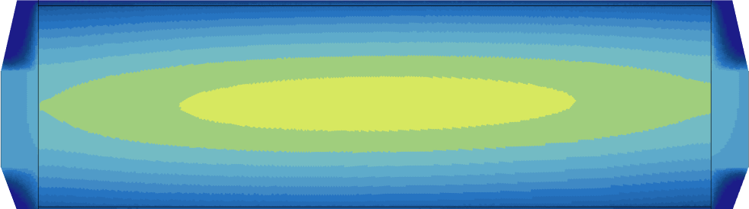
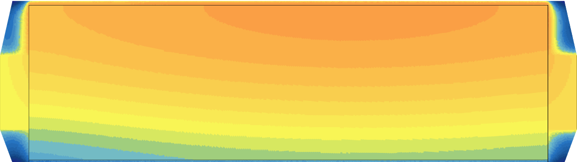
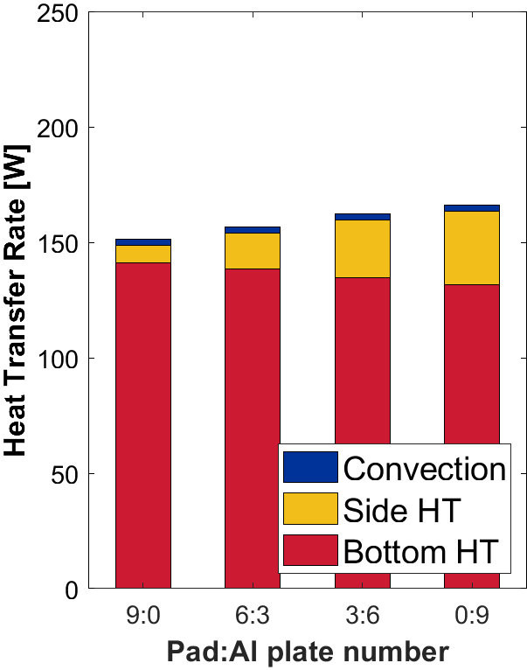
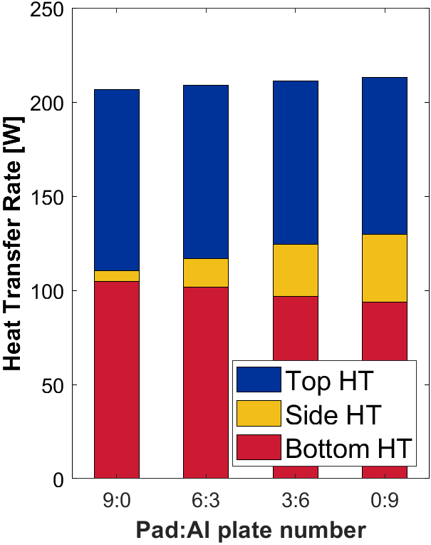
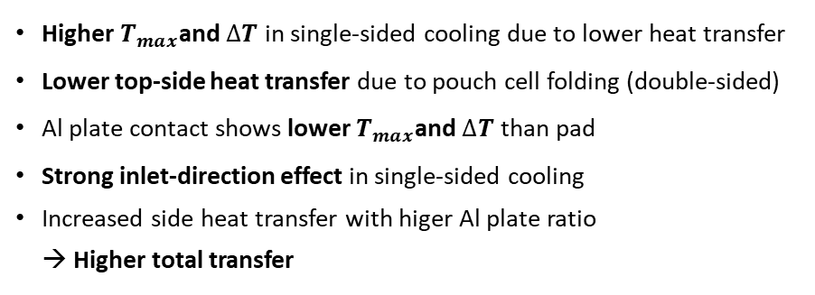
Results - Temperature Distribution by Cooling Method
Temperature [℃]
Temperature [℃]
47.5%
(77.5W)
Pad contact
Pad contact
115.4 W
52.5%
(85.6W)
Al plate contact
Al plate contact
▲Single-Sided Cooling
▲Double-Sided Cooling
▲Single-Sided Cooling
▲Double-Sided Cooling
Higher $T_{max}$and $∆T$ in single-sided cooling due to lower heat transfer
Lower top-side heat transfer due to pouch cell folding (double-sided)
Al plate contact shows lower $T_{max}$and $∆T$ than pad
Strong inlet-direction effect in single-sided cooling
Increased side heat transfer with higer Al plate ratio
→ Higher total transfer

Slide 18
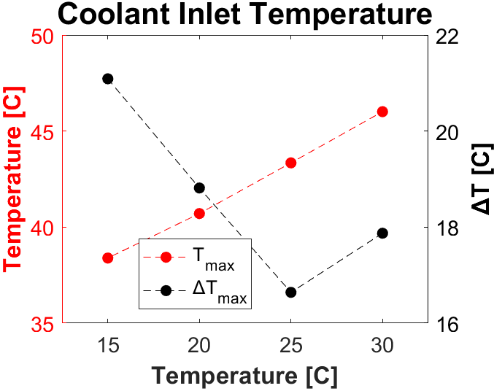
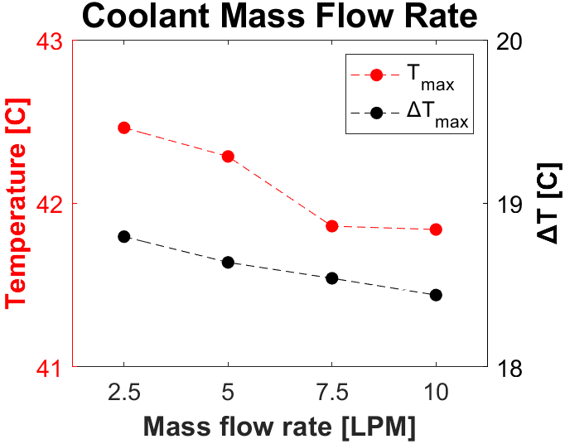
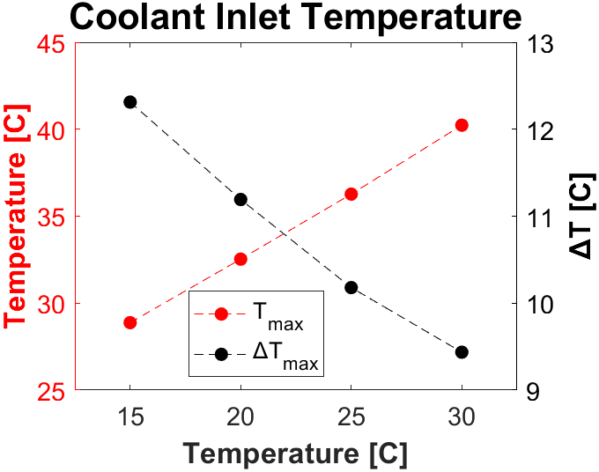
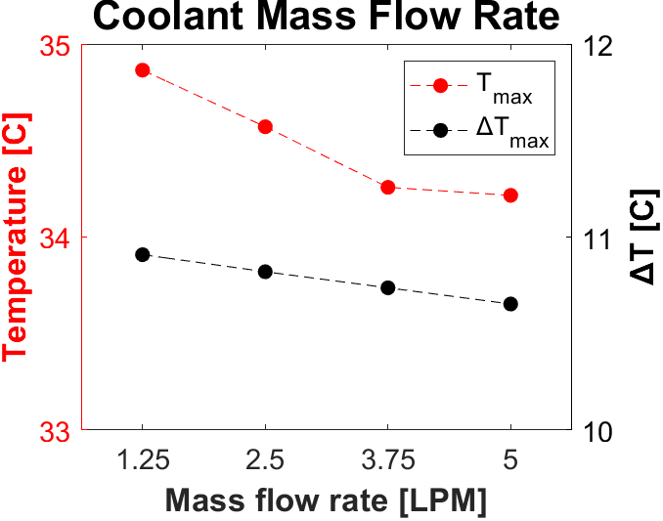
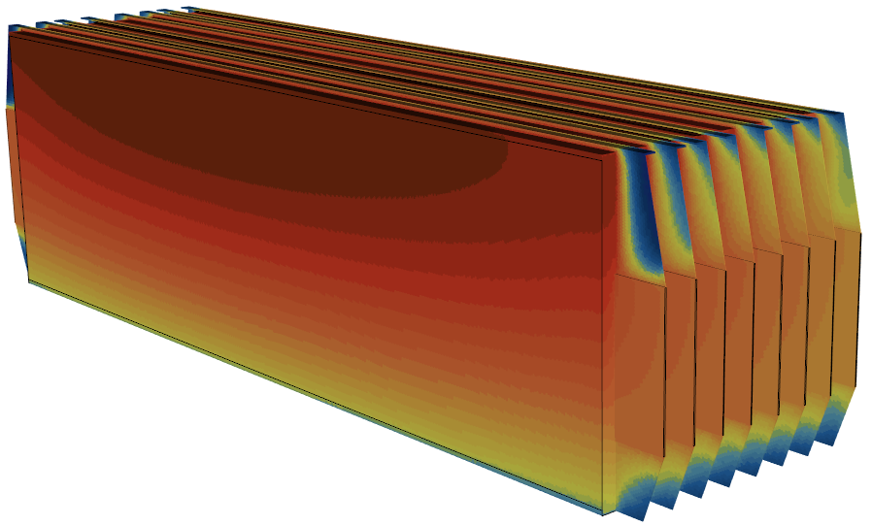
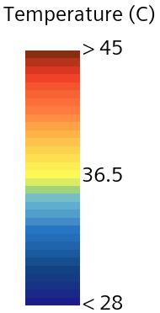

Results - Range Analysis of Coolant Property Parameters
Single-Sided Cooling
Double-Sided Cooling
28.1 ℃
~5 ℃ lower $T_{max}$ and ~10 ℃ lower $∆T$ in double-sided cooling
Reversal of $T_{max}$ - $∆T$ trend with decreasing $T_{inlet}$ due to lower $T_{min}$
Nonlinear $∆T$ behavior at 30 ℃ inlet in single-sided cooling
→ $T_{min}$ shift from cooling plate contact to air-exposed cell cover
Reduced $T_{max}$ drop at higher flow rates (7.5 LPM/3.75 LPM)
33.0 ℃
▲Single-Sided Cooling, Coolant Inlet Temperature:30℃

Slide 19





Results - Range Analysis of Module Component Parameters
Single-Sided Cooling
Double-Sided Cooling
Consistent trends in $T_{max}$ and $∆T$ across Pad/Al plate ratio and gap filler thickness, redardless of cooling type
Similar $T_{max}$ sensitivity to both parameters in double-sided cooling; stronger Pad/Al effect in single-sided cooling
Greater $∆T$ sensitivity to Pad/Al ratio than to gap filler thickness in both cooling types
Sharp $∆T$ drop when gap filler thickness decreases from 3mm to 2mm (both cooling types)

Slide 20




Results - Range Analysis Comparison
11.35
4.45
7.62
2.88
3.22
3.20
1.37
1.06
0.62
0.65
1.36
1.24
1.76
0.36
0.26
0.54
0.27
0.10
0.25
0.15
Coolant inlet temperature: key factor for $T_{max}$ and $∆T$
→ More effective in double-sided ($T_{max}$ ) and single-sided ($∆T$) cooling
Pad/Al plate ratio: more impact in single-sided cooling ($T_{max}$ & $∆T$)
→ Single-sided cooling: higher ratio of lateral heat transfer
Gap filler thickness: more impact in double-sided cooling ($T_{max}$ & $∆T$)
→ Double-sided cooling: higher ratio of top/bottom heat transfer
→ Gap filler acting as a major bottleneck, resulting in greater influence
T - $T_{coolant inlet}$
M - $Mass Flow Rate$
P:A - $Pad:Al plate$
d - $Gap filler thickness$
E - $Error$

Slide 21






Results - Range Analysis Comparison
T - $T_{coolant inlet}$
M - $Mass Flow Rate$
P:A - $Pad:Al plate$
d - $Gap filler thickness$
E - $Error$
0.22
0.13
0.13
0.08
0.05
0.01
0.01
0.03
0.00
0.01
Consistent trend in $T_{std}$ across cooling types
Single-sided cooling shows ~0.2℃ higher $T_{std}$, greater sensitivity to parameter variation
Pad/Al plate ratio is the most dominant factor for $T_{std}$, but the relationship is non-linear
→ With the same heat dissipating materials, inner cells are hotter and outer cells are cooler
→ 6:3 ratio (6 Pads): Temperature of Cell 1▼, Cell 8▲ → reduced $T_{std}$
→ 3:6 ratio (6 Al plates): Temperature of Cell 1▲, Cell 8▼ → increased $T_{std}$
1
2
3
4
5
6
7
8
▲All-Pad case
Cut plane

Slide 22


Results - Analysis of Variance
Variance | $$T_{max}$$ |  | $$∆T$$ |  | $$T_{std}$$
 | Single | Double | Single | Double | Single | Double
Coolant inlet temperature | 43.4006 | 95.2530 | 14.1410 | 6.2454 | 0.0119 | 0.0044
Coolant mass flow rate | 0.3868 | 0.3670 | 0.0922 | 0.0481 | 8.6405 e-5 | 4.1540 e-5
Pad: Al plate ratio | 7.5276 | 1.3925 | 7.4121 | 1.4488 | 0.0327 | 0.0117
Gap filler thickness | 1.1541 | 2.3383 | 0.1995 | 0.8015 | 0.0024 | 5.6791 e-4
Error | 0.0563 | 0.0219 | 0.0628 → 0.0775 | 0.01 | 5.3991 e-6 | 1.1496 e-4 → 7.8248 e-5
Variance for factor j ($V_{j}$) < Twice the Variance for test error (2$V_{E}$) → Very small factor effect
→ Minimal factor effect of mass flow rate on $∆T$ (single-sided) and $T_{std}$ (double-sided)
[Jianqin Wang et al, Applied Thermal Engineering, 2019]
$T_{max, single}$, ${∆T}_{ both}$ → Coolant inlet temperature > Pad : Al plate > Gap filler thickness > Mass flow rate
$T_{max, double}$ → Coolant inlet temperature > Gap filler thickness > Pad : Al plate > Mass flow rate
$T_{std, both}$ → Pad : Al plate > Coolant inlet temperature > Gap filler thickness > Mass flow rate

Slide 23



Results – Analysis of Variance
Coolant inlet temperature and Pad:Al plate ratio
→ 99.5% confidence for $T_{max}$, $∆T$, and $T_{std}$
Coolant inlet temperature - key for thermal safety
Pad:Al plate ratio – key for reducing cell-to-cell variation
Mass flow rate < 90% confidence for $∆T$
Gap filler thickness > 99.5% confidence for $T_{max}$& $∆T$
→ Greater significance in double-sided cooling
T - $T_{coolant inlet}$
M - $Mass Flow Rate$
P:A - $Pad:Al plate$
d - $Gap filler thickness$

Slide 24
Summary

Slide 25

Summary & Future Works
Summary
Sensitivity analysis of key parameters’ influences on single & double sided cooling methods
Dominant influence of coolant inlet temperature on $T_{max}$, $∆T$ regardless of cooling method
→ Critical for maintaining ideal battery operating temperature
Primary impact of Pad : Al plate ratio on $T_{std}$ independent of cooling method
→ Essential for preventing battery lifespan due to cell imbalance
Highlighted importance of Pad : Al plate ratio in single-sided and gap filler thickness in double-sided cooling
Generally low influence of mass flow rate acrossing cooling methods
Future Works
Sensitivity analysis on new parameters such as Pad:Al plate arrangement and coolant channel placement
Further investigation into meaningful performance metrics for evaluating battery cooling effectiveness
Optimization based on analysis of cost-related factors such as pump power and mass in cooling system design

Slide 26
Thank you for listening
      Sensitivity Analysis of Various Cooling Methods
      for Battery Thermal Management
      Under Fast Charging Conditions Using CFD Simulation
      Sangyeop Lee
      Seoul National University, Seoul, South Korea
      saltlake9707@snu.ac.kr

Slide 27
Appendix

Slide 28





Appendix - Heat Transfer Ratio between Top Side and Bottom Side
<Experiment>
<Simulation>
Fin Side
Fin Side
Normal Side
Normal Side
Cooling plate
Cell
90 %
90.5 %
Gap filler

Slide 29
Appendix - Pad : Al plate Arrangement
Cut Plane
Cut Plane
Outside
Outside
Cell
Pad
Al plate
Pad : Al plate = 6:3
Pad : Al plate = 3:6

Slide 30



Appendix - Error Calculation Methods
Range Analysis Error
Analysis of Variance Error
Level 2
$$K_{j}=\sum_{i=1}^{n_{j}}{x_{ij}}$$
$$k_{j}=\frac{K_{j}}{n_{j}}$$
$$R_{j}=max\left(k_{j}\right)−min(k_{j})$$
Level 1
Level 3
Avg (Level 1)
$${SSQ}_{w}=\sum_{j=1}^{p}{\sum_{i=1}^{n_{j}}{{(x_{ij}−x_{∙j})}^{2}}}$$
Estimation of error through variance among cases at the same level of factor j
Inclusion of an artificial error factor with designated levels
Execution of range anlaysis based on results for each error level
Estimation of error based on variation across error levels

Slide 31



Appendix - Analysis of Variance
$F_{0.1}(3,3)$ = 5.3908
$F_{0.05}(3,3)$ = 9.2766
$F_{0.01}(3,3)$ = 29.4567
$F_{0.005}(3,3)$ = 47.4672
$F_{0.1}(3,6)$ = 3.2888
$F_{0.05}(3,6)$ = 4.7571
$F_{0.01}(3,6)$ = 9.7795
$F_{0.005}(3,6)$ = 12.9166
F - Value | $$T_{max}$$ |  | $$∆T$$ |  | $$T_{std}$$
 | Single | Double | Single | Double | Single | Double
Coolant inlet temperature | 771.43 | 4355.90 | 182.49 | 625.81 | 2203.90 | 55.67
Coolant mass flow rate | 6.87 | 16.78 | 1.19 | 4.82 | 16.00 | 0.53
Pad: Al plate ratio | 133.80 | 63.68 | 95.66 | 145.17 | 6052.22 | 149.10
Gap filler thickness | 20.51 | 106.93 | 2.57 | 80.31 | 435.85 | 7.26
Variance | $$T_{max}$$ |  | $$∆T$$ |  | $$T_{std}$$
 | Single | Double | Single | Double | Single | Double
Coolant inlet temperature | 43.4006 | 95.2530 | 14.1410 | 6.2454 | 0.0119 | 0.0044
Coolant mass flow rate | 0.3868 | 0.3670 | 0.0922 | 0.0481 | 8.6405 e-5 | 4.1540 e-5
Pad: Al plate ratio | 7.5276 | 1.3925 | 7.4121 | 1.4488 | 0.0327 | 0.0117
Gap filler thickness | 1.1541 | 2.3383 | 0.1995 | 0.8015 | 0.0024 | 5.6791 e-4
Error | 0.0563 | 0.0219 | 0.0628 | 0.01 | 5.3991 e-6 | 1.1496 e-4
[Jianqin Wang et al, Applied Thermal Engineering, 2019]

Slide 32


Appendix - Pump Power
Other Parameters
Level 1
Level 2
Level 3
Level 4

