Slide 1
Simulating Battery Thermal Management with Varying Flow Rates Using the LTI+HTC ROM
Xiao Hu
Ansys Inc

Slide 2
Introduction
Battery thermal LTI ROM has been successfully by many Ansys customers.
LTI ROM (Linear Time-Invariant Reduced Order Mode)
LTI ROMs cannot model varying coolant flow rate.
In the project, a new ROM methodology is developed to model varying coolant flow rate.

Slide 3
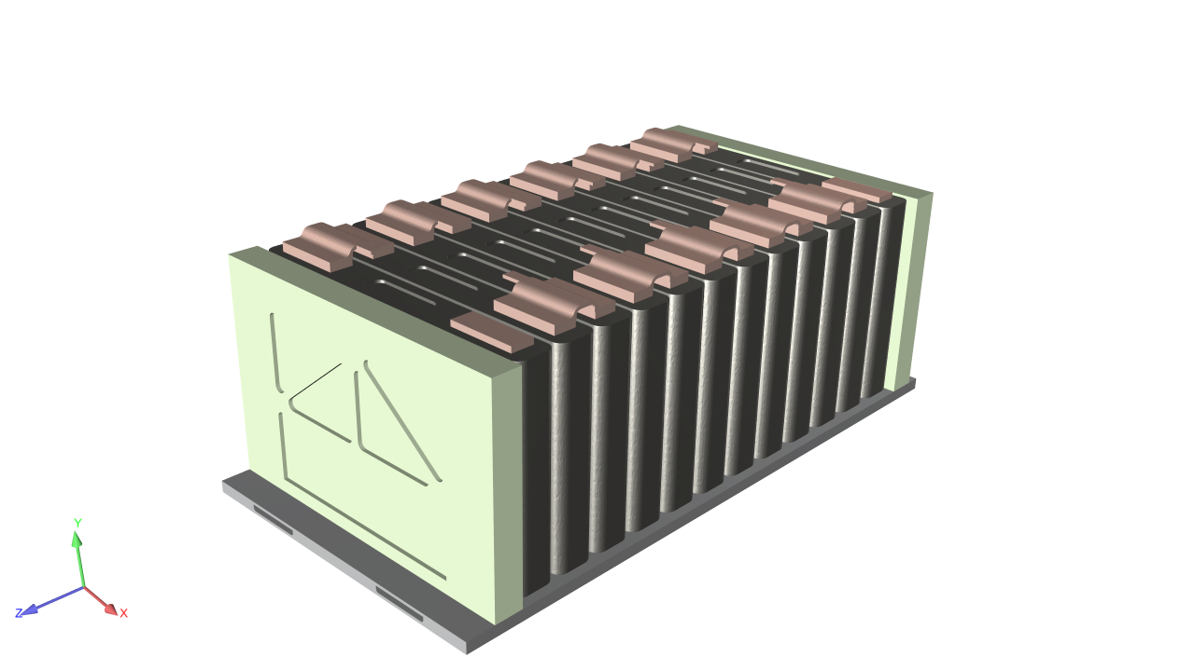
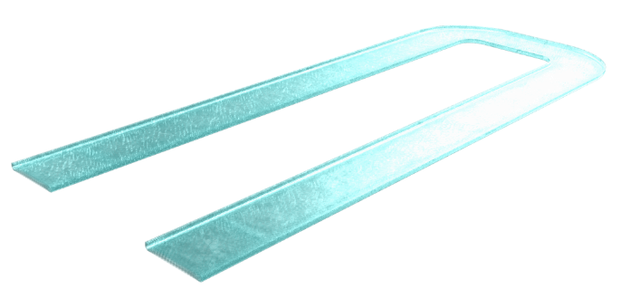
Introducing the LTI + HTC ROM
LTI ROM
Solid Parts
Q
T
Newton Cooling Law
$$Q=htc∙A∙\left(T−T_{in}\right)$$
htc is flow rate dependent
Fluid Channels

Slide 4
Introducing the LTI ROM + HTC ROM
Cell Heat Dissipation
Cell Temp.
Cell Heat Dissipation
LTI ROM
Cell Temp.
Joule Heat
Any Temp.
LTI ROM
Joule
Heat
Any Temp.
Heat Flow @
Temp @
Heat Flow @
Temp. @
CFD Model for Solid Parts
Heat Flow@
Temp. @
HTCs at
Different Flow Rates
$$Q=htc∙A∙\left(T−T_{in}\right)$$
HTCs at
Different Flow Rates
Different Flow Rates at Inlet
LTI + HTC ROM
CFD Model for Coolant
Notes:
How to implement it in our product.

Slide 5
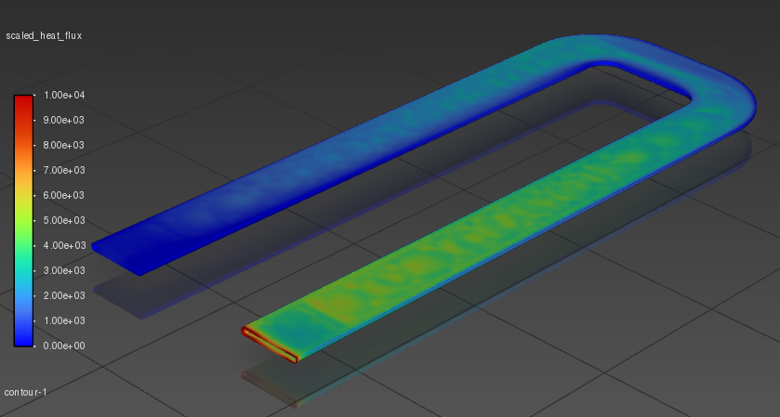
Assumptions in the LTI + HTC ROM in Additional to LTI ROM
Heat flux distribution at the fluid-solid interface is the average of a few distributions from different flow rates.
Flow rate change is quasi-steady.
The flow time constant is much smaller than the thermal time constant.
Flow rate change causes instantaneous HTC change.
Thermal mass of the fluid is negligible.
Heat Flux Distribution at the Interface

Slide 6
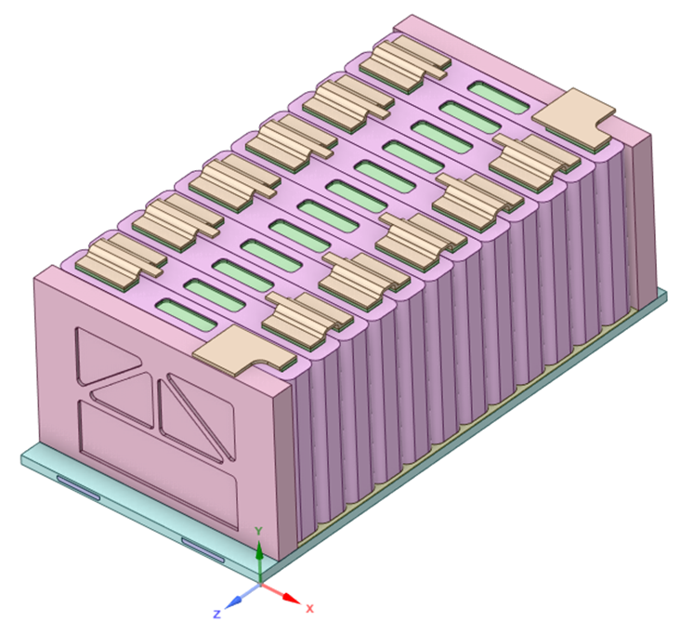
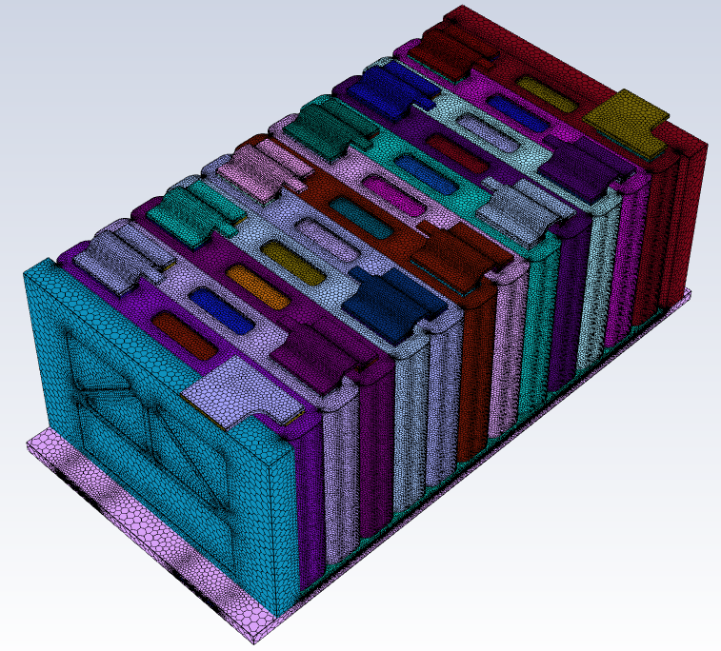
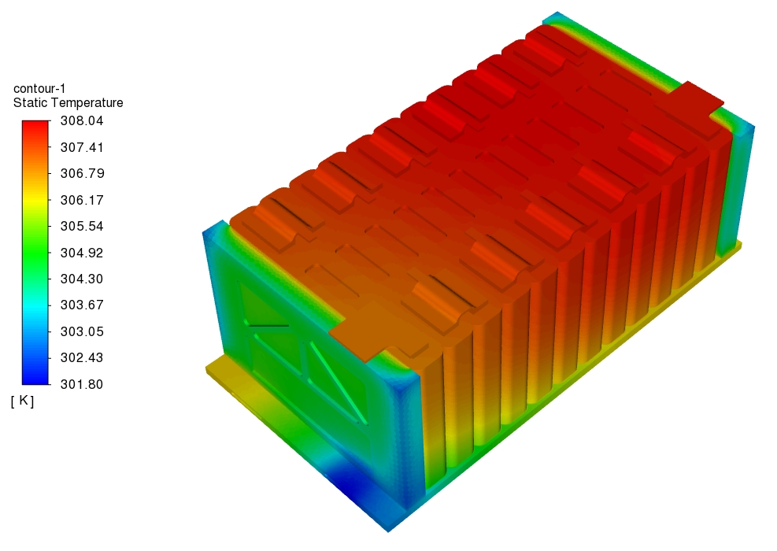
Battery Module Geometry, Mesh, and CHT Solution
14 cells with 1P12S configuration.
Cold plate with convective cooling at the bottom.
Busbars and connectors are included in the geometry.
Mesh type and size: 1.7 million of poly

Slide 7
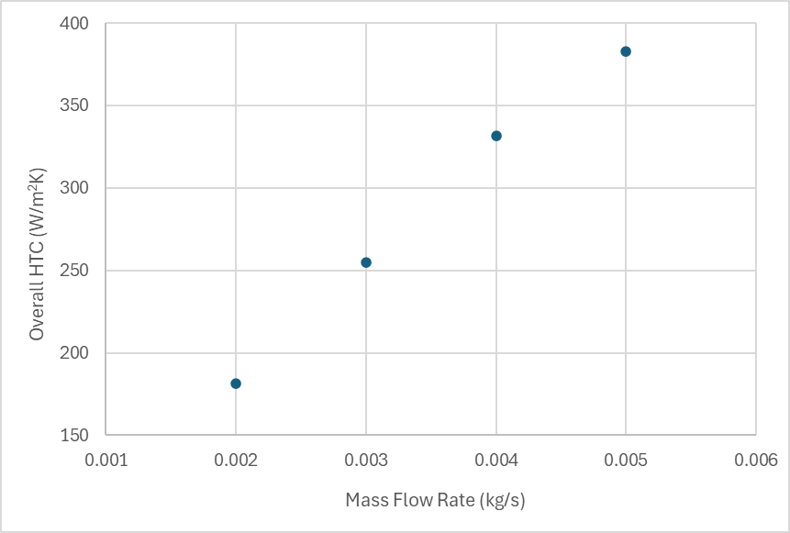
Heat Transfer Coefficient at Different Flow Rates
Inlet mass flow rate (kg/s) | 0.002 | 0.003 | 0.004 | 0.005
Area-weighted average temperature at the interface (K) | 311.44 | 308.27 | 306.71 | 305.76
Inlet temperature (K) | 300 | 300 | 300 | 300
Interface surface area (m²) | 0.043548 | 0.043548 | 0.043548 | 0.043548
Total heat flow at the interface (W) | 102.73 | 106.62 | 108.54 | 109.70
Overall HTC (W/Kꞏm²) | 206.14 | 295.93 | 371.64 | 437.04

Slide 8
LTI ROM for the Solid Parts
Inputs
Total cell heat
Joule heat is ignored for now
Heat flow at fluid-solid interface
Outputs
Cell volume average temperature for all 12 cells
Temperature at fluid-solid interface
Cell 15
Cell 14
Cell 22
Cell 07
Cell 28
Cell 01

Slide 9
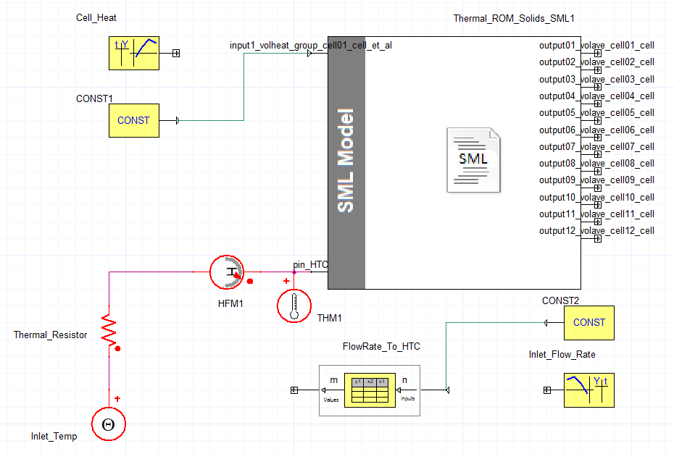
LTI + HTC ROM Using Ansys Twin Builder
A pair of conservative pins is created from heat flow input and interface temperature output for implicit coupling.
Explicit coupling also works if the time step size is small enough.
Some 3rd party tools only support the explicit coupling method.
Use the implicit coupling method whenever supported.

Slide 10
ROM Validation 01: Steady State Conditions
Inlet mass flow rate (kg/s) | 0.002 | 0.003 | 0.004 | 0.005
CFD temperature at interface (K) | 311.44 | 308.27 | 306.71 | 305.76
ROM temperature at interface (K) | 311.44 | 308.27 | 306.71 | 305.77
Error (%) | 0.0% | 0.0% | 0.1% | 0.1%
CFD heat flow at the interface (W) | 102.73 | 106.62 | 108.54 | 109.70
ROM heat flow at the interface (W) | 102.76 | 106.65 | 108.57 | 109.74
Error (%) | 0.0% | 0.0% | 0.0% | 0.0%
Each cell gives 10 W of heat in this steady state validation.

Slide 11
ROM Validation 01: Steady State Conditions
Flow Rate (kg/s) |  | Cell 01 | Cell 03 | Cell 05 | Cell 07 | Cell 09 | Cell 11
0.002 | CFD cell temperature (K) | 313.24 | 313.95 | 314.60 | 315.03 | 315.20 | 315.06
 | ROM cell temperature (K) | 313.50 | 314.06 | 314.49 | 314.71 | 314.71 | 314.49
 | Error (%) | 1.9 | 0.7 | 0.8 | 2.1 | 3.3 | 3.9
0.003 | CFD cell temperature (K) | 310.57 | 311.13 | 311.57 | 311.83 | 311.85 | 311.64
 | ROM cell temperature (K) | 310.57 | 311.12 | 311.55 | 311.77 | 311.80 | 311.59
 | Error (%) | 0.0% | 0.1% | 0.2% | 0.5% | 0.4% | 0.4%
0.004 | CFD cell temperature (K) | 309.23 | 309.71 | 310.08 | 310.25 | 310.22 | 309.96
 | ROM cell temperature (K) | 309.05 | 309.59 | 310.02 | 310.23 | 310.28 | 310.07
 | Error (%) | 2.0% | 1.3% | 0.6% | 0.1% | 0.6% | 1.1%
0.005 | CFD cell temperature (K) | 308.41 | 308.86 | 309.17 | 309.30 | 309.23 | 308.96
 | ROM cell temperature (K) | 308.13 | 308.67 | 309.09 | 309.31 | 309.36 | 309.16
 | Error (%) | 3.4% | 2.2% | 0.9% | 0.1% | 1.3% | 2.2%

Slide 12
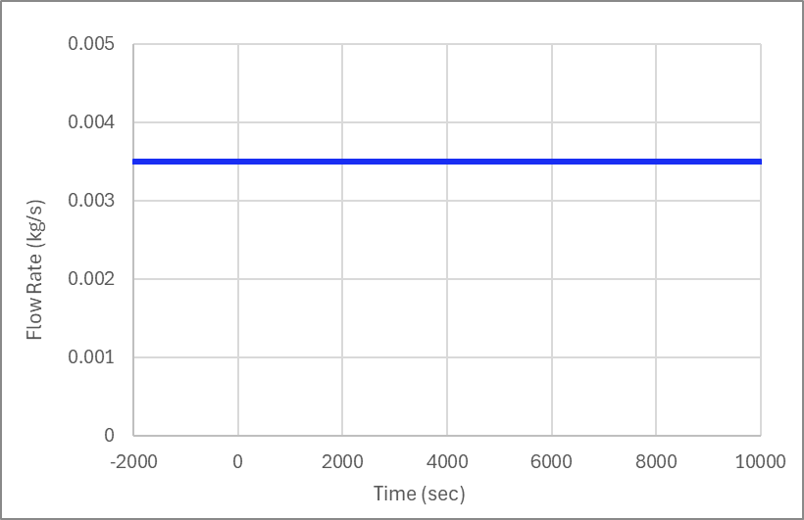
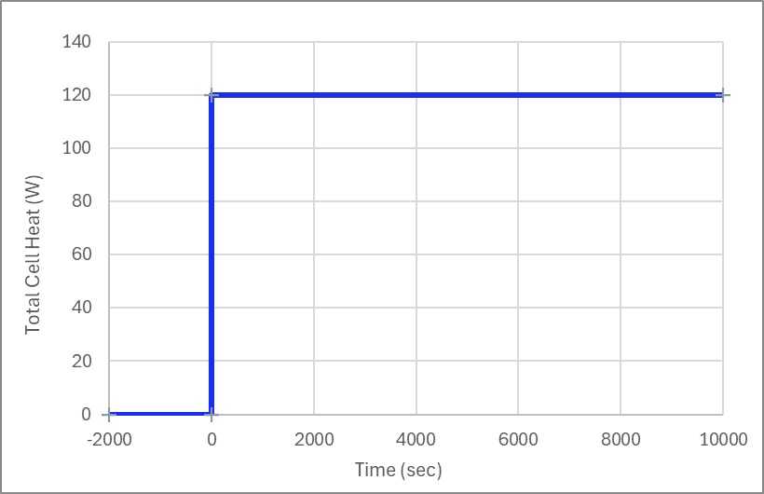
ROM Validation 02: Constant Flow Rate with Step Cell Heat
This use case can be modeled by an LTI ROM. But the LTI ROM requires new training for each new flow rate. The LTI + HTC ROM allows for the same ROM to be used for different flow rates.
Constant flow rate of 0.0035 kg/s
Step cell heat source of 120 W

Slide 13
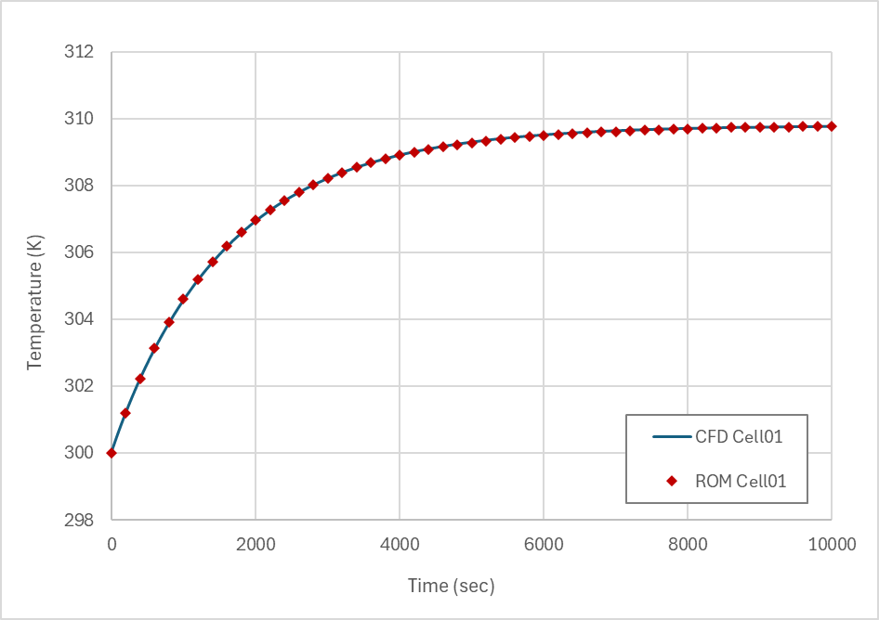
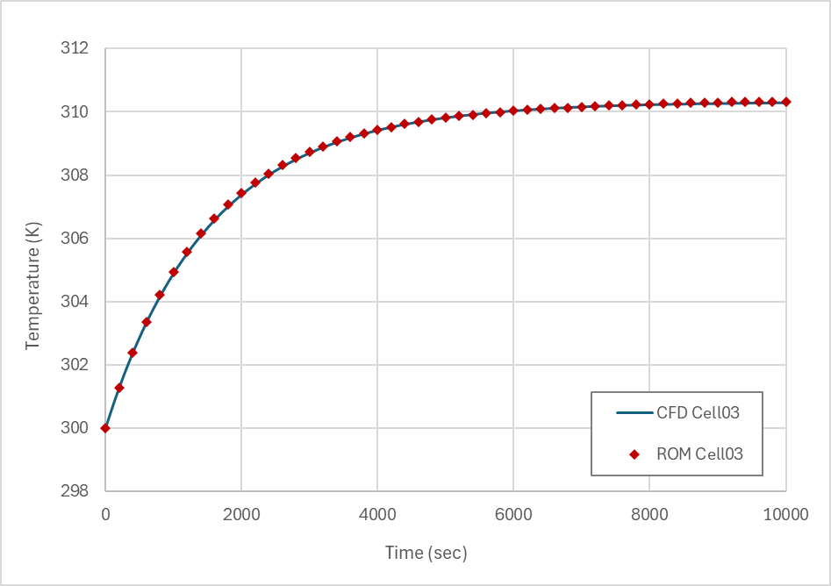
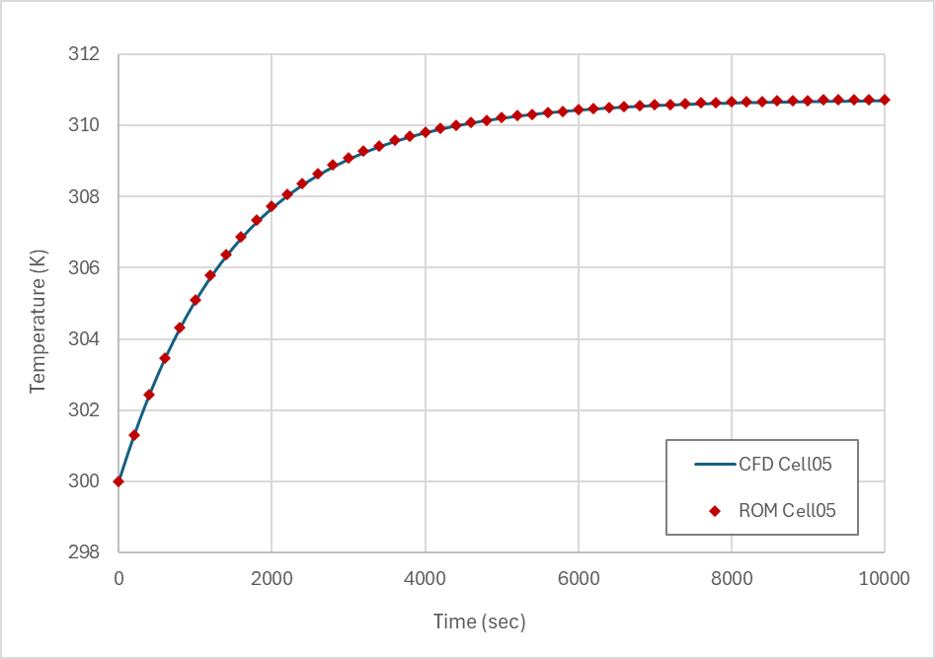
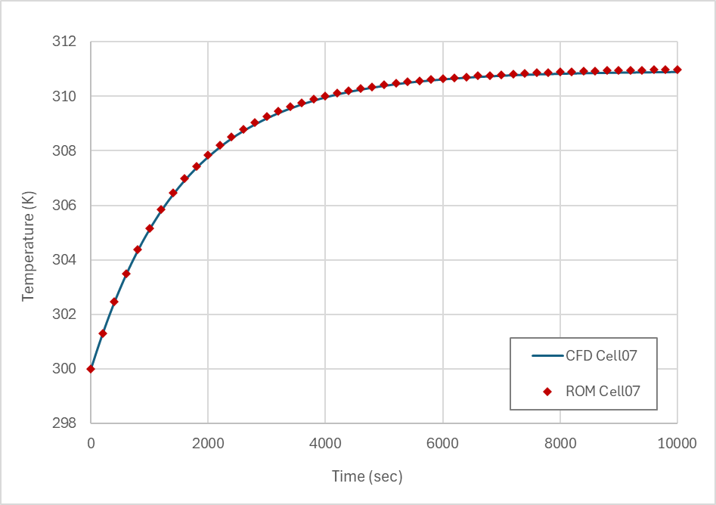
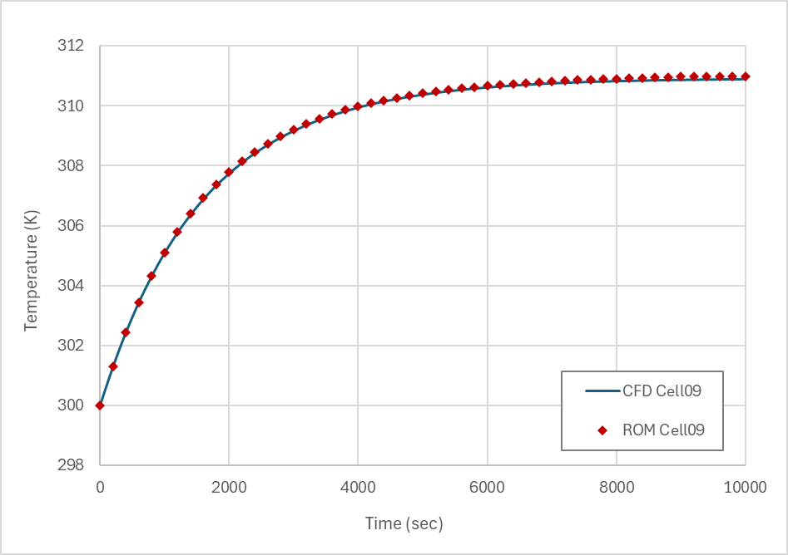
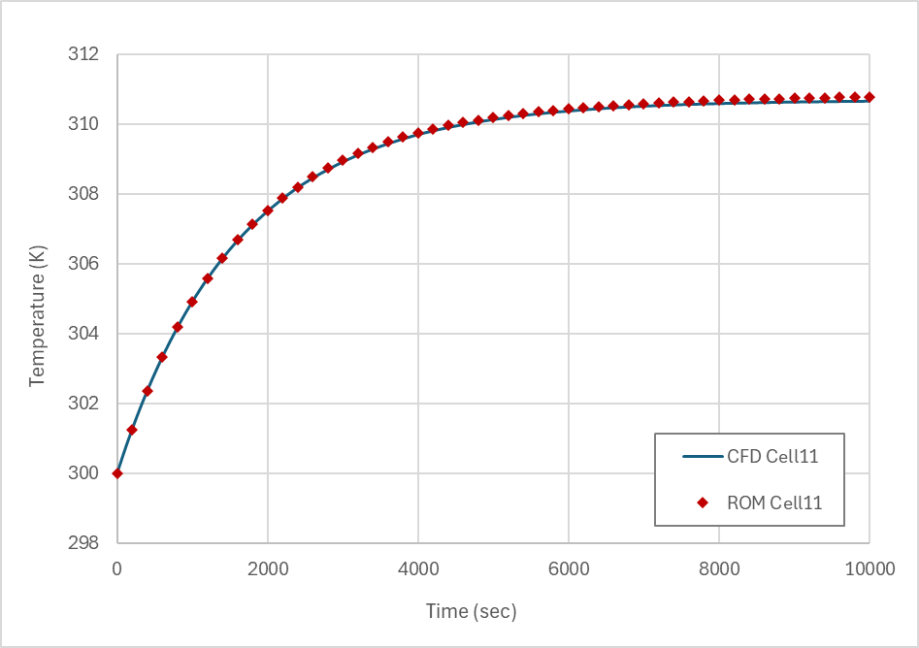
ROM Validation 02: Constant Flow Rate with Step Cell Heat

Slide 14
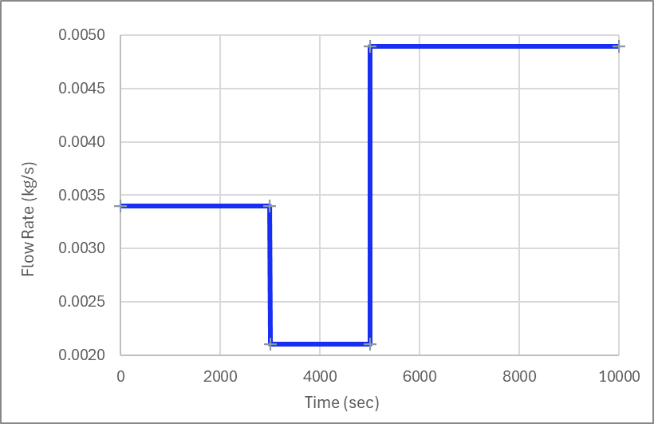
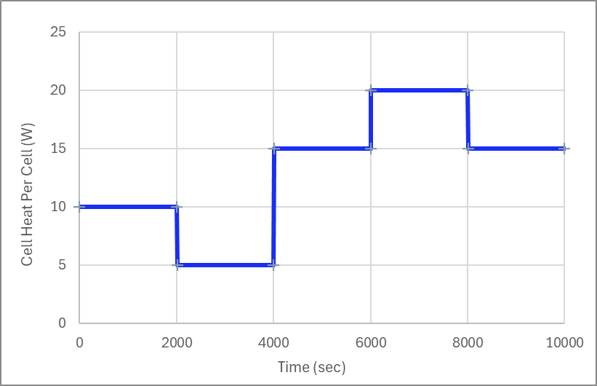
ROM Validation 03: Transient Flow Rate with Transient Cell Heat
Both flow rate and heat are functions of time.
A step change of flow rate is typical in battery cooling.
A step changes of cell heat is the more challenging test for the ROM compared with a continuous change.

Slide 15
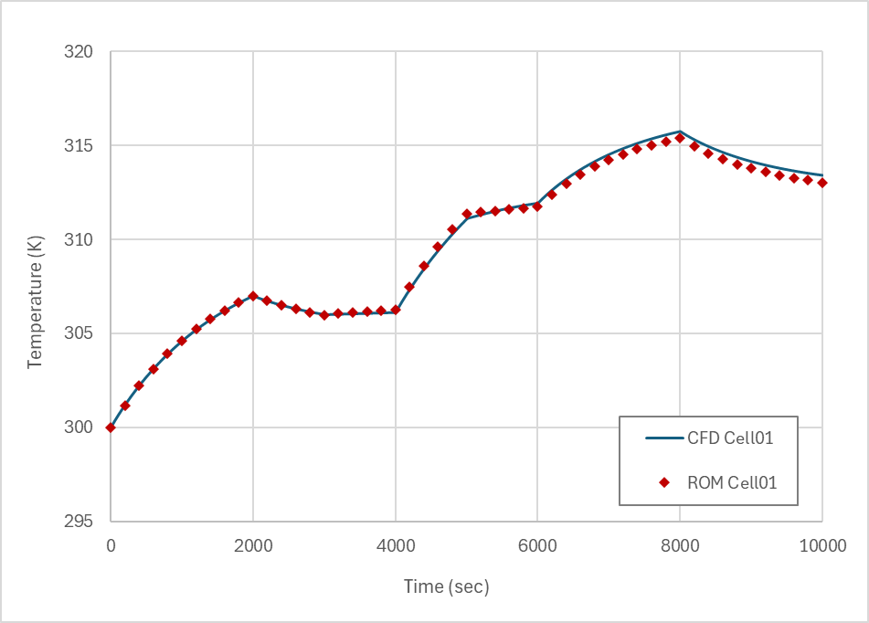
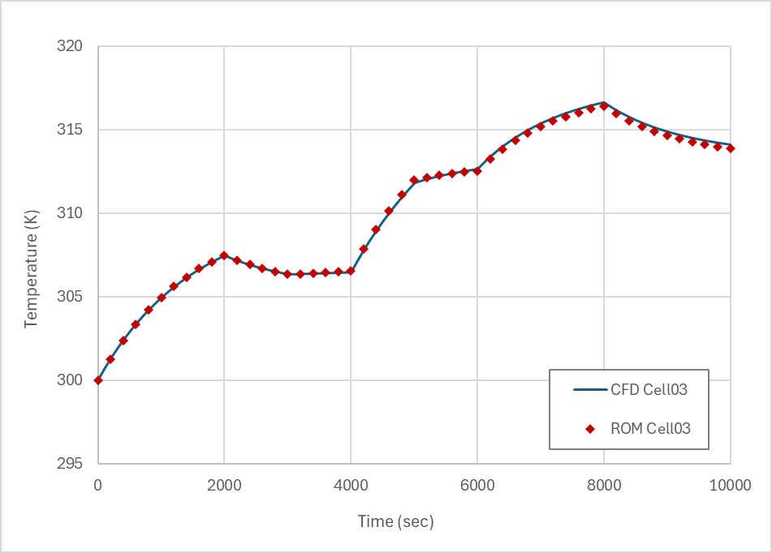
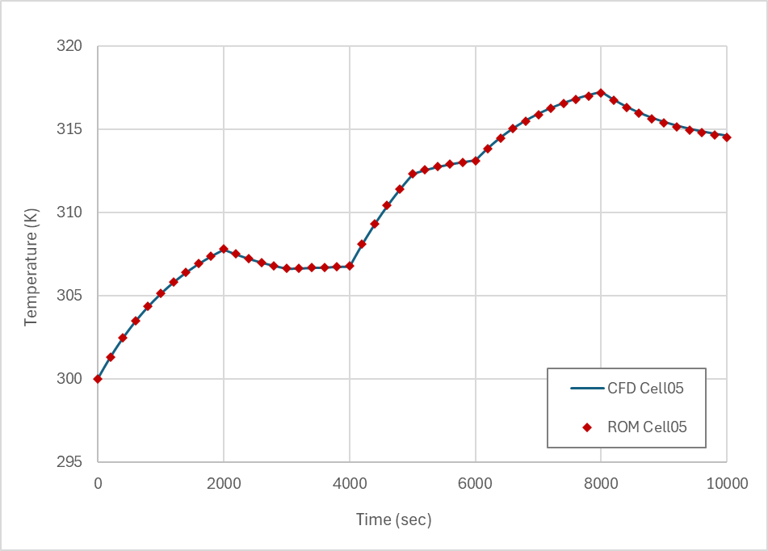
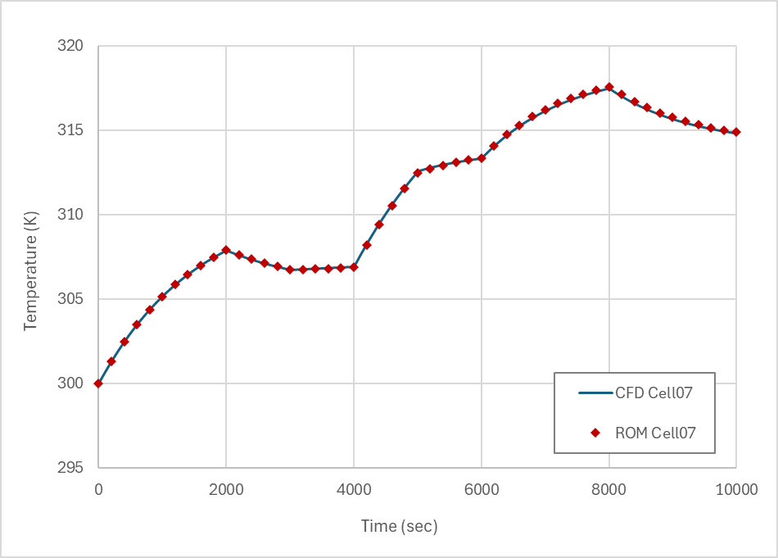
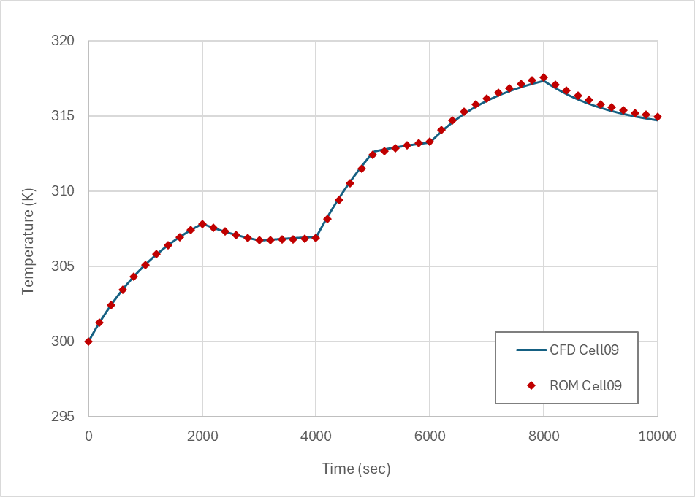
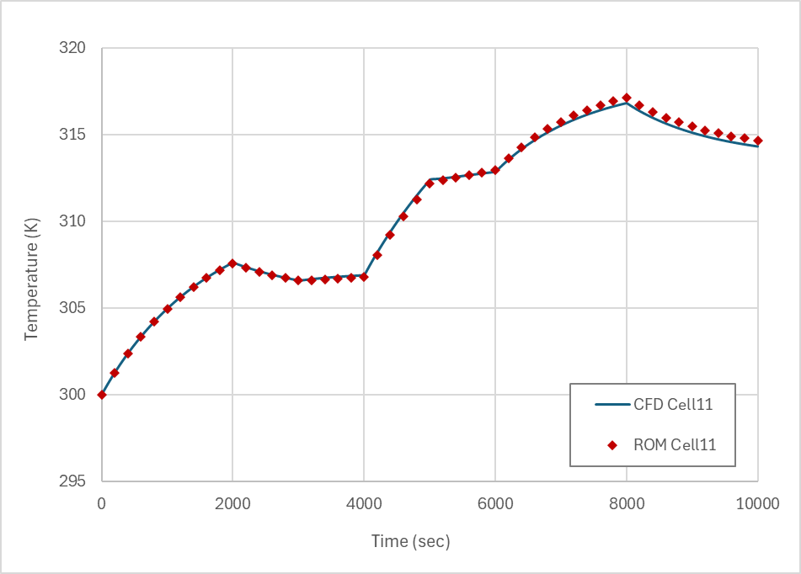
ROM Validation 03: Transient Flow Rate with Transient Cell Heat
Cell Temperature

Slide 16
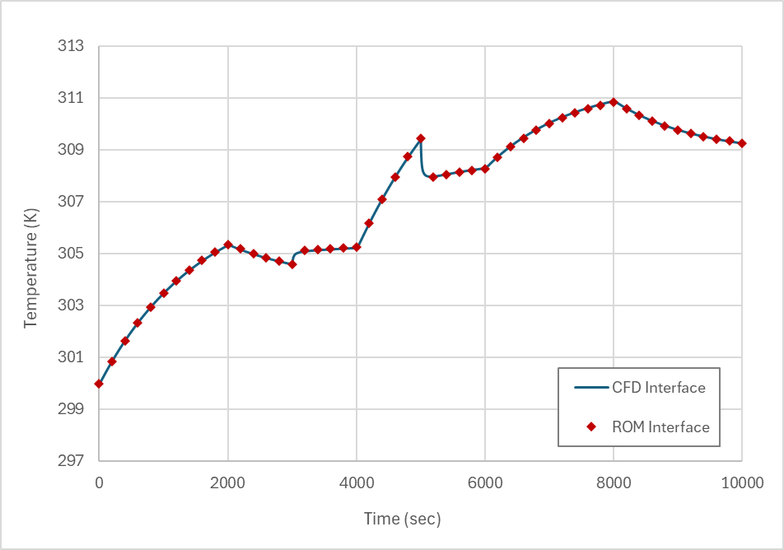
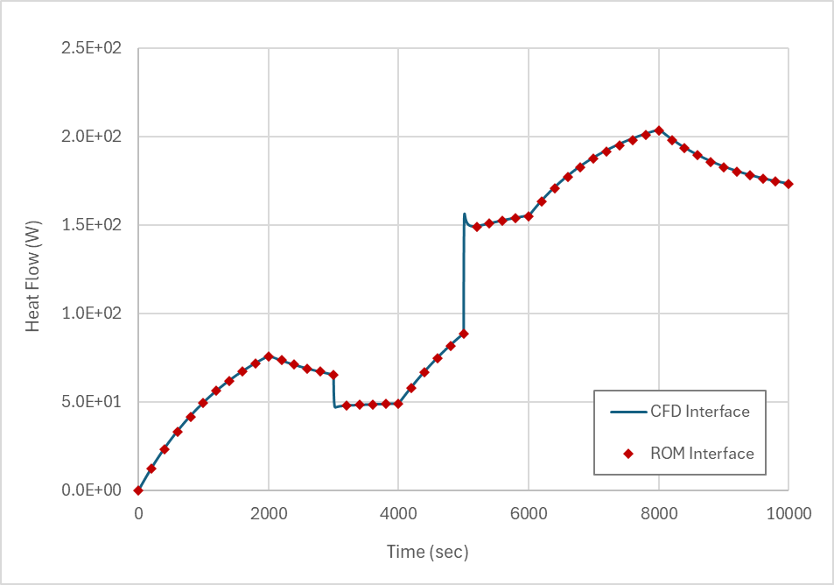
ROM Validation 03: Transient Flow Rate with Transient Cell Heat
Temperature at Fluid-Solid Interface
Heat Flow at Fluid-Solid Interface

Slide 17
Our Next Energy (ONE) Case Study

Slide 18
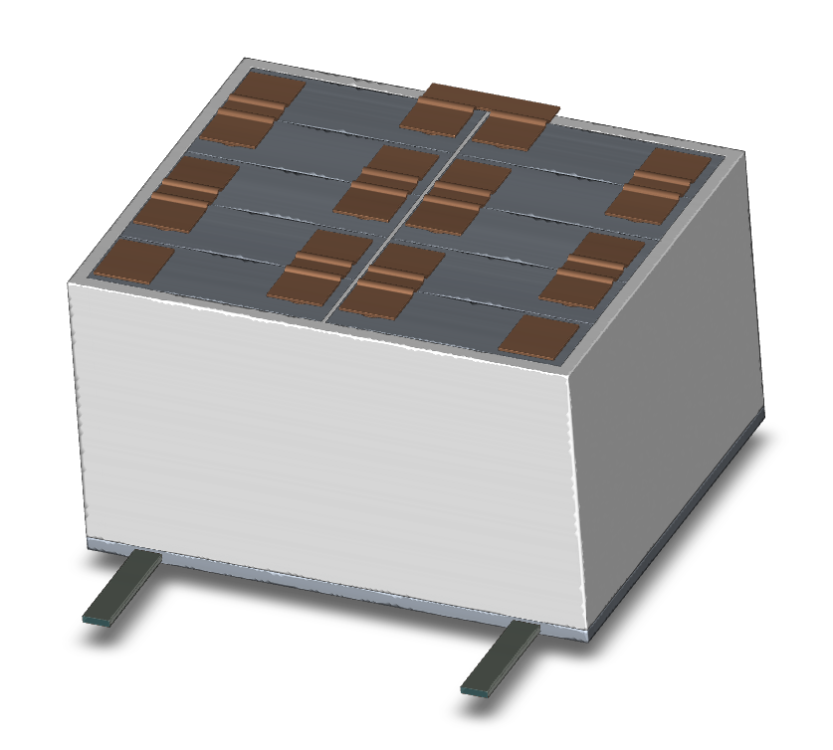
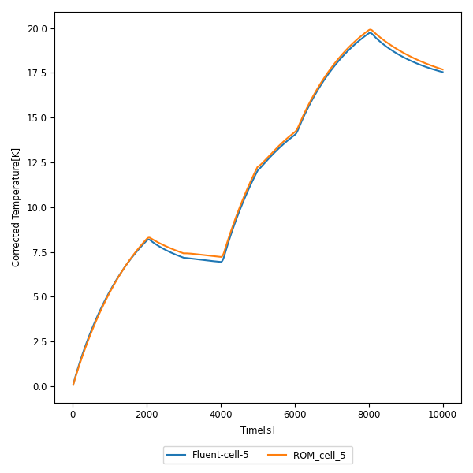
ONE Battery LTI+HTC ROM Results

Slide 19
Wartsila Case Study

Slide 20
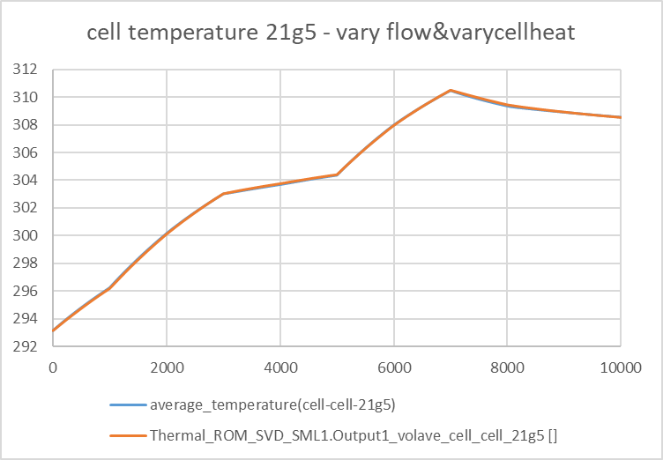
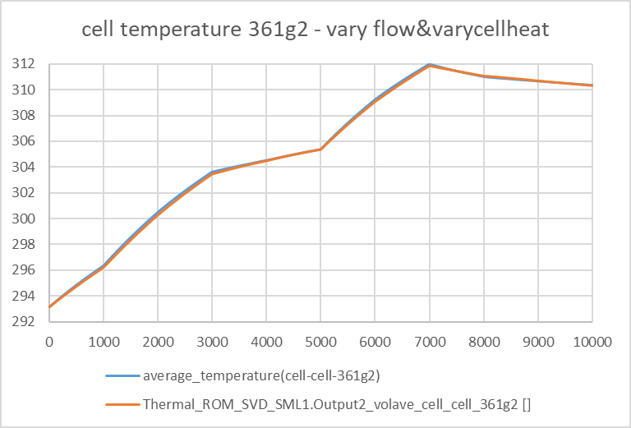
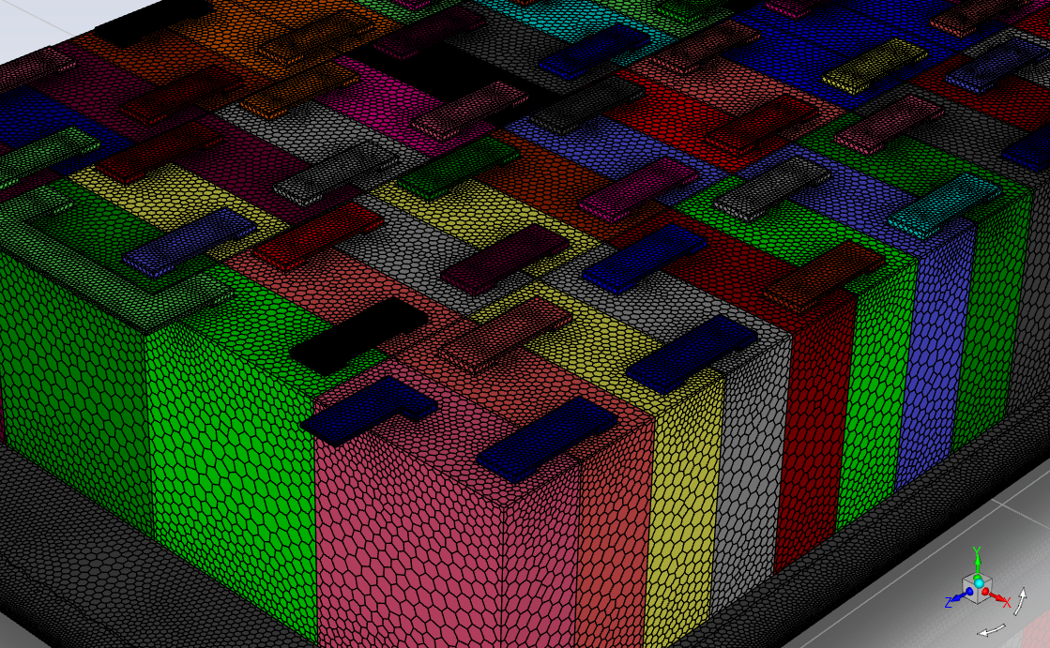
Wartsila Battery LTI+HTC ROM Results

Slide 21
Conclusions
A new LTI + HTC ROM is introduced to solve the transient battery thermal management problem with varying flow rate.
The new LTI + ROM consists of two components, an LTI ROM for the solid parts and an HTC component for the fluid part. Both components are created based on results from high fidelity CFD models.
The two components are two-way coupled through heat flow and temperature at the fluid-solid interface. The coupling can be either implicit or explicit. Implicit method is recommended whenever supported. The explicit method may not converge when using large time step sizes.
The ROM results are within 3% when compared with the high fidelity CFD results. And the ROM is orders of magnitude faster than the CFD model.

Slide 22
Appendix : Explicit Coupling

Slide 23
Twin Builder Implementation Using Explicit Coupling
The Explicit Coupling Model Starts to Diverge at a dt of 300 seconds.

