Slide 2

Modeling of Thermal Runaway Propagation in Battery Module Considering Vent Gas Combustion
Haechan Choi, Hyunjoo Kim, Kyoungdoug Min*

Slide 3



Introduction
Characteristics of thermal runaway
Positive temperature feedback loop
: Hotter battery generate more heat due to chain chemical reactions
Large amount of heat generation
: Highly reactive internal chemicals generate sufficient heat to raise
the battery temperature above 1000 °C.
Generation and release of vent gas
: Release of large amounts of high-temperature gas mixed with
flammable gases and oxygen
Integrated modeling incorporating all 3 elements is required
→ Detailed incorporation of chemical
reactions is essential.

Slide 4
Introduction
Chemical reactions during thermal runaway
Volatile chemicals inside the battery are highly sensitive to temperature changes.
Various chemical reactions occur simultaneously inside the battery during thermal runaway.
Complex chain reactions make it difficult to understand thermal runaway kinetics.
The exact mechanism remains unidentified due to complex reactions in a confined area.
Anode region
Electrolyte region
Cathode region
Self decomposition of SEI
SEI + Li
SEI + Fluorinated gases
Li + Binder (CMC)
Polymerization of Electrolyte
Decomposition of Salt
Oxidation of Electrolyte
Salt + Electrolyte
Salt + moisture
Phase transition of cathode
Binder + Li
Oxidation of conductor carbon
Transport of chemical species

Slide 5

Introduction
Reported chemical reactions
Hydrocarbons (CH₄, C₂H₄, C₂H₆, etc.)
$${\left(CH_{2}OCO_{2}Li\right)}_{2}→{Li}_{2}CO_{3}+C_{2}H_{4}+CO_{2}+0.5O_{2}$$
$$2Li+2C_{3}H_{4}O_{3}→{Li}_{2}CO_{3}+C_{2}H_{4}$$
$${Li}_{2}CO_{3}+PF_{5}→2LiF+POF_{3}+CO_{2}$$
$${Li}_{2}CO_{3}+2HF→2LiF+H_{2}O+CO_{2}$$
$$CMC−OH+Li→CMC−OLi+1/2H_{2}$$
$$−CH_{2}−CF_{2}− + Li→LiF + −CH=CF− + 1/2H_{2}$$
$${Li}_{0.2}MO_{2}→0.4 [{Li}_{0.5}M_{2.5}O_{3}]+0.4 O_{2}$$
$$C_{3}H_{4}O_{3}+2.5O_{2}→3CO_{2}+2H_{2}O$$
Hydrogen, water
Carbon dioxide, carbon monoxide
Oxygen
Others (PF₅, POF₃, etc.)
Generation of flammable gases and oxygen through chemical reactions
Ignition due to heat generation or arc formation between electrodes
→ Combustion of vent gas

Slide 6
Introduction
Composition of vent gas (Graphite/NMC811 pouch cell)
[Zou et al., International Journal of Heat and Mass Transfer, 2022.]
[Wang et al., Journal of Power Sources, 2024.]
[Chen et al., Journal of Loss Prevention in the Process Industries, 2020.]
Main components of vent gas include CO₂, CO, H₂, and hydrocarbons.
Experimental conditions can lead to varying results even for batteries with the same chemistry.
Contrary to chemical predictions, O₂ and H₂O are not detected.

Slide 7
Objective
Analysis of the effect of vent gas combustion on thermal runaway propagation using CFD simulation in a battery module
Contents
Development of a thermal runaway model capable of predicting vent gas composition
Development of a CFD simulation for thermal runaway propagation within a battery module
Analysis of thermal runaway propagation mechanisms within the battery module

Slide 8
Models used in research
Heat generation model
Model for simulating heat generation as a function of battery temperature
3 equations for anode, 3 equations for cathode, 1 equations for electrolyte
Chemical reaction model
Model for calculating quantity & composition of vent gas
Coupling chemical reactions with the heat generation model to determine reaction extent
Considering a total of 8 chemical reactions
Simulation for thermal runaway propagation
Simulation for modeling and analyzing thermal runaway propagation within the battery module
Developed using the commercial CFD tool STAR-CCM+

Slide 9
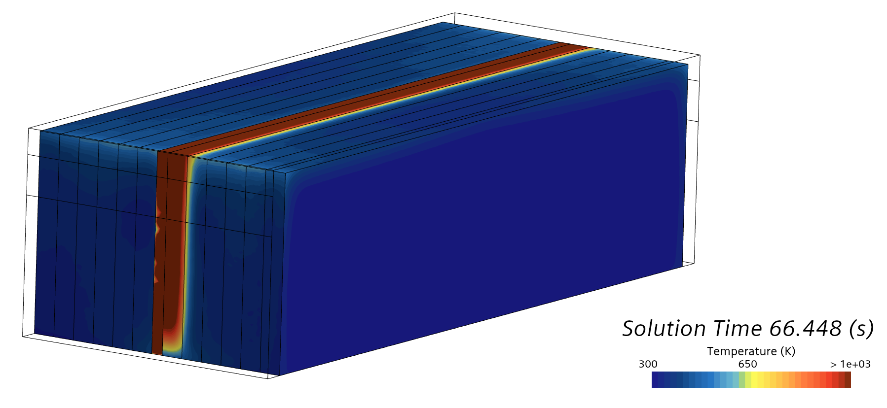
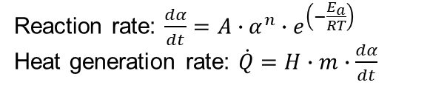







Schematic of research framework
TRP: Thermal runaway propagation
Heat generation model
CFD simulation for TRP
Reaction rate: $\frac{dα}{dt}=A∙α^{n}∙e^{\left(−\frac{E_{a}}{RT}\right)}$
Heat generation rate: $\dot{Q}=H∙m∙\frac{dα}{dt}$
$$T$$
Calculation of conjugate heat transfer
Heat transfer between cell & air
Heat transfer between cell & plate
Modeling of vent gas combustion
Use of chemical kinetic mechanism
Calculation of heat generation from reactions
Tracking of air composition within the module
$$\dot{Q}$$
(α: conversion ratio, $A$: frequency factor, $n$: reaction order, $E_{a}$: Activation energy, $H$: Enthalpy of reaction)
$$\frac{dα}{dt}$$
Chemical reaction model
$$\frac{dn_{A}}{dt}=−n_{A,i}∙\frac{dα}{dt}$$
$$\frac{dn_{B}}{dt}=−2∙n_{A,i}∙\frac{dα}{dt}$$
$$\frac{dn_{C}}{dt}=+3∙n_{A,i}∙\frac{dα}{dt}$$
$$\dot{m}, x$$
Reaction:
$A+2B →3C$
($n$: molar amount of species, $n_{i}$: initial molar amount of species)
(T: temperature, $\dot{Q}$: heat generation rate, $\frac{dα}{dt}$: conversion rate, $\dot{m}$: mass flow rate of vent gas, $x$: Composition of vent gas)

Slide 10
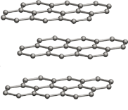


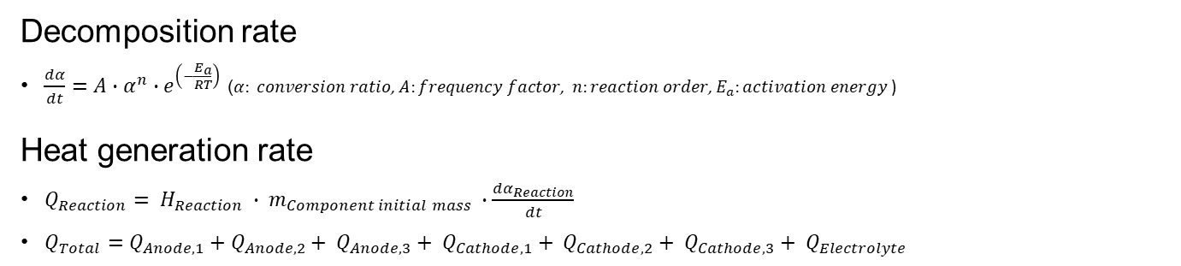
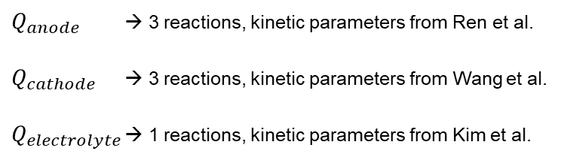
Methodology (Heat generation model)
SEI
$Q_{anode}$ → 3 reactions, kinetic parameters from Ren et al.
$Q_{cathode}$ → 3 reactions, kinetic parameters from Wang et al.
$Q_{electrolyte}$ → 1 reactions, kinetic parameters from Kim et al.
Anode
Cathode
Electrolyte
Separator
Decomposition rate
$\frac{dα}{dt}=A∙α^{n}∙e^{\left(−\frac{E_{a}}{RT}\right)}$ ($α: conversion ratio$, $A:frequency factor\text{, } n:reaction order\text{, }E_{a}:activation energy$)
Heat generation rate
$Q_{Reaction}= H_{Reaction} ∙ m_{Component initial mass} ∙\frac{dα_{Reaction}}{dt}$
$Q_{Total}=Q_{Anode,1}+Q_{Anode,2}+ Q_{Anode,3}+ Q_{Cathode,1}+ Q_{Cathode,2}+ Q_{Cathode,3}+ Q_{Electrolyte}$

Slide 11
Methodology (Chemical reaction model)
Anode reaction | p-SEI decomposition | (CH₂OCO₂Li)₂ → Li₂CO₃ + C₂H₄ + CO₂ + 0.5O₂
 | s-SEI regeneration | 2Li + 2C₃H₄O₃ → (CH₂OCO₂Li)₂ + C₂H₄
 | s-SEI decomposition | Li₂CO₃ + PF₅ → 2LiF + POF₃ + CO₂
 | CMC decomposition | CMC-OH + Li → CMC-OLi + 0.5H₂
Cathode reaction | Structural collapse (Layered → Spinel) | Li_{0.2}MO₂ → 0.4[Li_{0.5}MO₄] + 0.2O₂
 | Structural collapse (Spinel → Rock salt) | 0.4[Li_{0.5}MO₄] → Li_{0.2}MO_{1.2} + 0.2O₂
 | PVDF decomposition | -CH₂-CF₂- + Li → LiF + -CH=CF- + 0.5H₂
Electrolyte reaction | EMC evaporation | Liquid phase → Gas phase
Selection of chemical reactions suitable for NMC 811-based pouch cell through literature review

Slide 12


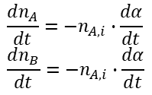


Methodology (Chemical reaction model)
Coupling decomposition rate ($\frac{dc}{dt}$) with chemical reactions
Chemical reaction model
$$\frac{dα}{dt}$$
Heat generation model
Selected chemical reaction
$$A+B →C+D$$
$$\frac{dn_{A}}{dt}=−n_{A,i}∙\frac{dα}{dt}$$
$$\frac{dn_{B}}{dt}=−n_{A,i}∙\frac{dα}{dt}$$
$$\frac{dn_{C}}{dt}=+n_{A,i}∙\frac{dα}{dt}$$
$$\frac{dn_{D}}{dt}=+n_{A,i}∙\frac{dα}{dt}$$
Anode reaction 1 | p-SEI decomposition
 | s-SEI regeneration
Anode reaction 2 | s-SEI decomposition
Anode reaction 3 | CMC decomposition
Cathode reaction 1 | Structural collapse (Layered → Spinel)
Cathode reaction 2 | Structural collapse (Spinel → Rock salt)
Cathode reaction 3 | PVDF decomposition
Electrolyte reaction | EMC evaporation

Slide 13
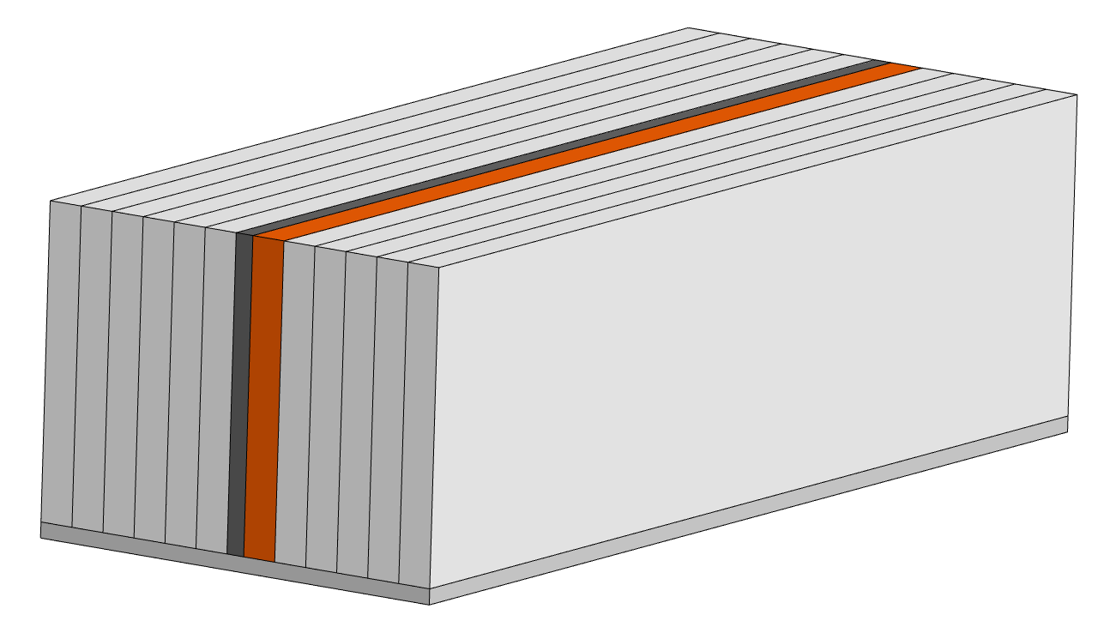
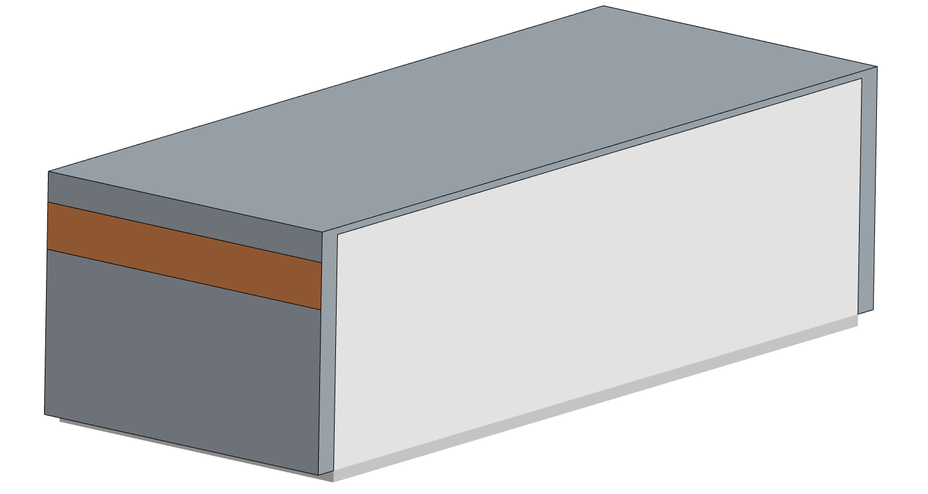
CFD Simulation setting
Size of module components
Cell #6
Part | Size [mm]
Cell | 340 x 11.5 x 100
Insulating pad | 340 x 6.2 x 100
Plate | 340 x 144.2 x 5
Exhaust hole | 144.2 x 20
Module | 350 x 144.2 x 103
Cell
Plate
Insulating pad
Exhaust hole
Properties of battery cell
Property | Value
Capacity | 60 Ah
Chemistry | Graphite / NCM811
Composition of electrolyte | 1:1 weight ratio of EC, EMC
Exhaust hole
Air

Slide 14
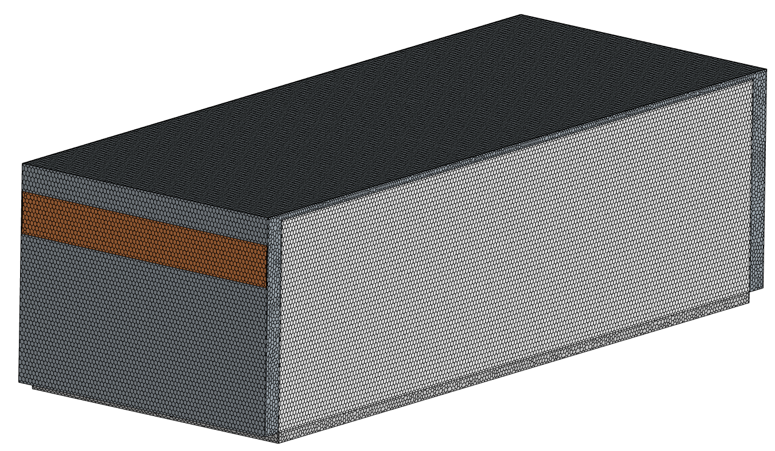
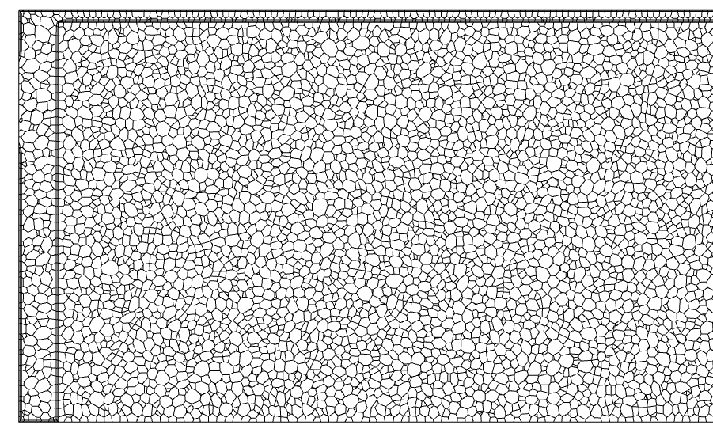
CFD Simulation setting
- CFD tool: STAR-CCM+
- Time step: 0.001 - 1 sec (variable time step)
- Mesher: polyhedral
- Basic mesh size : 2 mm
- Number of mesh element
Part | Number of mesh elements
Cell (each) | 40,005
Module | 180,290
Air | 544,782

Slide 15
CFD Simulation setting
Initial condition
Temperature of module : 300K
Temperature of cell #6 : 370K
Composition of air
→ N₂:O₂ = 0.78:0.22 (mole fraction)
Pressure of air : 1atm
Boundary condition
Exhaust hole – pressure outlet
Outer surface of air – adiabatic condition
Trigger for thermal runaway
Heat addition to cell 6 : 5000 W (Until 470 K)
Vent gas ejection
Vent duration: 10 s
Mass flow rate: 0.00714 kg/s
Mole fraction
Species | C₂H₄ | CO₂ | O₂
Mole fraction | 0.228 | 0.171 | 0.602
Thermal property of battery cell
Property | Value
Density | 2175 kg/m³
Specific heat | 1220 J/kg∙K
Thermal conductivity | 22.6 W/m∙K (in plane) 1.6 W/m∙K (through plane)
[Li et al., Journal of Energy Storage, 2024]

Slide 16
Validation of heat generation model
Comparison with experimental results of Zhang et al.
Comparison conducted between EV-ARC experimental results and modeling
Small difference in characteristic parameters
Futher improvement possible by incorporating endothermic reaction of the separator and internal short circuit reactions
Considered sufficiently reasonable for use in CFD
T₃
T₂
T₁
Parameter | Exp. | Model
T1 (℃) | 91.3 | 88.1
T2 (℃) | 202.1 | 223.0
T3 (℃) | 745 | 755.9
Thermal characteristic parameters
- T1: Self-heating onset temp.
- T2: Thermal runaway occurred temp.
- T3: Maximum temp.
[Zhang et al., Journal of Electrochemical Energy Conversion and Storage, 2023]

Slide 17
Validation of Chemical reaction model
Comparison of experimental vent gas composition with modeling to validate the selected chemical reactions
Calculations using Cantera were conducted to reflect composition changes due to gas-phase reactions.
Chemical reaction calculations using Cantera are not included in the CFD simulation process.
Validation process
Initial vent gas composition from chemical reaction model → Gas-phase reaction calculation using Cantera → Comparison
Chemical reaction calculation
A lithium-ion battery electrolyte surrogate model was used for the Cantera calculations.
This mechanism includes the combustion of lithium-ion battery electrolytes(EC, EMC, DMC and DEC).
The mechanism was numerically validated and calibrated using experimental data.
The calculations were performed under the assumption of isothermal and isobaric conditions.
[Kanayama et al., Combustion and Flame, 2024]

Slide 18
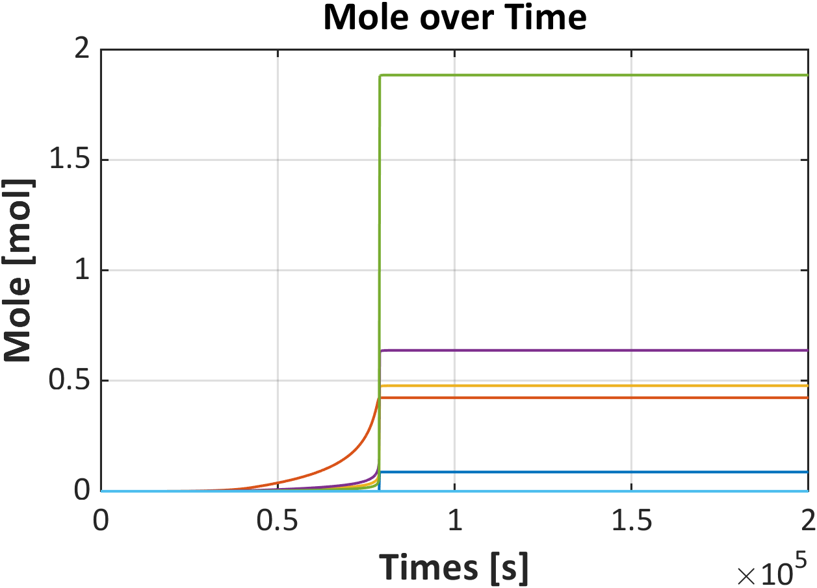
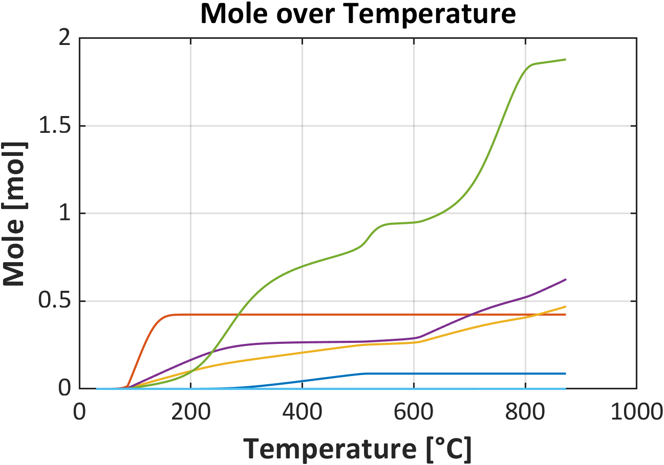
Validation of Chemical reaction model
Gas generation calculated through the chemical reaction model
POF₃
EMC_{(g)}
CO₂
Gas composition ratio
Gas generation calculated through a chemical reaction model coupled with a heat generation model
Reactions between gases not considered
Rapid consumption of O₂ and C₂H₄ through reaction
Absence of H₂ generation, unlike experimental results
C₂H₄
O₂
H₂
POF₃
EMC_{(g)}
CO₂
C₂H₄
O₂
H₂
Reaction calculations between gases using Cantera

Slide 19
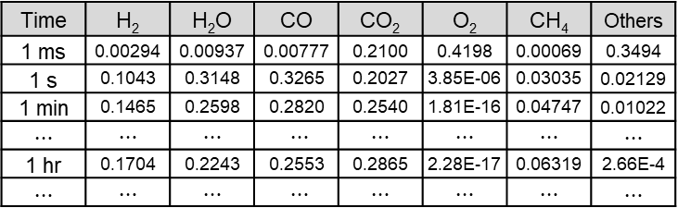
Validation of Chemical reaction model
Initial state of gases
1 min after
Temperature: 872.9℃
Amount of Gas Species (mol)
Heat of reaction: 631.67 kJ
Amount of Gas Species (mol)
H₂ | EMC | O₂ | CO₂ | C₂H₄ | POF₃
0.0002164 | 0.4235 | 1.8836 | 0.4778 | 0.6379 | 0.08703
H₂ | H₂O | CO | CO₂ | CH₄
0.1465 | 0.2598 | 0.2820 | 0.2540 | 0.04747
Gas Composition (mol)
Time | H₂ | H₂O | CO | CO₂ | O₂ | CH₄ | Others
1 ms | 0.00294 | 0.00937 | 0.00777 | 0.2100 | 0.4198 | 0.00069 | 0.3494
1 s | 0.1043 | 0.3148 | 0.3265 | 0.2027 | 3.85E-06 | 0.03035 | 0.02129
1 min | 0.1465 | 0.2598 | 0.2820 | 0.2540 | 1.81E-16 | 0.04747 | 0.01022
$⋯$ | $⋯$ | $⋯$ | $⋯$ | $⋯$ | $⋯$ | $⋯$ | $⋯$
1 hr | 0.1704 | 0.2243 | 0.2553 | 0.2865 | 2.28E-17 | 0.06319 | 2.66E-4
$⋯$ | $⋯$ | $⋯$ | $⋯$ | $⋯$ | $⋯$ | $⋯$ | $⋯$
Arbitrary setting of reaction time to 1 min
H₂, H₂O, CO, CO₂ ↑
O₂, Other gas ↓
Significant variation in gas composition when inter-gas reactions are considered

Slide 20
Validation of Chemical reaction model
Difference with experiment
 | Model | Previous research
H₂ | - 3.5 | - 20.39
CO | + 6.4 | + 14.4
CO₂ | - 0.1 | + 7.1
CH₄ | - 0.4 | - 4.48
O₂ | - | + 11.7
Others | - 2.5 | - 8.31
H₂ CO CO₂ CH₄ O₂ Others
[Yang et al., Applied Thermal Engineering, 2024] [Wang et al., Journal of Power Sources, 2024]
High prediction accuracy of gas composition with a maximum deviation below 6.4%
Improved gas composition prediction compared to previous researches
→ Demonstration of the validity of gas prediction using the chemical reaction model

Slide 21
Results
Cell 6 reaches its max. temp. (1037.6 K) at 62.2 s.
The other cells reach their max. temp. at 90 s.
At 90 sec, only Cell 4 exceeds 400 K, which is high enough to intiate thermal runaway
Due to the combustion of vent gas, the temp. of other cells also increased but remain below the self-heating temp.
Temperature of battery (at 0, 90 sec)
Time | Cell 1 | Cell 2 | Cell 3 | Cell 4 | Cell 5 | Cell 6 | Cell 7 | Cell 8 | Cell 9 | Cell 10 | Cell 11 | Cell 12
0 s | 300 | 300 | 300 | 300 | 300 | 370 | 300 | 300 | 300 | 300 | 300 | 300
90 s | 317 | 318 | 322 | 334 | 497 | 854 | 333 | 324 | 320 | 316 | 314 | 312

Slide 22
Results
③
3 Heat transfer mechanism
① Conduction heat transfer (direct)
: Heat transfer through direct surface contact between cells
② Conduction heat transfer (via plate)
: Heat transfer through the aluminum bottom plate
③ Convection heat transfer
: Heat transfer through high temperature vent gas
Cell
Cell
①
②
Amount of heat transfer by path
(Unit: J)
 | Cell 1 | Cell 2 | Cell 3 | Cell 4 | Cell 5 | Cell 7 | Cell 8 | Cell 9 | Cell 10 | Cell 11 | Cell 12
① | 259 | 264 | 312 | 8594 | 194484 | 2866 | 416 | 169 | 128 | 99 | 284
② | 7325 | 8644 | 11542 | 16086 | -1609 | 19123 | 12673 | 8608 | 5975 | 4430 | 3686
③ | 8914 | 9608 | 10203 | 10037 | 10208 | 11928 | 11094 | 11008 | 10238 | 8983 | 7610

Slide 23
Results
3 Heat transfer mechanism
① Conduction heat transfer (direct)
: Heat transfer through direct surface contact between cells
② Conduction heat transfer (via plate)
③ Convection heat transfer
Cell
Cell
①
Amount of heat transfer by path
(Unit: J)
 | Cell 1 | Cell 2 | Cell 3 | Cell 4 | Cell 5 | Cell 7 | Cell 8 | Cell 9 | Cell 10 | Cell 11 | Cell 12
① | 259 | 264 | 312 | 8594 | 194484 | 2866 | 416 | 169 | 128 | 99 | 284
② | 7325 | 8644 | 11542 | 16086 | -1609 | 19123 | 12673 | 8608 | 5975 | 4430 | 3686
③ | 8914 | 9608 | 10203 | 10037 | 10208 | 11928 | 11094 | 11008 | 10238 | 8983 | 7610
Direct conduction via surface contact accounts for 50.2 % of the total heat transfer.
Most of the heat transfer is concentrated in the adjacent Cell 5.
It’s the main cause of chain thermal runaway propagation in the module.

Slide 24
Results
3 Heat transfer mechanism
① Conduction heat transfer (direct)
② Conduction heat transfer (via plate)
: Heat transfer through the aluminum bottom plate
③ Convection heat transfer
Cell
Cell
②
Amount of heat transfer by path
(Unit: J)
 | Cell 1 | Cell 2 | Cell 3 | Cell 4 | Cell 5 | Cell 7 | Cell 8 | Cell 9 | Cell 10 | Cell 11 | Cell 12
① | 259 | 264 | 312 | 8594 | 194484 | 2866 | 416 | 169 | 128 | 99 | 284
② | 7325 | 8644 | 11542 | 16086 | -1609 | 19123 | 12673 | 8608 | 5975 | 4430 | 3686
③ | 8914 | 9608 | 10203 | 10037 | 10208 | 11928 | 11094 | 11008 | 10238 | 8983 | 7610
Conduction through plate below the module accounts for 23.3 % of the total heat transfer.
Cell 5 has a higher temp. than the plate, resulting in a negative heat transfer value.
Heat transfer through the plate tends to increase as proximity to Cell 6 increases.

Slide 25
Results
③
3 Heat transfer mechanism
① Conduction heat transfer (direct)
② Conduction heat transfer (via plate)
③ Convection heat transfer
: Heat transfer through high temperature vent gas
Cell
Cell
Amount of heat transfer by path
(Unit: J)
 | Cell 1 | Cell 2 | Cell 3 | Cell 4 | Cell 5 | Cell 7 | Cell 8 | Cell 9 | Cell 10 | Cell 11 | Cell 12
① | 259 | 264 | 312 | 8594 | 194484 | 2866 | 416 | 169 | 128 | 99 | 284
② | 7325 | 8644 | 11542 | 16086 | -1609 | 19123 | 12673 | 8608 | 5975 | 4430 | 3686
③ | 8914 | 9608 | 10203 | 10037 | 10208 | 11928 | 11094 | 11008 | 10238 | 8983 | 7610
Convection heat transfer accounts for 26.5 % of the total heat transfer.
Heat transfer by convection shows relatively more uniform heat distribution among the cells.
If a different module shape is assumed, the simulation results would be significantly different.

Slide 26
Results
③
State change of air during thermal runaway progression
Before venting, the temp. of the air slowly increases due to the hot surface of the battery.
After venting start, the inflow of vent gas rapidly raises the air temp. to a level comparable to that of the battery.
Combustion occurs a few seconds after venting start, increasing the air temp. to over 2500 K.
After venting ends and the flame extinguishes, the air temp. rapidly decreases below 500 K.
②
④
①
Composition of air in module
Before venting
Before combustion
During combustion
After combustion

Slide 27
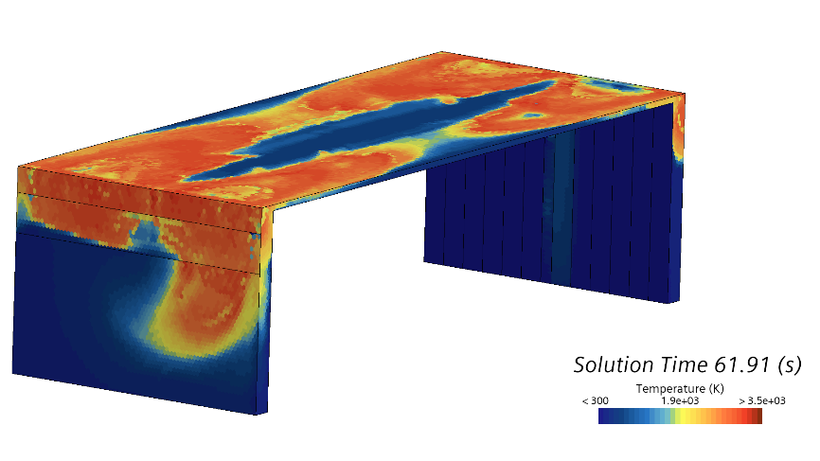
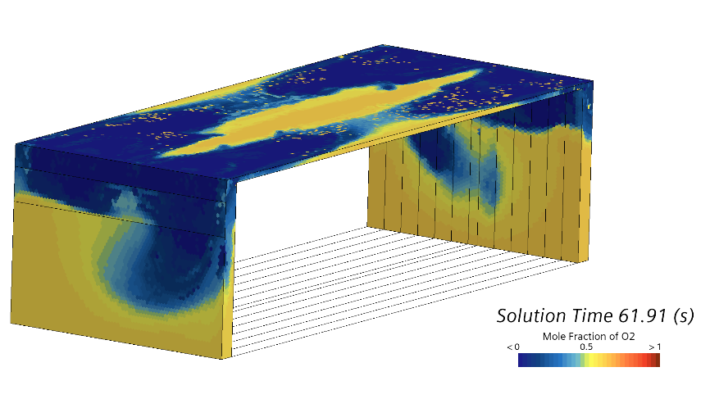
Results
Temperature of gas
①
②
Mole fraction of O₂
① Initiation of vent gas combustion
Accumulated vent gas combusts all at once, releasing large
amount of heat in a short period
Flame propagates in air region, consuming oxygen and fuel.

Slide 28
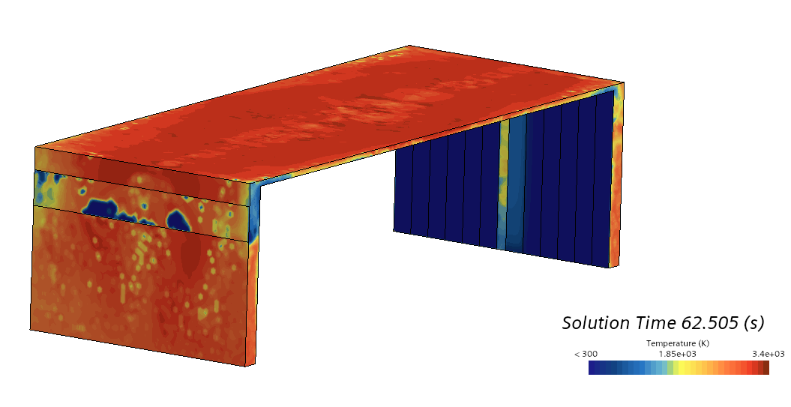
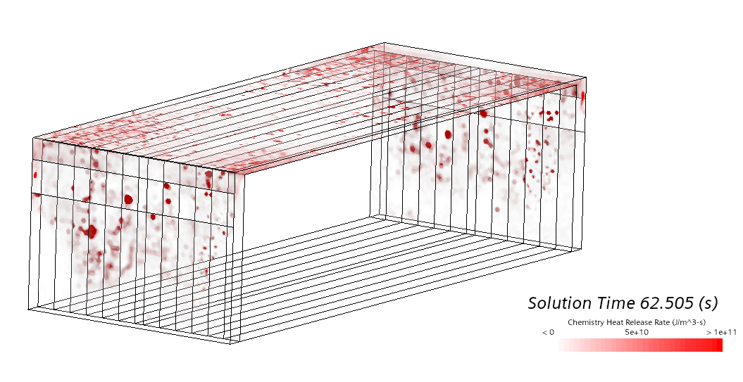
Results
Temperature of gas
①
②
Chemical heat release rate
② Continous combustion of vent gas
Generated vent gas ignites immediately upon release
Relatively uniform heat generation is achieved.

Slide 29
Conclusion
TRP: Thermal runaway propagation
Summary
Simulation for TRP is developed by combination of heat generation model, chemical reaction model, and CFD simulation.
Good agreement between heat generation model and chemical reaction model with experimental results
TRP simulation modeled heat transfer from a single cell undergoing thermal runaway to neighboring cells in module.
Thermal runaway propagation mechanism were revealed through analysis of heat transfer path.
Direct conduction was the dominant pathway for thermal runaway propagation, followed by convection and indirect conduction (through plate).
Change of gas composition, gas temperature and propagation of flame is observed.
Future works
1. Validation of simulation through comparison between experimental results will conducted.
2. Surrogate model for the combustion of vent gas needed to investigated.
3. Through parametric study, optimization of battery module / pack design will be conducted.

Slide 30
Contact Info
Thank you
      Haechan Choi
      Seoul National University
      1, Gwanak-ro, Gwanak-gu, Seoul, Republic of Korea
      +82-10-2492-1528
      Haechan@snu.ac.kr

