Slide 2
Impact of Extreme Temperatures on EVs in Kingdom of Saudi Arabia (KSA)
Lama Mohammed A Bedywi, Haneen Radi A AlJuhani, Dr. Bashar S. AbdulNour

Slide 3
Introduction
The electric vehicle (EV) industry in the Kingdom of Saudi Arabia (KSA) is experiencing rapid growth, supported by companies such as CEER, Lucid, and Tesla.
This presentation evaluates how extreme ambient temperatures, which can exceed 50°C in some regions of KSA during summer, affect EV battery performance and charging infrastructure.
Notes:
Understanding these thermal conditions is crucial for ensuring reliability, safety, and system efficiency, which are vital for sustainable EV adoption. This presentation will highlight the critical relationship between charging infrastructure, thermal conditions, and battery behavior, especially in urban areas with high EV concentrations and elevated ambient temperatures. We will also explore the broader context of infrastructure demand, consumer behavior, and Saudi Arabia's strategic plans for EV charging.Arabia’s unique geographic and environmental conditions.

Slide 4
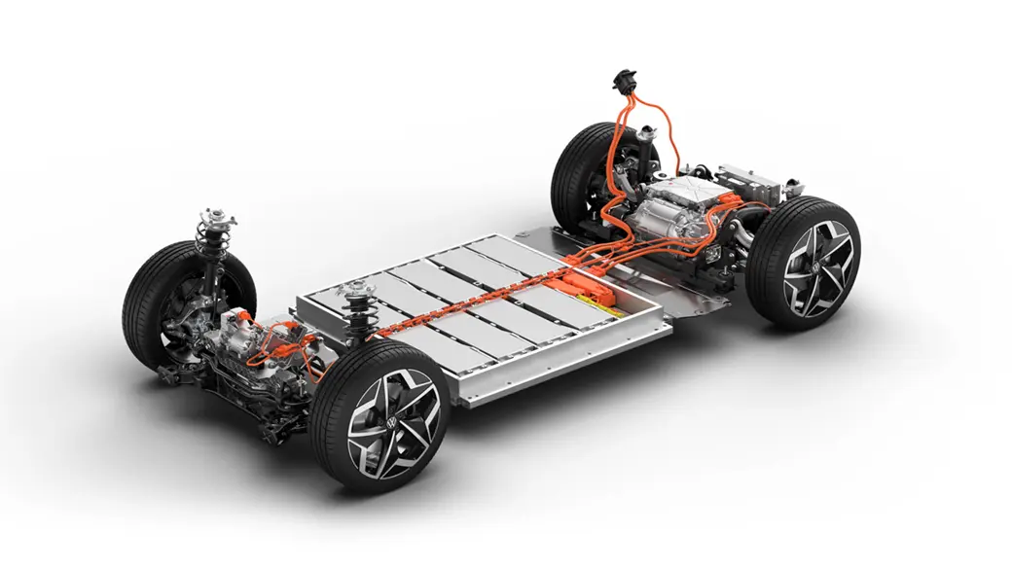
Temperature in Saudi Arabia
Electric Vehicles (EVs) depend mainly on lithium-ion battery systems, which are extremely sensitive to temperature changes.

Slide 5
Optimal Performance: | Extreme Heat in KSA:
Lithium-ion batteries function best at temperatures between 20°C and 40°C, with 20°C to 30°C being ideal for both charging and discharging. | Summer temperatures in hot regions of Saudi Arabia, particularly in cities like Riyadh, frequently rise above 45°C and can reach up to 50°C.

Slide 6
Why Temperature Matters for EV Batteries
Long-term exposure to high temperatures has detrimental effects on:
Lifespan of a battery
Efficiency of energy
Speed and capacity of charging
Dependability and safety

Slide 7
Accelerated Battery Degradation
Chemical Reactions | Elevated temperatures intensify harmful chemical reactions within lithium-ion batteries, such as electrolyte breakdown and the formation of a solid electrolyte interphase (SEI) layer on the anode. These reactions lead to a permanent loss of battery capacity.
Cycle Life Reduction | Operating a battery at 40°C instead of 20°C can reduce its cycle life by up to 40%. At 45°C, a battery may only endure half the charge cycles it would under optimal temperatures.
Long-Term Consequences | Hot climates like Saudi Arabia face a higher risk of rapid capacity loss compared to those in cooler regions. This results in a shorter battery lifespan, lower vehicle resale value, and increased total cost of ownership due to earlier battery replacement needs.

Slide 8
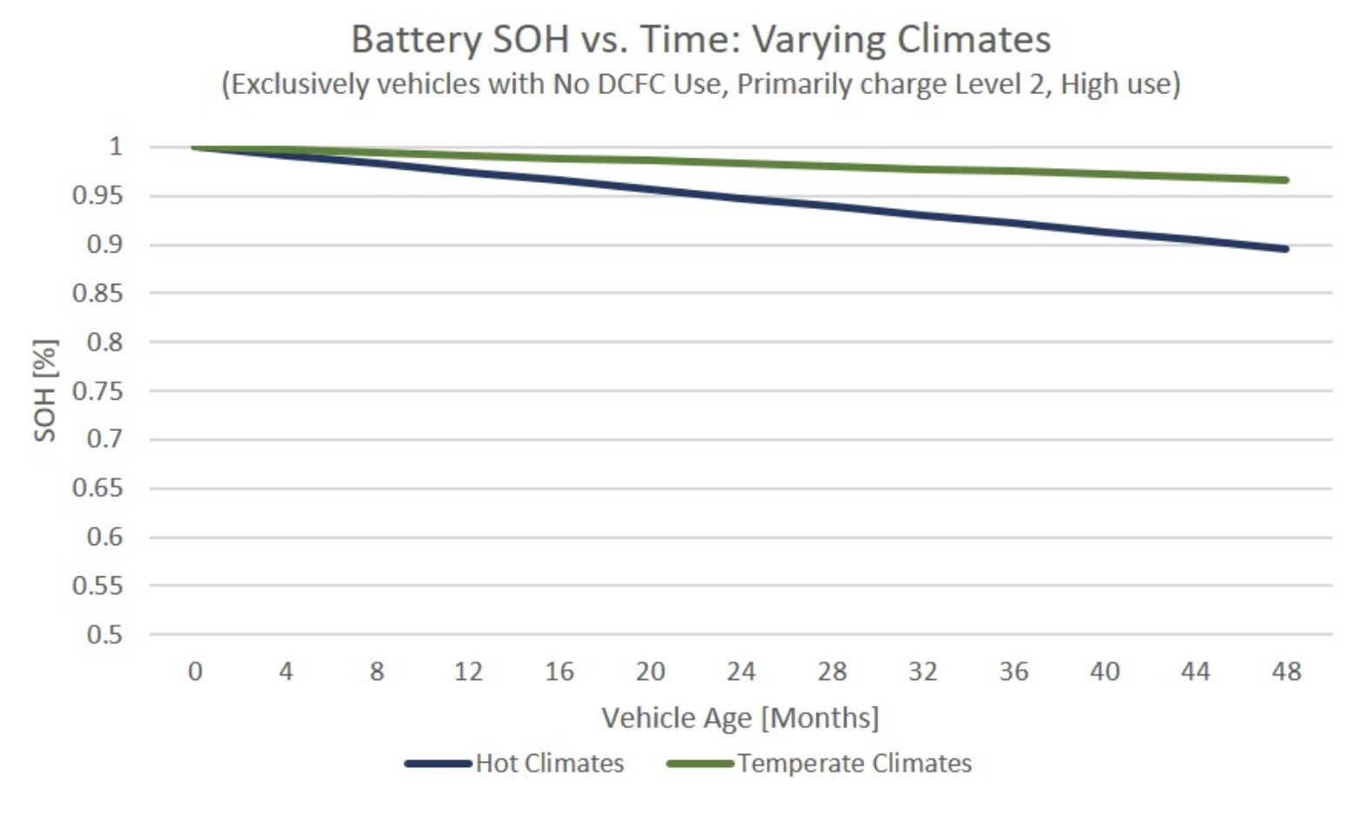
Battery SOH vs. Time : Varying Climates

Slide 9
Battery Charge vs. Year
Estimated recoverable capacity when storing Li-ion for one year at various temperatures

Slide 10
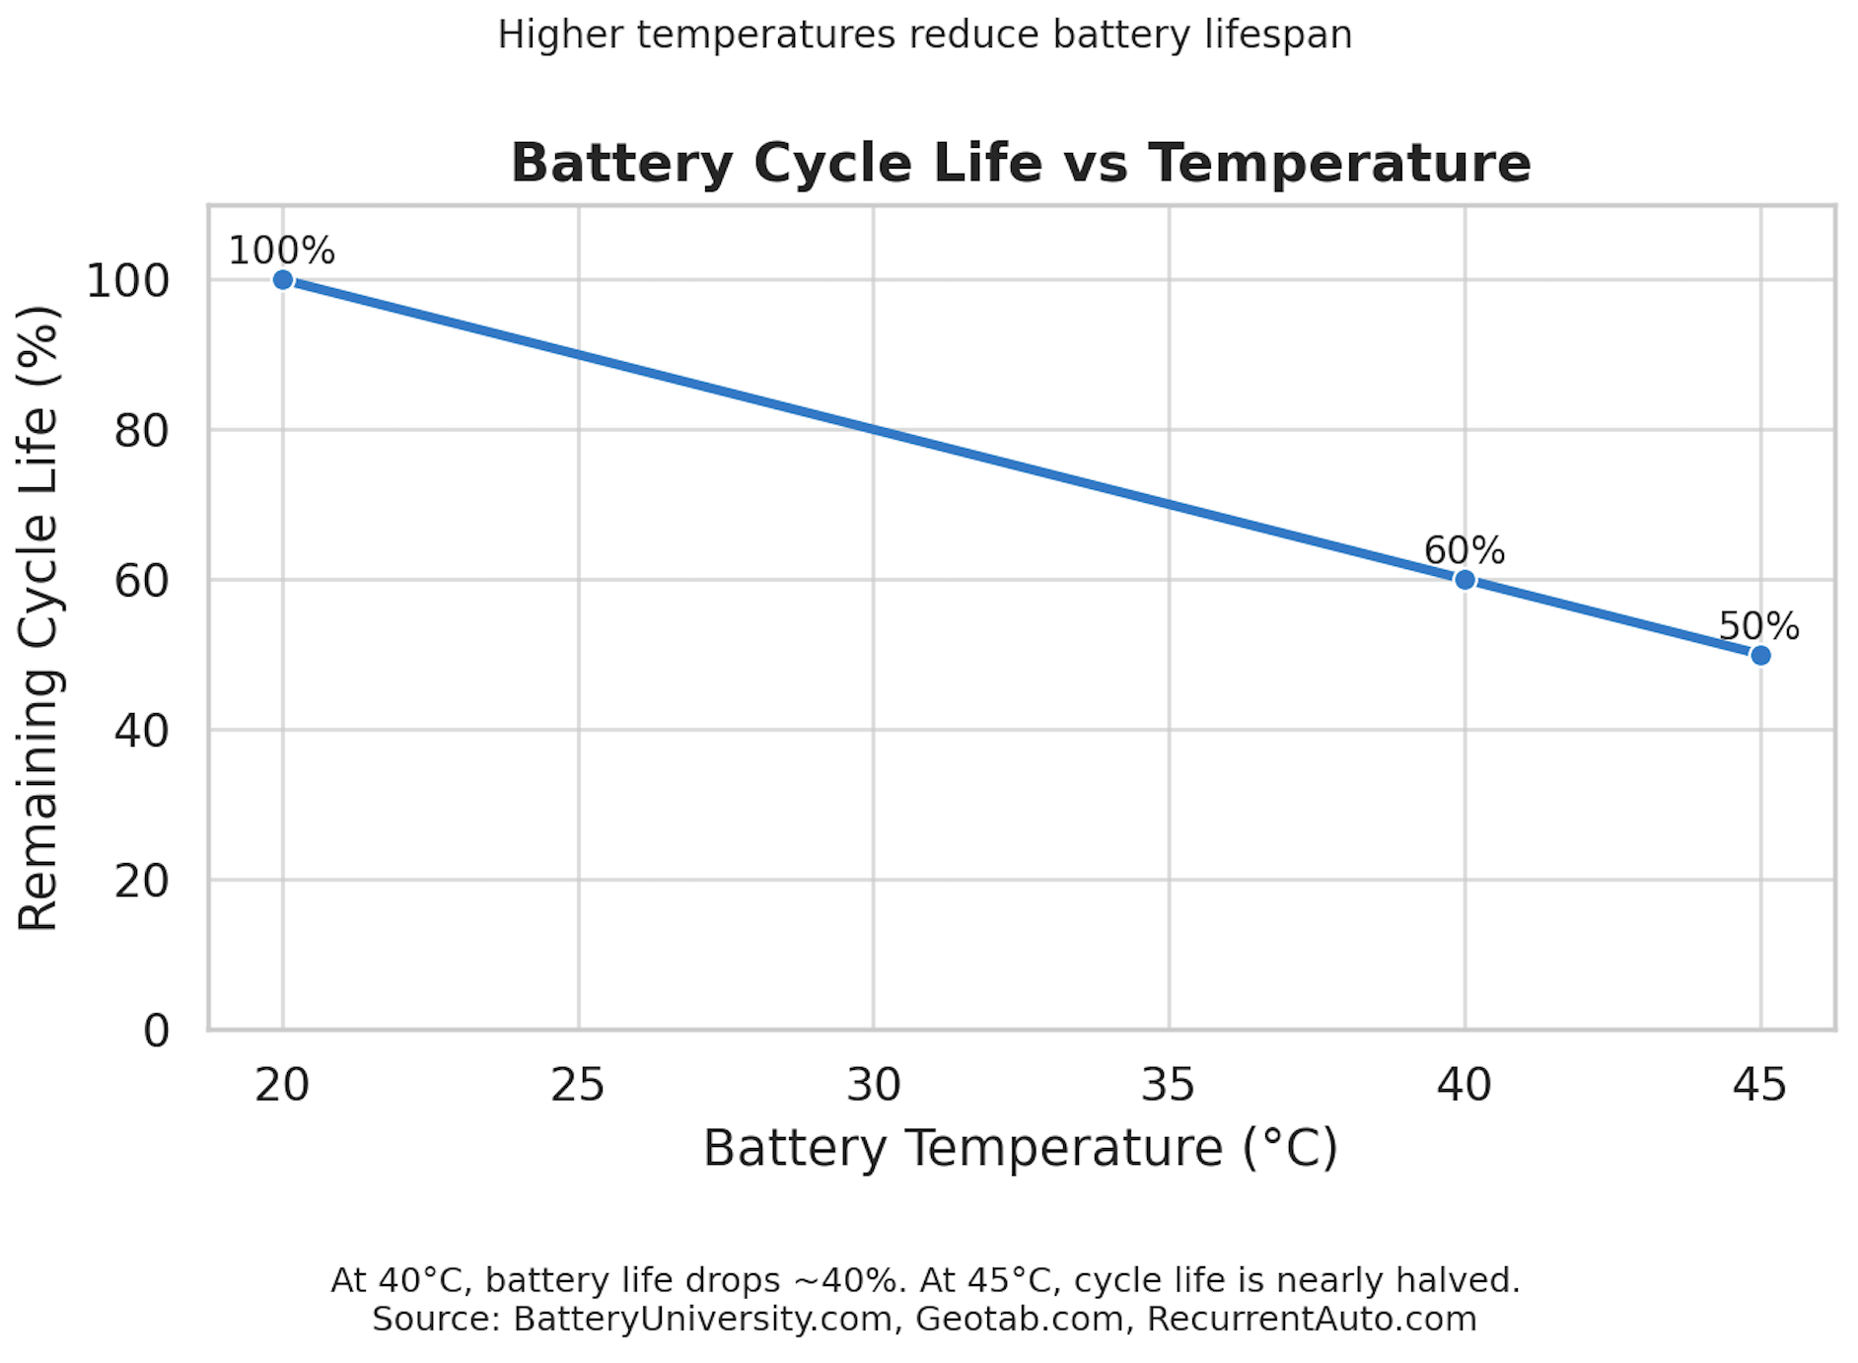
Accelerated Battery Degradation
Higher temperatures reduce battery lifespan

Slide 11
Self-Discharge in High Temperatures
Battery degradation continues even when an EV is parked, not just during driving or charging.
High ambient temperatures cause a significant increase in self-discharge rates, the battery slowly loses energy even when not in use.
Parking in direct sunlight or outdoors during hot weather accelerates this energy loss, especially in cities like Riyadh.

Slide 12
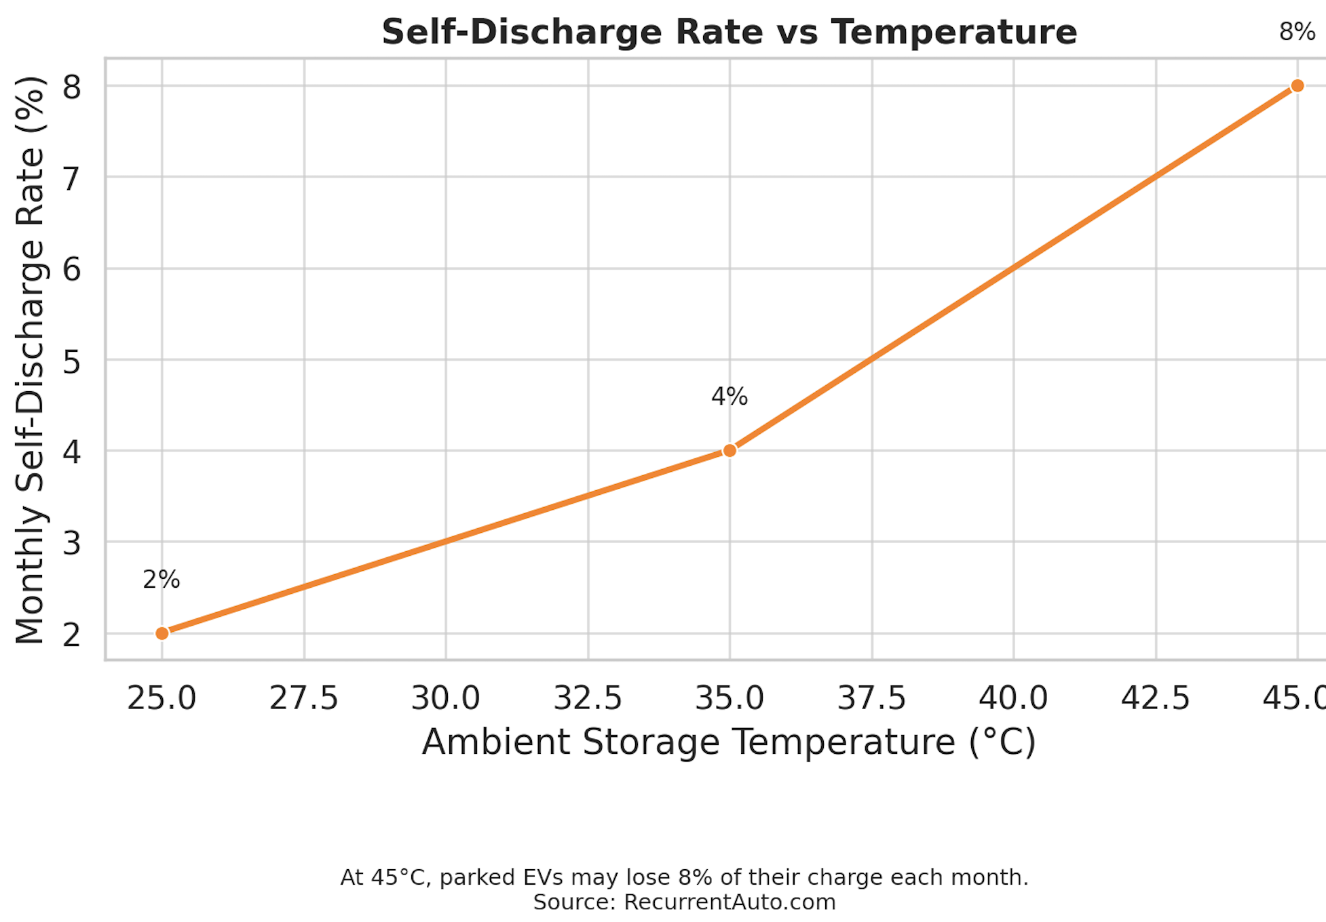
Self-Discharge Rate vs. Temperatures

Slide 13
Charging Performance
High temperatures reduce charging efficiency in EVs. The Battery Management System (BMS) limits charging current when the battery overheats. This is especially true during DC fast charging, which generates internal heat. In temps above 45°C, EVs may:
Slow down charging
Extend charging time
Pause charging until the battery cools

Slide 14
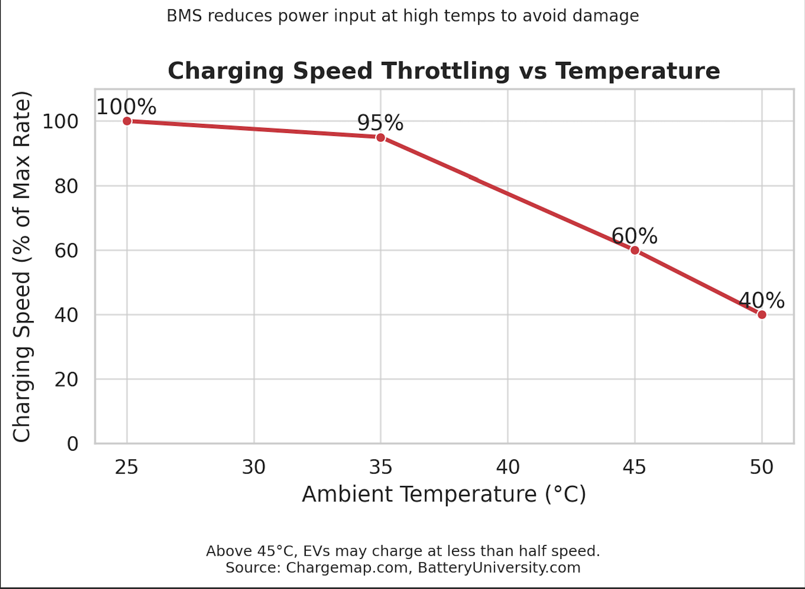
Speed vs. Temperatures
BMS reduces power input at high temperatures to avoid damage

Slide 15
Thermal Runaway
Thermal runaway (Slow-Moving Cancer) occurs when a battery’s internal temperature rises uncontrollably, potentially leading to fire or explosion. Although rare, it becomes more likely when the battery is already weakened by extended heat exposure. At temperatures above 60°C, even minor triggers (e.g., manufacturing defects or voltage imbalances) can initiate thermal runaway. In Saudi Arabia’s climate, prolonged exposure to ~50°C ambient heat can cause:
Internal short circuits
Cell swelling
Gas buildup inside battery cells

Slide 16
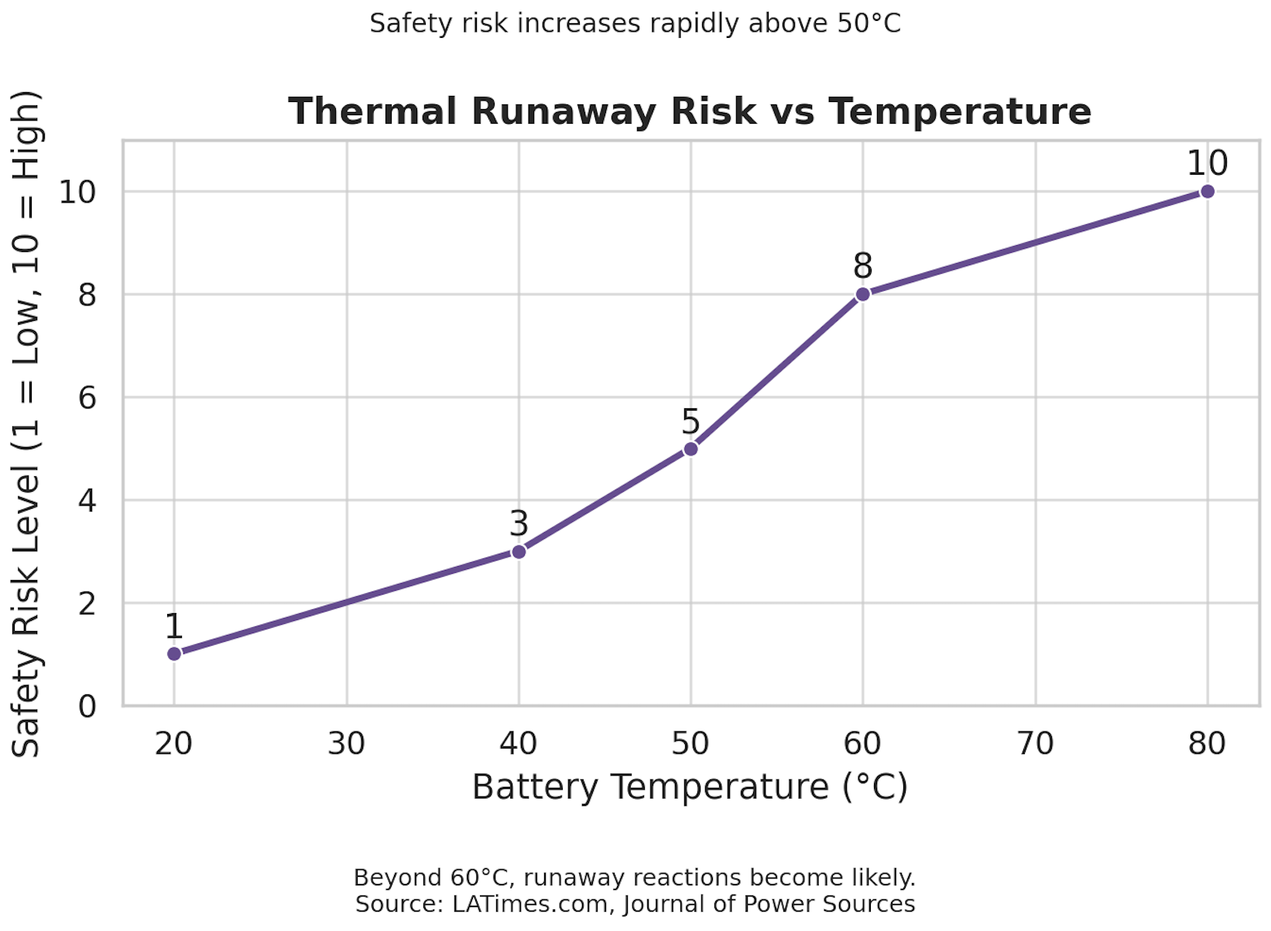
Thermal Runaway
Safety risk increases rapidly above 50 C

Slide 17
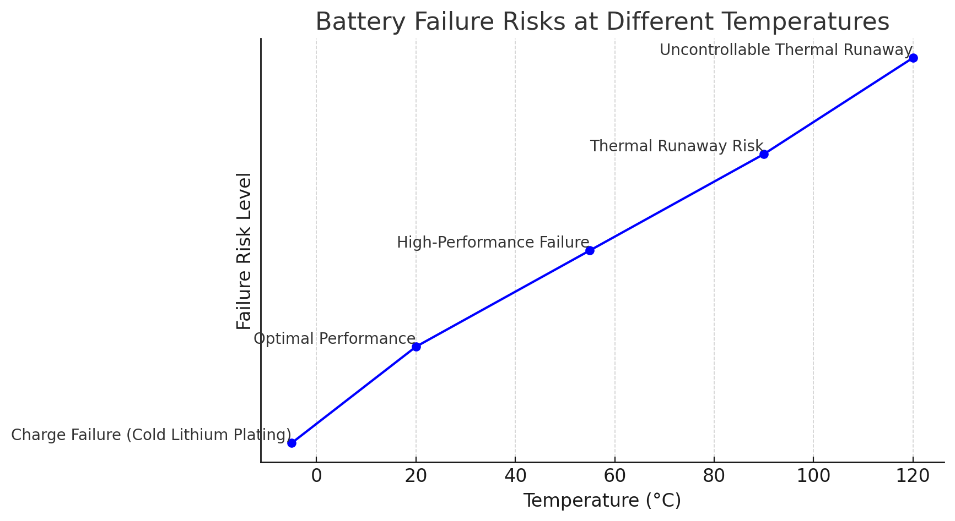
Battery Failure Risks at Different Temperatures

Slide 18
Preparing the Grid for EV Growth
EV integration is projected to increase electricity consumption in Saudi Arabia, this additional demand places greater pressure on the national power grid.
The growing number of EVs necessitates comprehensive upgrades to energy infrastructure, and strategic planning is essential to ensure reliable power supply and avoid grid strain.
Meanwhile, the national grid is being prepared to support widespread EV adoption and future electrification goals.

Slide 19
A National Strategy for Green Mobility
Mandated Target: 30% of vehicles in Riyadh to be electric by 2030
Long-Term Objective: Adoption of more than 3 million EVs across Saudi Arabia by 2035
Charging Infrastructure Demand:
Estimated 30,000–34,000 public charging stations required by 2030
Over 5,000 fast-charging points to be deployed under EVIQ by 2030

Slide 20
Building a Zero-Emission Mobility Ecosystem
NEOM Overview: $500B smart city powered entirely by renewable energy sources.
The LINE: A 170 km futuristic city designed with zero-car streets, relying on electric, autonomous transit:
Underground high-speed electric rail
Autonomous shuttles and micro-mobility options
Grid-tied EV charging embedded within transit hubs
EV Integration: The infrastructure of NEOM and The LINE is designed to optimize the performance and charging conditions of EVs in high-temperature environments, mitigating risks associated with lithium-ion battery stress.

Slide 21
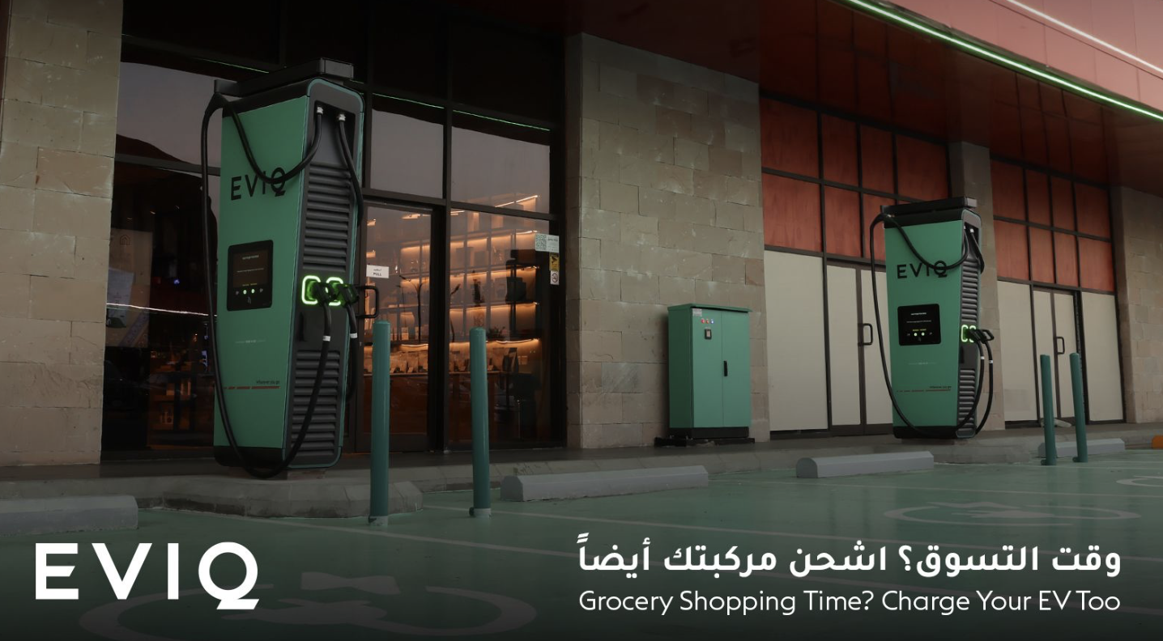
EVIQ: Backbone of the Public Charging Ecosystem
Target: Deploy over 5,000 fast-charging stations in more than 1,000 locations by 2030
Focus Areas:
Intercity corridors
Urban commercial centers
Airports and logistics hubs

Slide 22
CEER Motors – Saudi Arabia’s Domestic EV Pioneer
First Saudi electric vehicle brand, focused on smart, affordable, and climate-resilient EVs.
Ceer will produce a range of fully electric sedans, SUVs, and compact city cars tailored to GCC conditions.
Ceer vehicles will be equipped with lithium-ion battery packs optimized for high-temperature endurance and fast-charging cycles, supporting both AC and DC charging standards.

Slide 23
Saudi Arabia EV Market

Slide 24
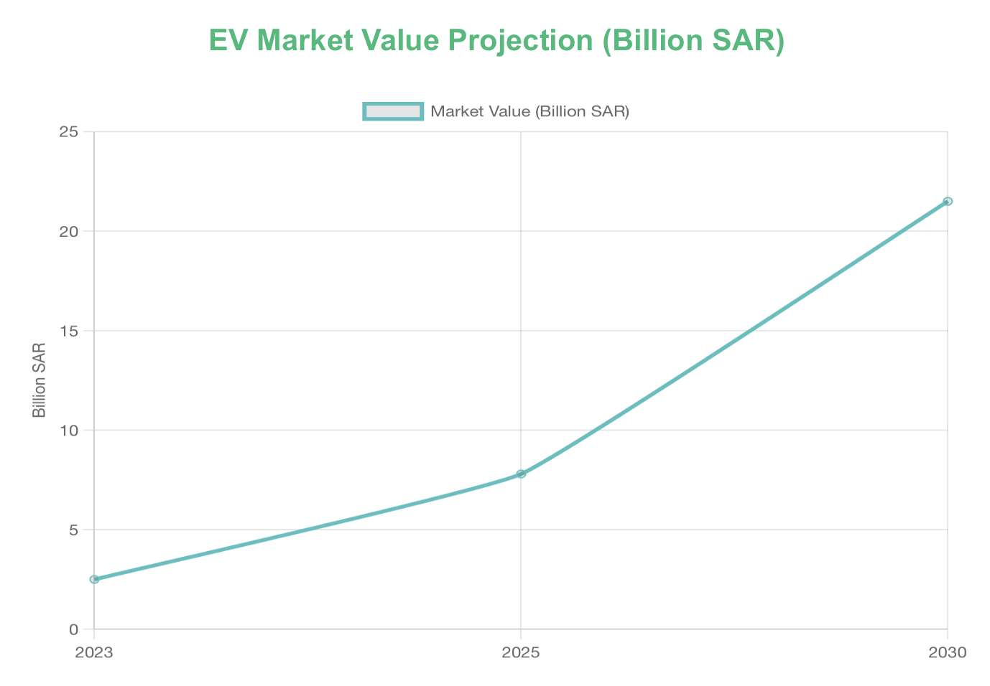
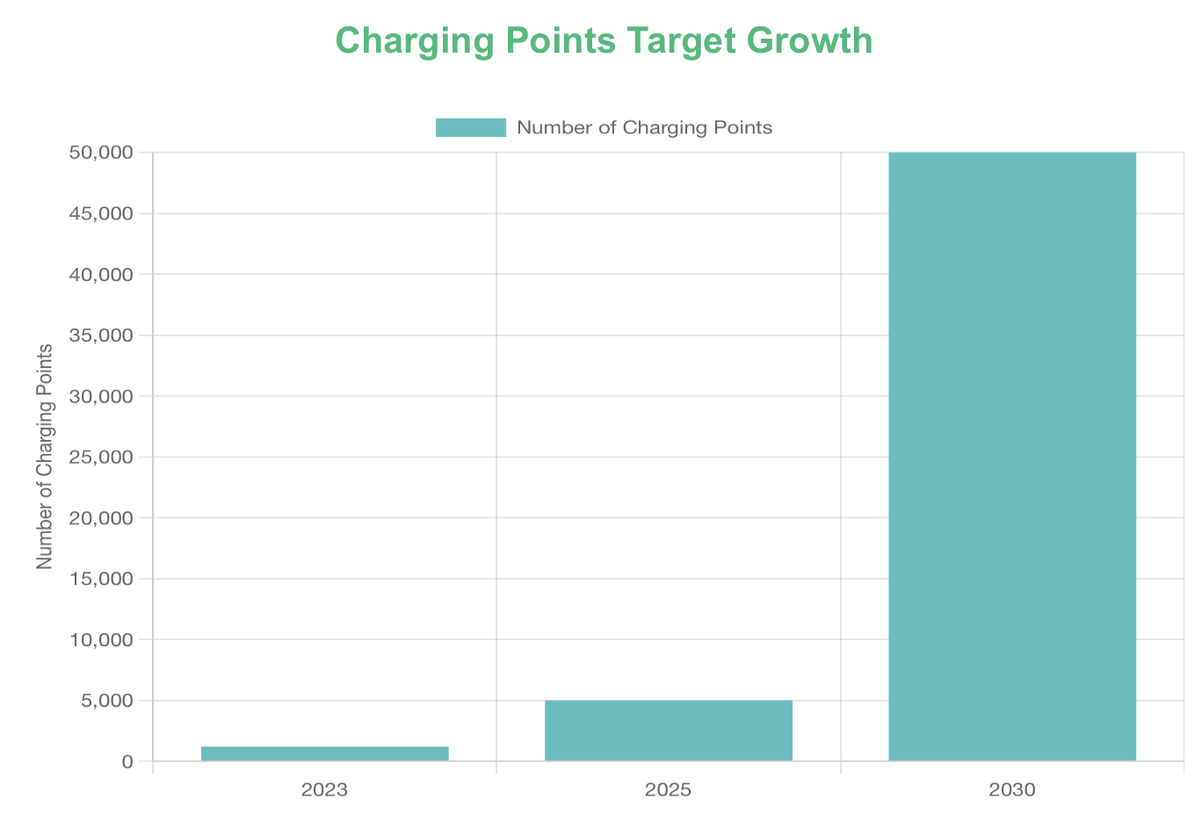
Saudi Arabia EV Market Analysis (2023-2030)

Slide 25
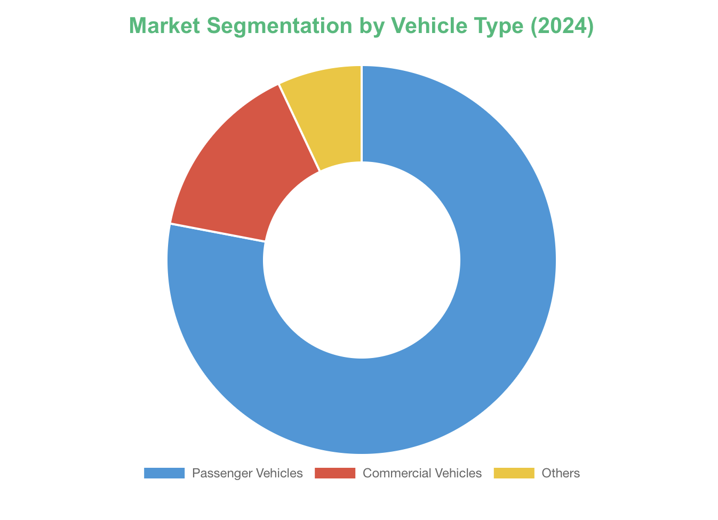
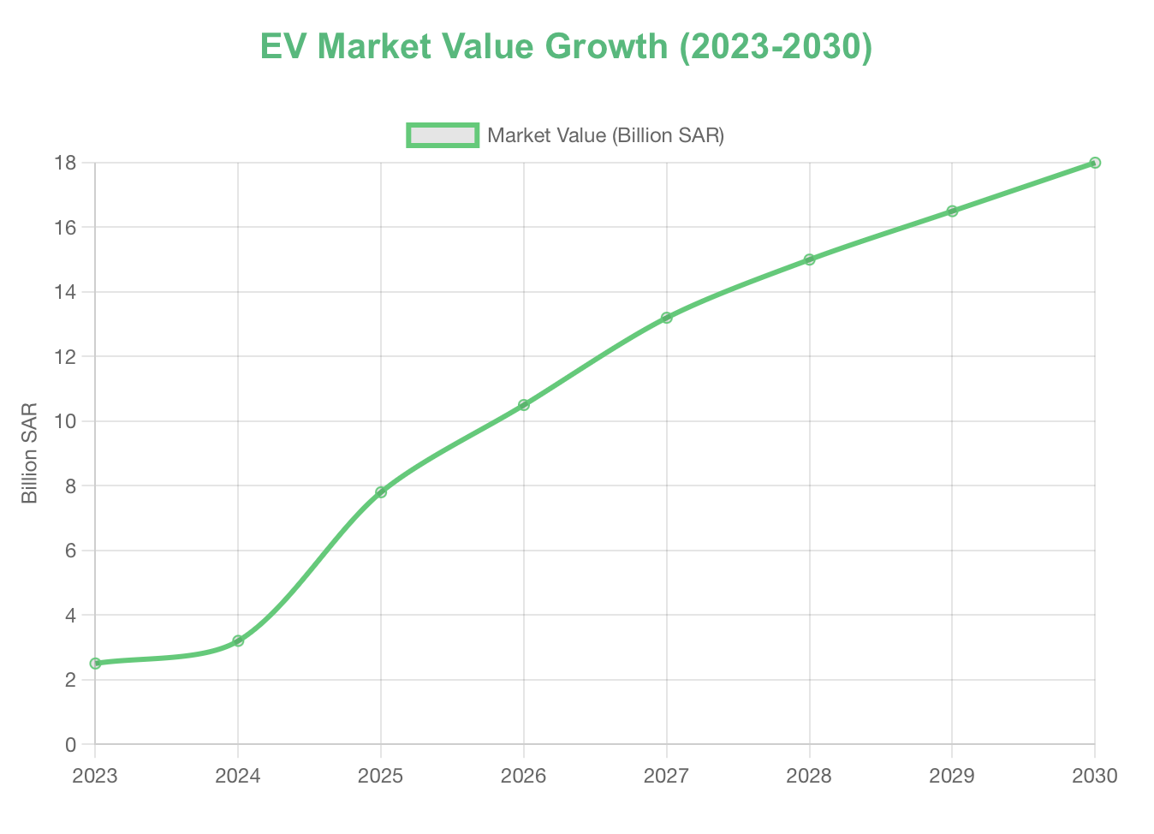
How Big is The EV Market in Saudi Arabia?

Slide 26
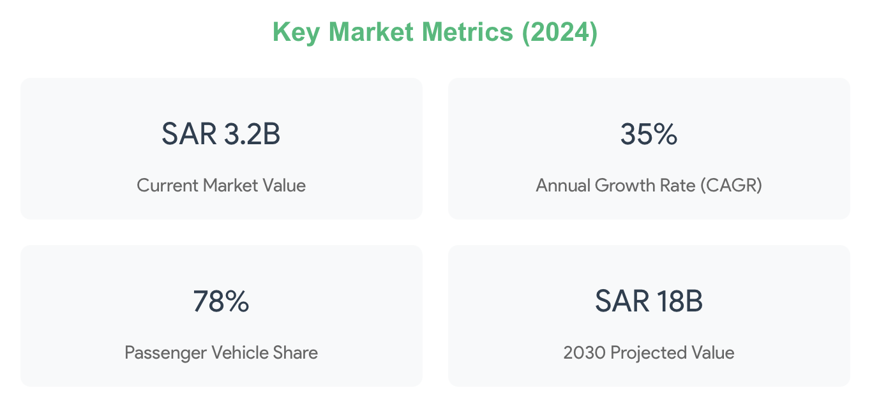
How Big is The EV Market in Saudi Arabia?

Slide 27
Conclusion
Understanding how thermal conditions affect reliability, safety, and system efficiency is crucial for the sustainable development of the EV industry in Saudi Arabia.
The thermal sensitivity of EV batteries presents a significant challenge to scaling up EV usage in KSA, where consistent performance and safety are essential for public trust and market stability.
This study, along with strategic planning for infrastructure demand and the robust implementation of Saudi Arabia's EV charging plan, underscores the importance of climate-specific engineering as KSA advances towards its goals for clean energy and sustainable transportation.

Slide 28
Guidelines
Company logo may only be shown on the Cover slide
Please use font size 16pt or larger
Slides should not look like an outline. Use of charts, pictures and graphics to tell a story is strongly encouraged
If bullets must be used, then no more than 3-5 bullets per slide is encouraged
1-2 slides per minute is standard practice
Where appropriate, please recognize contributors prior to the “Thank You” slide REMEMBER - Science Not Communicated is Science Not Done

Slide 29
Contact Info
Thank you
Lama Mohammed A Bedywi
CEER Motors / Kettering University
+18102503500
Lamabedywi@gmail.com

