Slide 1
Ypsilanti, October 14-15, 2025
Tanguy Cabaret
Development of TMS
Prepared for
for BEV and FCEV trucks
2025 Thermal Management Symposium

Slide 2
BEV
Thermal Management system
FCEV
Thermal Management system

Slide 3
BEV
Thermal Management system
FCEV
Thermal Management system

Slide 4
Commercial vehicles’ TMS is divided in 4 main sub-systems with specific requirements: battery, EDU & PE, cabin and brake resistors
CV TMS – SUB-system overview
BATTERY THERMAL MANAGEMENT SYSTEM (BTMS)
EDU AND PE THERMAL MANAGEMENT SYSTEM
4 main sub-systems compose CV thermal management system
BRAKE RESISTORS THERMAL MANAGEMENT SYSTEM
CABIN THERMAL MANAGEMENT SYSTEM
EDU: electric drive unit; PE: power electronics Source: FEV

Slide 5
Lower level of integration between the different thermal management systems is currently observed in the CV segment compared to PVs
CV TMS – SUB-system overview
BATTERY THERMAL MANAGEMENT SYSTEM (BTMS)
EDU AND PE THERMAL MANAGEMENT SYSTEM
Currently lower integration and interactions observed between the different TMS in CVs compared to PVs
BRAKE RESISTORS THERMAL MANAGEMENT SYSTEM
CABIN THERMAL MANAGEMENT SYSTEM
CV: commercial vehicle; PV: passenger vehicle; EDU: electric drive unit; PE: power electronics Source: FEV

Slide 6
The current low level of TMS integration for CVs can be explained by factors linked both to market conditions and technological challenges
CV TMS – SUB-system overview
2 main reasons explain the lower level of integration of CVs TMS compared to PVs
BATTERY THERMAL MANAGEMENT SYSTEM (BTMS)
EDU AND PE THERMAL MANAGEMENT SYSTEM
Market conditions and internal OEM organization
Technological challenges and low maturity
Low commercial vehicle xEVs sales volumes
Currently lower integration and interactions observed between the different TMS in CVs compared to PVs
Specific cooling requirements
Multiple suppliers' sub-systems integration
BRAKE RESISTORS THERMAL MANAGEMENT SYSTEM
CABIN THERMAL MANAGEMENT SYSTEM
Commercial vehicle specific component availability
Internal OEM organization
Technology maturity and reliability
Electrification skepticism
CV: commercial vehicle; PV: passenger vehicle; EDU: electric drive unit; ICE: internal combustion engine Source: FEV

Slide 7
Commercial vehicle TMS layouts are differentiated by 4 main factors that are impacting the design and the efficiency of the system
CV TMS – MAIN DESIGN DIFFERENTIATION FACTORS
Main challenges
Main current approaches
Refrigerant circuit(s) integration
High battery cooling requirements
limited power of AC compressor
Separate refrigerant circuits for battery and cabin cooling as main solution
EDU and PE integration
High cooling need of EDU and PE
Single circuit for PE and EDU in most CVs, but diversity of solutions remain
Heat pump adoption
High costs of development and integration
Only visible for LCVs today
High heat energy to dissipate
Risk to overheat other comp.
Need to oversize some components (e.g., electric fan)
Brake resistors cooling
Dedicated coolant circuit or integration with battery loop
Source: FEV

Slide 8
BEV
Thermal Management system
FCEV
Thermal Management system

Slide 9
Fuel cell vehicles can be clustered in range-extender, mid-power and full-hybrid depending on the relevance ratio between fuel cell and battery
Fuel cell powertrain CLUSTERING
REFCEV
MID-POWER FCEV
FULL-HYBRID FCEV
+
+
+
Primary source of power
Range extender
Balanced power between fuel cell and battery
Additional power and regen. braking
Primary source of power
More common on LCV segment
Past & current state-of-the-art on M&HD
Current & future M&HD
Source: FEV

Slide 10
Lower level of integration between the different thermal management systems is currently observed in the CV segment compared to PVs
CV TMS – SUB-system overview
BATTERY THERMAL MANAGEMENT SYSTEM (BTMS)
EDU AND PE THERMAL MANAGEMENT SYSTEM
Possible leveraging of thermal architecture from BEV or ICE, with adaptation to FCEV powertrain
CABIN THERMAL MANAGEMENT SYSTEM
BRAKE RESISTORS THERMAL MANAGEMENT SYSTEM
FUEL CELL THERMAL MANAGEMENT SYSTEM
H₂
O₂
CV: commercial vehicle; PV: passenger vehicle; EDU: electric drive unit; PE: power electronics Source: FEV

Slide 11
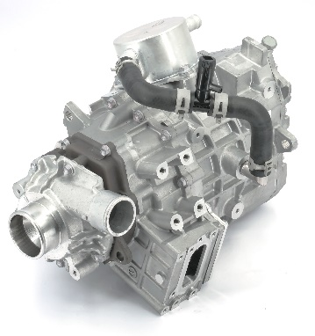
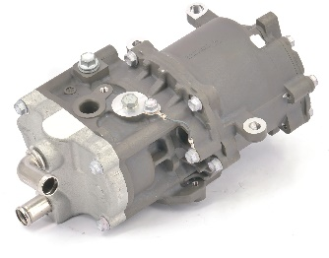
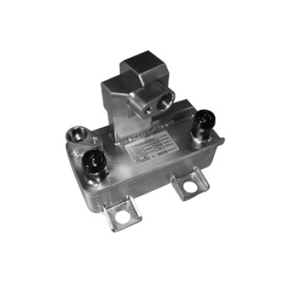
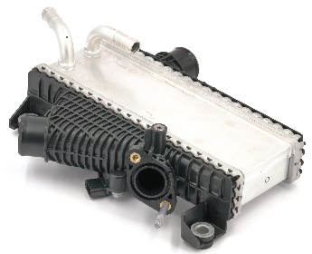
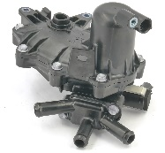
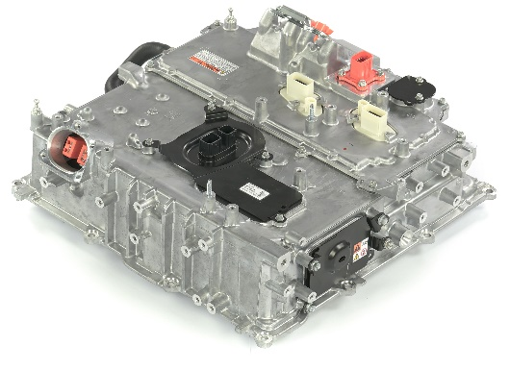
Integration of several BoP components with TMS system enables to ensure optimal temperature and water management in the fuel cell system
FCEV TMS – BOP integration
Why
Are BoP components integ. within TMS ?
What
components can be integrated with TMS ?
How
are the BoP components integ. with TMS ?
FC air compressor
Temperature management
H₂ recirculation blower / pump
Integration with LT/MT coolant loop
H₂ heater
Intercooler
Water management
Anode water separator
Integration with fuel cell HT coolant loop
FC related PE (e.g., DC/DC boost,)
Main integ. reason
Rarely integ. with TMS
Often integ. with TMS
Main observed integration
Source: FEV
Possible integ. reason
Sometimes integ. with TMS
Other observed integration

Slide 12
Fuel cell thermal management system complexity increases compared to BEV one, due to additional components and cooling efforts
Qualitative assessment
+
BEV VS FCEV vehicles Thermal architectures
BEV TMS
Complexity
FCEV TMS
Thermal loops
3 to 4 loops
4 to 5 loops
Battery cooling
Dedicated LT + refrigerant
Dedicated LT + refrigerant Refrigerant only possible
PE and EDU cooling
MT loop – coolant or oil for EDU
Additional FC auxiliaries
Cabin management
PTC/HP for heating
possible heat re-use
Current integration level
Limited on CV – high on PV
Low, including for PV
Coolant
No major challenge
Low electric conductivity, material compatibility
Controls and complexity
Battery TMS as major challenge
Battery and fuel cell TMS
FC: fuel cell; EDU: electric drive unit; PE: power electronics; PV: passenger vehicle; MD: medium duty; HD: heavy duty; PTC: positive temperature coefficient Source: FEV

Slide 13
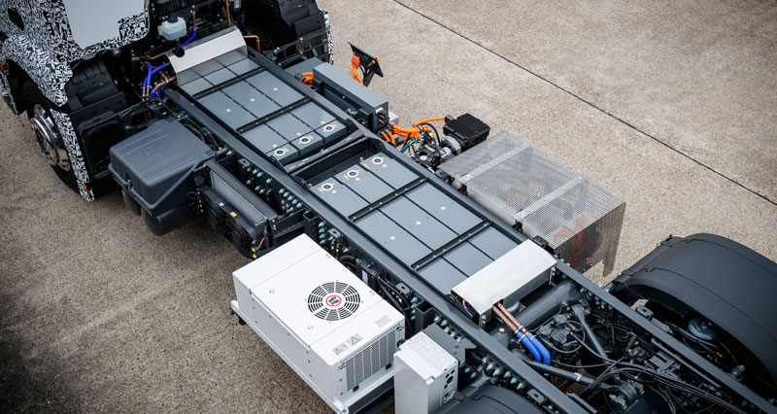
TMS development trends are divided into performance, integration and sustainability considerations; multiple factors to take into account
TMS TRENDS - INTRODUCTION
PERFORMANCE
Cooling / heating / efficiency / functionality optimization
Multiple int. or ext. influence factors
TMS
global trends
Powertrain components trends
INTEGRATION
Complexity and cost reduction, portfolio synergies
Global make-or-buy strategy
Regulatory framework
SUSTAINABILITY
and more…
Environmental and safety compliance
Source: FEV

Slide 14
Efficiency level is mainly determined through heat exchanges and re-use possibilities, while integration is defined by the level of TMS centralization
TMs clustering – EXPLANATION
Number or functions & Efficiency level
Exemplary ranking criteria
Advanced heat exchange possibilities (e.g., chillers, LCCs)
Advanced
Limited utilization of PTC heaters
Integration of multiple EDUs
Exemplary ranking criteria
Presence of a heat pump
Merge of EDU and PE circuits
Intermediate
Re-use of waste heat
Utilization of multi-way valves
…
Centralized thermal management module
Integration of brake resistor circuits with others
Basic
Merge of cabin and battery refrigerant circuits
…
Integration level
No
Partially
Highly
Source: FEV

Slide 15
Current PV thermal management systems are both more integrated and more efficient than M&HD ones, especially through adoption of ITMS
TMs clustering – PV VS M&HD comparison
Number or functions & Efficiency level
Advanced
Intermediate
Basic
No
Partially
Highly
Integration level
No
Partially
Highly
CIM: coolant integrated module; RIM: refrigerant integrated module; ITMS: integrated thermal management module Source: FEV
Share of available CV BEV models
Share of available PV BEV models

Slide 16
M&HDs are expected to reach an intermediate to advanced TMS performance by 2030, and partial to high level of integration by 2035
TMs TRENDS – 2030 and 2035 development path
Functionality & Efficiency level
Advanced
Performance
Basic to intermediate performance (e.g., re-use of waste heat)
Intermediate
Integration
No to partial integration through sub-modules (e.g., HVAC, battery)
Basic
Current M&HD situation
Integration level
No
Partially
Highly
Source: FEV

Slide 17
M&HDs are expected to reach an intermediate to advanced TMS performance by 2030, and partial to high level of integration by 2035
TMs TRENDS – 2030 and 2035 development path
Functionality & Efficiency level
Performance
Intermediate to advanced to improve efficiency
E.g., heat pump, improved HEX, HV components
Advanced
2030 focus
Intermediate
Integration
Low focus towards 2030
Mainly sub-modules
Basic
Current M&HD situation
Integration level
No
Partially
Highly
Source: FEV

Slide 18
M&HDs are expected to reach an intermediate to advanced TMS performance by 2030, and partial to high level of integration by 2035
TMs TRENDS – 2030 and 2035 development path
Functionality & Efficiency level
Advanced
2035 focus
2030 focus
Integration
Larger development of semi- integrated modules
CV dedicated fully integrated modules for premium OEMs
Not expected to be as integrated as PVs ITMS
Intermediate
Performance
Continuous improvements to reach advanced levels
Basic
Current M&HD situation
Integration level
No
Partially
Highly
Source: FEV

Slide 19
Contact Details
Tanguy Cabaret
FEV Consulting Inc.
Consultant
FEV CONSULTING
+1 248 739 2611
cabaret@fev.com
444 N Michigan Avenue
Chicago, Il, 60611
consulting@fev.com
www.fev-consulting.com

