Slide 1
Flat-Out Innovation for Next-Gen Thermal Management
October 14th, 2025

Slide 2
Brief Husco Introduction
Husco is a Tier 1 supplier with over 25 years of automotive production experience serving global OEM customers
Full in-house engineering, development, test validation
In-house automation team with a global manufacturing footprint.
Husco specializes in custom electo-mechanical actuation systems and fluid management control solutions.
$550+ million revenue
6 global manufacturing sites, worldwide engineering team
1,500 global employees including 400+ degreed engineers
Family-owned and minority owned business
Notes:
1946 HUSCO started
1985 Management buyout

Slide 3
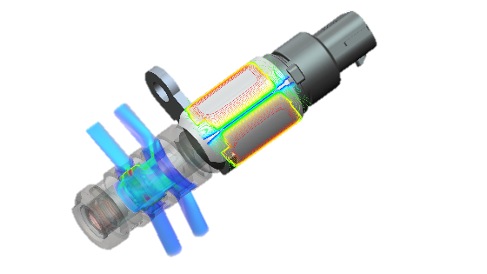
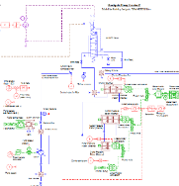
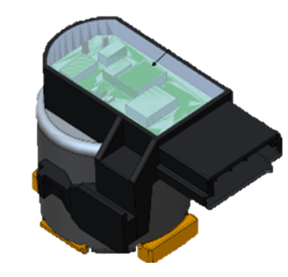
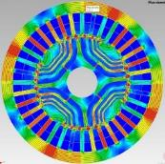
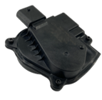
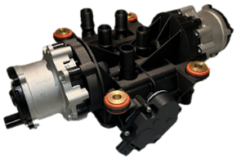
Husco Automotive capabilities
World Class Technology
Electro-Hydraulic Solenoid Design | System Level Modeling & Development | On-Board Sensing & Controls | Brushless DC, Stepper Motors & Controls | Actuators | System Integration
Leading digital signal to flow & pressure control for any application | Develop, model & test complete systems including engine, transmission, E-Vehicle & cooling systems | Full integration of PCB, software, control & sensors | In house solutions that provide efficient & precise rotational control with angular position sensing feedback | Compact motor and transmission integration technologies | Complete system integration designs for cooling, multiple clutches and gearing systems
Notes:
Husco's core technologies of fluid control and electromechanical actuation

Slide 4
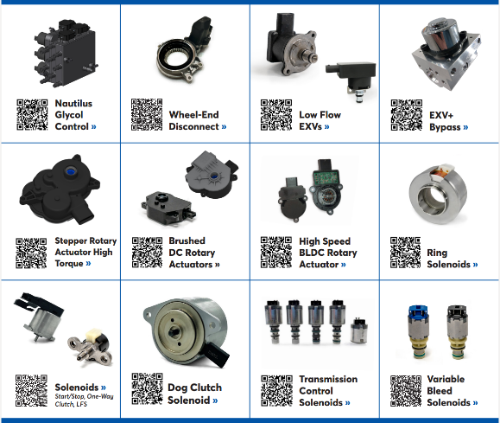
Husco automotive product families
Notes:
For international use, remove you can remove Minority-owned company

Slide 5
Notes:
Staging the challenges of new innovation in today’s environment.
• I want/need something new, but I can’t afford to invest, and there is wavering uncertainty from many directions at once.
• The investment required needs product volume to make it worthwhile. Meanwhile, the technology is still changing rapidly. Obsolescence is a high risk.
• This drives a trend to “stick with what is safe”.
• But clearly electrification will continue, and further innovation will still be required.

Slide 6
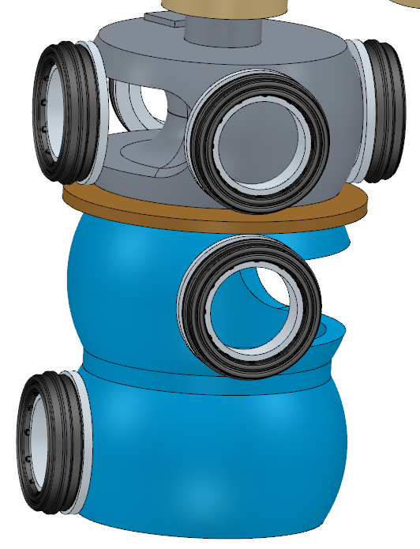
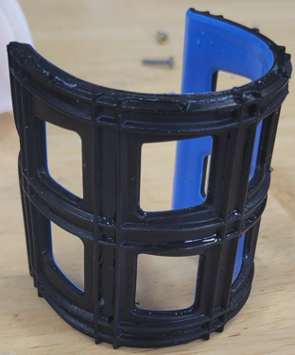
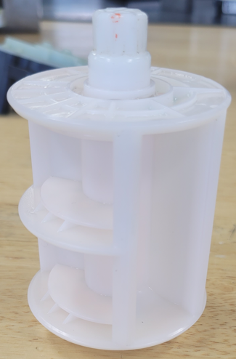
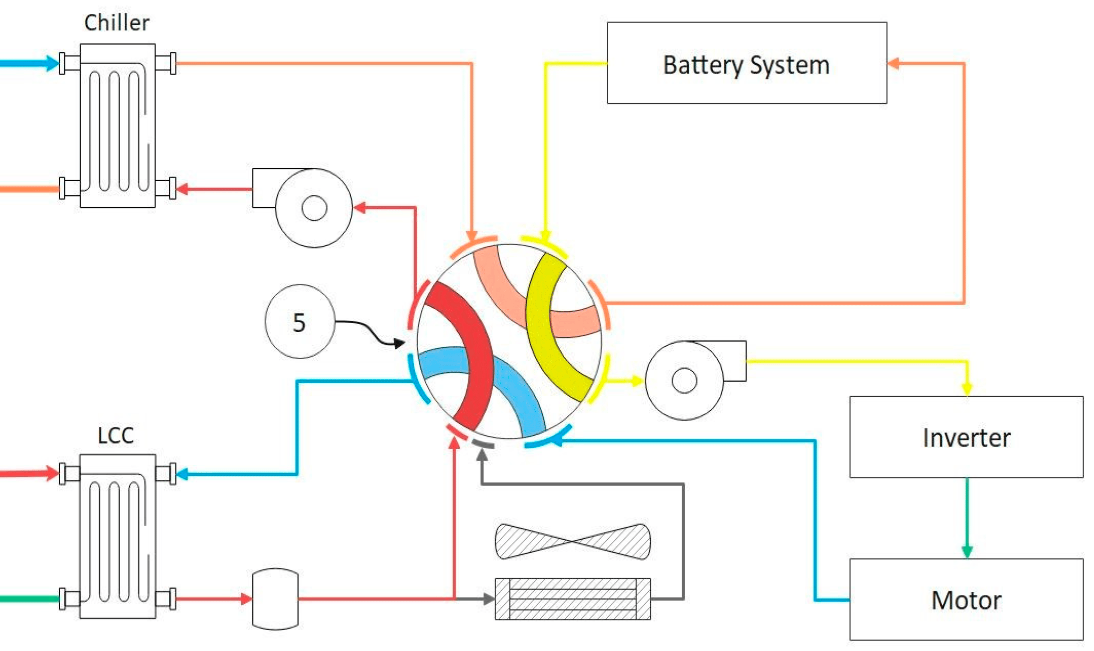
Today’s state of the art
Advantages
A known technology in production
Existing capital/tooling/re-use components
Disadvantages
Complex mold tooling
Parting lines/flash vs sealing
Expensive seals
Inherent flow channel cross talk
As valve complexity increases beyond 4-way, the cost and failure opportunity increase exponentially.
Requires chamber separation
Increasing torque = increased actuator
Increased seal assemblies
Increased number of operations
Increased failure locations
Requires circuit that can handle repeating patterns
How many years will these two design solutions continue?

Slide 7
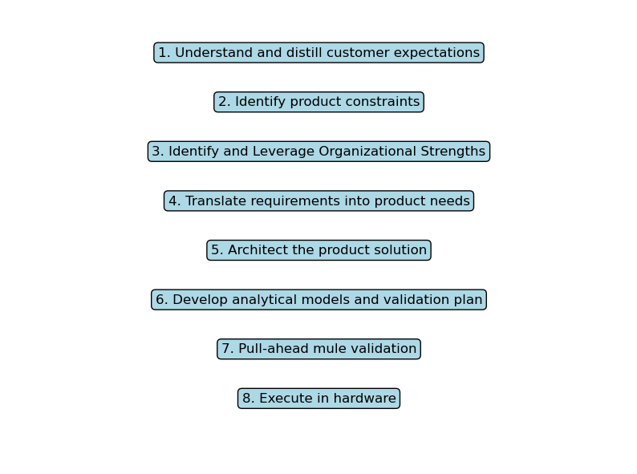
Husco’s flat-valve development approach
Innovation beyond today’s solution. A journey through our innovation experience.

Slide 8
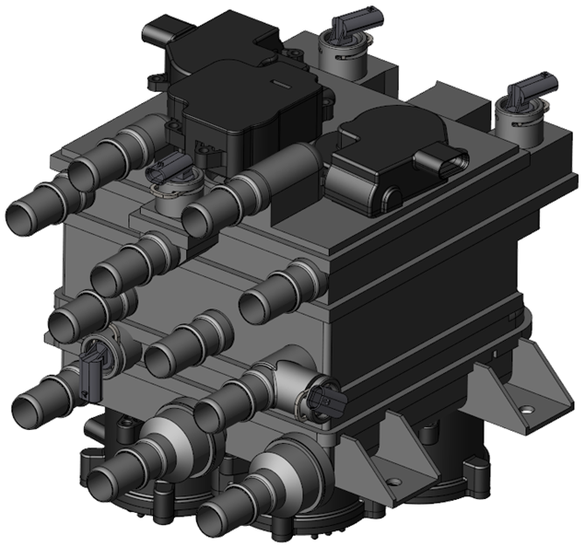
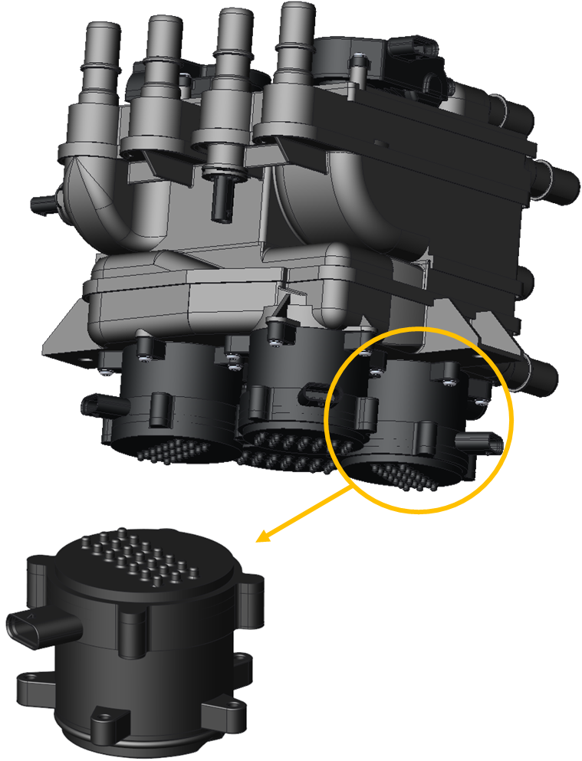
Customer expectations / Reality
Development, tooling, iterations, flexibility, etc.
Expectations:
Low Cost
Fully Validated
Unique Packaging for Every Customer (Always Smaller)
Low to No Internal Leakage
Zero External Leakage
Low Pressure Drop
High Integration Ability
High Thermal Resistance
Program Constraints:
No Upfront Investment in Soft Tooling (All Development Costs Incurred by Supplier)
Flexible Port Locations
Reduced Customer Timelines w/ Delayed Kickoff
Responsible for Pump Sizing
Undefined / Not Finalized Customer Packaging

Slide 9
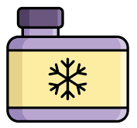
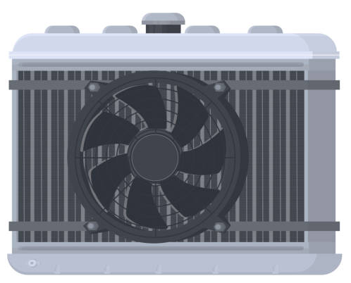
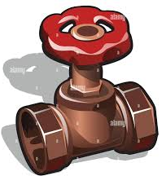
Formation of development strategy
Where to draw the boundaries of responsibility?
Capability?
Cost feasibility?
Battery
Coolant Bottle
Role of Suppliers
Valve
Power Electronics
Radiator
Temperature Sensor
?
?
Power Drive Motors
?
Water
Pumps
Heat Exchangers (LCC’s Chillers, Cabin Coolers/Heaters)

Slide 10
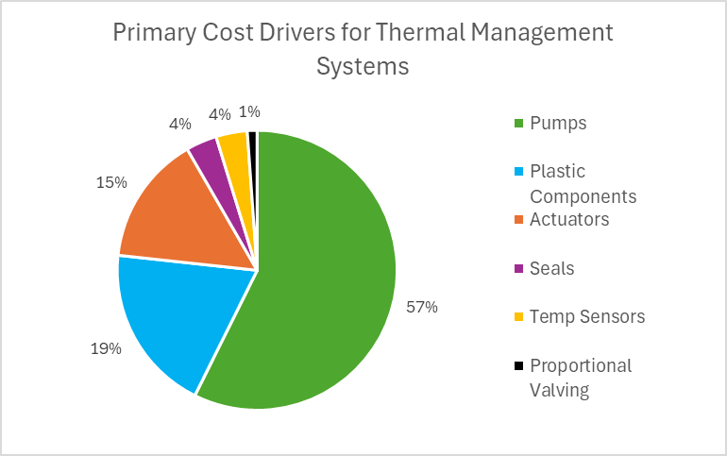
Cost drivers in thermal valving solutions
Breakdown of cost drivers.
Also need to consider:
Capital
Labor
Overhead
Plant Costs
Margin
Notes:
Thermal Module Cost Drivers (Pie Chart)
Actuators
Plastic Material Used
Processing - Capital Equipment & Tooling & Labor
PCBA/Controls
MFG Location
Brackets/Mounting/Vibration
USMCA & Tariff
Sealing Strategy
Re-occurring Parts Optimization
Tooling!
System Level Cost Drivers
• # of hose connections
• hoses & clamps
•Physical mounting
• # of wiring harnesses
• NVH grommets & considerations
• Fasteners
• Assembly labor

Slide 11
Formation of development strategy
Design Requirements
Interface to other systems
Minimizes Space-claim
Low Pressure Drop
Reduce Pump Sizing
More room for B to C sales points
Faster Customer Turn Around
Flexible to Circuit Layouts
Low Leakage
Design Requirements
Common parts across programs
Reduced HEX sizing
Easy to Process Parts
Low Thermal Losses
Easier Assembly Lines
Maximize Functions per Actuator
Robust to Durability
Minimize cost to customer
Product lasts full life cycle

Slide 12
Formation of development strategy
Design Requirements
Interface to other systems
Minimizes Space-claim
Low Pressure Drop
Reduce Pump Sizing
More room for B to C sales points
Faster Customer Turn Around
Flexible to Circuit Layouts
Low Leakage
Design Requirements
Common parts across programs
Reduced HEX sizing
Easy to Process Parts
Low Thermal Losses
Easier Assembly Lines
Maximize Functions per Actuator
Robust to Durability
Minimize cost to customer
Product lasts full life cycle

Slide 13
Formation of development strategy
Solution Direction
Minimizes Space-claim
Low Pressure Drop
De-couple valve elements for optimal placement within manifold
High utilization of flow paths across planes
High area gain
Easy to sculpt flow paths – stacked planar plates
De-coupling - only move valving elements that are changing state
Planar plates for connecting individual valve functions
Flexible to Circuit Layouts
Low Leakage
High overlap
Good conformity between surfaces
No parting lines at critical seal surface
Design Requirements
Flat surfaces/planar designs
Simple drop in assembly processes
Single pull direction for plastic parts
Easy to Process Parts
Low Thermal Losses
De-coupling of hot and cold flow channel locations
Easily able to integrate thermal insulation barriers – single pull directions
Maximize Functions per Actuator
Robust to Durability
No parting lines on dynamic sealing surfaces
Seal robust to wear/material removal
De-coupling - only move valving elements that are changing state
De-coupling - only move valving elements that are changing state

Slide 14
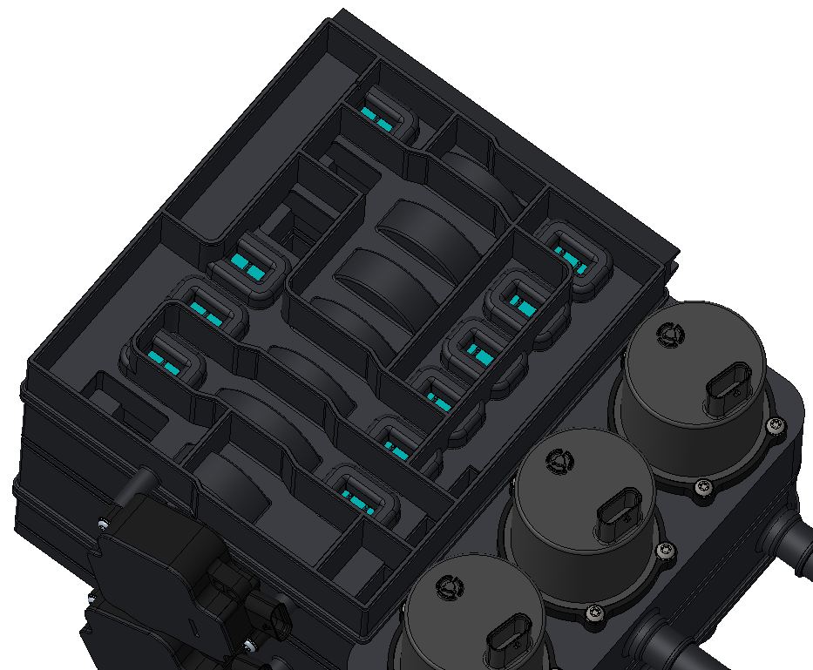
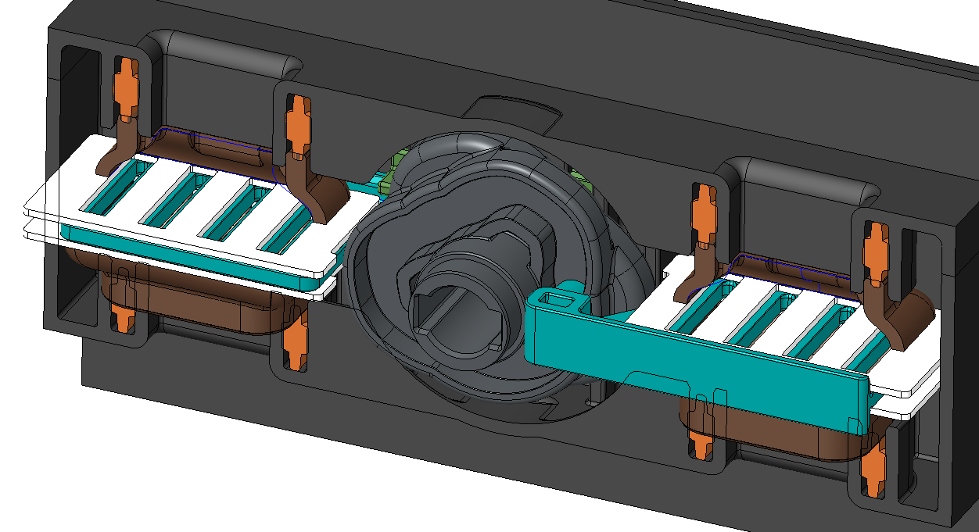
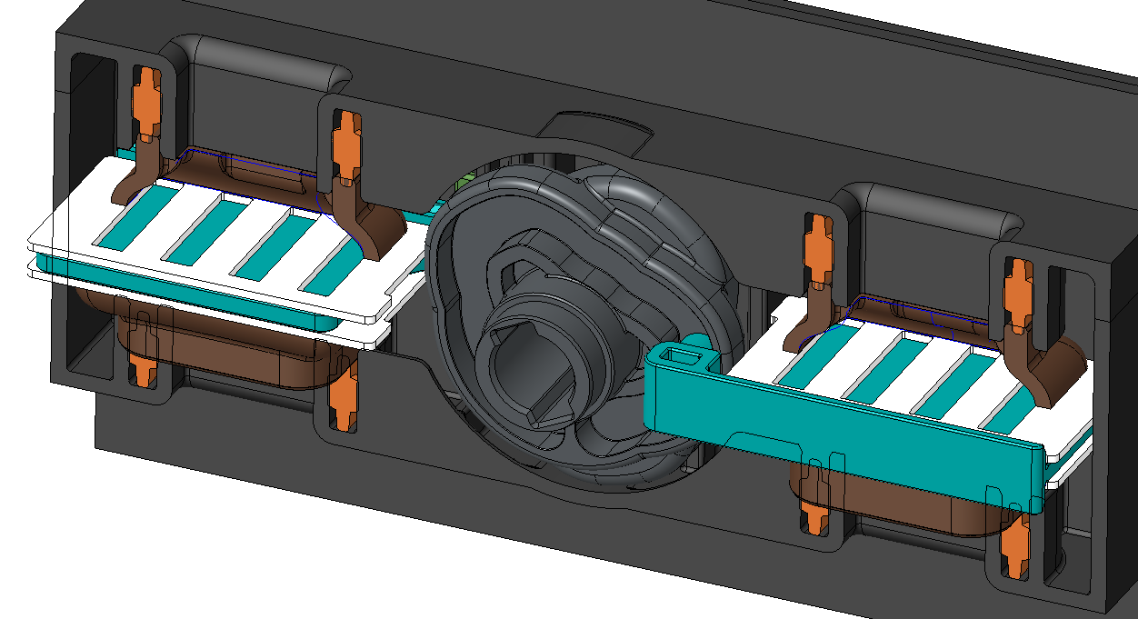
HUSco flat valving technology
Design Architecture
Flow Out
Low Pressure Drop
High louver flow area gain
Minimization of flow path losses
Decoupling of flow paths from each other allows optimal internal placement – minimizing pressure drop from port to port
Low Leakage
PIP seal and pressure plate create effective sealing
No parting line across seal surfaces
Low Thermal Losses
Planer design/single pull direction → implementation of thermal barriers
Robust to Durability
No parting line across seal surfaces
Low rate PIP seals maintain contact pressure regardless of wear
Conformity matching if wear occurs – leakage improves with age
Open
Louver Open
No Flow
Closed
Louver Closed

Slide 15
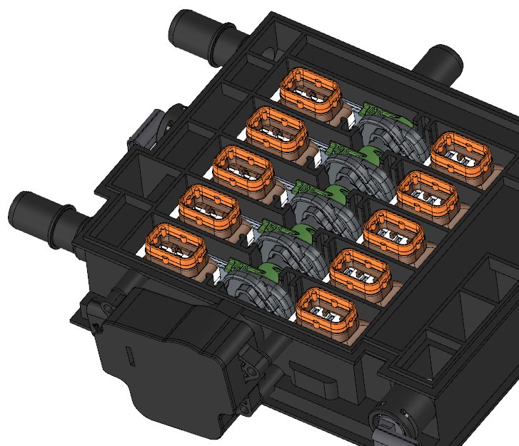
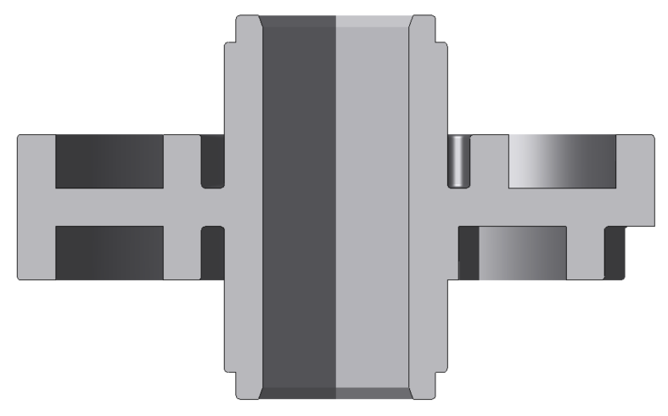
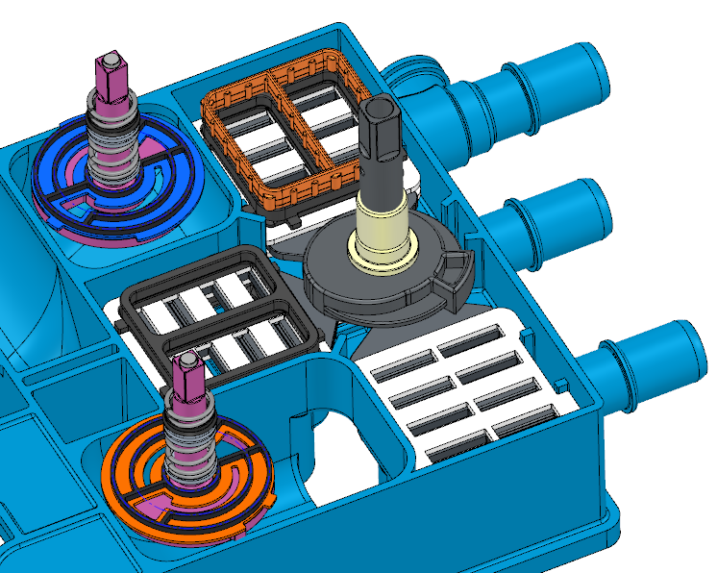
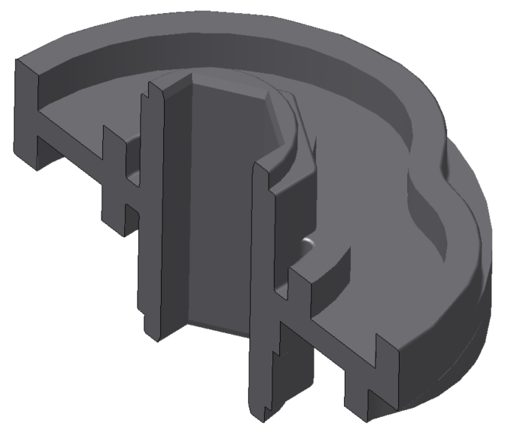
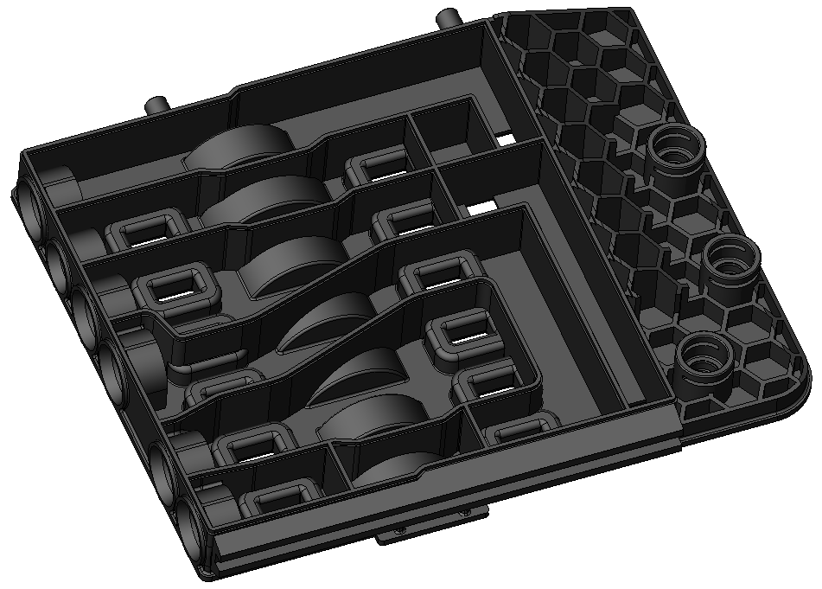
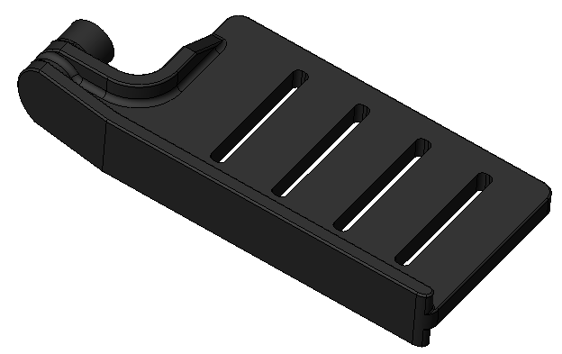
HUSco flat valving technology
Primary Cost Drivers
CAM
Flow Out
Maximize Functions Per Actuator
2/2, 3/2 and 4/2 optional louvers
Flow path valving connections are decoupled
Flexible valving patterns/modes allowed
Flexibly optimized valve element placement
Minimize parasitic heat transfer by placing hot and cold circuits on opposite sides of manifold
Minimize pressure drop
Only actuate louvers that needs to change state – minimizes torque and wear
Design for Moldability
Parts are easy to make uniform wall thickness – minimizing plastic volume and cycle time
Single pull direction minimizes tooling costs

Slide 16
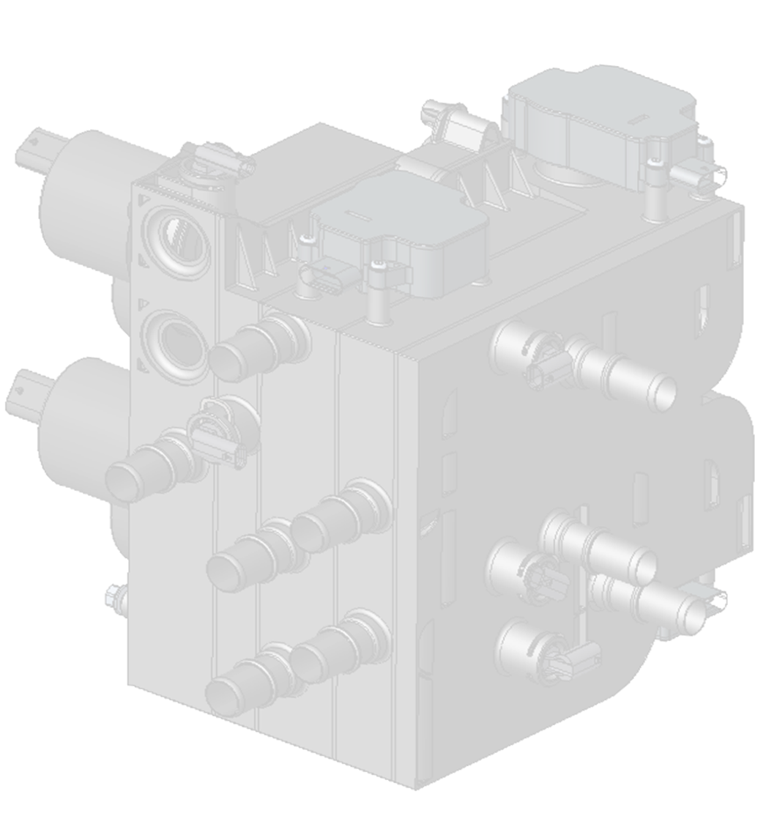
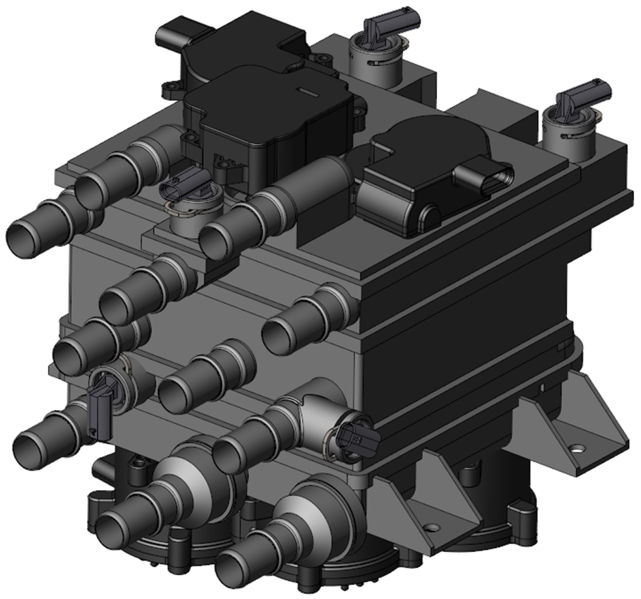
HUSco flat valving technology
Flexibility and Space Claim
Flexibility to Circuit Layouts
Planar nature makes connections easy – parallel to drive shaft, perpendicular across plates, through plates etc.
Camshafts can be “reprogrammed” to allow for different mode connections
Space Claim Minimization
Design allows for effective space utilization
Flexible flow channels ease port location requirements

Slide 17
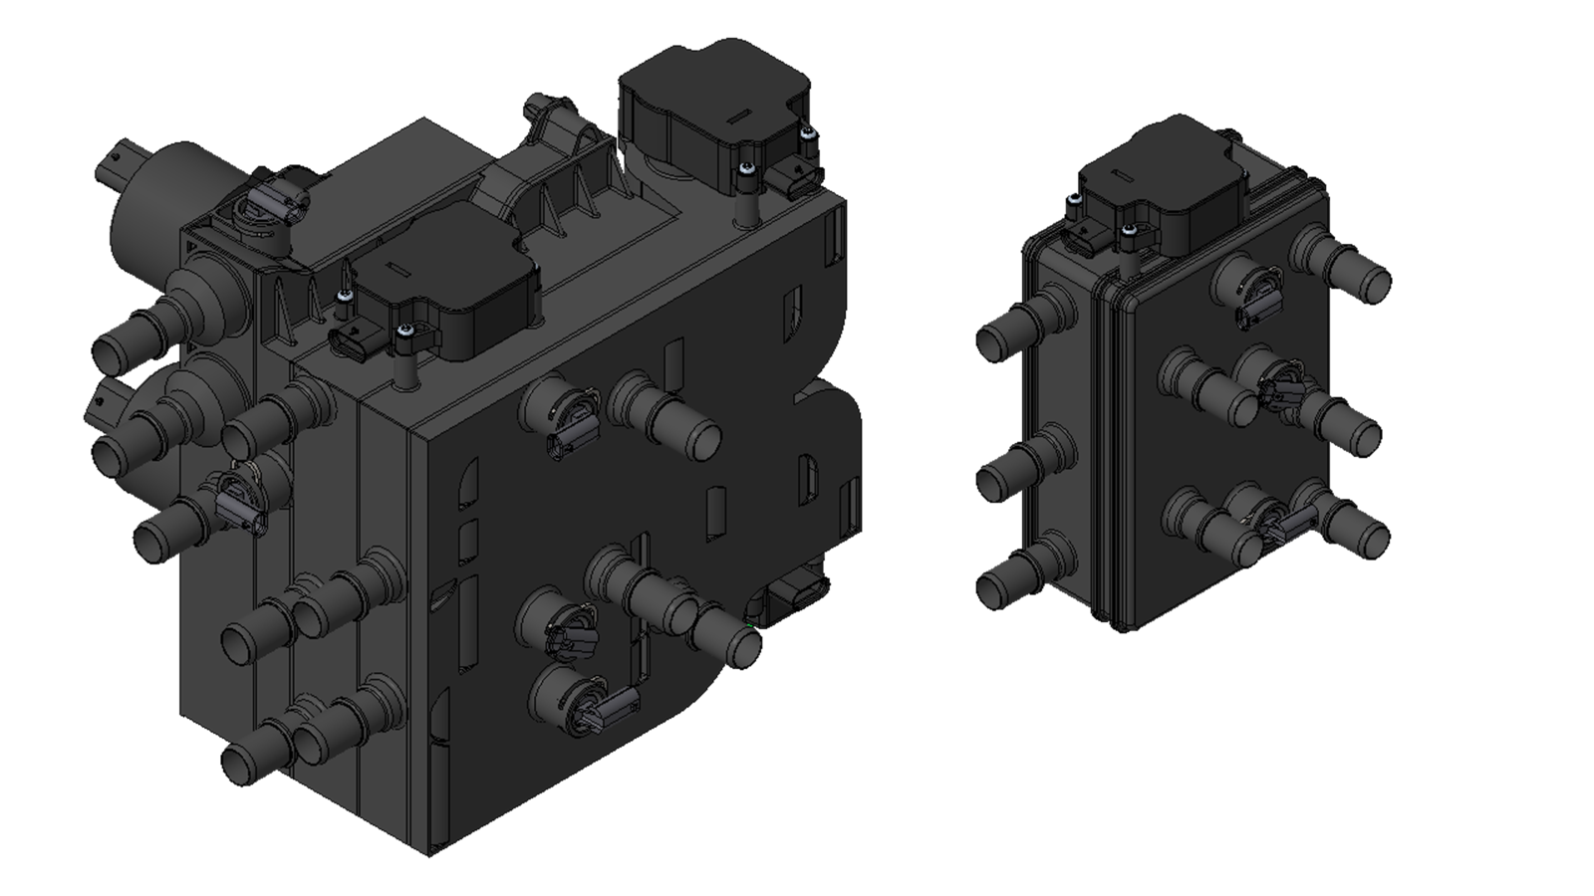
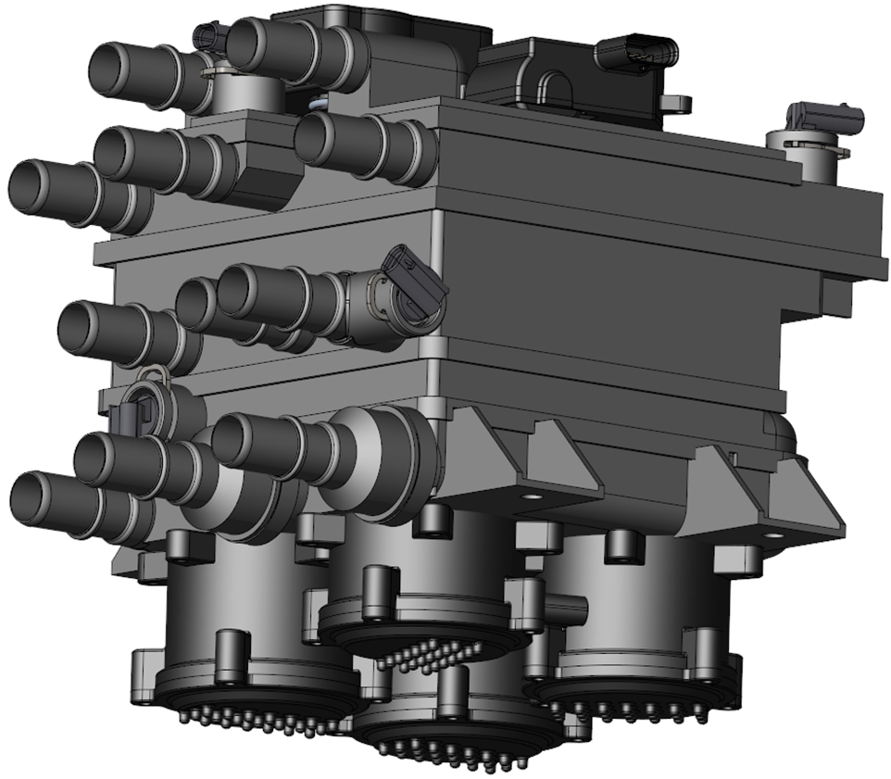
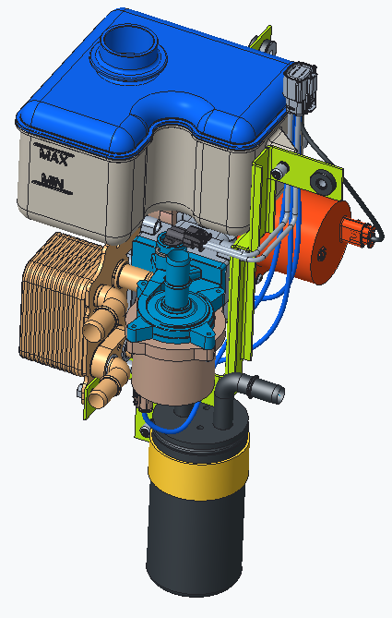
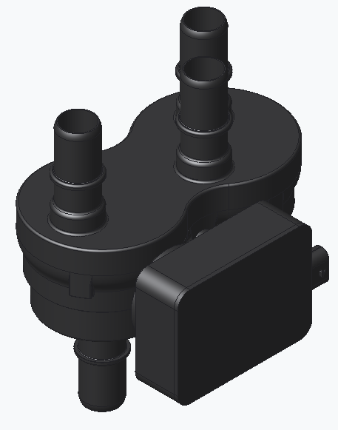
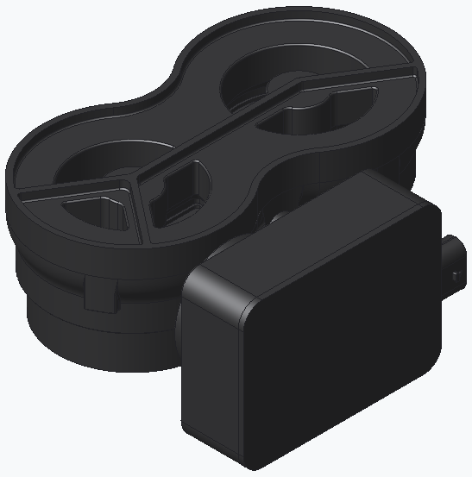
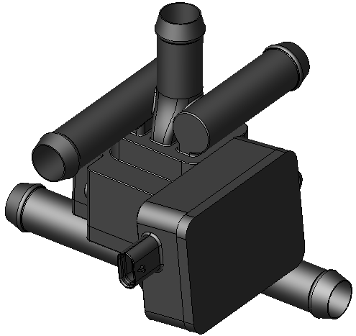
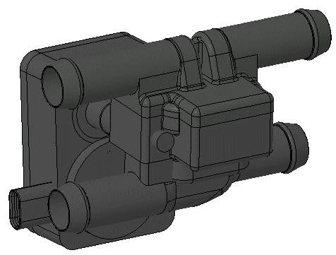
Nautilus
Nautilus Flat Valving Technology & Arrangements
5 Way / 4 Position Proportional
14 Way / 4 Mode Proportional
6 Way / 5 Position
Proportional
Integration
8 Way / 4 Mode
5 Way / 4 Position Proportional
4 Way / 2 Position
Complexity

Slide 18
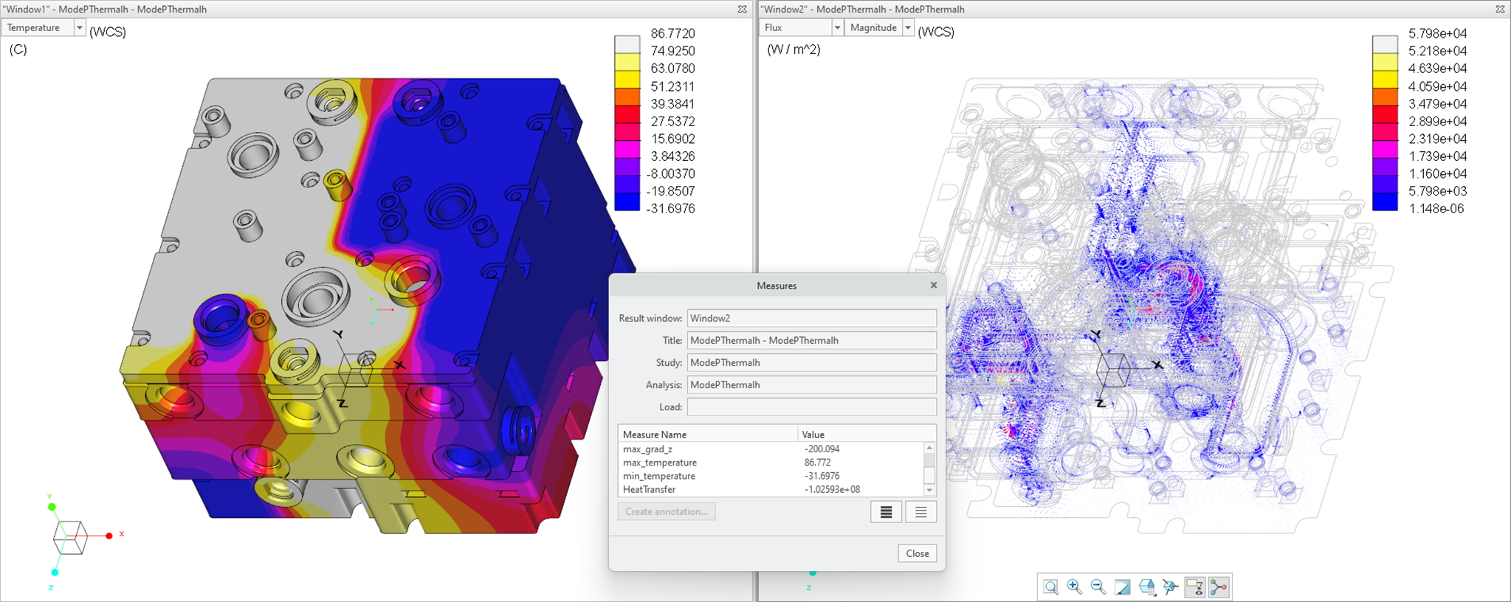
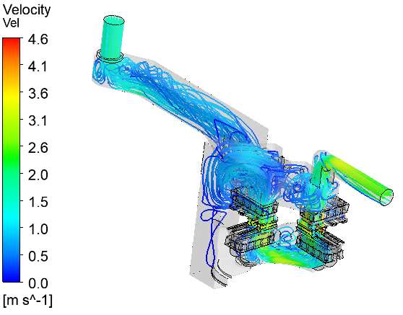
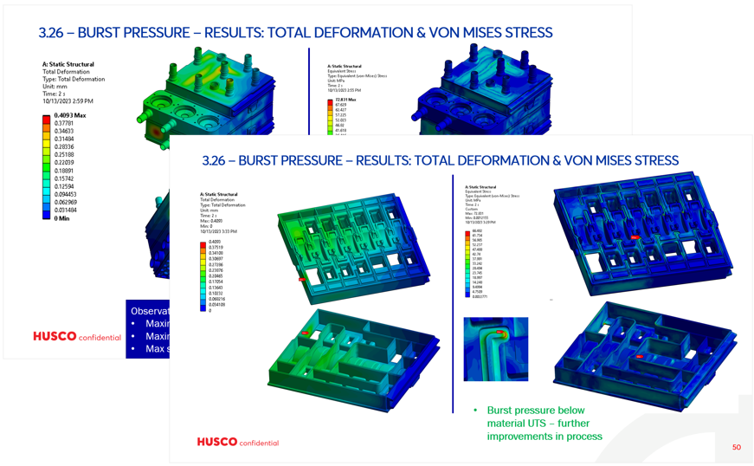
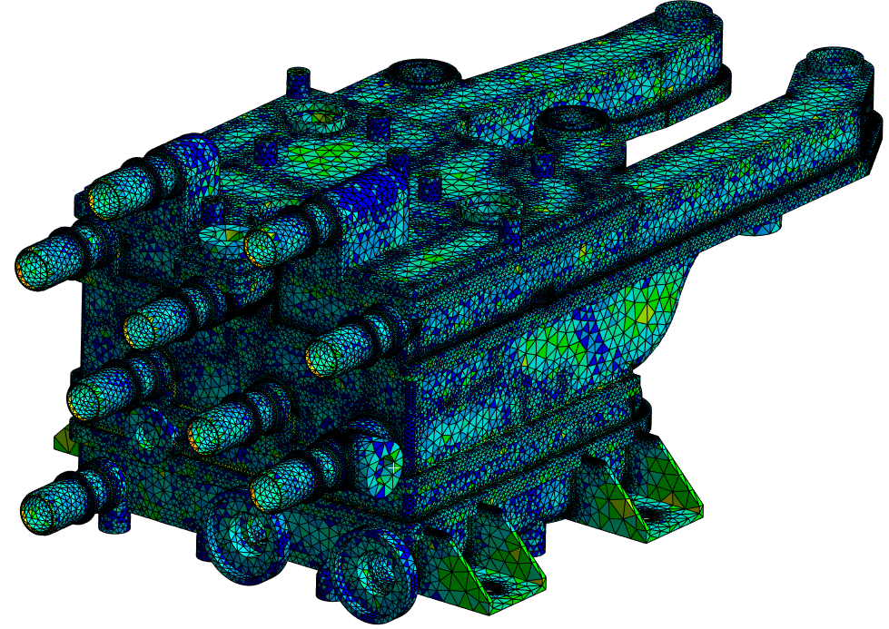
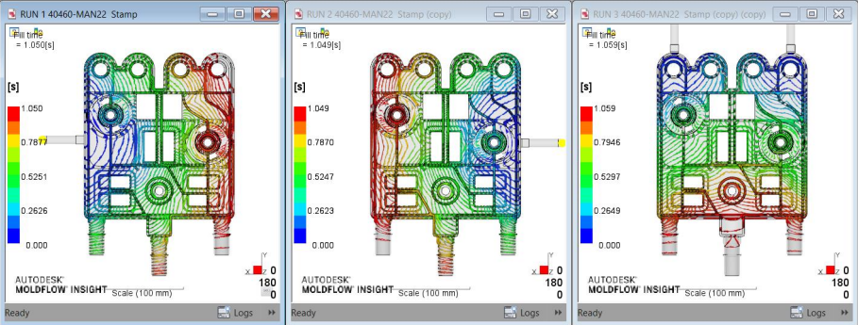
Nautilus
CAE Analysis
Completed Analysis:
Thermal Cross Talk (<100 W at extreme temperature deltas)
Correlated Full System CFD (Worst of 25 flow paths is <15 kPa @25 LPM
Leakage Tolerance Stacks (<5 mL/min at min overlap)
Burst Pressure FEA (Pass)
Pressure Pulsation FEA (Pass with FoS >2)
Sub-Component Wear Out Life (Pass)
Mold Flow

Slide 19
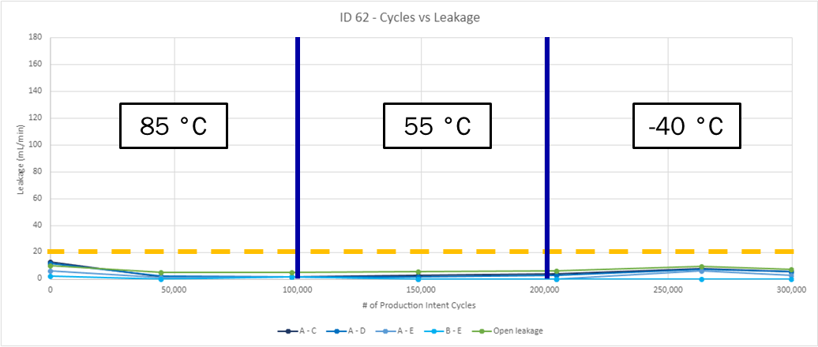
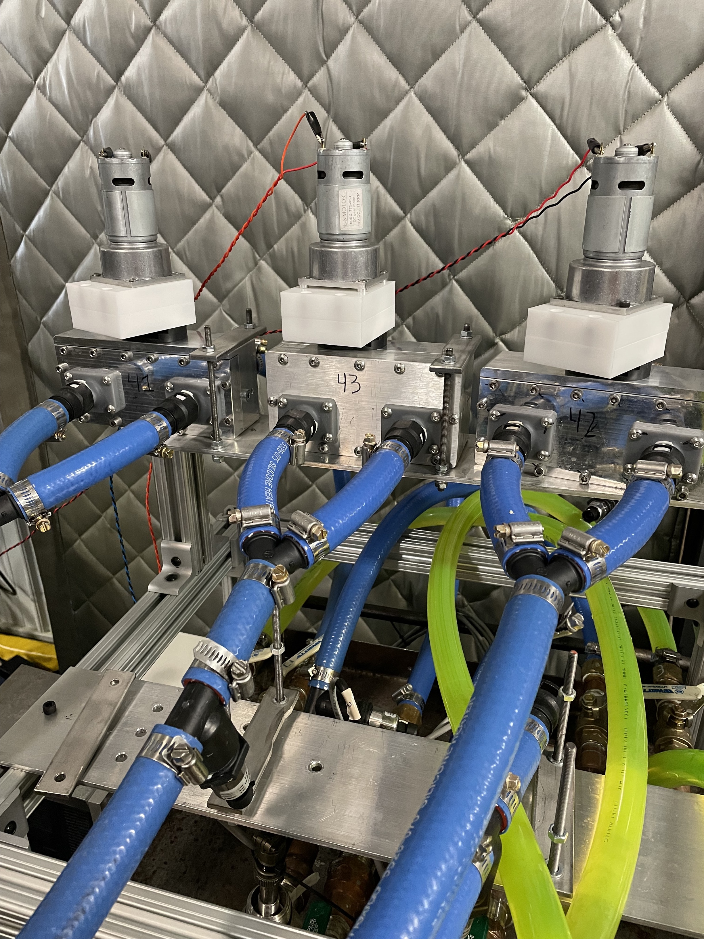
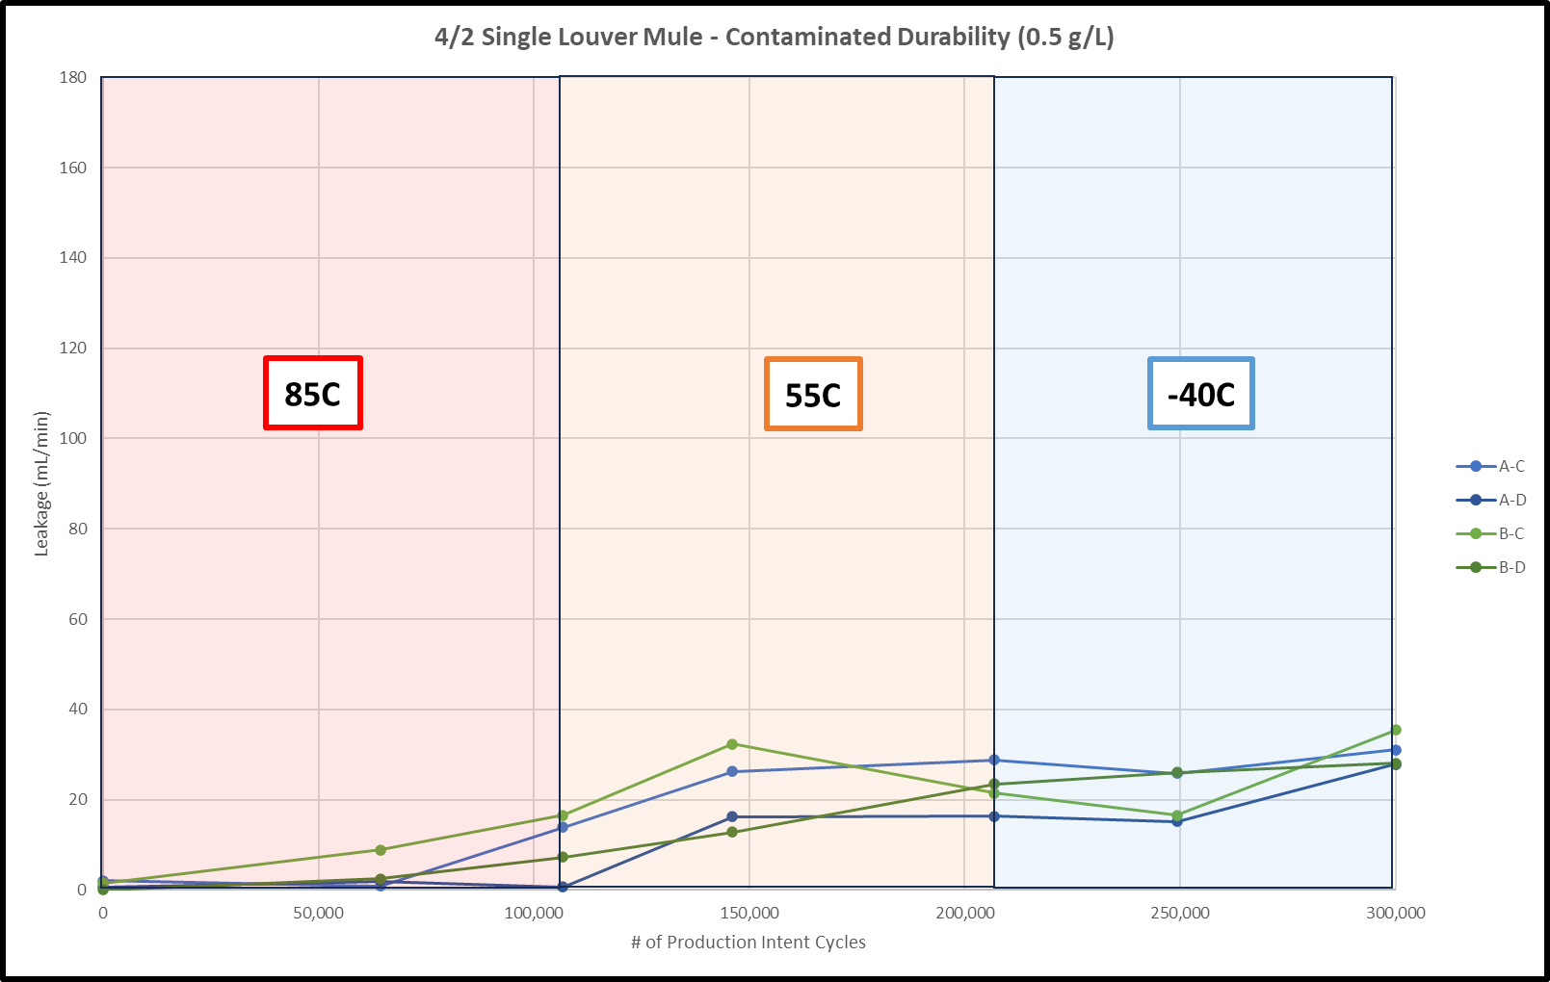
Nautilus
Physical Validation of Flat Valving Solutions
Completed Validation Testing:
Full Valve Physical Simulation and Component Pressure Drop (Matches CAE)
Room temp Contaminated Durability w/ 0-1 g/L of Contamination (<10 mL/min internal leakage per louver post test)
Varying Temp Non-Contaminated Durability (<5 mL/min average internal leakage per louver post test)
300K Cycle Contaminated Durability (~30 mL/min internal leakage per louver post test)(100K cycle @ -40, 55, and 85 °C w/ 0.5 g/L of contamination)

Slide 20
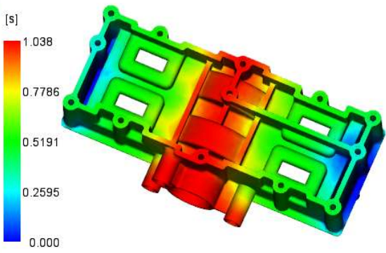
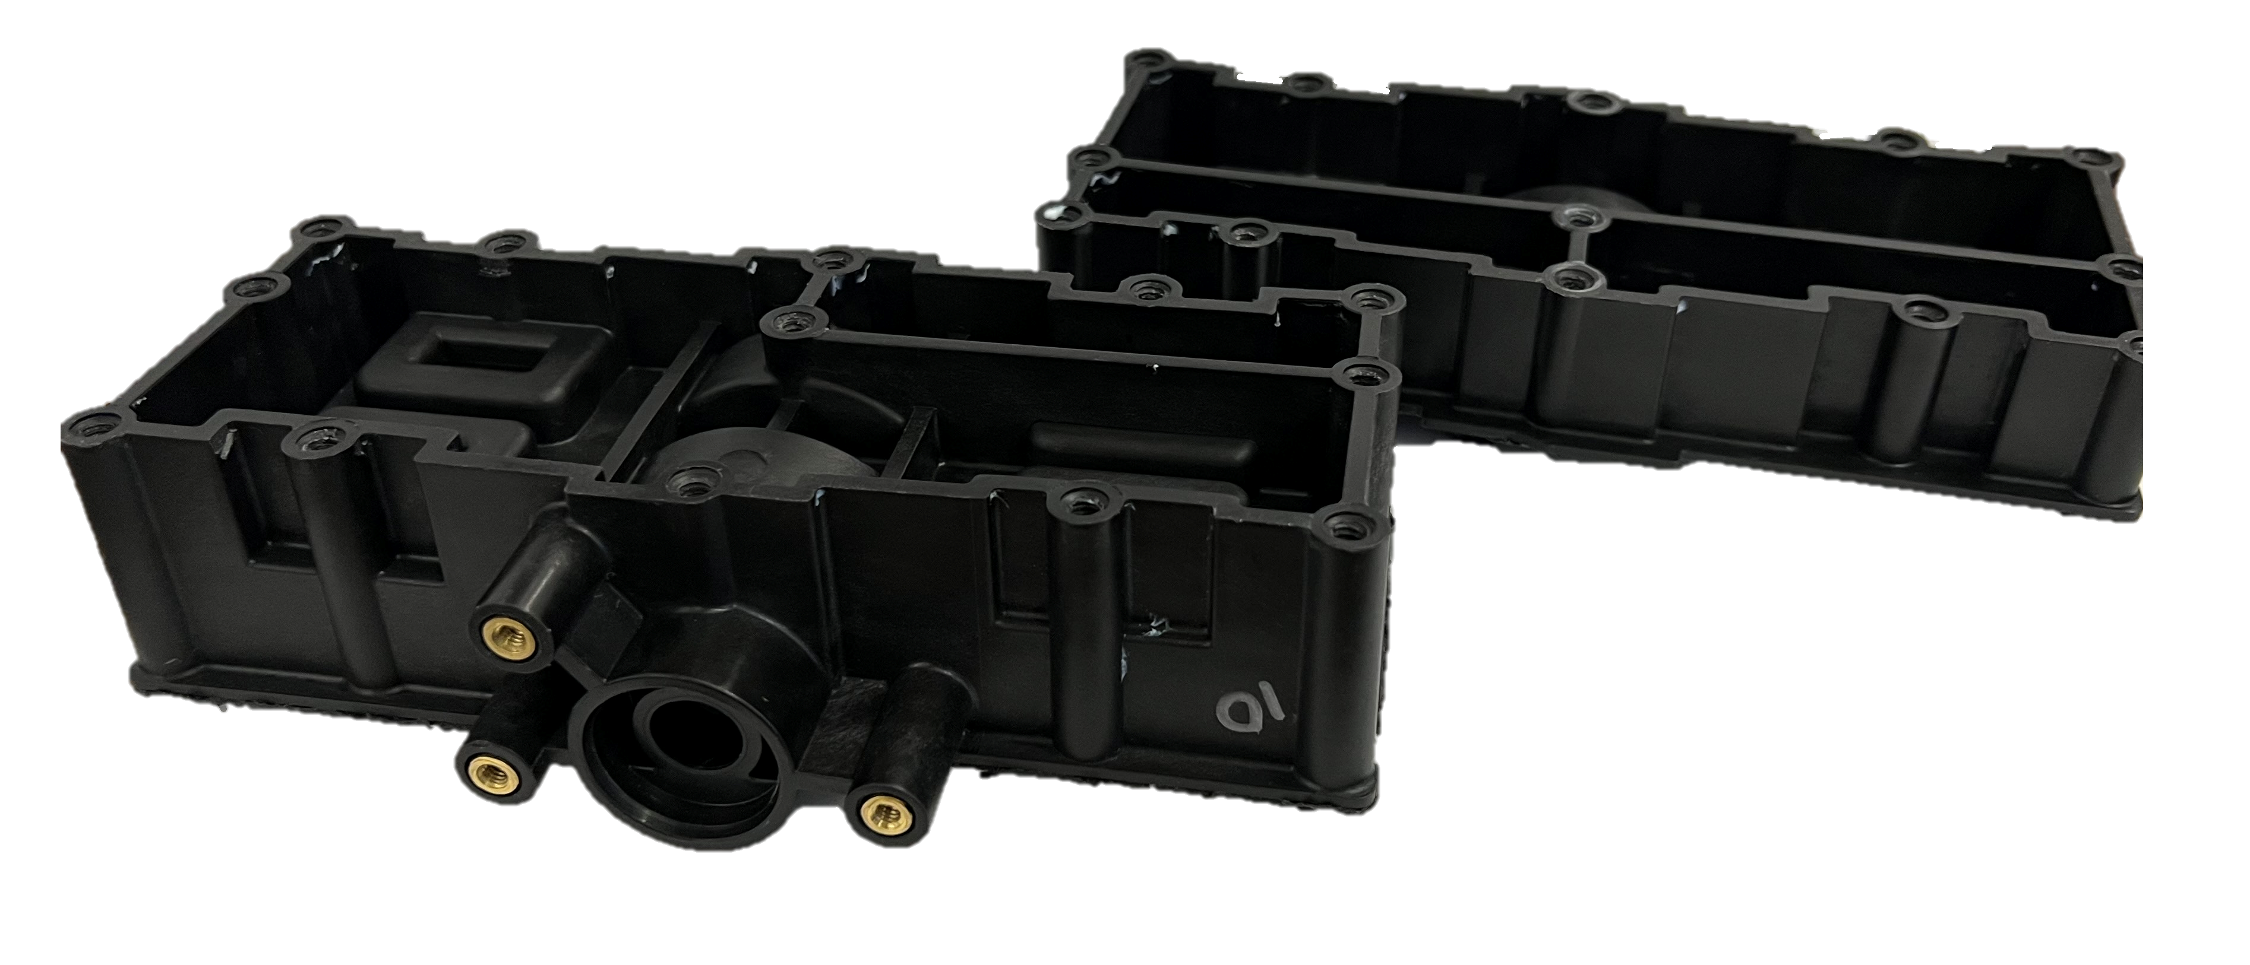
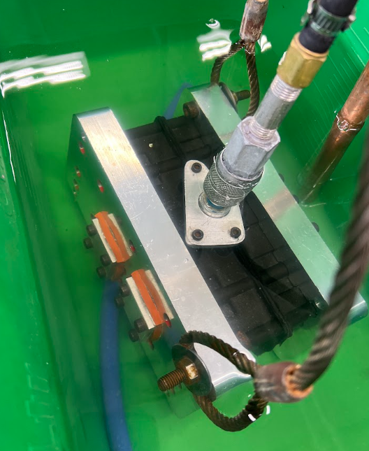
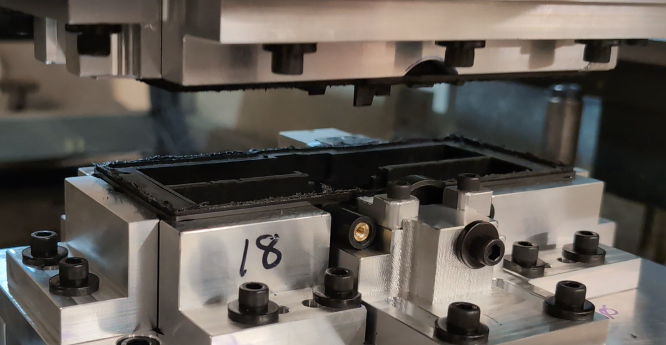
Nautilus
Mold Flow Analysis
Physical Validation of Flat Valving Solutions - Continued
Completed Validation Testing:
Thermal Shock – Cold Water Submersion (Passed 20 transfers from 85 °C to 0 °C with no leakage at 2.4 Bar)
Burst Pressure (Passed 500 kPa at room temperature with production intent welding methods)
Pressure Pulsation (Passed 200k Cycles between 0 kPa and 320 kPa)
Soft-Tooled Prototypes
Plastic Weld R&D
Functional Test Parts

Slide 21
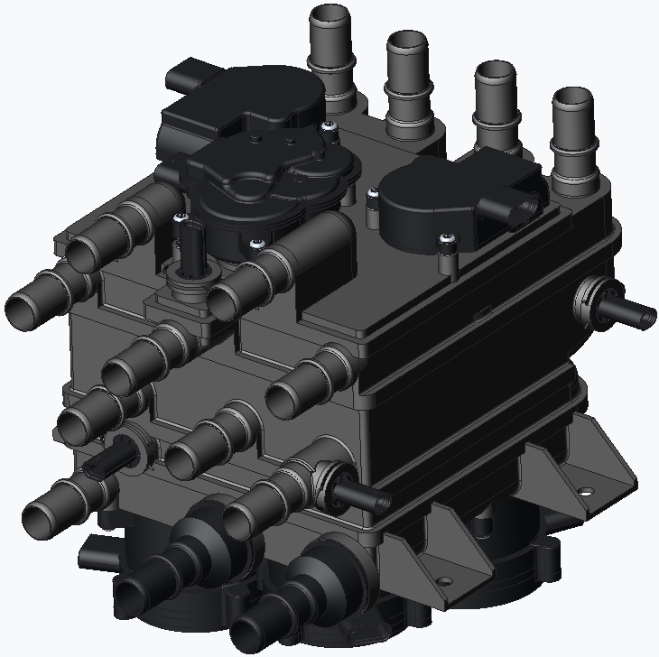
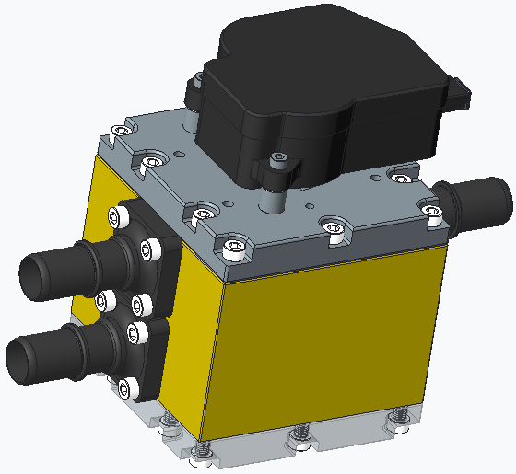
Nautilus
Disc Valve Test Mule
Full Valve Simulation
Verify test setup and general pump sizing by simulating all louvers and disc valves using test mules
Reduces investment cost while proving out functionality)
3W Discs
Louvers
Single Louver Test Mule

Slide 22
Nautilus
Full Valve Simulation
Single Louver Mules
Coolant Bottle
3W Disc Mules

Slide 23
Flat-out manufacturing
Husco AMG Benefits
In-House
Expert System Design
Customized Software Tools
Coupled with Nautilus DFM
Low volume / High Volume scalability
Simple stacked assembly
Minimal unique parts

Slide 24
Lesson’s & considerations
7 Questions to be asking and re-asking.
What is our customer ultimately trying to do?
What are our company advantages and how do we leverage them into this market?
What cost drivers are dependent on external sourcing?
Where do we need competitive system partners (supplier and customer)?
How are our competitors similar/different in product, manufacturing, sourcing, vertical integration strategy?
How does our product strategy make the system more competitive?
What level of validation/investment do we need to have to prove the core innovation is ready?

Slide 25
Sub-system technology development
Actuator Portfolio
Life
Actuator Family
Brushed, Brushless, & Stepper
0.5 Nm – 3.3 Nm
BLDC Motor
-Timing Adjustment
-Active Aero/Positioning
-Thermal Management
Stepper Motor
-HVAC
-Thermal Management
-Refrigerant
Brushed
-HVAC
-Grill Shutter
-Thermal Management
Performance

Slide 26
Sub-system technology development
Refrigerant control portfolio
Precision Proportional EXV
High Flow EXV Integration w/ throttling and By-pass
Refrigerant Control Valve

Slide 27
Thank you
WWW.HUSCO.COM

