Slide 1

A comprehensive approach for Integrated Thermal Management Module development
Antonio Savi
Product Design Director – Thermal Management
Saleri TMS Competence Center GmbH
antonio.savi@saleri.com
SAE Thermal Management Systems Symposium
xx/xx/2025

Slide 2
Integration Examples in ICE
From ICE to BEV: Why Integration matters now…
Integration Example: eCoFlow® Switch pump
Will there be an ultimate TMM architecture?
Case study: Coolant Integrated Module development
Takeaways

Slide 3
Integration Examples in ICE
From ICE to BEV: Why Integration matters now…
Integration Example: eCoFlow® Switch pump
Will there be an ultimate TMM architecture?
Case study: Coolant Integrated Module development
Takeaways

Slide 4
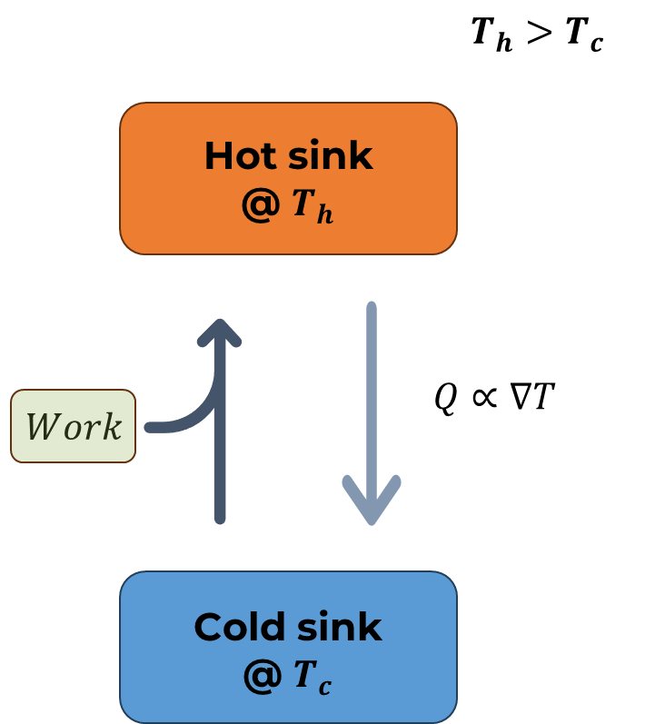


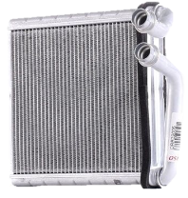

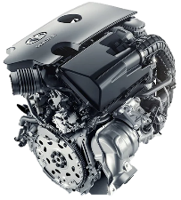
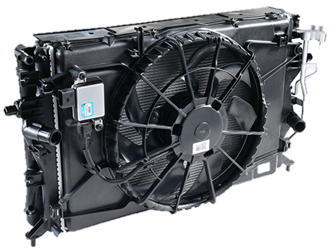
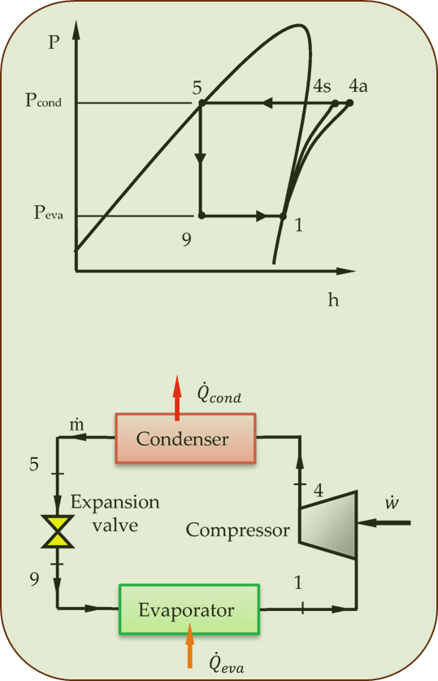
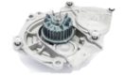
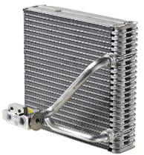

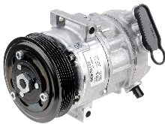





ICE Thermal Management Layout
SAE Thermal Management Systems Symposium 2025
ICE Energy flow is quite basic
    Excess Heat is available at
      High quantity (ca. 50% waste heat)
      High “quality” (high Temperature)
Ambient is always the final heat sink.
“Simple” passive control
      Thermostat for HT loop
      Mechanical compressor + TXV for A/C
Environment
Cabin
Thermostat
ECM
Heater
M-water pump
“Source”
“Sink”
“Sink” / ”Source”
Evap
M-CMP
A/C

Slide 5

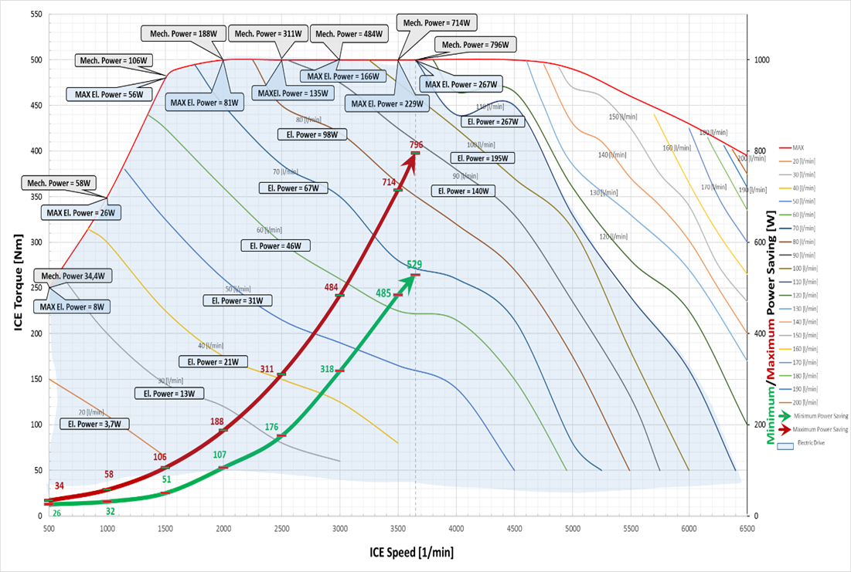

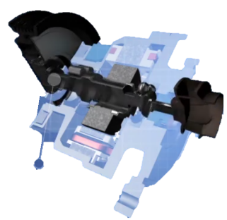
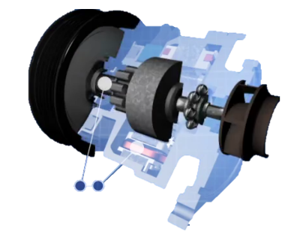
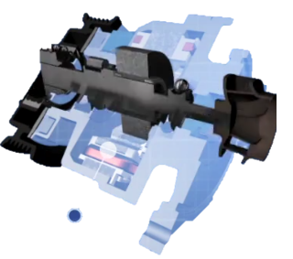

Example 1: Electro-Mechanical Water Pump
SAE Thermal Management Systems Symposium 2025
(pumping) Power Savings in “E-Mode”
Electric Mode
Mechanical Mode
Hybrid Mode
New function Enabled: “Post-run”
Optimized warm-up and 0-flow achieved
From 66% up 100% power saving @ max power
Higher complexity & cost

Slide 6
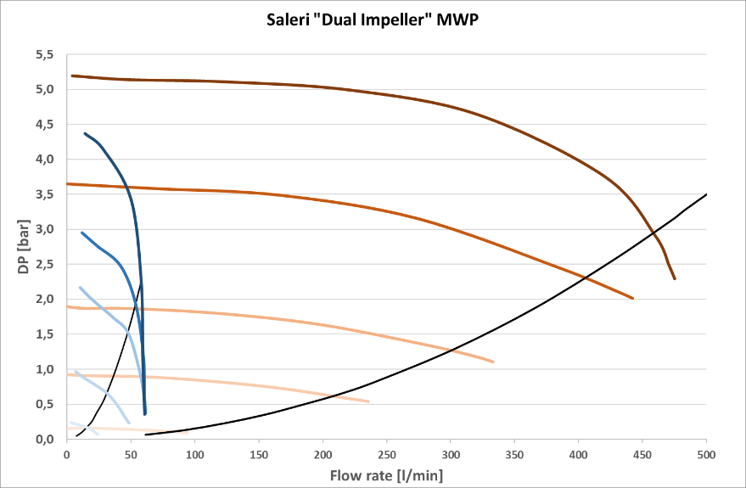
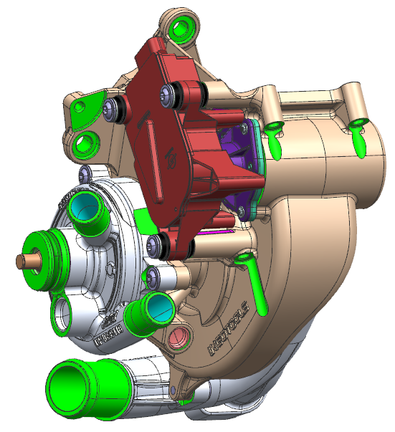
Example 2: Dual-Impeller Mechanical Water Pump
SAE Thermal Management Systems Symposium 2025
HT flow-control valve
Combined performance map
LT Loop
HT Loop
LT water pump
HT water pump
 | Δp [barG] | Flow [l/m] | Power [kW]
HT | < 5,5 | < 500 | 2,3
LT | < 4,5 | < 60 | 0,3
High-level integration
Weight and cost reduction
Higher complexity & cost than standard MWP
Notes:
For ICE, The business case for integrated solutions is more challenging. While cost is very important, end users are much less sensitive to range and efficiency than in BEV – so much less inclined to pay premium for that

Slide 7
Integration Examples in ICE
From ICE to BEV: Why Integration matters now…
Integration Example: eCoFlow® Switch pump
Will there be an ultimate TMM architecture?
Case study: Coolant Integrated Module development
Takeaways

Slide 8
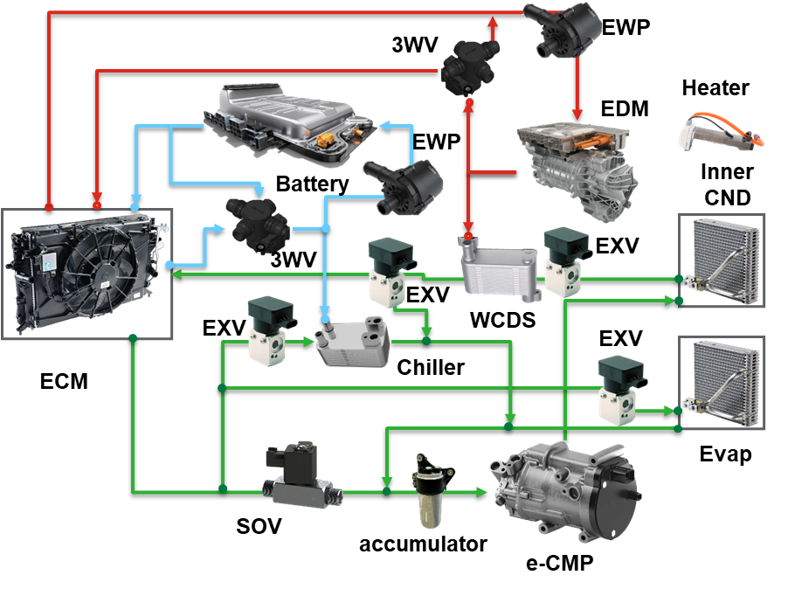
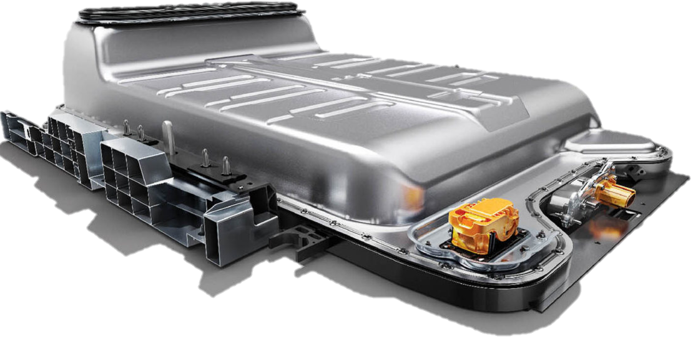

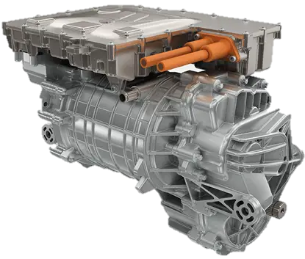
BEV TMM Architecture Example
SAE Thermal Management Systems Symposium 2025
BEV Energy flows get tricky..
    Heat is scarce:
      low quantity
      low “quality” (low Temp.)
    Capillary heat scavenging:
      Refrigerant line increase
      Compressor power
    Complicated “Multi-level” refrigerant pressure control required
Environment
Cabin
A/C

Slide 9
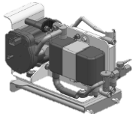
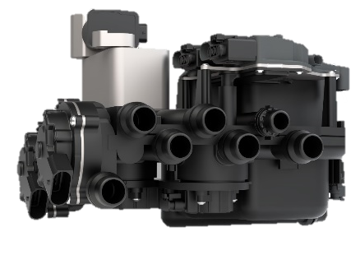
Why Integration Matters now…
SAE Thermal Management Systems Symposium 2025
Coolant
High-End
BEV
Refrigerant
High cost-reduction potential from Refrigerant system simplification
Cost
High weight-reduction potential from Coolant system simplification
Weight
Source: ITB FLUID CONTROL AND CONVEYANCE ADVANCEMENTS FOR ELECTRIFIED VEHICLES
Weight and Cost reduction are highly Valuable to overcome two major EVS issues that directly impact final users: RANGE & PRICE
System complexity and fluid amount to impact serviceability as well.

Slide 10
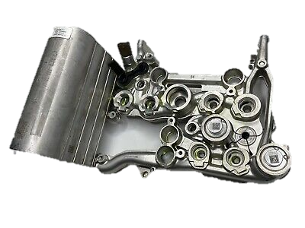
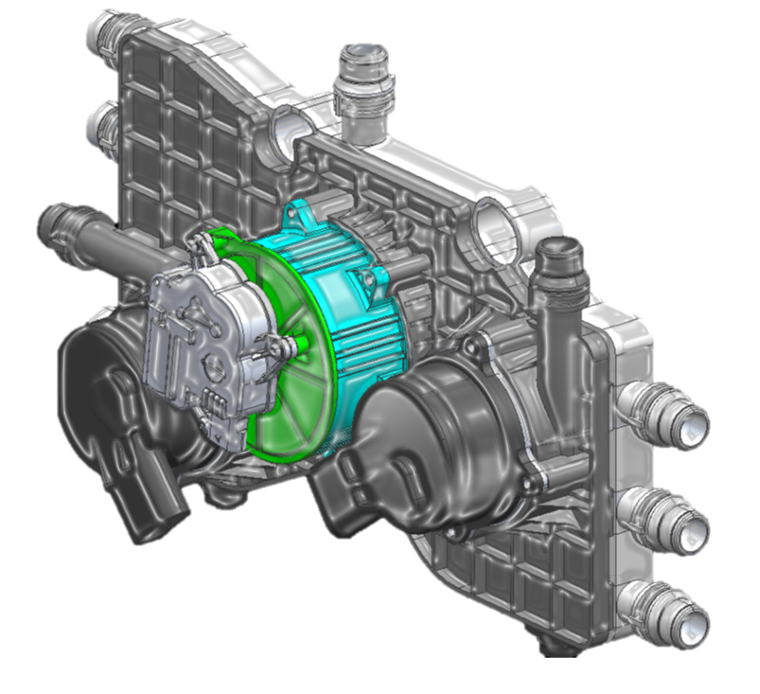
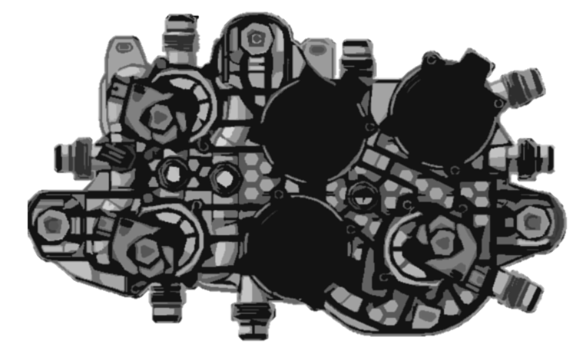
Complexity reduction: which path to follow?
SAE Thermal Management Systems Symposium 2025
“Mainly” Direct H/P system
Aluminum Manifold
Multiple Refrigerant Valves and EXVS
Sophisticated refrigerant control
High charge amount ~ 1000g
Refrigerant complexity
Over-Engineering
“High BoM cost”
“High development cost”
Simplified BoM on water-side
Switch-only (ON/OFF) Valves
Customized Multi-way water Valve
Coolant complexity
Completely Indirect H/P system
Extremely lean refrigerant design
1 EXV (possible to switch to TXV)
Extremely low charge amount <200g
No such a thing as a “hyper-simply efficient system”
Sophisticated BoM on water-side
Plastic Manifold
Working mode control on water-side
Proportional flow rate control is a Key requirement for power distribution

Slide 11
Integration Examples in ICE
From ICE to BEV: Why Integration matters now…
Integration Example: eCoFlow® Switch pump
Will there be an ultimate TMM architecture?
Case study: Coolant Integrated Module development
Takeaways

Slide 12



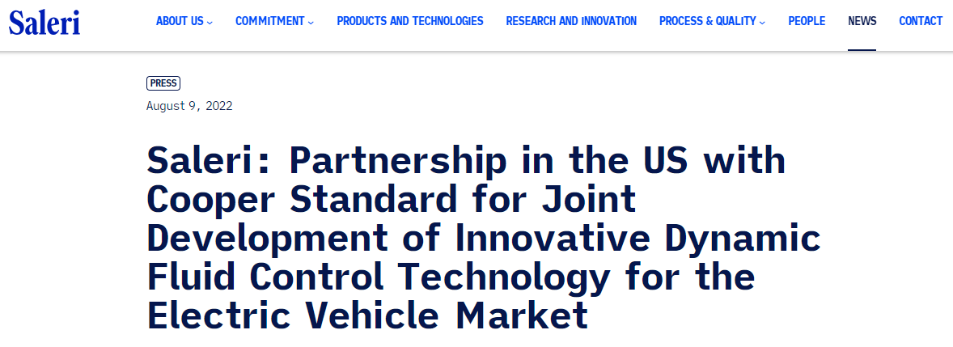

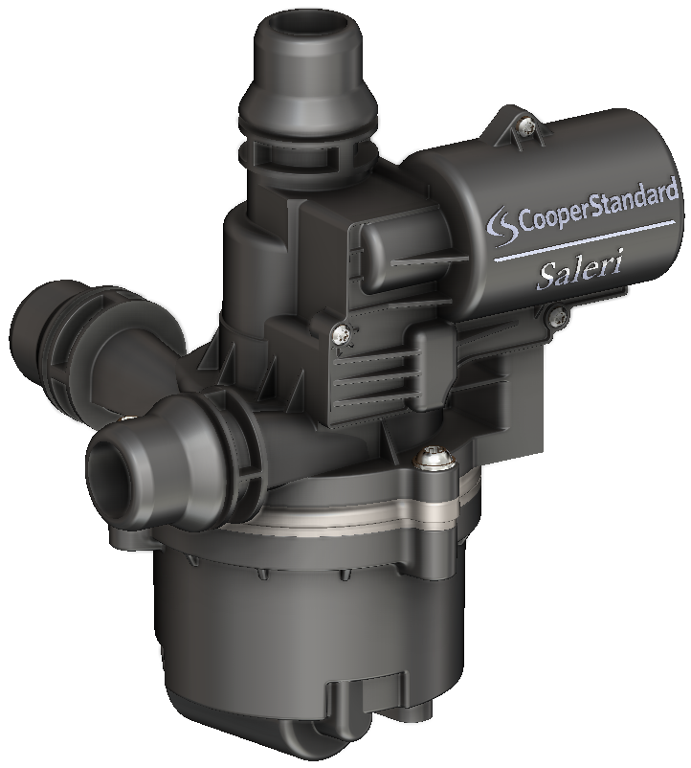
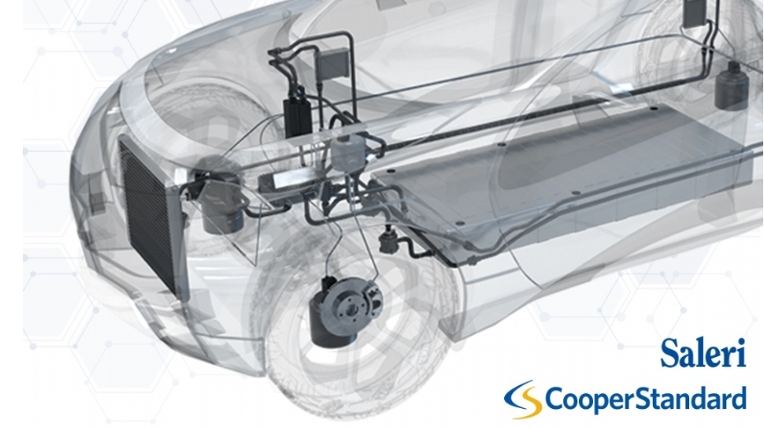
eCoFlow® Switch Pump
SAE Thermal Management Systems Symposium 2025
World-class Fluid Handling and Pump Suppliers Partner for Success

Slide 13
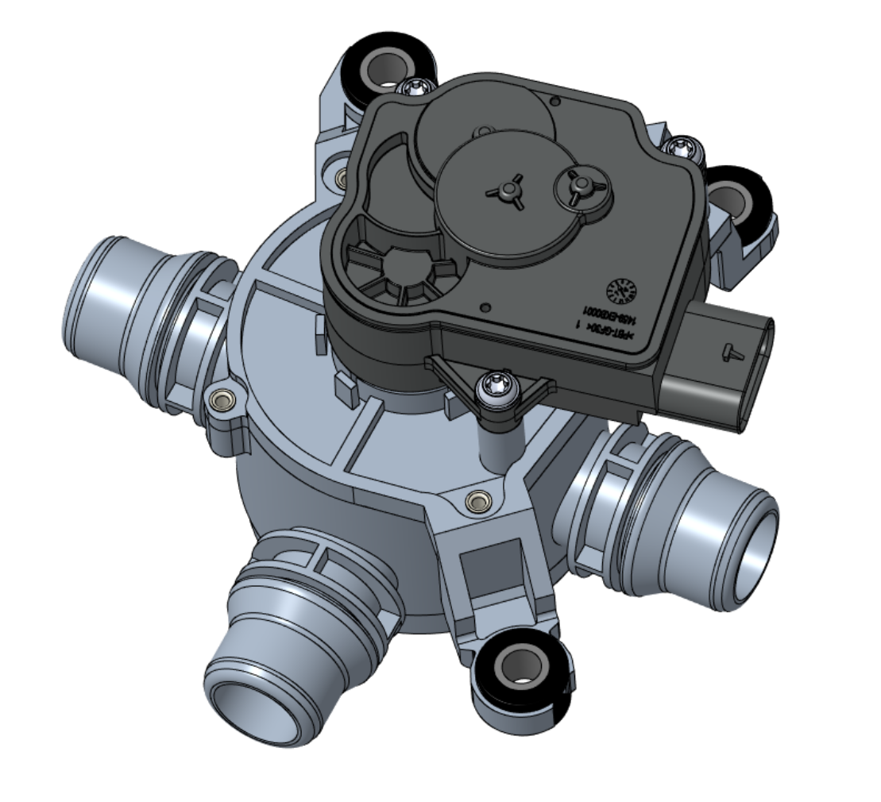
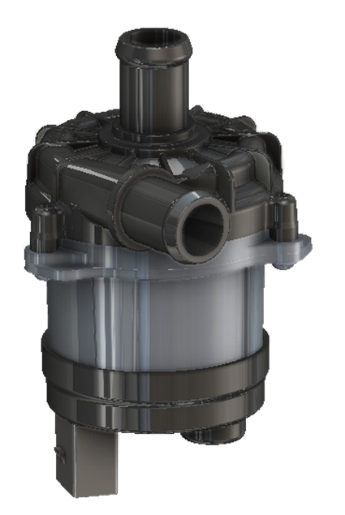




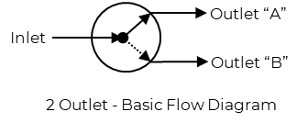
eCoFlow™ Switch Pump Integrated Coolant Control Module
SAE Thermal Management Systems Symposium 2025
Scalable Technology Integrating the Functions of a Pump and Valve
Outlet “A”
inlet
Reduces Complexity
Eliminates independent valves
Allows flow switching and regulation
Reduces joints and connections
Single electrical connection
Integrates to existing vehicle architectures
Reduces space requirements by 50%
Improves Efficiency
Reduces system pressure drop
Optimizes tube and adaptor routing
Enhances vehicle range
Outlet “A”
3-way
Valve
Outlet “B”
“inlets”
Outlet “B”
Electrical water pump
Electric Vehicle
Enhanced use of Payload
Reduced Emissions
Improved Lifecycle

Slide 14
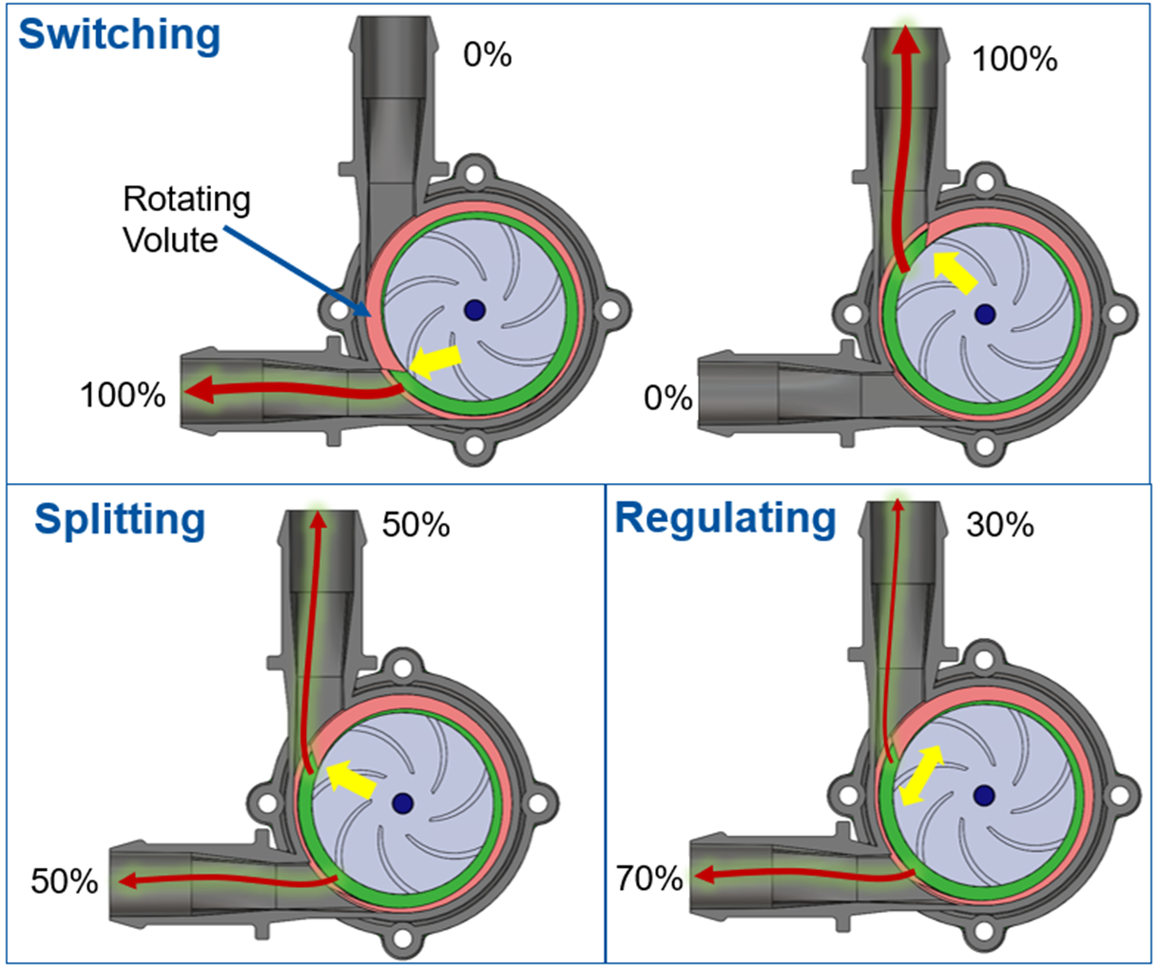
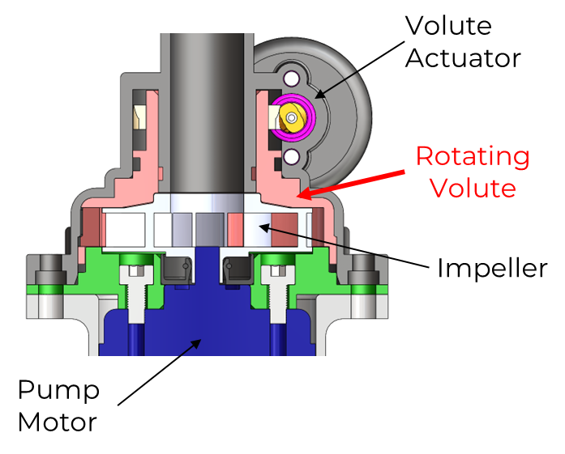
How it works..
SAE Thermal Management Systems Symposium 2025
Electromechanically Controlled Rotating Volute
Rotating Volute

Slide 15
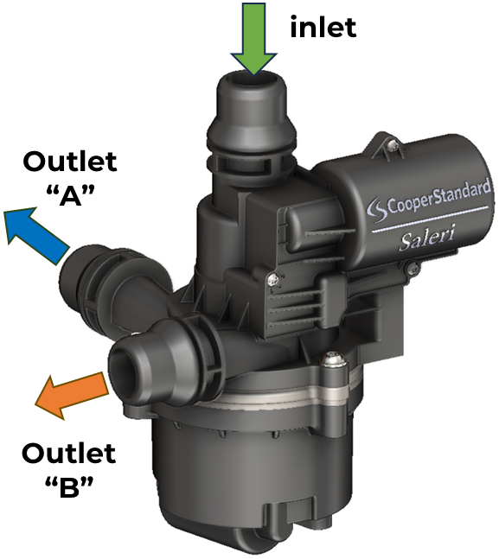
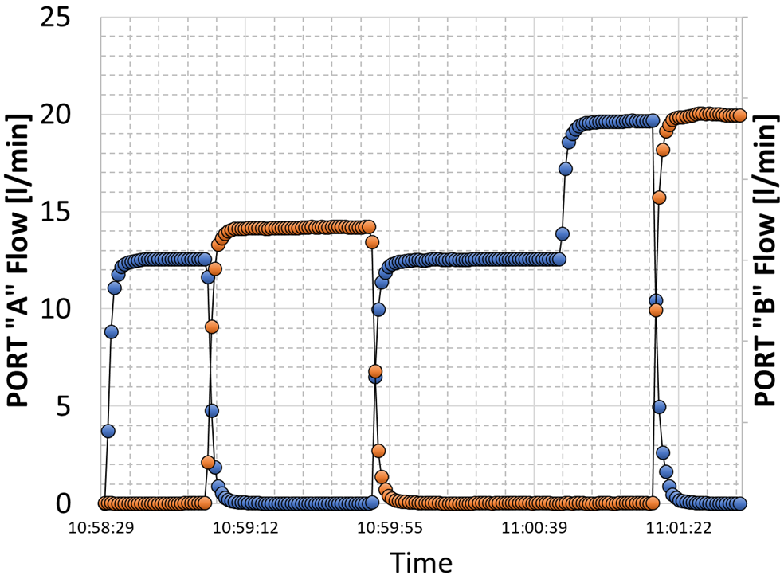
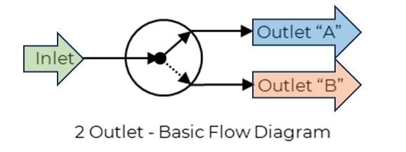
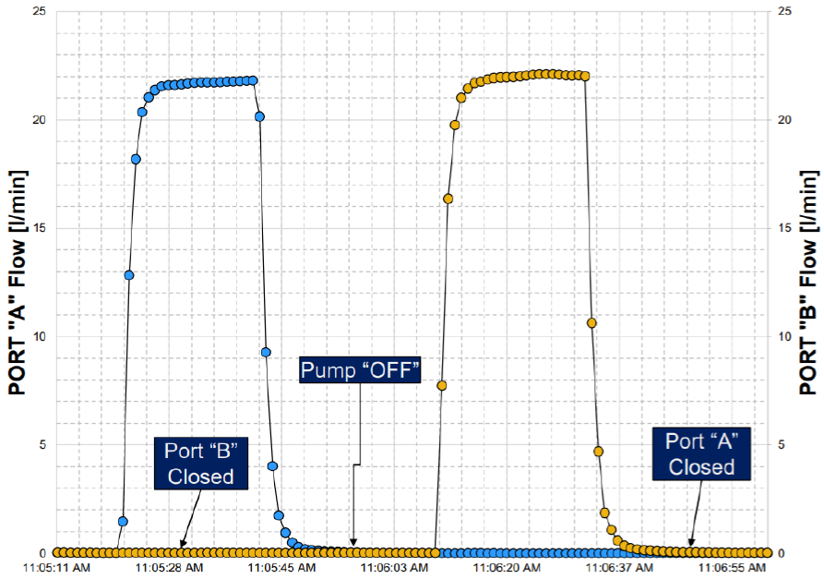
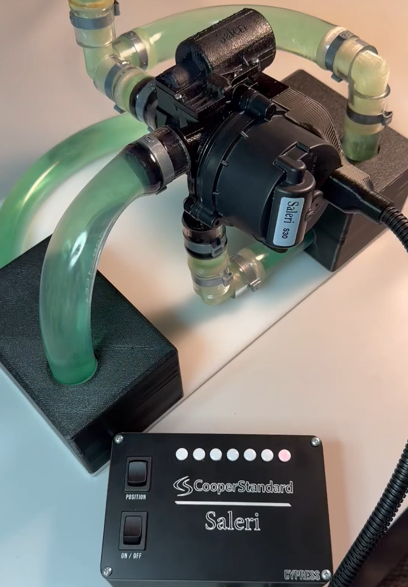
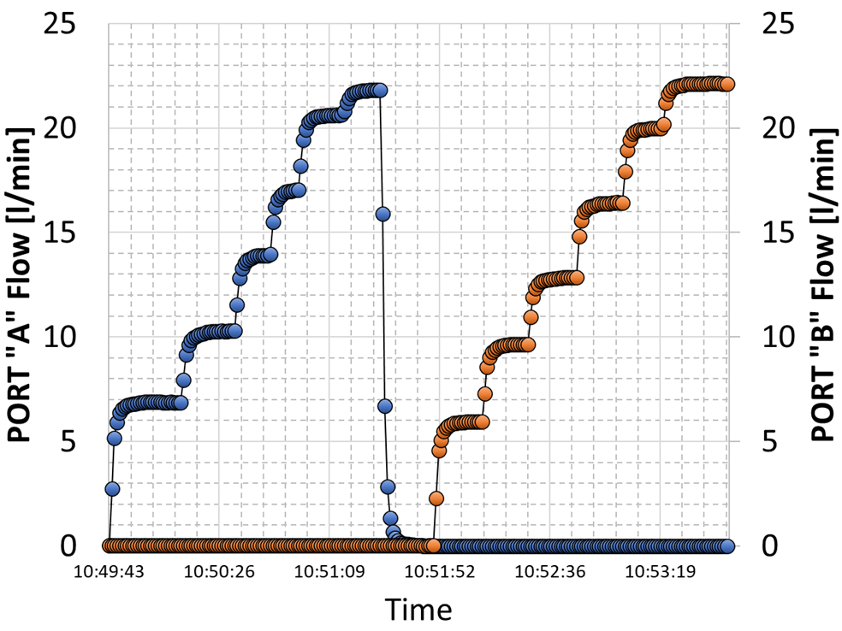
Performance
SAE Thermal Management Systems Symposium 2025
Regulation curves at different pump speed
Inlet
Outlet B
Outlet A

Slide 16
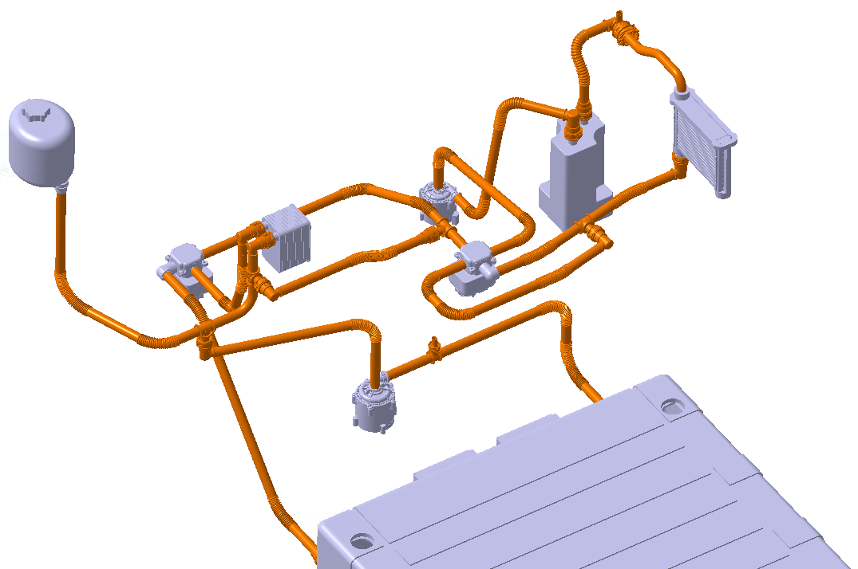
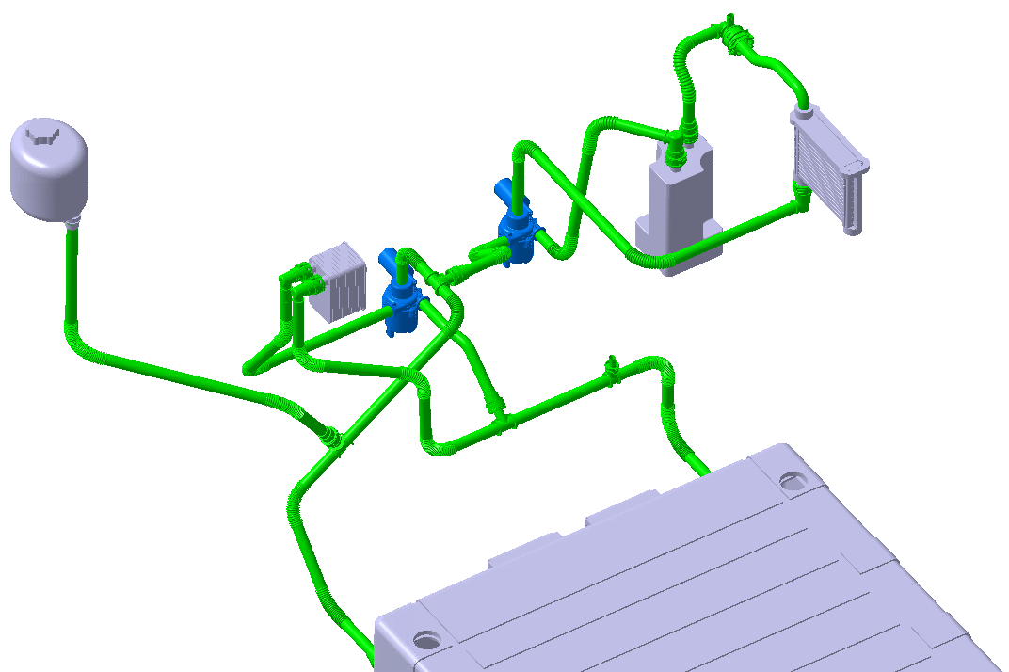
eCoFlow™ Switch Pump Simplifies Systems
SAE Thermal Management Systems Symposium 2025
CURRENT STATE
Two Pumps and Two Valves
Complexity, Mass, Packaging and Efficiency Improvements
Eliminates
FUTURE STATE
Two eCoFlow™ Switch Pumps
50%
15%
50%
20%
20%

Slide 17
Integration Examples in ICE
From ICE to BEV: Why Integration matters now…
Integration Example: eCoFlow® Switch pump
Will there be an ultimate TMM architecture?
Case study: Coolant Integrated Module development
Takeaways

Slide 18
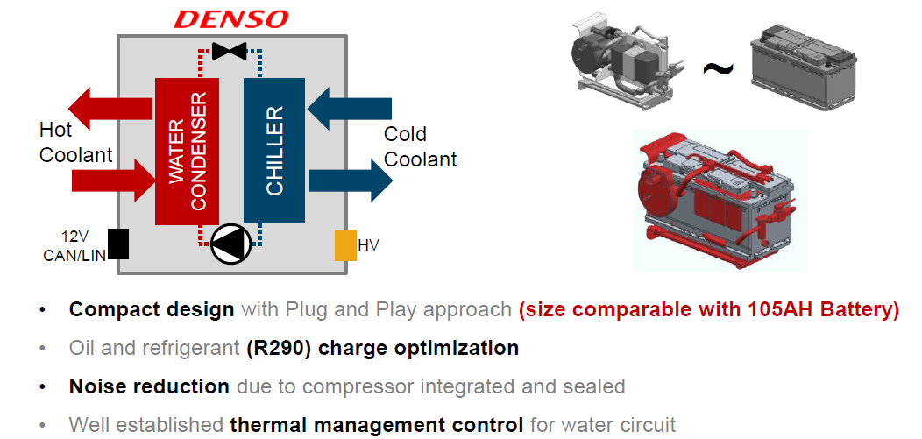
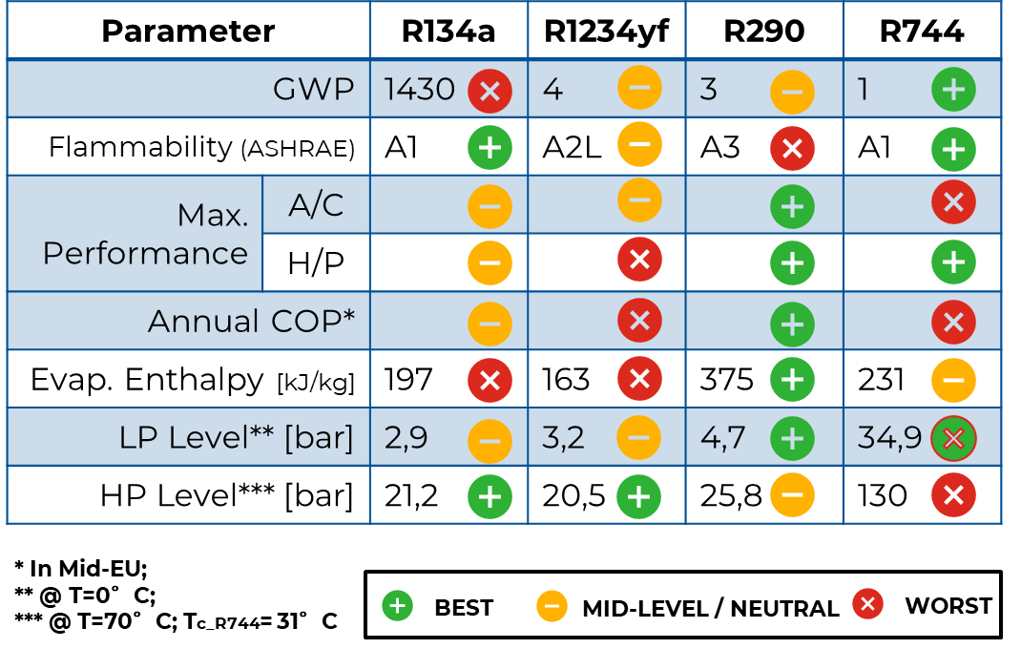



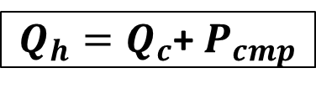






Integrated Refrigeration Unit
SAE Thermal Management Systems Symposium 2025
“PFAS-ready”
Preferred solution for natural refrigerant system
Charge amount < 150g
$$T_{h_OUT}$$
$$T_{c_IN}$$
$${\dot{m}}_{h}$$
$${\dot{m}}_{c}$$
$$T_{h_IN}$$
$$T_{c_OUT}$$
Complete decoupling of power generation (heating/cooling) and power distribution
$$P_{cmp}$$
Compact design (LV Battery size)
Plug & Play scalable approach (multi-platform application)
Simplest refrigerant design and easiest control (on water loop)
Compressor NVH optimization
Fully-Indirect system
$$Q_{h}=\dot{m_{h}}c_{p,h}(T_{h,OUT} −T_{h_IN})$$
$$Q_{c}=\dot{m_{c}}c_{p,c}(T_{c_OUT} −T_{c_IN})$$
$Q_{h}=Q_{c}$+ $P_{cmp}$
Source: OPTEMUS H2020 EU-funded project

Slide 19
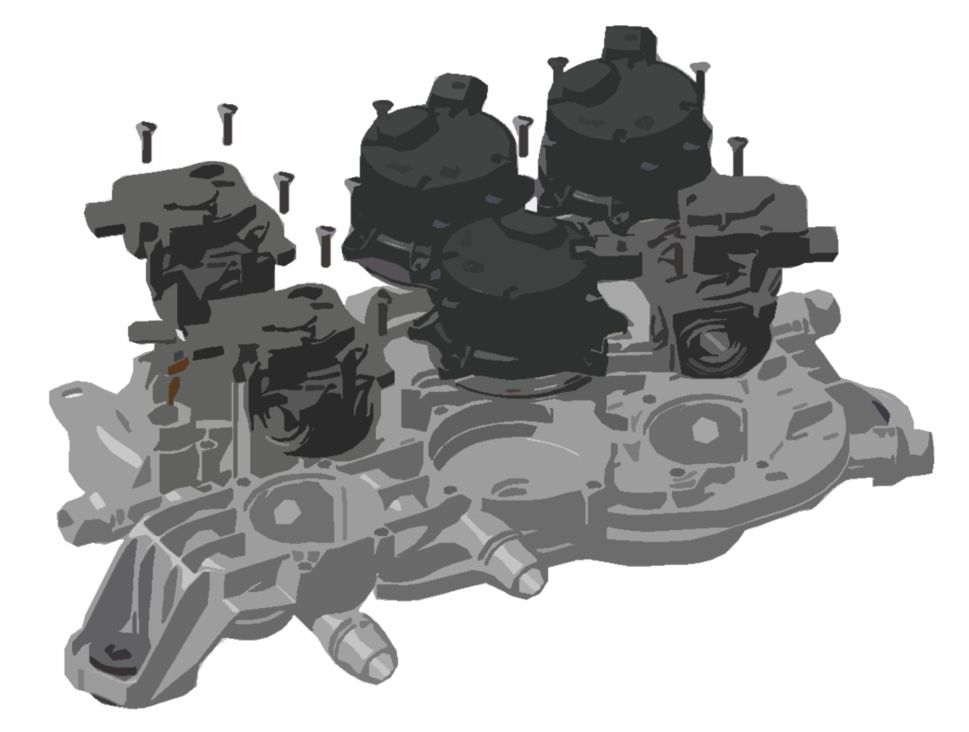



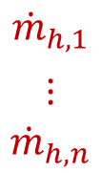
Integrated Coolant module
SAE Thermal Management Systems Symposium 2025
$${\dot{m}}_{h,1}$$
$$⋮$$
$${\dot{m}}_{h,n}$$
Heating flows
BoM:
Electrical Water pumps
Regulating Valves
Plastic Frame
$${\dot{m}}_{c,1}$$
$$⋮$$
$${\dot{m}}_{c,n}$$
Cooling flows
Optional:
Plate-type heat exchangers
Water Tank
Temperature sensors
$${\dot{m}}_{c,n}$$
GOAL FUNCTION:
Allow the right Flow/Power distribution among the thermal management system components
  In all working modes
  In all environmental conditions
$${\dot{m}}_{h,n}$$
${\dot{m}}_{c,n}$= ${\dot{m}}_{h,n}=$f (T, pump speed, valve position, working mode)

Slide 20

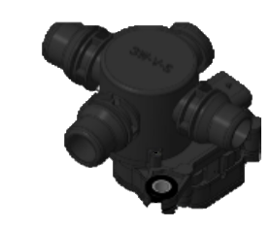


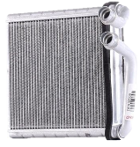
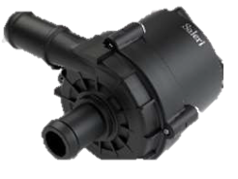


One Loop to fit them all..
SAE Thermal Management Systems Symposium 2025
WG
50-50
Cooling loop
Coolant-oriented Architecture
    Flexible heat scavenging
      Heat to be collected starting from lower temperature level
    Standard control strategy through different platform
    Power control parameters:
      Flow rate (distribution)
      Temperature Level (for single users)
Heating loop
4w_{p}
Heat & Cooling
4w_{p}
3w_{p}
Battery
EDM
4w_{s}
Ambient
Cabin
“ITMM”

Slide 21
Integration Examples in ICE
From ICE to BEV: Why Integration matters now…
Integration Example: eCoFlow® Switch pump
Will there be an ultimate TMM architecture?
Case study: Coolant Integrated Module development
Takeaways

Slide 22
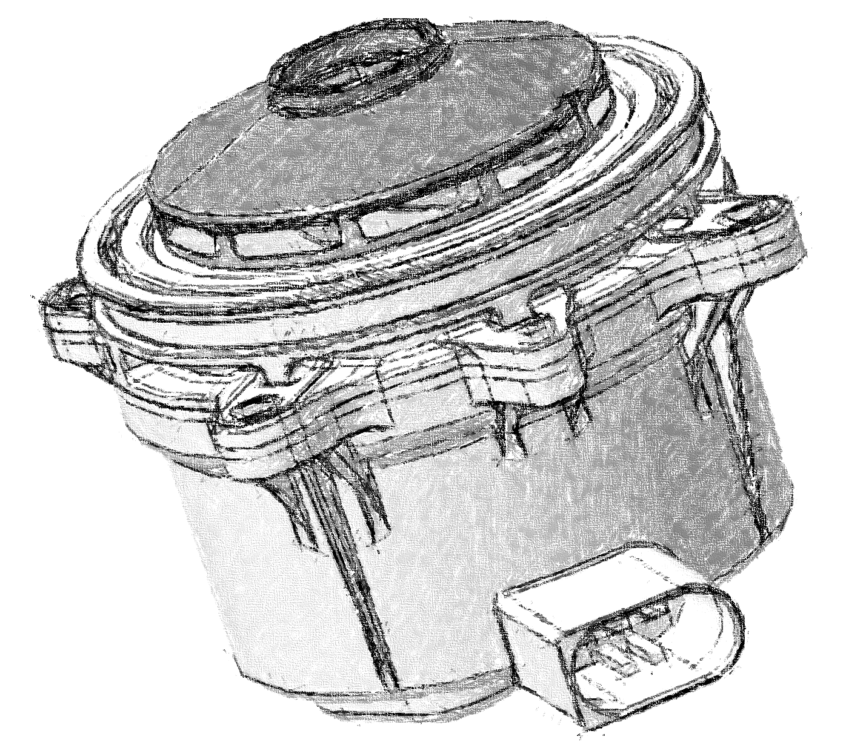

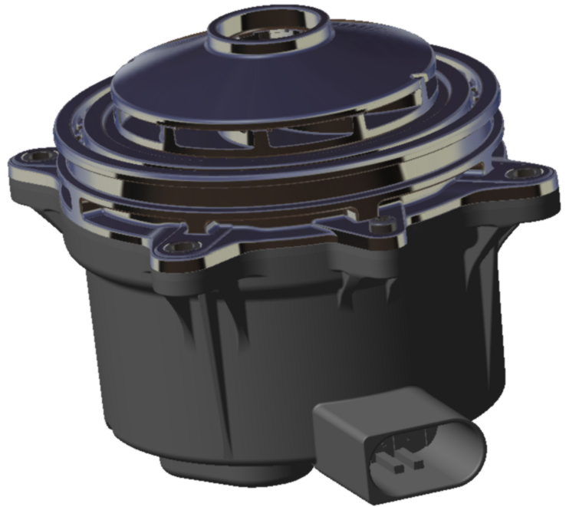
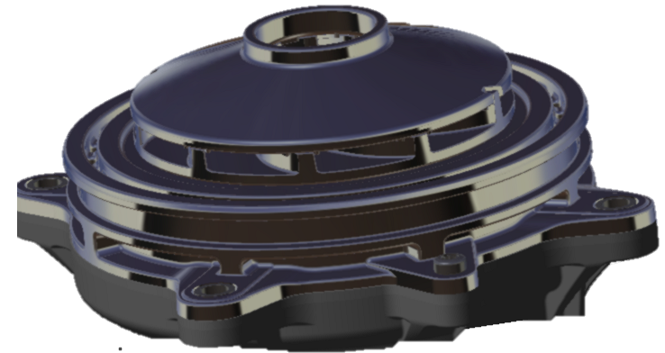
Electric Water Pumps
SAE Thermal Management Systems Symposium 2025
TMM-specific pump design
Optimized center of gravity
Common hydraulic interface
Simplified modularization
Scale up/down according vehicle specifications
M
L
XL
Pump spec
Common Hydraulic interface
Pump “size”
M
L
XL

Slide 23
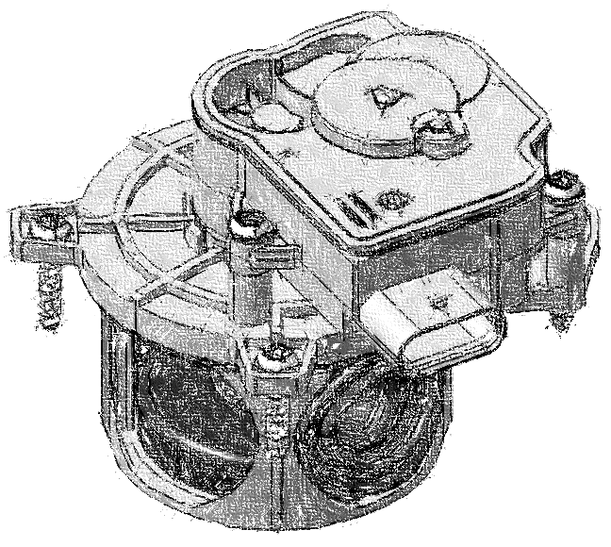





Regulating Water Valves
SAE Thermal Management Systems Symposium 2025
Name | Flow / position | IN / OUT | Valve diagram
3Wp |  | 1 IN 2 OUT (2 IN and 1 OUT also possible)
4Ws |  | 2 IN 2 OUT
4Wp |  | 1 IN 3 OUT (up to 2 outlet @ the same time)
3w_{p}
inlet
4w_{s}
4w_{p}
O2
O1
TMM-specific “cartridge” design
Smooth Linear flow control
minimal leakage rate*
Reduced hysteresis
* <10ml/min @2bar Δp

Slide 24
4-Way proportional Valve Characterization
SAE Thermal Management Systems Symposium 2025
Proportional Capabilities are guaranteed:
At different Valve orientations (Vertical VS Horizontal)
At different Temperatures
At different pump speed (pressure and flow rates)

Slide 25






In-Module pressure drop characterization
SAE Thermal Management Systems Symposium 2025
Test bench set-up
Path A
Paths B & C
Path D
Transparent mock-up
In-frame instrumentation
Path A
In-Module single path pressure characterization
Dedicated DOEs
CFD results validation
Transparent mock-up for flow-line verification
Path C
Path D
Path B

Slide 26










System 1D-digitalization
SAE Thermal Management Systems Symposium 2025
Customer
super-component (complete cooling circuit)
Saleri
Super-component
Customer cooling layout
info
Full set of validated super-components from Saleri portfolio.
Model encryption for Know-how preservation from both side.
Enabled Co-simulation even with different software with FMI.
Enabled Virtual validation of new working modes or subcomponent of the thermal architecture.

Slide 27
Digital Twin Performance Validation: 1
SAE Thermal Management Systems Symposium 2025
Testing
Simulation ± 10%
Speed 3
Speed 2
Speed 1
Multiple pump speed combinations have been tested (3 speeds for each of the three pump)
Pressure head prediction within a 10% range (<0,1 bar)
Different Valve position translates into a thin flow split within the module.
Model flow rate prediction within a 10% range (<3 lpm)

Slide 28

Digital Twin Performance Validation: 2
SAE Thermal Management Systems Symposium 2025
EDS loop
Speed 3
Battery loop
LTR loop
Speed 2
Cabin loop
Simulation ± 10%
Speed 1
System working mode have been verified.
Target flow rates achieved for single components
Proportional capabilities verified at system level
Model flow rate prediction within a 10% range (<3 lpm)

Slide 29
Integration Examples in ICE
From ICE to BEV: Why Integration matters now…
Integration Example: eCoFlow® Switch pump
Will there be an ultimate TMM architecture?
Case study: Coolant Integrated Module development
Takeaways

Slide 30






Summary
SAE Thermal Management Systems Symposium 2025
Efficiency requirements drives complication of TMM systems
Integration as an opportunity
Virtual Development is essential
Standardization as a way forward
Multi-vehicle / Multi-platform module
Reduced Development time & cost
Reduced validation efforts
Increased BoM
Increased cost & weight
Increased R&D Cost
Cost and Range are drivers
Modularity as mindset
Supplier-Customer collaboration crucial for system development
Especially for BEV as they remain the main barriers for widespread adoption
Sub-component to become commodities
Integration-specific design with minimal dedicate development
Switch from component supplier to system development partner approach
Notes:
While complication (of TMM) is driven by the look for range increase, costs remain a key barrier for BEV adoption.
Integration, modularity and virtual development are big opportunities to reduce weight and cost and development time.

Slide 31
Thank you

Slide 32
A comprehensive approach for Integrated Thermal Management Module development
Antonio Savi
Product Design Director – Thermal Management
Saleri TMS Competence Center GmbH
Antonio.savi@saleri.com

Slide 34









The 2nd principle of Thermodynamics
SAE Thermal Management Systems Symposium 2025
$$T_{h}>T_{c}$$
Hot sink
@ $T_{h}$
$$Q∝∇T$$
$$Work$$
Clausius’ statement:
“ While heat spontaneously flows from hot to cold sinks, Heat cannot spontaneously flow from cold sinks to hot sinks without external work being performed on the system”
Cold sink
@ $T_{c}$

